Slide 1
PORESO2015
Philosophical Transactions to the Finch report
The events that defined academic dissemination
Nick Sheppard
9th June 2015

Slide 2
Repository Developer
Began working at Leeds Metropolitan University in 2007
Repositories Start-up and Enhancement projects (Jisc)
Technical Officer for UKCoRR (UK Council of Research Repositories)
http://ukcorr.org/
Over 300 members
Repository practitioners across UK HE

Slide 3
Academic dissemination: The problem with the status-quo

Slide 4
The Open Access movement
Open Access (OA) means that items of scholarly work are made available online, in a digital format, at no charge to the reader and with limited restrictions on re-use.
The OA movement is a worldwide effort to make scholarly work available online to everyone regardless of their ability to pay for access.
Arguments for OA:
maximises research impact
maximises the use of public funds
accelerates research and increases impact
ethical practice
ensures compliance with funder requirements

Slide 5
HEFCE Policy for open access in the post-2014 Research Excellence Framework
“to be eligible for submission to the post-2014 REF, authors’ final peer-reviewed manuscripts must have been deposited in an institutional or subject repository on acceptance for publication” http://www.hefce.ac.uk/pubs/year/2014/201407/
Self-archiving or “green” Open Access
Applies to journal articles and conference proceedings accepted for publication after 1 April 2016
Where there is an embargo, authors can comply by making a ‘closed’ deposit on acceptance
Various exceptions

Slide 6
The problem with Status Quo
1978*
2005
*Status Quo at the Hammersmith Odeon in 1978
Public domain - http://commons.wikimedia.org/wiki/File:Status_Quo1978.jpg

Slide 7
In the beginning was the Word
Language: the primal technology (approx. 100,000yrs)
Oral tradition
Cuneiform (3000-3500 BCE)
Classical civilizations and proto-science (900 BCE – 500 CE)
European Dark Ages (500-1000 CE)
The Renaissance (1400 CE – 1700 CE)
Invention of printing press (≈1440 CE)
Caxton brings printing press to Britain (≈1476 CE)
Henry Oldenburg inaugurates PhilTrans (1665 CE)
Universities / research output increased (C19th -> C20th)
ARPANET (1969)
“Serials crisis” (1970s)
WWW invented (1989)
1st peer-reviewed scientific journal on the internet (1990)
Stevan Harnad’s “Subversive proposal” (1994)
Budapest Open Access Initiative (2002)
Mainstream social media (2000 – Future)
Academic social media (2007 – Future)
Finch report (2012)
RCUK policy (2012)
HEFCE announce Policy for OA in post-2014 REF (2014)
PORESO 2015
April 1st 2016
The Future
Notes:
Facebook (2004) Twitter (2006) Mendeley (2007) academia.edu (2008)

Slide 8
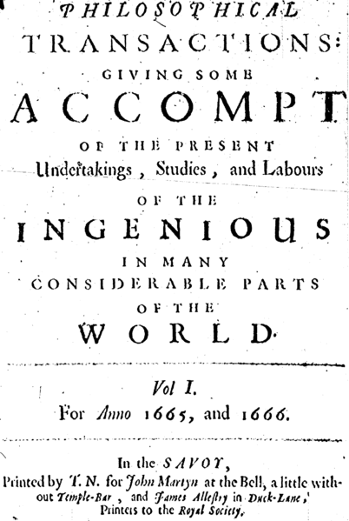
Source: http://commons.wikimedia.org/wiki/File:Henry_Oldenburg.jpg
This image is in the public domain because its copyright has expired.
Source http://commons.wikimedia.org/wiki/File:1665_phil_trans_vol_i_title.png
This image is in the public domain because its copyright has expired.
Notes:
Henry Oldenburg
First secretary of the Royal Society
The Philosophical Transactions of the Royal Society of London (Phil Trans)
Established principles of scientific priority & peer review
Evolved in the age of print
Modern scholarly journals do not pay authors for their articles

Slide 9
Serials crisis
C19th and C20th
Number of universities/ associated research output increased
Market with established creative source & pattern of consumption
Unsustainable price rises of traditionally published journals
1990 - Stevan Harnad introduced Psycoloquy, the first peer-reviewed scientific journal on the internet
Paved the way for free academic publishing on the web after 1993
Notes:
Robert Maxwell

Slide 10
Stevan Harnad’s subversive proposal (1994)
“If all scholars' preprints were universally available to all scholars by anonymous ftp (and gopher, and World-Wide Web, and the search/retrieval wonders of the future), NO scholar would ever consent to WITHDRAW any preprint of his from the public eye after the refereed version was accepted for paper "PUBLICation." Instead, everyone would, quite naturally, substitute the refereed, published reprint for the unrefereed preprint.”
http://eprints.soton.ac.uk/253351/
“one of the seminal texts of the open access movement” Richard Poynder June 2014

Slide 11
Budapest Open Access Initiative (2002)
“An old tradition and a new technology have converged to make possible an unprecedented public good…Removing access barriers to this literature will accelerate research, enrich education, share the learning of the rich with the poor and the poor with the rich, make this literature as useful as it can be, and lay the foundation for uniting humanity in a common intellectual conversation and quest for knowledge.”
Recommend two complementary strategies:
Self-archiving (green)
Open-access Journals (gold)

Slide 12
Seismic shift
The Finch report (2012)
Emphasised gold over green
5 year "transition period“
Average APC ≈ £1800
Robbing Peter to pay Paul?
Criticised by OA advocates
Influence of publishing lobby?
Market forces will drive APCs down (won't they??)

Slide 13
RCUK policy (April 2012)
RCUK-compliant journals
Offer suitable gold OR suitable green option
Creative Commons-Attribution (CC-BY)
RCUK OA block grants
Establish institutional publication funds
expect primary use to be payments of APCs
Preference is gold OA
Decision lies with authors and institutions

Slide 14
HEFCE policy: a new chapter
Arms race with commercial publishers
“Online first”
Embargoes (SHERPA/RoMEO)
Is green a long term solution?
Is gold sustainable?
Books and monographs?
e-theses
EThOS - http://ethos.bl.uk/
Open Data
What might a new paradigm look like?
Institutional/library publishing?
PKP - Open Journal System e.g. http://journals.ed.ac.uk/
UCL Press
Open Library of the Humanities

Slide 15
Social media and the academy: network effects
Academic blogs
Facebook / Twitter
OA and impact
http://sparceurope.org/oaca/
Academic tools
Mendeley
Figshare
academia.edu
ResearchGate
Article level metrics
Alternative or “altmetrics”
Notes:
Facebook (2004) Twitter (2006) Slideshare (2006) Mendeley (2007) academia.edu (2008)

Slide 16
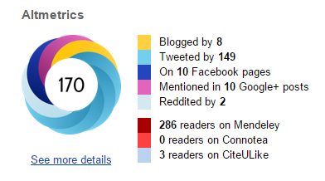
Alternative metrics
Article level metrics
frontiers in Psychology http://journal.frontiersin.org/article/10.3389/fpsyg.2013.00058/abstract
PLoS One http://journals.plos.org/plosone/article?id=10.1371/journal.pone.0121708
Repositories
IRUS-UK
Statistics at Leeds Beckett
The end of JIF?
Various flavours
Plum analytics - http://www.plumanalytics.com/
Impact story - https://impactstory.org/
Altmetric - http://www.altmetric.com/

Slide 17
Online networks
https://twitter.com/BeckettResearch/lists/leeds-beckett-university/members

Slide 18
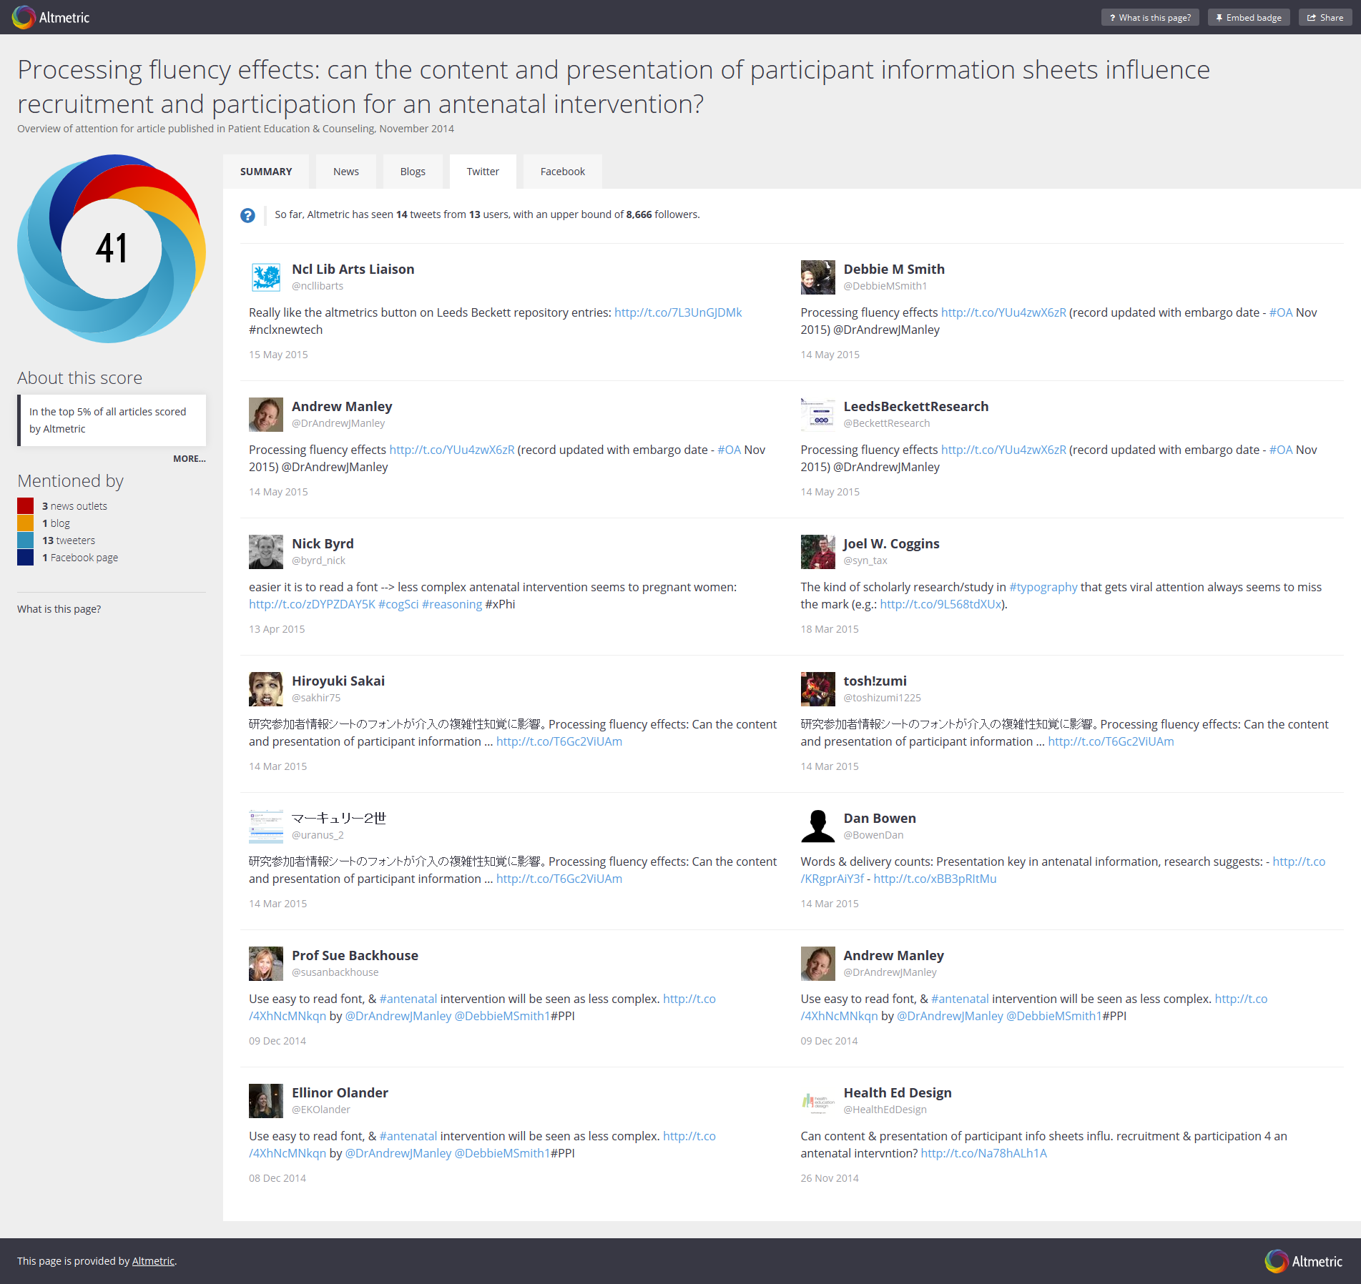

Slide 19
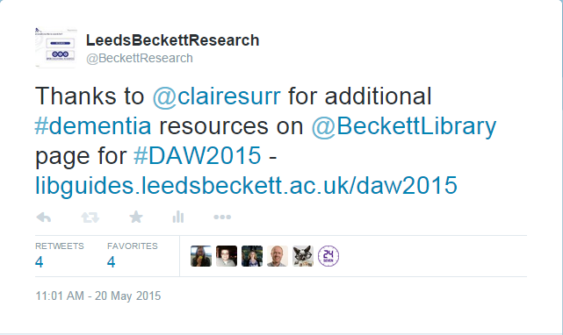
Promoting research through events
http://libguides.leedsbeckett.ac.uk/world_diabetes_day
http://libguides.leedsbeckett.ac.uk/IWD2014
http://libguides.leedsbeckett.ac.uk/Budget2014
http://libguides.leedsbeckett.ac.uk/LeTour2014
http://libguides.leedsbeckett.ac.uk/MentalHealthAwareness
http://libguides.leedsbeckett.ac.uk/daw2015
http://libguides.leedsbeckett.ac.uk/menshealthweek2015

Slide 20
References & bibliography
Suber, P. Open Access Overview. Available at: http://www.earlham.edu/~peters/fos/overview.htm [Accessed 17 November 2014]
Guédon, J.-C. (2001) In Oldenburg’s long shadow: librarians, research scientists, publishers, and the control of scientific publishing. Available at: http://eprints.rclis.org/6375/ [Accessed 17 November 2016]
Budapest Open Access Initiative (2002) Available at: http://www.soros.org/openaccess/read.shtml [Accessed 17 November 2014]
Yiotis, K. (2005) The Open Access Initiative: a new paradigm for scholarly communications. Information Technology and Libraries 24(4). Available at: http://ejournals.bc.edu/ojs/index.php/ital/article/view/3378 [Accessed 17th November 2014]
Monbiot, G. (2011). The Lairds of Learning | George Monbiot. [online] Monbiot.com. Available at: http://www.monbiot.com/2011/08/29/the-lairds-of-learning/ [Accessed 17 Nov. 2014].
Accessibility, sustainability, excellence: how to expand access to research publications: Report of the Working Group on Expanding Access to Published Research Findings (June 2012) Available at http://www.researchinfonet.org/wp-content/uploads/2012/06/Finch-Group-report-FINAL-VERSION.pdf [Accessed 17 November 2014]
RCUK Policy on Open Access (April 2012) Available at http://www.rcuk.ac.uk/research/openaccess/policy/ [Accessed 17 November 2014]
HEFCE (2013) Policy for open access in the post-2014 Research Excellence Framework Available at http://www.hefce.ac.uk/pubs/year/2014/201407/ [Accessed 17 November 2014]

