Slide 1
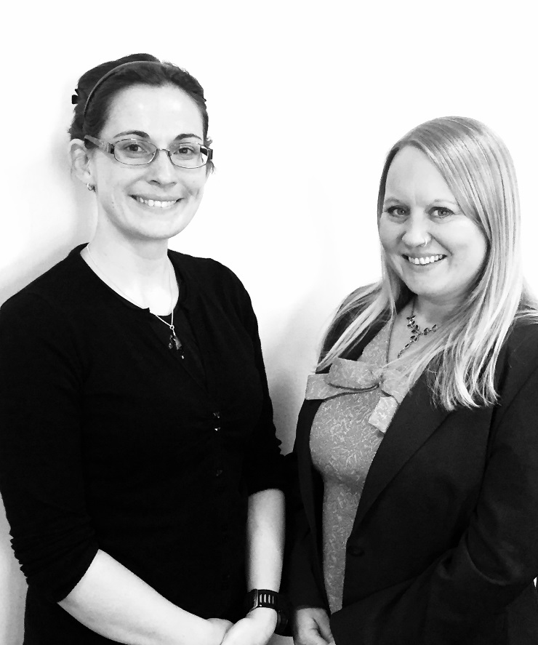
Developing Preferred Licensing Terms for Ebooks and Journals/Databases at Leeds Beckett University
Libraries and Learning Innovation,
Elly Cope – Content Delivery Manager Julie Cleverley – Journals and Electronic Resources Manager
Notes:
Today I would like to talk to you about a preferred licensing project I led over the last year where we developed a set of preferred licensing terms for our eBooks and journals databases.

Slide 2
Why did we do it? – Student as customer
Student as customer - Customer expectations
“Most Generation Y … know they can find a book faster by searching on Amazon”
Generation Y “expect a lot and expect it “now
Generation Y students, customisation, and the growing importance of data science ICEF Monitor http://monitor.icef.com/2013/07/generation-y-students-customisation-and-the-growing-importance-of-data-science
Anderson, J (2010) 'New Generation, Old Questions', Incite, 31 (11), p.15,
Providing the right resources
Notes:
Why did we do it?
The last 10 years has seen a massive movement from print to electronic journals in Higher Education. The move to e-books has increased in the last 5 years with a number of libraries preferring to purchase the eBook as the primary option.
The general feeling is users expect libraries to have all the resources they need electronically.
Generation Y (our current students brought up using amazon and being able to get products at the touch of a button or the swipe of a smart phone) expect a lot and expect it now
However it is no longer just about providing e-resources it’s about providing the right resources. It’s the value to that student.
We as librarians need to ensure that the resources we are purchasing are fit for purpose. This was the impetus for our preferred licensing project.

Slide 3
Why did we do it? – Access, Accessibility and Authentication
Increase in e-book provision but access problematic
Different access and license models – authentication, concurrency, access on mobile devices
Page turning software for our eJournals
Problems with DRM
Accessibility for users with impairments
Marrying customer expectations with supplier capabilities
Personalised services vs easy access
Notes:
We have found that since their introduction, e-books have been slower to develop than other e-resources and the standard product and licence terms offered by publishers and aggregators are proving less suitable to our University’s needs.
Although we have seen an increase in e-book provision access is problematic –
Each provider has diff access and license models. There are differences in the number of concurrent users. There are a number of authentication issues with users having to login twice and accessibility on mobile devices
Although there majority of our eJournals are accessible we do still have some that aren’t as accessible and have page turning software which doesn't not work particularly on a mobile device
There are problems with DRM
There are issues with accessibility for users with impairments – particularly visual or upper limb. There are too many clicks to access, there is a lack of compatibility with screen reader software and no provision of proper e-copies.
We need to marry customer expectations with supplier capabilities – We need to find the middle ground between what publishers are willing to offer and what our users expect. What publishers offer is sometimes not what users want
For eg Personalised services vs easy access – Our students just want to access the resource quickly using their university login not an individual password that may give them additional functionality.

Slide 4
Why did we do it? – value for money
Library budgets and specific importance on Value for Money and Return on Investment
It is no longer just about providing e-resources it’s about providing the right resources.
Notes:
Over the last 10 years our spend on electronic resources has gone up from 32% to 71%.
Our library budgets are not necessarily increasing to match the increase in spending. We are now at a level where it is not sustainable for us to continue to spend increasing amounts on e resources. The emphasis is on value for money and return on investment.
It is no longer just about providing e-resources it’s about providing the right resources.
Through our ebook usage stats we have noticed that our e-books are currently providing less value for money than they were 1-2 years ago.
Which was why we decided to set out a checklist of things we wanted to see with regard to the e-resources to ensure they are viable for our users needs.

Slide 5
Why did we do it? – usage and monitoring return on investment
E-journal data is more consistent and reliable than that for eBooks
Inconsistent usage statistics between eBook providers
Definitions of BR2 - chapter versus page view
Return on Investment
Use of cover images for promotion via social media
Notes:
Like many libraries, at Leeds Beckett, we have been using statistics to assess how well and how hard our e-resources have been working for us.
E-journal data is more consistent and reliable than that for e-books but the overall trends are clear and we have noticed that e-books are currently providing less value for money than they were 1-2 years ago. We wanted to increase our usage of ebooks. However we do find it difficult to monitor usage when comparing ebook providers.
There are inconsistent usage statistics between eBook providers with different providers defining BR2 in different ways. Some count BR2 as a chapter download while others define it as a page view
With this project we wanted to put down what we would ideally want to see in our ebook stats onto paper to lobby publishers to create better stats collection so we can consistently compare
As mentioned on the previous slide we need to ensure our resources are producing a ROI . While some are more open some of the ebook publishers are becoming stricter with regard to concurrency and how many users can access at a time – the jnls model became more consistent
With our increased spend on ebooks we wanted to ensure increase in usage and return on investment therefore we wanted to promote them. One of the best ways to do this is through social media but a number of the ebook providers would not allow us to post cover images via twitter and Facebook thus This became one of the terms in our preferred license.

Slide 6
Preferred Licensing Project
Libraries and Learning Innovation Operational Plan 2014-15 objective 47: Develop preferred licensing criteria for individual and package Ebooks and EJournals and databases for use in negotiation with providers.
Full project plan & documentation to LLI Management Team in September 2014
Regular meetings
Closure report at the end of project in March 2015
Notes:
In the 2014-15 Libraries and Learning Innovation Operational Plan which fed into the Universities strategic plan one of the objectives was to Develop preferred licensing criteria for individual and package Ebooks and EJournals and databases for use in negotiation with providers.
This project had importance at institutional level as well as library level.
In September 2014 a project plan was taken to our LLI management team which stated the intention to address the objective by developing a set of preferred licensing terms, encompassing both essential and desirable features, for use in negotiation with suppliers.
A project group was set up which held regular meetings. This was a short term project which was completed in March and a closure report was taken to the march LLI management team meeting

Slide 7
Project group
Made up of various representation from Libraries and Learning Innovation
Academic Librarians
Disability support
Copyright and Licensing
Information Services Librarians – eBooks, E-journals, access
Library Assistants in Learning Resources
Notes:
The project group consisted of various representatives from Libraries and Learning Innovation.
We wanted a broad perspective and everyone brought a different insight.
We wanted to use different people from different areas (not just Learning Resources) so we had lots of different viewpoints e.g. Academic Librarians, Disability Support, representatives from copyright and licensing and our ISLs – who deal with eresource accesses,
We also invited 2 of the Library assistants to give them some experience of working on a project group at this level and to gat feedback form them as they work on the frontline services including the desk and the Telephone enquiry Service where they get a number of 1st line e-resource queries

Slide 8
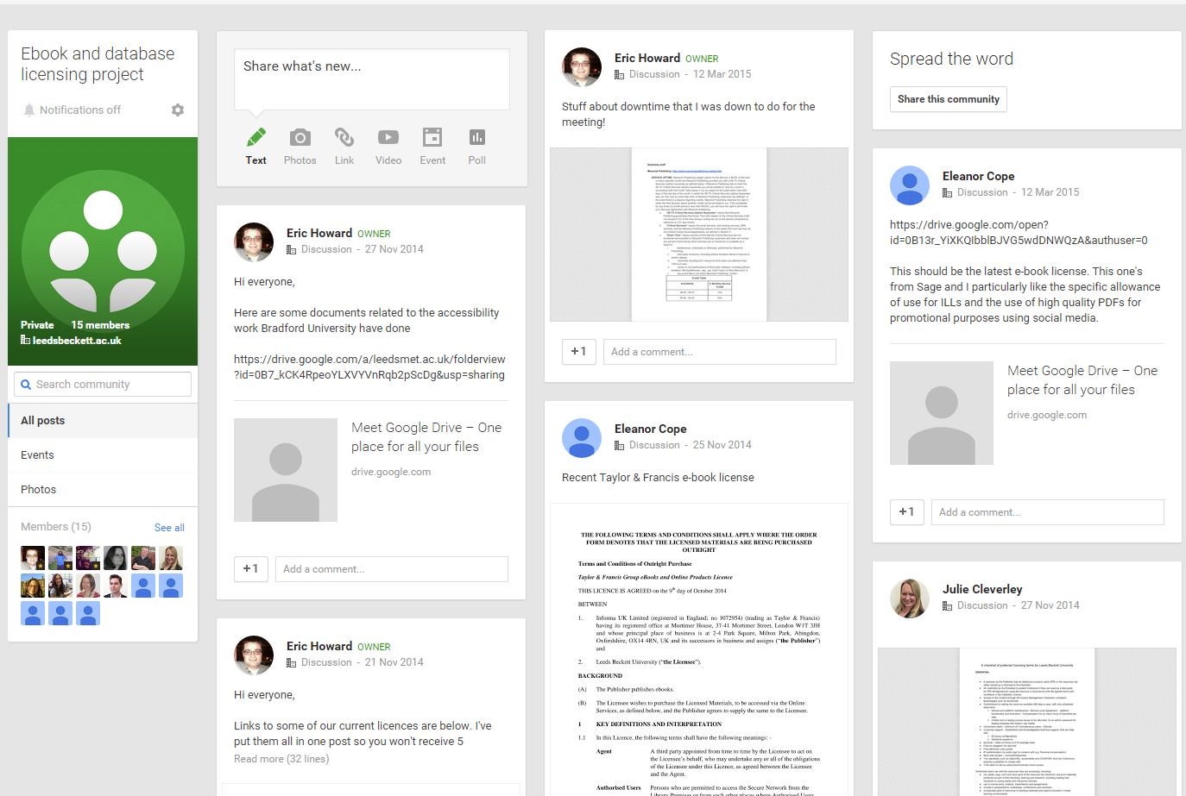
Google docs community
Notes:
The Group tried using Google docs to share, edit and update documentation. While it was useful having all the documents in one place where multiple people could update them at the same time as with anything new there were a few hiccups. It took a while to get everyone set up and uploading documents into google docs wasn't as straightforward as saving them on our shared drive. Using a google community didn’t replace our face to face discussions which were more valuable.

Slide 9
Evaluating best practice
Review sector activity and best practice in licensing negotiation including other institutions’ licences
Review and summarise current licensing and usage reports using the JISC Model Licence
Notes:
Our first project objectives were to Review sector activity and best practice in licensing negotiation including other institutions’ licences and Review and summarise current licensing and usage reports using the JISC Model licence as a model
The group reviewed current developments in the sector utilising best practice documentation including the JISC model licence and some of the licences from our more established eJournal providers including Wiley and EBSCO.

Slide 10
Evaluating best practice
Examples of best practice
Access “for all” 365 days a year
Multi-user, unlimited concurrency with some exceptions
Customer support
Standards adhered to, such as OpenURL, accessibility and COUNTER
Authorised users can
cut, paste, copy, print and save parts of the resource into electronic and print materials produced as part of their teaching, learning and research, including reading lists, handouts or course packs and interactive tutorials
reproduce extracts in a format that aids accessibility
Notes:
Examples of best practice
Access “for all” 365 days a year
Multi-user, unlimited concurrency with some exceptions
Customer support
Standards adhered to, such as OpenURL, accessibility and COUNTER
Authorised users can
cut, paste, copy, print and save parts of the resource into electronic and print materials produced as part of their teaching, learning and research, including reading lists, handouts or course packs and interactive tutorials
reproduce extracts in a format that aids accessibility

Slide 11
Sources
Frances Pinter Knowledge Unlatched http://www.slideshare.net/OAbooks/frances-pinter-jiscbl - What libraries want – Discovery – IP, EZ Proxy, Full bib records, Accessible on various platforms, Notification when content is removed, Counter compliant usage, Perpetual access to purchased content.
JISC-TechDis Towards Accessible e-Book Platforms http://www.jisctechdis.ac.uk/assets/Documents/accessebookresearch.pdf
University of Bradford’s accessibility audit
University of Huddersfield eBooks Co-Design Report – pain points http://eprints.hud.ac.uk/20168/1/140423-ebooks-co-design-report-final.pdf – existing provision, reviewing market
University of Hull’s eBooks matrix
Notes:
We consulted a number of sources to inform our preferred licensing terms.
Frances Pinter’s Knowledge Unlatched was a useful starting point. His slide on what libraries want which included Discovery – IP, EZ Proxy, Full bib records, Accessible on various platforms, notification when content is removed, Counter compliant usage, Perpetual access to purchased content. helped to spell out some of the wording for our preferred terms.
We looked at the JISC-TechDis Towards Accessible e-Book Platforms report on accessible e-book platforms and added relevant terms to our preferred licensing document
We also looked at what some of our local benchmark universities were doing
University of Bradford’s accessibility audit
University of Hull’s ebooks matrix
http://eprints.hud.ac.uk/20168/1/140423-ebooks-co-design-report-final.pdf
University of Huddersfield eBooks Co-Design Report – pain points Understand the pain points experienced by libraries in terms of management and user experience in dealing with eBooks in all their guises.
Bradford, Hull and hudds were evaluating what providers provide. The difference between what we were doing and what other institutions have been doing is we were not just looking at what they do. We were highlighting what we want.
Devices & Accessibility Licensing Standardise and simplify licensing
Selection Single e-book acquisition and discovery service including pricing and models
Evaluation & Analytics Better usage stats – JUSP for e-books
Metadata & Discovery Normalise e-book ISBNs 28 R4 I –
Continuing Access Provide continuing and archival access 28 R6 I - Continuing Access Preservation of DRM free content 26 R6 C – Selection Finding out what e-books are available 26 R7 F - Evaluation & Analytics Share techniques for local stats collection 26 R9

Slide 12
Preferred terms
Define a minimum level of accessibility and mobile access functionality as standard
Identify optimum licensing terms
‘Deal breakers’ – would mean we can't purchase
Hosted on a bespoke system not compatible with ours
‘Seat’ licences
On-campus only access
Notes:
Our 3rd and 4th project objectives were to Define a minimum level of accessibility and mobile access functionality as standard and Identify optimum licensing terms
Initially the project group got together to create a checklist of terms and issues that would determine whether we purchased a resource
These included what we termed Deal breakers’- where if resource offered this functionality we wouldn't be able to purchase it.
Hosted on a bespoke system not compatible with ours (needs to be web-based)
‘Seat’ licences – i.e. you buy a certain number of seats; this usually ties the resource down to a particular number of PCs. Not practical for our purposes
IP only

Slide 13
Preferred terms
Issues – would consider, but we may prioritise other resources
Concurrent licence limiting to x number of users
[Ejournals] – format on screen (page-turning software)
Not mobile enabled
Non-COUNTER compliant stats
Preferences
Hosted on an established platform
Fully integrated with Discover. [Ejournal] – listed on Ebsco A-Z Knowledge base
COUNTER compliant stats
Established and knowledgeable technical support
Provides material for promotion of resources
Notes:
We identified some Issues with e resource accessibility where we would still consider purchasing the resource but we may favour other resources that didn't have these issues.
These included
Concurrency limits.
[Ejournals] – format on screen (page-turning software)
Not mobile enabled
Non-COUNTER compliant stats
We also put down a list of our ideal preferences
Hosted on an established platform
Fully integrated with Discover. [Ejournal] – listed on Ebsco A-Z Knowledge base.
COUNTER compliant stats with the ability for CSV download. [For journals, compatability with JUSP].
Established and knowledgeable technical support, that can help with
Ez-proxy configurations
Statistical questions
Provides material for promotion of resources

Slide 14
Preferred licensing document
Create a preferred licensing model for Ebooks and for Journals/Databases for use in acquisition and renewal of resources including essential and desirable characteristics of the licence
A preferred licensing document with a checklist of preferred terms: ‘essential’, ‘desirable’ and, ‘wish list’.
Master template created
Notes:
We then utilised this checklist t create a preferred licensing model for Ebooks and for Journals/Databases for use in acquisition and renewal of resources including essential and desirable characteristics of the licence
A preferred licensing document was developed with a checklist of preferred terms which were split, like a person specification for recruitment, into ‘essential’, ‘desirable’ and, ‘wish list’.
Put into a master template to be used when evaluating resources in future.
We also created a supplier template

Slide 15
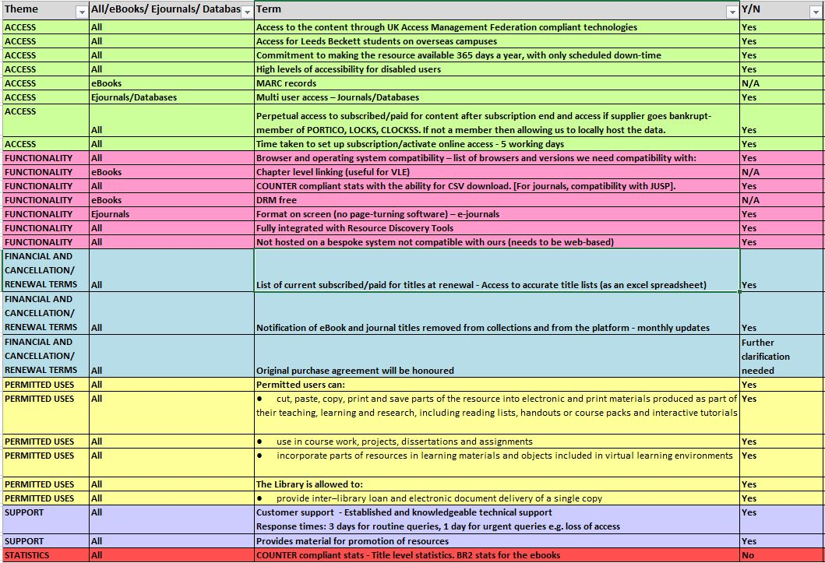
Supplier template
Notes:
From the preferred licensing document we created a master template still with the essential, ‘desirable’ and, ‘wish list’ splits.
We also produced supplier templates to distribute to our resource providers with the essential and desirable and wish list terminology removed to ensure more authentic, transparent, consistent responses and to avoid concentration over the essential terms.
We identified some that were specific to ebooks and ejournals so when we send these out to our suppliers we will only send the template with the relevant criteria.
As you can see the template is split into themes: Access, Functionality, Financial and Cancellation/Renewal Terms, Permitted Uses and support and criteria within each theme is alphabetised
Yes and no column refers to whether the resource meets the stated terms or whether any further investigation or clarification is needed - these are made up. I haven’t used a real evaluation
We have colour coordinated the themes to make it more accessible visually but we do also have templates without the colour coding.

Slide 16
Policies and procedures – business as usual
From a strategic/operational objective to day to day procedure - ‘business as usual’
Embedded into policies and procedures
Consistent tracking of communications and evaluations
Marking template and log spreadsheet for completed evaluations
Annual review meetings
Further evaluation needed of our existing subscribed resources against the licensing template to develop actions for each supplier/contract
Notes:
So from strategic/operational objective has come an improvement in day to day procedure becoming ‘business as usual’.
The template has become embedded into policies and procedures – we are utilising the supplier template for our trialled resources
To ensure consistent tracking of communications and evaluations a folder has been created on the shared drive to store the templates and any communication emails.
We have created a marking template for supplier comparisons. We have also created a log spreadsheet to log completed evaluations.
We have utilised the template so far while undertaking trials of resources and are hoping the evaluation of the template will inform our decision making
We will be holding Annual review meetings of the project group to see if there have been any technical developments to incorporate into the preferred licensing terms to keep them current.
We plan to evaluate our existing subscribed resources against the licensing template to develop actions for each supplier/contract.

Slide 17
Lessons learned
Lot more discussion over terms than anticipated
Takes time to get results – need to factor time in to procedure
Need for more consistent evaluation of resources but time constraints could affect this evaluation
When a supplier says that they “can provide service X”, what they mean is “on paper, we have the potential to provide service X”
Google docs and group representation might need rethinking
Good development opportunity for our Library Services Assistants
Notes:
Inevitably we learnt a few lessons along the way
Producing the checklist of terms in the template took time and there was a lot of discussion over phrasing and jargon.
It takes time to get results. We did use this template with one of our publishers and while they were more than willing to work with us there was a lot of toing and froing.
Also we found using the template with our trialled resources took time. Each template takes about 1-2 hours to go through.
The project highlighted the fact there is a need to have more consistent evaluation of resources and the licensing template can be used to demonstrate how we have chosen these resources. However when it comes to end of year spend and we have to purchase resources quickly sometimes we don’t have the time to evaluate potential resources thoroughly.
Also it became clear in this instance that when a supplier says that they “can provide service X”, what they mean is “on paper, we have the potential to provide service X”. The learning curve was at least as steep for the supplier as it was for us. Publishers say they can do things when in reality the functionality might not yet be in place
Google docs and group representation might need rethinking. Took time to upload on google docs. Sometimes it was quicker to just use the shared drive, We had things saved on the shared drive anyway so there was a bit of duplication.
Having such a large group meant sometimes we couldn’t get everyone to attend. However the positive was there was always enough people to have a meaningful meeting and as we held the meeting at both of our campuses there was always someone around to attend.
Was a good development opportunity for our library services assistants and got them more involved in the wider library

Slide 18
Benefits realised
More consistent, transparent evaluation of resources
More rigorous process to manage and store this data for use in future
Avoid duplication of work with the same resources being evaluated again
Process should aid evaluation and decision making to ensure more cost effective use of budgets in the long run
Use cover images for publicity purposes ensuring value for money and return on investment through promotion of new e-Books on social media
Notes:
We have a more consistent, transparent evaluation of resources with a more rigorous process to manage and store this data for use in future which should hopefully avoid duplication of work with the same resources being evaluated again.
This preferred licensing process should aid evaluation and decision making to ensure more cost effective use of budgets in the long run.
Through utilising the preferred licensing terms checklist we have had a success with one of our e-book suppliers and are now able to use cover images for publicity purposes. This was one of our preferred terms on our checklist related to ensuring value for money and return on investment through promotion of new e-books on social media.

Slide 19
Successes
https://vine.co/v/O0BBxr0hD2z
https://vine.co/v/ea7HrldOtqF
Notes:
Through utilising the preferred licensing terms checklist we have had a success with one of our e-book suppliers and are now able to use cover images for publicity purposes. This was one of our preferred terms on our checklist related to ensuring value for money and return on investment through promotion of new e-books on social media.
https://vine.co/v/O0BBxr0hD2z
https://vine.co/v/ea7HrldOtqF

Slide 20
Future plans
Academic Librarians able to use template with academics ‘will it meet these requirements?’
Can be used for demonstrating value and assessment following trials
Disability access
Further embedding into day to day
Potentially working with JISC and The Northern Collaboration
Revisiting all resources not just new
Notes:
Academic Librarians able to use template with academics ‘will it meet these requirements?’
Hopefully the preferred licensing template will be utilised by the academic staff so when they are requesting new resources they are better informed over what types of resources we can purchase with regard to licensing and accessibility. We do get requests for resources that are only for single named users with individual logins that need particular bits of software installing.
We are hoping to further use the template to demonstrate value and assessment following trials (with REG & academics)
Potentially working with JISC and The Northern Collaboration group – Elly recently attended a meeting where the discussion was on this topic.
Further embedding into day to day
Revisiting all resources not just new

Slide 21
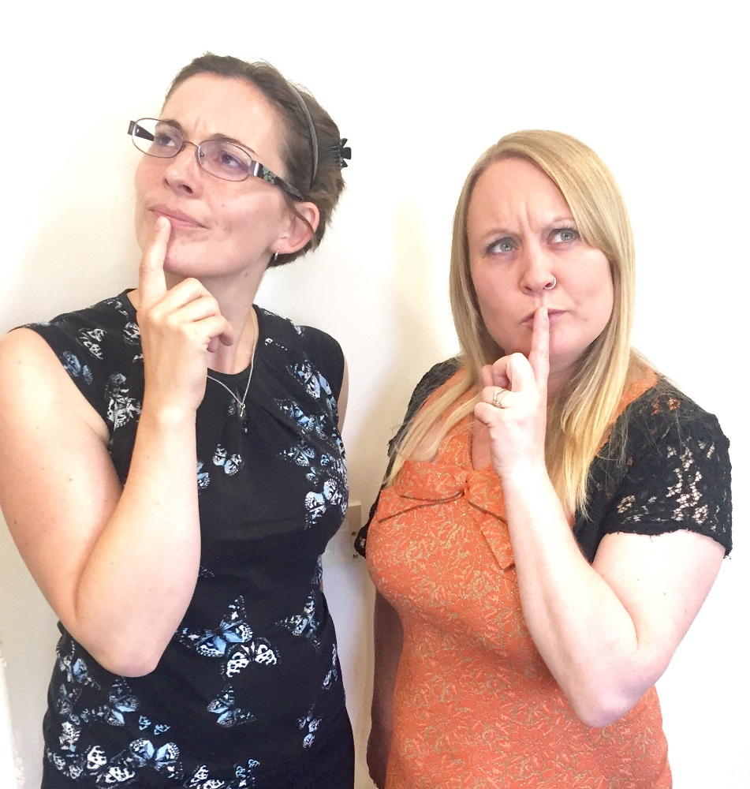
Any questions?
E.C.Cope@leedsbeckett.ac.uk
@ellycope
J.Cleverley@leedsbeckett.ac.uk
@stirli02

