Slide 1



Can physical activity reduce work-related stress?
What do we know?
Clare Smith, Mariana Kaiseler and Jim McKenna
Institute of Sport, Physical Activity and Leisure, Leeds Beckett University (UK)
Clare Smith
PhD Research Student
@clarefsmith c.f.smith@leedsbeckett.ac.uk
Notes:
Good morning/afternoon, my name is Clare Smith and I am a PhD student at Leeds Beckett. My 5-minute challenge will explain what we know about the interaction between physical activity and work related stress.
WRS has reached “epidemic” proportions causing a considerable and far-reaching detrimental impact at a number of levels. Impact can be felt at individual level (mental/physical health), organisational level (absenteeism, productivity) and at global economic level.
So what do we know about physical activity and work related stress …

Slide 2

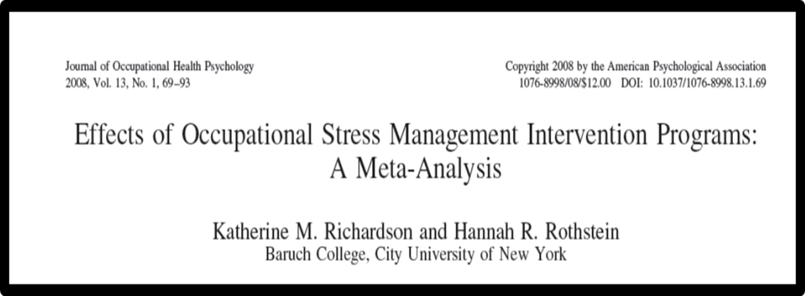

1.Workplace stress management interventions work
Notes:
Evidence suggests that workplace stress management interventions reduce stress. Richardson and Rothstein’s 2008 meta-analysis found a moderate to large effect size of 0.53. Review included 36 studies and covered 55 interventions. After categorising by type they found that cognitive behaviour interventions were most effective but they made up over 50% of the studies. Only 4 out of the 55 interventions included any element of PA and only one study used this as a sole ‘treatment’ option. Note of caution Highlighted lack of organisational measures and organisational led interventions and follow up measures

Slide 3
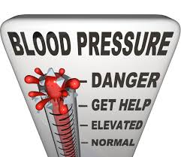

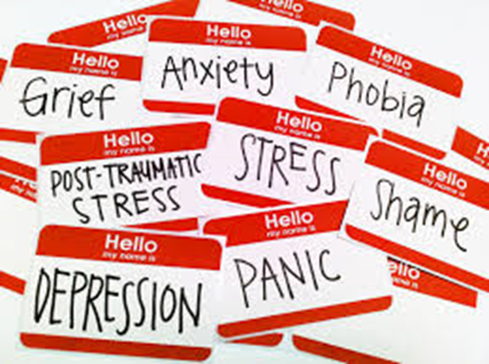

2. Positive impacts of physical activity
Notes:
But there is evidence to suggest that physical activity is beneficial for mental and physical health, physical fitness and cognitive functioning. These factors would have positive impact on work-related dimensions of productivity, absenteeism etc. Note of caution evidence suggests reciprocal relationship stress and exercise

Slide 4

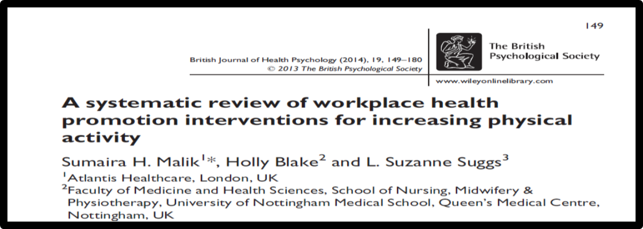
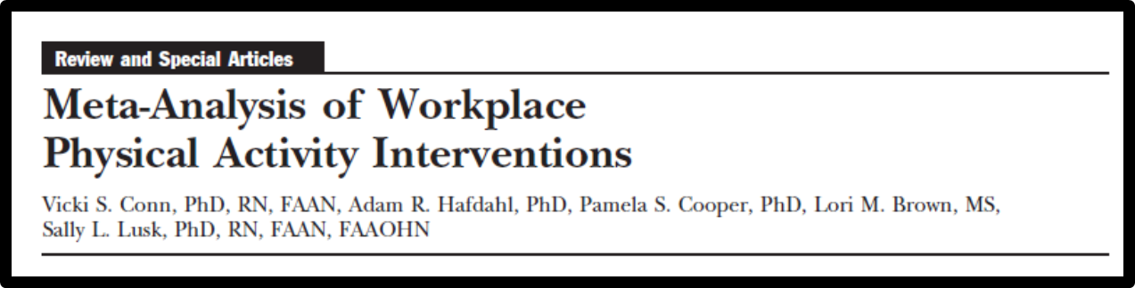
3. Workplace physical activity interventions work
Notes:
there’s evidence to suggest that workplace physical activity interventions work and behaviour change interventions with theoretical underpin are more effective. There have been numerous reviews of literature looking at a variety of outcome measures, from physical activity, to mental health outcomes and wider range of organisational outcomes. One of latest reviews (Malik et al., 2014) did not calculate effect size due to lack of homogeneity. However, Conn et al’s 2009 meta-analysis calculated effect sizes of 0.33 impact of PA on job-related stress but this was based on a very small sample size, included published and unpublished studies and looked at post-hoc measures. Conn’s study did not report on theoretical underpin and behaviour change techniques. Agreement amongst reviews that better designed studies are needed

Slide 5
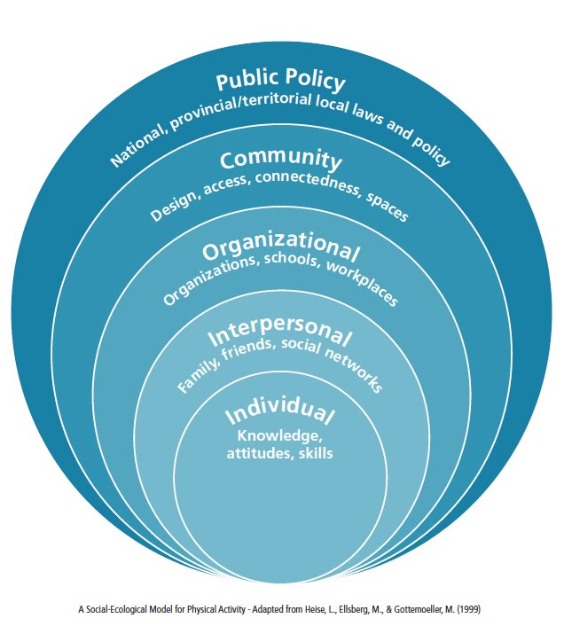



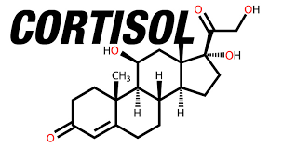
4. Future directions
Notes:
More primary studies with interventions designed with a theoretical underpin and explicitly described behaviour change techniques. Objective and subjective outcome measures including at different levels, individual and organisational with appropriate follow up measures

Slide 6




Thank you for listening
c.f.smith@leedsbeckett.ac.uk

