Slide 1
LEEDS BECKETT UNIVERSITY
We’re API and we know it: embedding and exploiting data from multiple sources
Nick Sheppard, Kirsty Bower, Jennifer Bayjoo

Slide 2
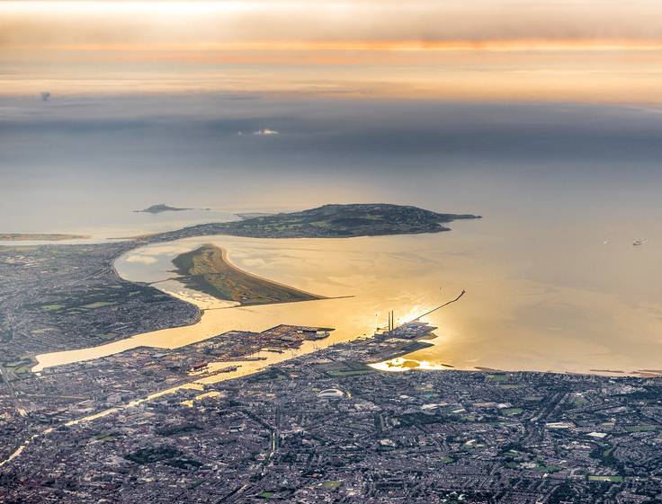
Overview
Carrots and sticks
Building a research infrastructure
Technical
Social media
Metrics

Slide 3
Hello
Research Services
Research Services Advisor (2015)
Technical Officer - UKCoRR (UK Council of Research Repositories)
http://ukcorr.org
Journals team
Academic Support
Faculties
CAF | AET
FBL | HSS
Heads of Research Heads of School
Research administrators
Academic staff
Research Office
Notes:
Leeds Beckett University
Growing research profile
Good performance in REF (Unit 26 - Sport and Exercise Sciences, Leisure and Tourism)
Men’s Health / Retail
_____________________________________________________________
Pseudo-technical - I am NOT a developer
Research Services team
OA advocacy & training, policy compliance
Technical infrastructure
Research Data Management (RDM)
Impact (REF)
______________________________________________________________
UKCoRR is an independent body for repository managers, administrators and staff in the UK that:
Promotes repository management as a recognised and respected profession
Provides a forum for discussion and exchange of experience
Represents the views and concerns of those who work with repositories in organisational, policy and strategic development

Slide 4
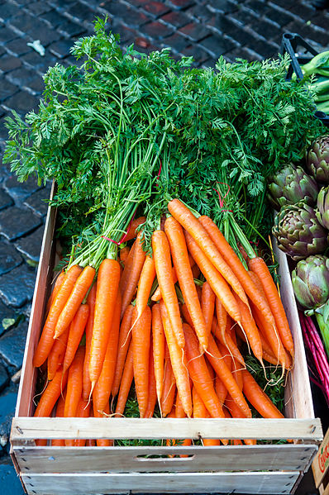
What is a repository?
“a set of services that a university offers to the members of its community for the management and dissemination of digital materials created by the institution and its community members”
Clifford Lynch (2003)
What is a repository? (Jisc blogpost. May 31st 2016)
@BeckettResearch
@mrnick
@Krustyb1
@epicbayj

Slide 5
What is a repository?
“to be eligible for submission to the post-2014 REF, authors’ final peer-reviewed manuscripts must have been deposited in an institutional or subject repository on acceptance for publication”
@BeckettResearch
@mrnick
@Krustyb1
@epicbayj

Slide 6
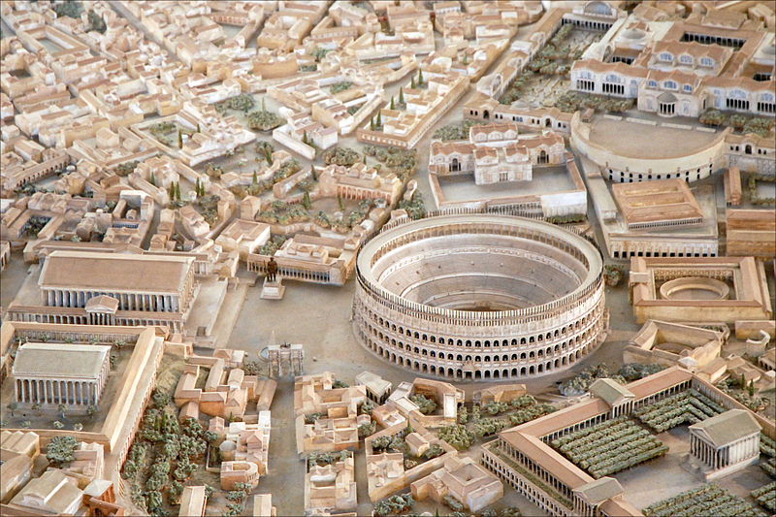
Social media
Academic blogs
Library website
Library resources
VLE
University website
Institutional Repository
Research web pages
@BeckettResearch
@mrnick
@Krustyb1
@epicbayj

Slide 7
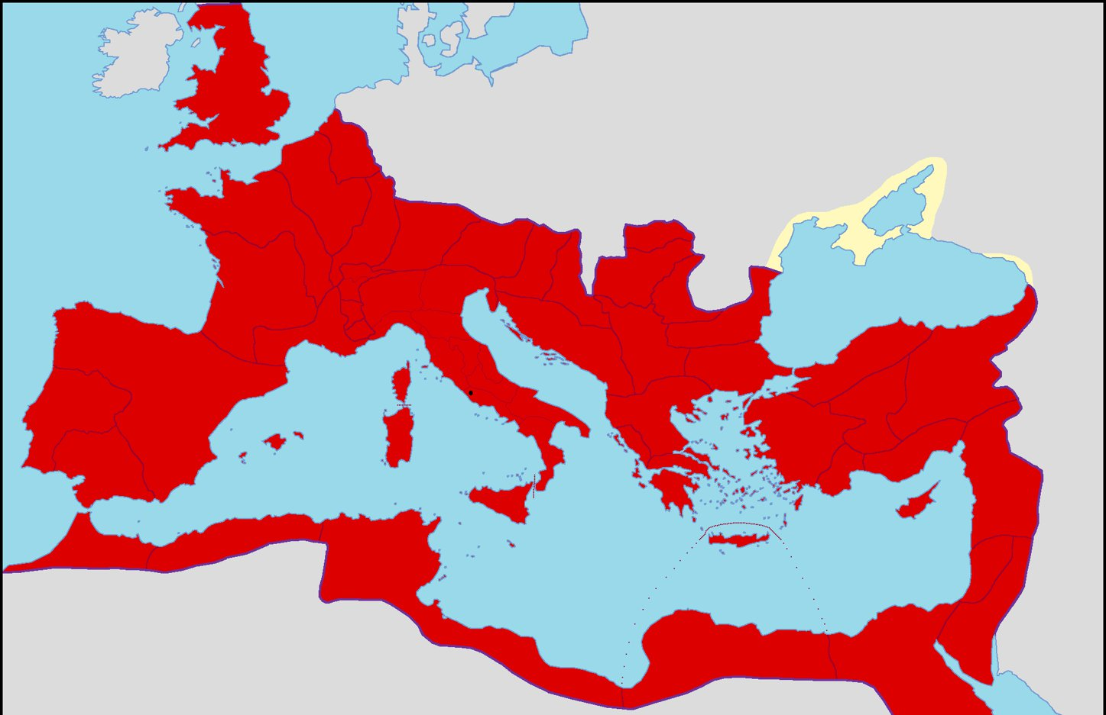
All roads…
@BeckettResearch
@mrnick
@Krustyb1
@epicbayj
Social media
Twitter
Facebook
Europe PMC
Academic blogs
Web of Science
Altmetric.com
Roma
IRUS-UK
Mendeley
Scopus
ORCiD
ResearchGate

Slide 8
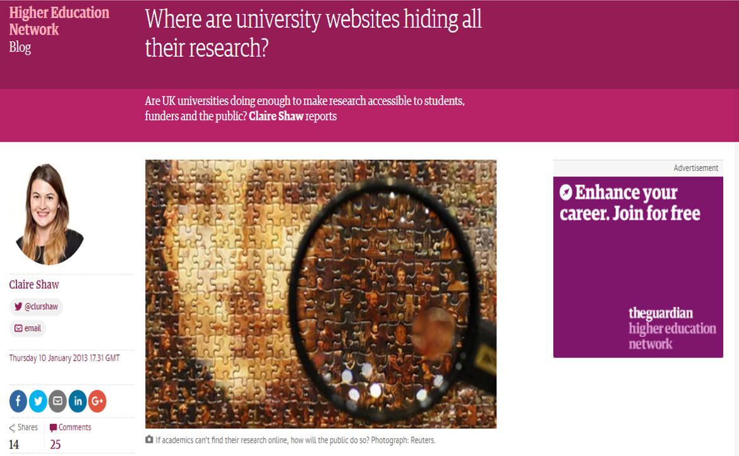
@BeckettResearch
@mrnick
@Krustyb1
@epicbayj
“Research is fundamental to a university's reputation, ranking and – with the introduction of the Research Excellence Framework (REF) – future funding, but are UK universities really doing enough to promote and inform the public of the research they do?”
Guardian 2013

Slide 9
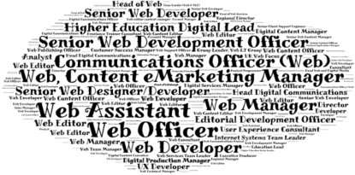
IWMW13
At my institution the repository/research management software is well embedded into institutional processes, systems and culture
It is easy to find up to date research information (e.g. current research projects) on my institutional website
It is easy to find recent research outputs (e.g. pdfs of Open Access articles, research data) on my institutional website
@BeckettResearch
@mrnick
@Krustyb1
@epicbayj
Notes:
The Institutional Web Site and the Institutional Repository: Addressing Challenges of Integration

Slide 10
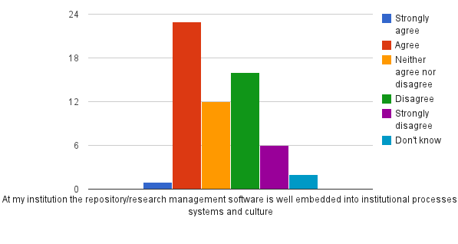
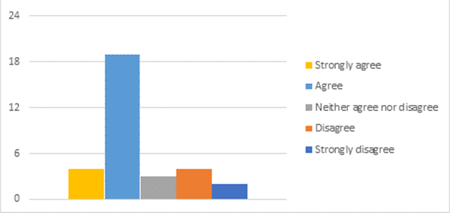
Survey 2013 (n=61) 2016 (n=32)
@BeckettResearch
@mrnick
@Krustyb1
@epicbayj

Slide 11
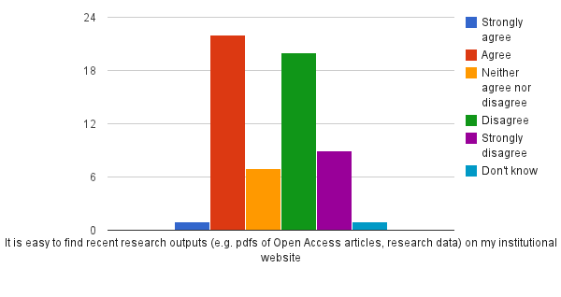
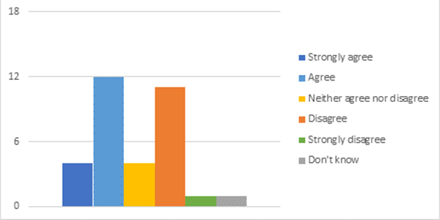
Survey 2013 (n=61) 2016 (n=32)
@BeckettResearch
@mrnick
@Krustyb1
@epicbayj

Slide 12
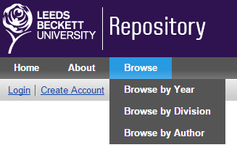
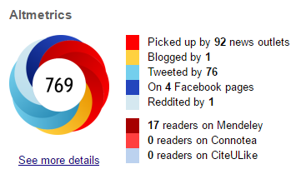
Infrastructure
Upload AAM* to repository
Bibliometrics
(Citations, “Alternative metrics”)
__________________
Flexible API
Reporting of research outputs
Publication feeds to staff-profile
Bespoke feeds (subject/keyword)
On acceptance workflow:
Title
Co-authors
Journal
Abstract
DOI (if available)
Date of Acceptance
Aggregate data from multiple sources
LibGuides
*AAM – Authors’ Accepted Manuscript

Slide 13
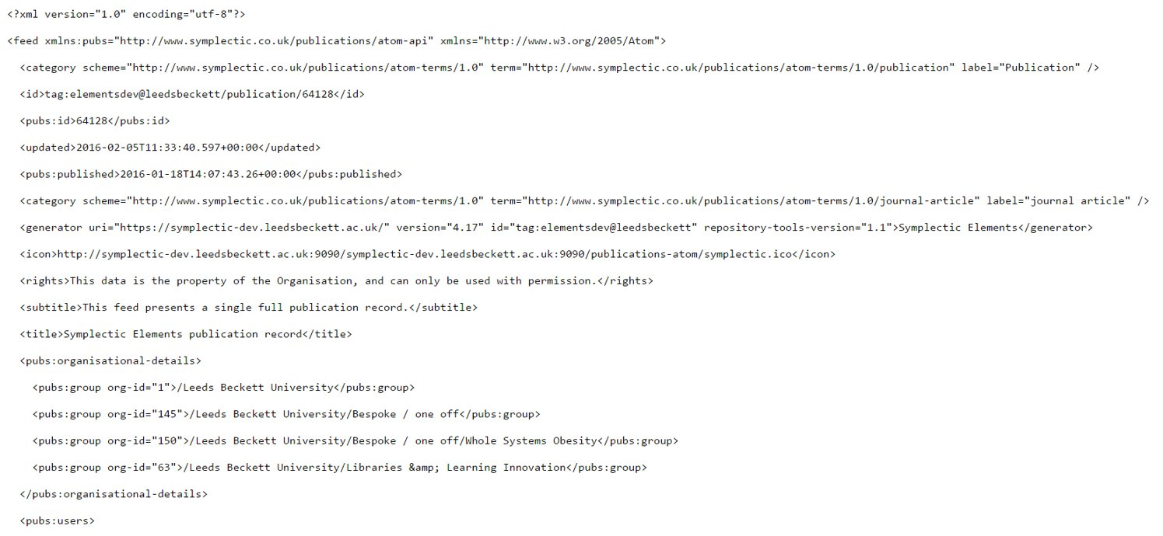
Symplectic “Repository Tools” connector (v1) - file / metadata as ATOM
(+ RIOXX / ORCiD)
Elements publications API (v4.9)
Symplectic crosswalks toolkit
LibGuides
@BeckettResearch
@mrnick
@Krustyb1
@epicbayj

Slide 14
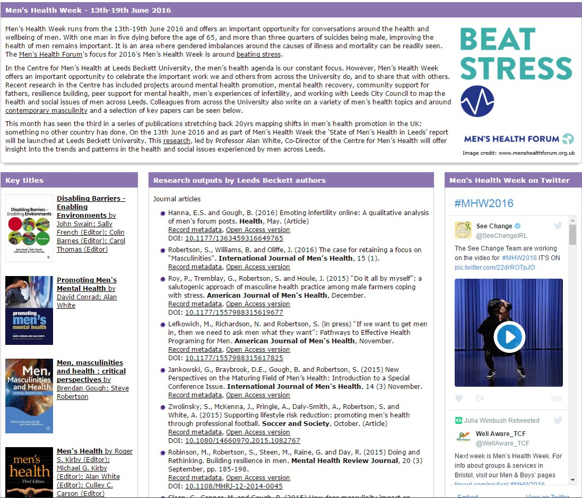

Slide 15
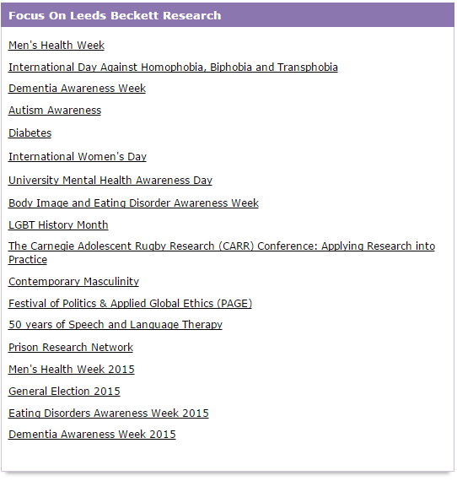
Focus on…
@BeckettResearch
@mrnick
@Krustyb1
@epicbayj

Slide 16
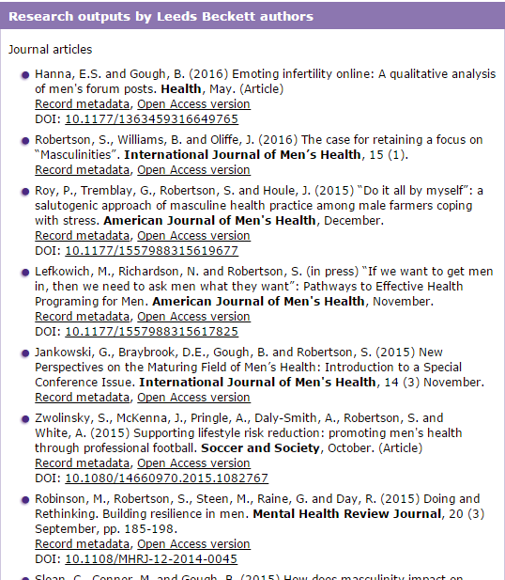
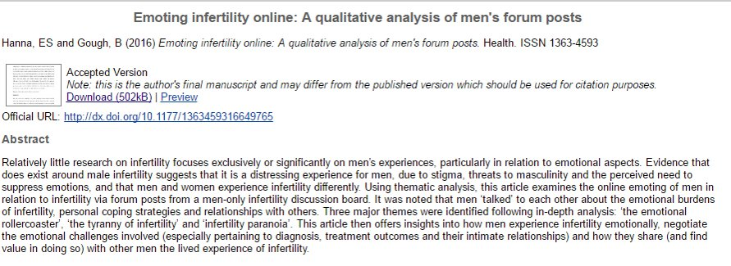
LibGuides
Notes:
Symplectic Elements:
Publication management software
Syncs with citation databases
Repository integration
Flexible API
LibGuides:
Springshare
CMS for libraries
Flexible widget support
Elements API

Slide 17
Link publications to grants
Link user to ORCiD
(mandatory
recommended
optional):
Research & Enterprise Management System (REMS)
ali:free_to_read
ali:license_ref
dc:coverage
dc:description
dc:format
dc:identifier
dc:language
dc:publisher
dc:relation
dc:source
dc:subject
dc:title
dcterms:dateAccepted
rioxxterms:apc
rioxxterms:author
rioxxterms:contributor
rioxxterms:project
rioxxterms:publication_date
rioxxterms:type
rioxxterms:version
rioxxterms:version_of_record
Grant data
File transfer + metadata mapped to RIOXX
@BeckettResearch
@mrnick
@Krustyb1
@epicbayj
Notes:
The RIOXX Metadata Application Profile provides a mechanism to help institutional repositories comply with the RCUK policy on open acccess.
RIOXX focuses on applying consistency to the metadata fields used to record research funder and project/grant identifiers and is designed to support the consistent tracking of open-access research publications across scholarly systems.

Slide 18
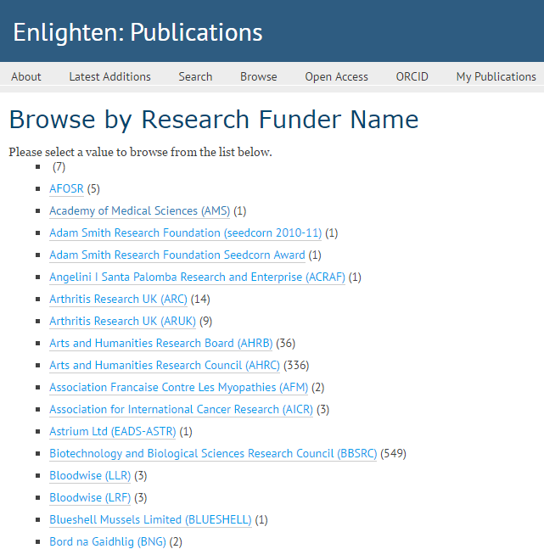
@BeckettResearch
@mrnick
@Krustyb1
@epicbayj

Slide 19
EPrints and ORCiD
@BeckettResearch
@mrnick
@Krustyb1
@epicbayj
doesn't seem to be a 'best practice' approach that has been adopted widely (April 2016)
https://wiki.eprints.org/w/ORCID
https://wiki.eprints.org/w/ORCID_connector

Slide 20
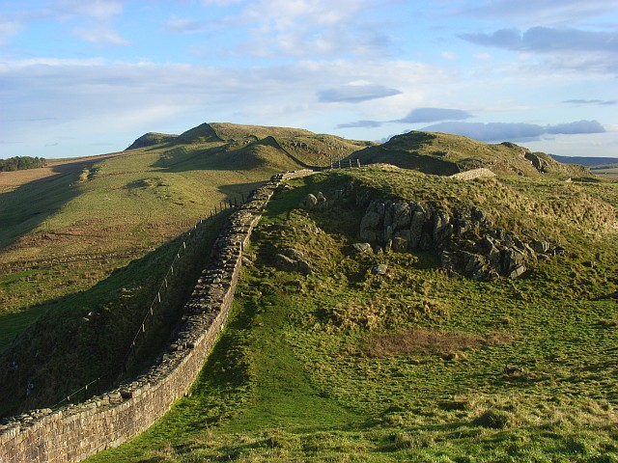
Social media
@BeckettResearch
@mrnick
@Krustyb1
@epicbayj

Slide 21
OA and impact
Fundamentals of research
REF impact agenda
Increases efficiency of research process
Evidence of increased citation
The Open Access Citation Advantage Service - http://sparceurope.org/oaca/
As scholarly communication moves increasingly online, more indicators have become available: how many times an article has been bookmarked, blogged about, cited in Wikipedia and so on. These metrics can be considered altmetrics – alternative metrics of impact. (Piwowar 2013)
Notes:
Creating, using, sharing and accessing information
Research can be easily disseminated online amongst communities of researchers and interested lay people, via social media for example, and it is clearly beneficial if that research is freely accessible on the open web rather than restricted by subscription access.
Traditional bibliometrics
“the branch of library science concerned with the application of mathematical and statistical
analysis to bibliography; the statistical analysis of books, articles, or other publications.”
(Oxford English Dictionary Online)
Citation count & h-index
Journal Impact Factor (JIF)
Other impact measures
Knowledge transfer
Activities (presentations, consultancy, review)
Prizes
Public engagement / education
Policy documents
Media
TV and radio
Blogs/social media

Slide 22
Online networks
@BeckettResearch
@mrnick
@Krustyb1
@epicbayj
https://twitter.com/BeckettResearch/lists/leeds-beckett-university/members
Notes:
240 members

Slide 23
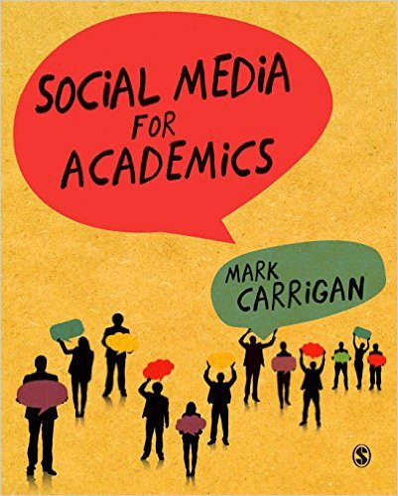
Social Media for Academics
Using social media to publicise your work
Potential pitfalls and how to avoid them
The evolving role of social media in higher education
Defining digital scholarship
Near-future trends in academia.
https://uk.sagepub.com/en-gb/eur/social-media-for-academics/book243690

Slide 24
View from Capitoline Hill

Slide 25
Social graph

Slide 26
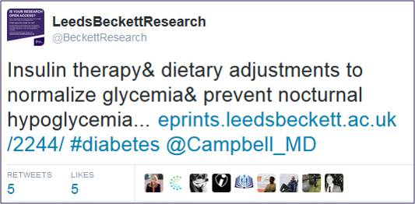
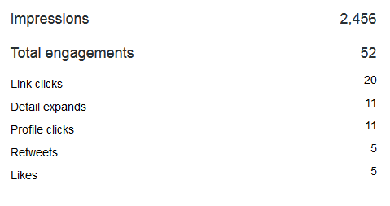
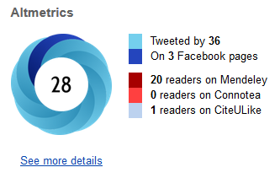
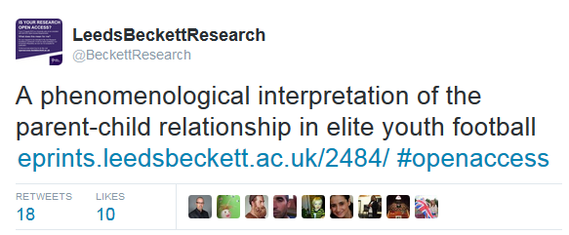
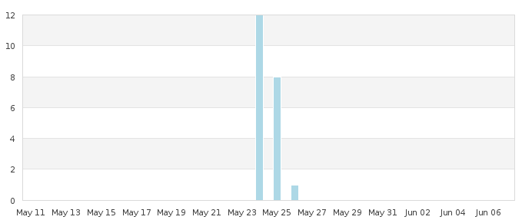
@BeckettResearch
@mrnick
@Krustyb1
@epicbayj

Slide 27
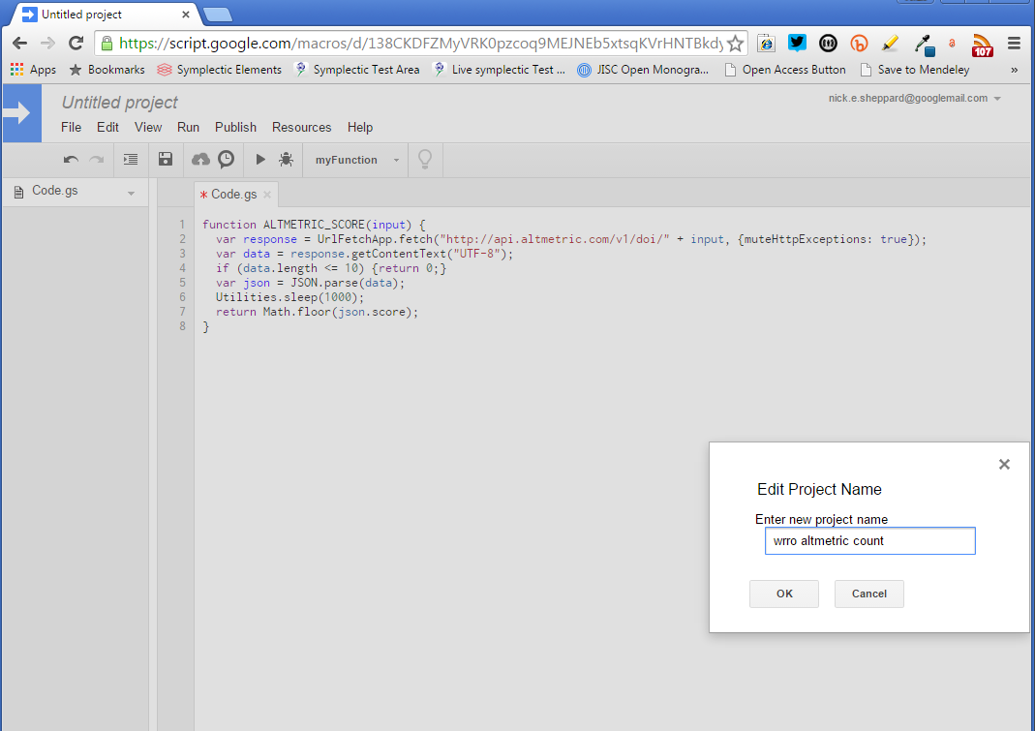
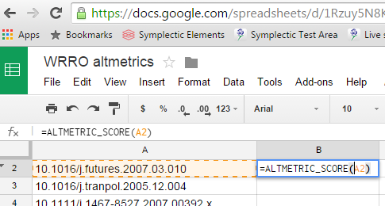
Ranking altmetrics: DIY (UKCoRR blogpost, 12th June 2015

Slide 28
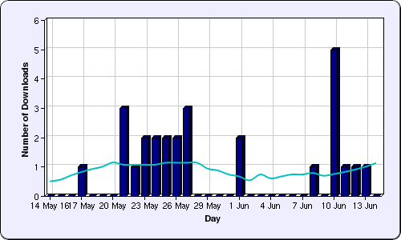
More development
Notes:
CORE dashboard

Slide 29
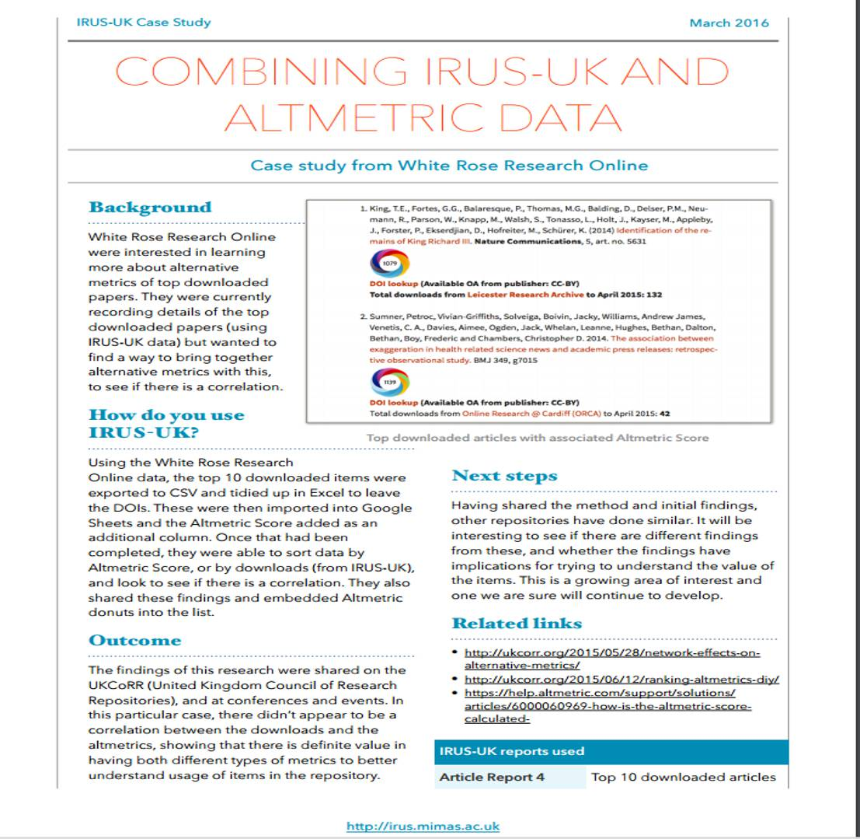

Slide 30
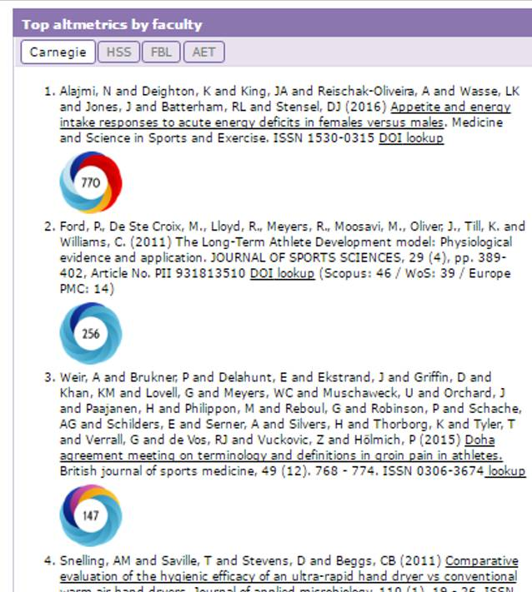
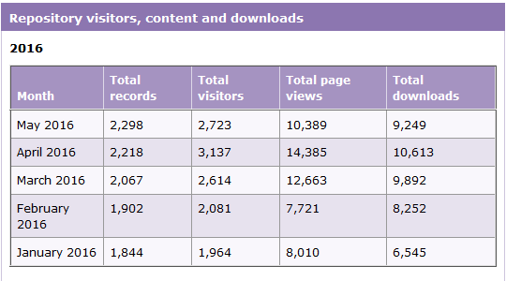
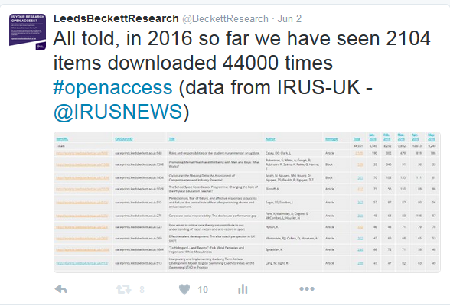
KPIs
@BeckettResearch
@mrnick
@Krustyb1
@epicbayj

Slide 31
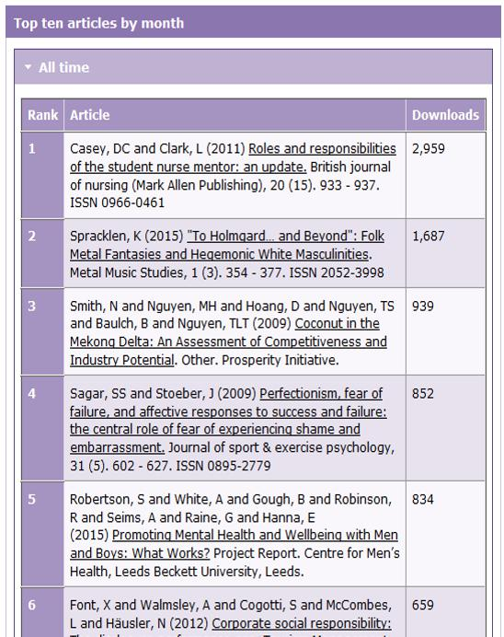
KPIs
Need DOIs for grey literature
DataCite

Slide 32
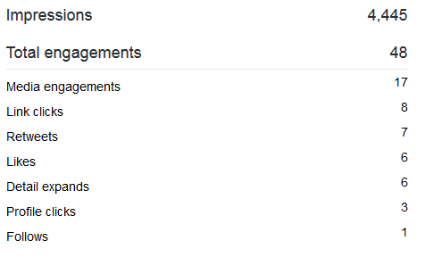
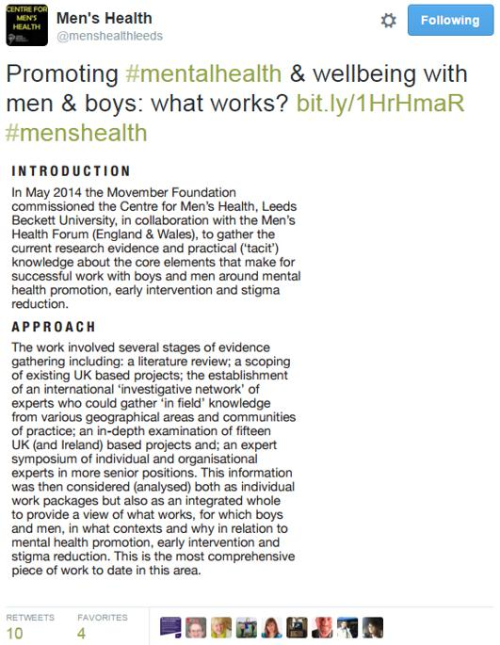

Slide 33
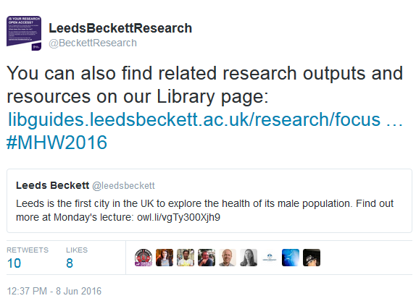
@BeckettResearch
@mrnick
@Krustyb1
@epicbayj

Slide 34
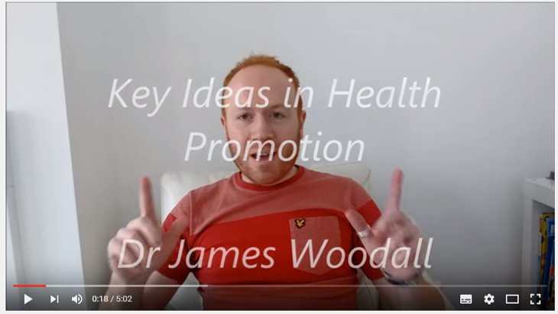
Looking forward
Library as publisher
Infographics
Vlogs
Video / Animation
Podcasts

Slide 35
Image sources
Slide 2: Dublin Bay, Giuseppe Milo [https://www.flickr.com/photos/giuseppemilo/19148671426/]
Slide 4: Karotten (Möhren) auf dem Campo de’ Fiori. Marco Verch, 9 Jan 2016 [https://commons.wikimedia.org/wiki/File:Karotten_(M%C3%B6hren)_auf_dem_Campo_de%E2%80%99_Fiori_(24225720321).jpg]
Slide 5: Two combatants attacking one another with cudgels and a whip, the gladiator mosaic at the Roman villa in Nennig, Germany. Carole Raddato, 10 July 2013 [https://commons.wikimedia.org/wiki/File:Two_combatants_attacking_one_another_with_cudgels_and_a_whip,_the_gladiator_mosaic_at_the_Roman_villa_in_Nennig,_Germany_(9288895115).jpg]
Slide 6: La maquette de Rome à l'époque de Constantin (306-337) réalisée par Italo Gismondi entre 1933 et 1937. Jean-Pierre Dalbéra, 10 June 2011 [https://commons.wikimedia.org/wiki/File:D%C3%A9tail_de_la_maquette_de_Rome_%C3%A0_l%C3%A9poque_de_Constantin_(5839479770).jpg]
Slide 20: Hadrian's Wall near Caw Gap. Andrew Smith, 28 Nov 2008 [https://commons.wikimedia.org/wiki/File:Hadrian%27s_Wall_near_Caw_Gap_-_geograph.org.uk_-_1068660.jpg]

