Slide 1
UX – small project / high value?
Jenny Morgan
Leeds Beckett University

Slide 2
Leeds Beckett University – formally Leeds Metropolitan University
Post 1992 University
Two campuses – one in Headingley and one in Leeds City Centre
21,600 FTE students
Approximately 1,400 international students from over 100 countries
© Leeds Beckett University

Slide 3
Why?
Library Operational Plan objective
Find out more about our international students - how, why and in what ways we could be supporting them
Inspired by the original UXLib conference wanted to have a go!
https://stocksnap.io/photo/93UWL59LZQ Creative Commons (CC0)

Slide 4
Touchstone tours
Structured and unstructured interviews
Cognitive mapping
Email feedback
Café Lingo

Slide 5
Analysis
Identified themes that had already been noted by previous research and feedback.
These included:
Use of resources
Finding resources in the Library
Facilities used in the Library
Alternative study spaces
Access to IT
What’s in their bag

Slide 6
Noise
“Everyone is loud”
“Word that comes to mind when I think of the Library is crowded”
“If I was studying in the Library and it would get busy I would leave due to too much noise”
“I couldn’t concentrate that is why I used to come at night”
Pixabay Creative Commons (CC0)

Slide 7
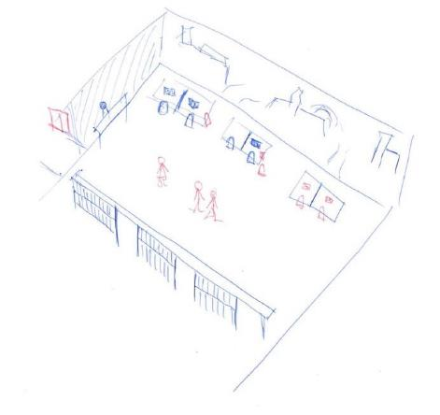
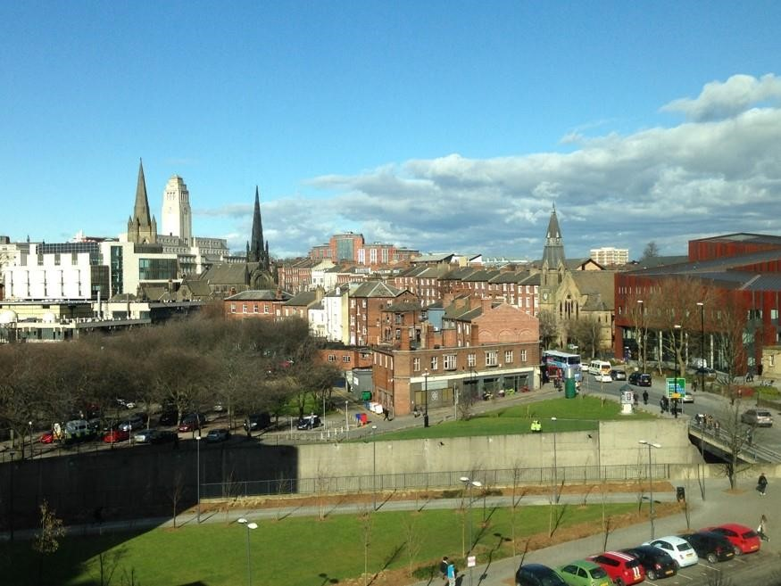
“Second floor with the view ……… and occasional sun, rainbow whatever”
“The view”
“Mainly in this area…..next to the windows”
“I really like the view”
“I used to study in this space here, next to the window”

Slide 8
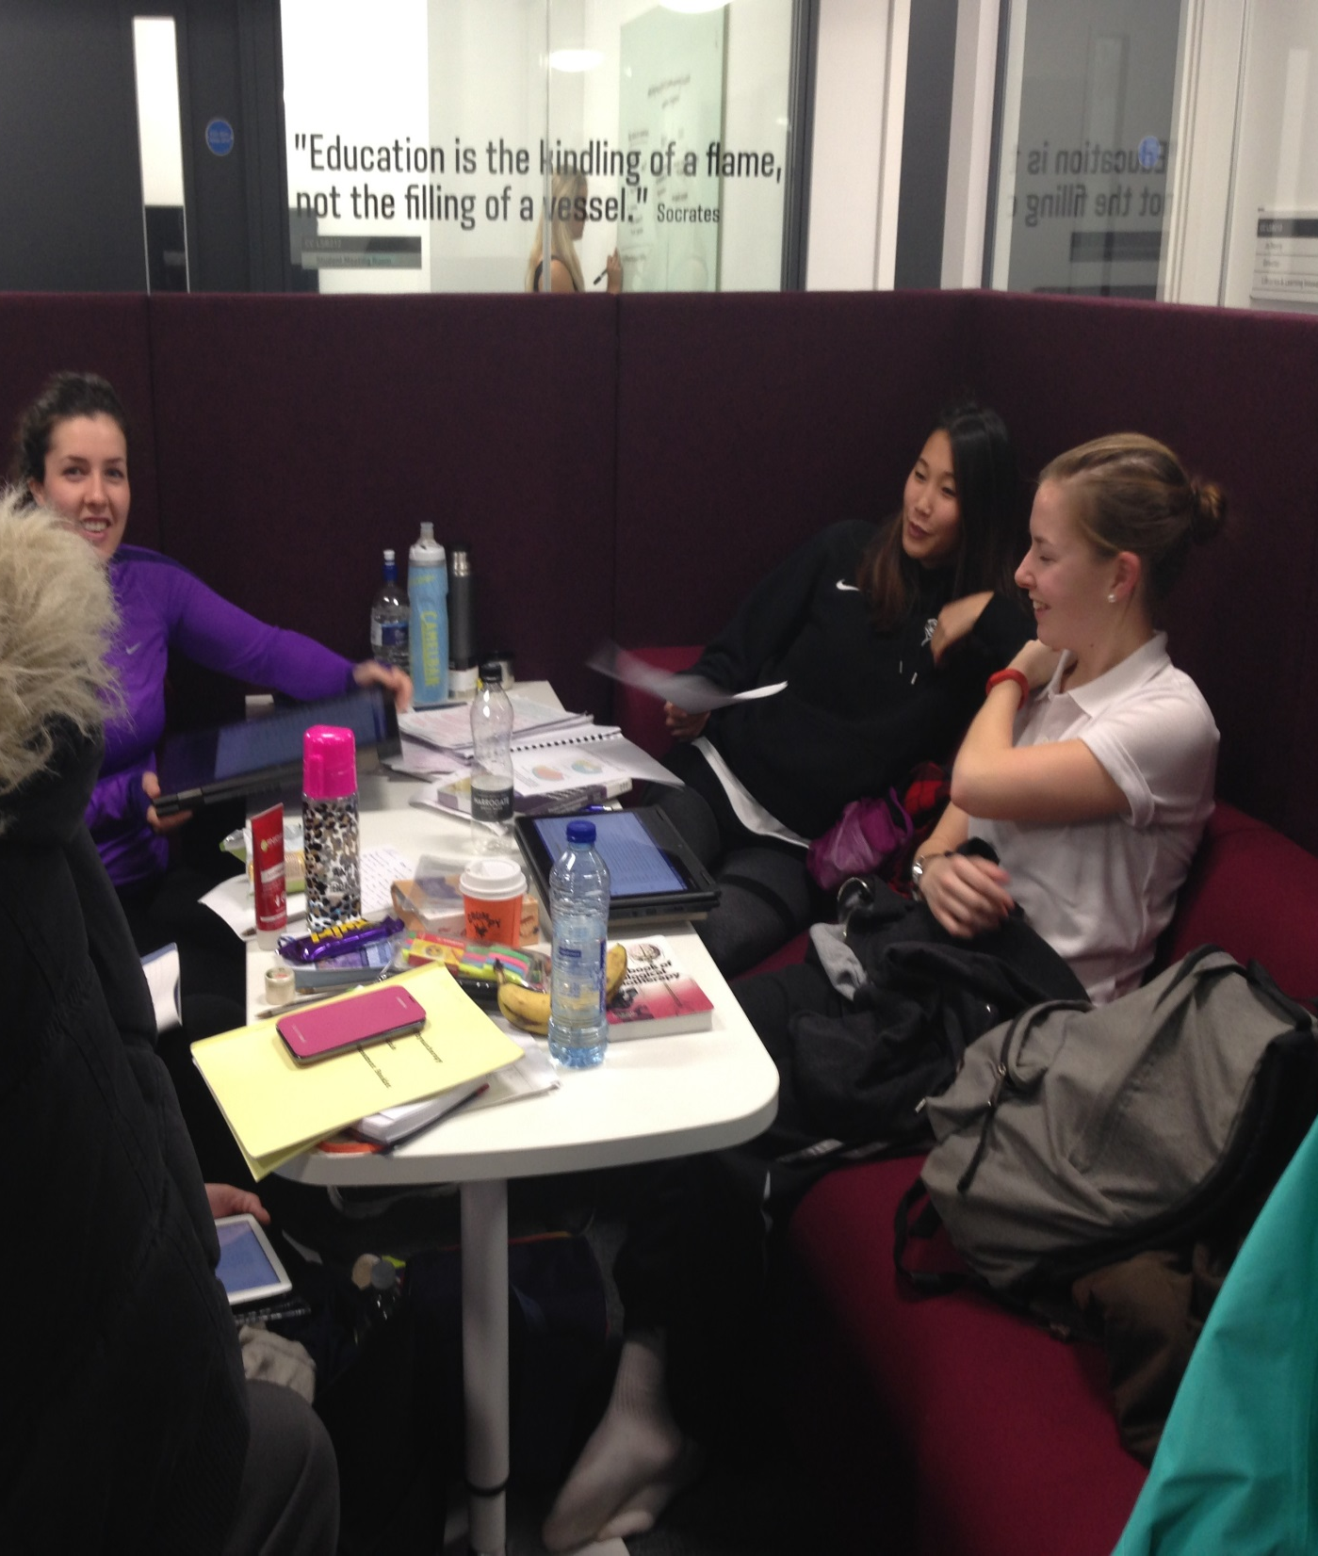
Social / community
“I was often here with friends and they would show me how to do things”
“At Christmas the home students go home, but all the international students are left here……I used to come here”
“There was a support element. It’s more than a library to me”
“As I was alone in the flat. I used to come here to see somebody and say hi”
© Leeds Beckett University

Slide 9
Ideas!
Used “How? Now, Wow!” and “How might we?”
How might we? Is hard!
Ideas put forward
Pixabay Creative Commons (CC0)

Slide 10
How did we do?
Found out lots!
Further developed links with the International Office and the Students’ Union
Further areas for study
Only Postgraduates and only one campus
Time at Café Lingo
Planning
Pixabay Creative Commons (CC0)

Slide 11
“Using the maps to encourage sharing information with us worked so much better than I imagine a list of set questions could ever offer. ”
“ I liked how we weren't given the chance to lead the students in their responses and what they drew was important to them.”
“The coding was good practice in analysing and teasing out information from questions that students had verbally answered. Overall, it was a definitely a good thing to be involved in.”
“It was nice to find out what they value about study spaces; I wouldn’t have predicted some of their answers!”
“It felt like they really valued having their experiences and opinions sought.”
“I would happily do something similar in the future”
Findaphoto Creative Commons (CC0)

Slide 12
Jenny Morgan
Leeds Beckett University Library
Twitter: @jennylm54
Email: j.e.morgan@leedsbeckett.ac.uk

