Slide 1
Voyages of Discoverability
Using analytics to assess the impact of EDS at Leeds Beckett University
Libraries and Learning Innovation
Eric Howard – Information Services Librarian

Slide 2
Our journey…
Bridge across Kalmar Sound, Hardy, Wilf (Wilfred) (20th century) / Private Collection / © Look and Learn / Bridgeman Images
Notes:
Introduction. Eric Howard, Information Services Librarian. Have been working to develop Discover since 2013, and one of the main areas of my role has been to improve collection and analyse of usage data across our e-resources.
This presentation will outline the steps we’ve taken to try and analyse the impact of Discover. Like many journeys, it hasn’t been straightforward or linear (unlike the lovely bridge in this picture!). I’ll try to cover:
Why we decided to embark on this voyage of discoverability
Some of the practical steps we took to try and address this issue
The findings and limitations of our initial discoverability measure
Our explorations of Google Analytics and some of the resulting customisations to Discover
The future – where do we see our journey heading to?
We hope this presentation can open up a dialogue and other institutions will share their experience of analysing usage. Lots of questions – this is a new area, and there may well be different or better ways out there! [This may need to be edited, depending on the content of the other presentations!]

Slide 3
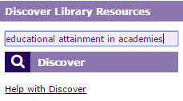
Why?
Key access points to library services
KPIs
Notes:
Do we need to think about discoverability separately? Is it just a means to an end, and should we be focusing on the impact on resource usage?
We decided we did need to try and analyse user interaction with Discover. Drivers included:
One of the main entry points to the library [embedded into portal and library website
Growing organizational culture of KPIs - capturing key areas of activity and setting targets, which can then be used in annual planning / individual work plans. As Discover was such a key system, we wanted to include one such Key Performance Indicator for Discoverability, and started to explore what we could practically measure. We created a measure to Increase in "Discoverability Statistics" from Discover - full text requests (PDF or HTML) and abstract views
Wanted to explore if we could use data to improve and refine the service

Slide 4
First steps
Discoverability is a new measure to reflect user activity in Discover. This needs a broader approach than traditional search and download figures.
Discoverability of resources is one of LLI’s key performance indicators for 2014/15 (5.2).
2014-15
(2013- 14)
+ 9%
2014-15
583050 full text requests (524,663) 762,882 abstract views (650,614)
1,345,932
2013-14
Total Discoverability
1,345,932 (1,175,277)
1,233,664
Notes:
We rejected search figures as these were artificially high due to the large number of automatic search. The move away from searches is also reflected in the COUNTER 4 release for databases, which moved towards looking at user actions.
Thought about key actions taking place on Discover
Used advice from EBSCO
Focused on full text downloads and abstract views. Easily understandable and explainable to a variety of audiences including senior managers and academic librarians. These statistics were also easy to retrieve from the EBSCO Admin site.
For internal purposes, we combined this into a measure we called Discoverability
This fed back into the KPI that I mentioned in the previous slide, with a target of a 20% increase for this academic year compared to last year.

Slide 5
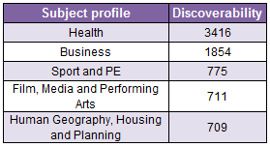
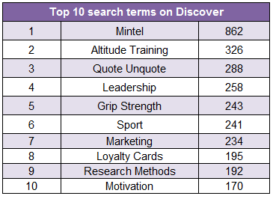
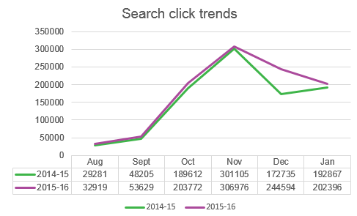
2015-16 (2014-15)
318,217 full text requests (345, 410)
454,914 abstract views (471,786)
Total Discoverability figure
773131 (817,196)
Discoverability
Future developments

Further use of Google Analytics

Enhance search experience - connect other databases / Libguides

Analysis of Rebus stats and discoverability
+ 12%
2015-6
1,044,286
2014-5
933,805
Notes:
We use the discoverability figure in 6 – monthly dashboards, highlighting key developments and trends with Discover. This shows the latest one I presented in March 2016.
We also use the search click report, recording number of interactions with any Discover search button. Again, this is a genuine user interaction. Both the Discoverability and search clicks are used very much for trend / healthcheck analysis as we know these measures aren’t perfect, and aren’t sampling quality of interaction. However, they do successfully get non-specialists and managers thinking about discoverability and we’ve had feedback that this is a useful advocacy tool.
As you can see, you’ll see a box highlighting the Top 10 Search terms on Discover. In the next part of my presentation, I’ll discuss how and why we came to use this as a system development tool.

Slide 6
Finding our way?
Notes:
Our initial findings were:
- As you may expect, abstract views were higher than full text views – indicates a certain degree of refining the search – or users being trained to view abstracts, or using abstracts rather than accessing full text of the articles
- Our Discoverability figure rose by around 45% in 2014-15 compared to 2013-14, but we’ve seen a 5% decrease in 2015-16 – both abstract views and full text views decreased. We haven’t identified a reason for this as yet – if the trend continues, we’d look at student numbers, whether the ‘shape’ of the academic year changed, etc.
It also raised questions about the validity of the KPI itself. We’ve fully acknowledged this from the start – one obvious example is that combining abstract views and full text requests into one figure could be double-counting one search interaction.
However, the measure has been successful from an advocacy point of view. Senior managers are more aware of discoverability as an issue, and we now have their support to increase staff time spent exploring library analytics data to try and improve Discover.
Our initial explorations were partially successful, in that they raised more questions:
- Does a click = quality? Difficult to answer
- Can we find any more information out about how the users navigate to content? What are they searching for? Where is their entry point?

Slide 7
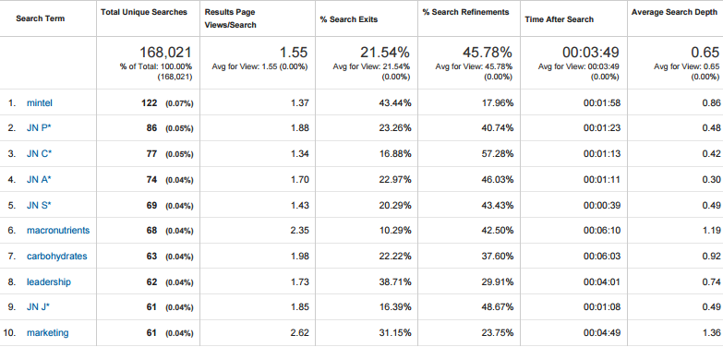
Google Analytics
Notes:
At the same time as we were exploring Discoverability, the wider department were investigating how best to capture user interaction with Libguides. Google Analytics was explored, mainly to get stats for visits to specific guides.
In 2015, we were asked to create a specific Discover profile for courses being delivered to our franchise partner institutions. Whilst EBSCO’s report would allow us to track abstract views and full text requests, we were specifically asked for as much data as possible on how students in these institutions used Discover.
We implemented Google Analytics. This was very easy for us to set up, with EBSCO Support working closely with us – we simply had to add a tracking code to our bottom branding.
This enabled us to quickly and easily find out more information about the most commonly used search terms.
The screenshot above displays the top 10 search terms for May. As you can see, the searches are quite simple – and the impact of integrating Full Text Finder into Discover can be seen, with the searches for specific letters of the alphabet.
What’s really reassuring is that the top 10 search terms represent a very small percentage of the overall usage – by each number, you can see each term adding up to less than 0.1%. This suggests to us that there’s a large number of unique searches and search terms – reassuring for a resource discovery tool that’s meant to be for everyone and encourage further exploration.

Slide 8
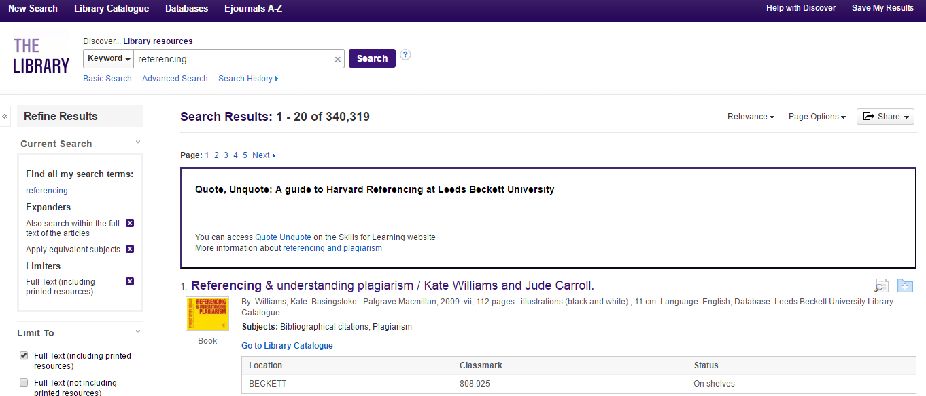
Signposting
Notes:
As a result of looking at the search terms, we could see that students were using EDS to search for more generic library material, such as referencing and Mintel.
A quick and easy way to react to this is to build placards, which are triggered to display when the student enters a particular search term. For example, if a student enters ‘referencing’ or ‘Quote Unquote’ – the name of our guide for Harvard Referencing – the placard will display, with links to the appropriate section of the library website.
The code for this is on the EDS Wiki, and it just took a few experiments with the HTML to get a basic prototype working…
This is a practical way to react to student’s searching.
Another possible way to support students, that we will explore in start of semester 2, is promotional activities around key searches. For instance, we noticed a lot of searches around the Wingate Anaerobic Test (WAnT). We could in future tweet with a link to pre-defined search results, encouraging students to find out more.

Slide 9
Exploring search…
Notes:
So far, we’ve used Google Analytics to look at search terms. However, it does also give you easy access to also search analytics such as % of search refinements, and the average number of page views per search.
At the moment, we’re unsure whether these figures could translate into actions we could implement. It would be interesting to see if the search refinement figure varies according to time of year or stays static? Also, this relates to key word searches being refined, so may not capture refinements using the facets on the left hand side. So at the moment, we’re still in the ‘collect and think’ stage with this.

Slide 10
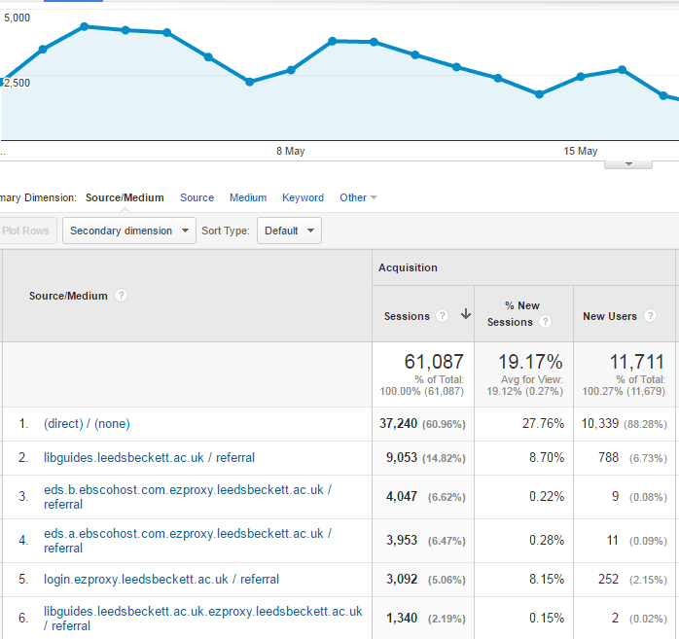
User journeys
Notes:
Another quick and easy report from Google Analytics is the Source / Medium report, where you can see the entry point into your EDS. For our system, most of the entry points are direct – we think this is probably the direct link to Discover embedded in the box on the VLE. However, you can see a healthy number of referrals from libguides, too.
This feeds into both our promotion and our enquiry desk / training work – when we give inductions to librarians, we can highlight that most people start off from the VLE, but to be aware of the significant minority using our library website too.

Slide 11
The future!
Notes:
Further exploration of Google Analytics – can we learn anything from the search comparisons? Is there a benchmark we should be aiming towards?
Exciting development of EBSCO’s Search Analytics report. Easier way into top search terms, and also has the very interesting measure of Search Click Conversions. Again, it would be interesting to see how this varies across the academic year – does growing amount of user confidence result in the proportion of result clicks increasing? Again, should we be aiming towards a specific figure here?
Going back to our original aims:
- Has this work resulted in any actions? Yes – in particular around the search term placards which we hope can pinpoint users to right material
- Greater institutional interest in using learning analytics as an indicator of student engagement. Our experiments with Google Analytics can hopefully place us in a good position to enter these conversations.
We are also in a more agile position, to answer the question ‘can you give us some top level statistics’ – should hopefully increase interest and the amount of queries we get about Discover and how it benefits the user community.
We’d like to see more shared industry standards, if possible. May be difficult as discovery tools are customised to institutions, unlike a database like CINAHL. We know we also need to gain more insight into the user’s experience – having stats for example around the entry points may enable us to create more focused questions.

