Slide 1
Customer Service Excellence Standard – adding value for your students
Helen Loughran
Libraries and Learning Innovation
Leeds Metropolitan University
(h.loughran@leedsmet.ac.uk)

Slide 2
Customer Service Excellence Standard
“aims to bring professional, high-level customer service concepts into common currency with every customer service by offering a unique improvement tool to help those delivering services put their customers at the core of what they do”
www.customerserviceexcellence.uk.com

Slide 3
Customer Service Excellence Standard
Driver of continuous improvement
Skills development tool
Independent validation

Slide 4
Customer Service Excellence Standard
Not only about front line services
But rather about providing an excellent standard of service regardless of where you are in the organisation.
It’s about knowing your customers, listening to them, acting on the information you receive, monitoring how you deliver the resulting services and starting the cycle again.
It’s not just for Christmas!

Slide 5
CSE Criteria
Customer Insight
The Culture of the Organisation
Information and Access
Delivery
Timeliness and Quality of Service

Slide 6
1. Customer Insight
Customer Identification
Segmentation / profile of key groups
Developing understanding of their needs
Delivering services for hard to reach groups
Engagement and Consultation
Strategy for engaging and involving customers / range of tools used
Examples of improvements resulting from engagement
Closing the loop – monitoring / informing of outcomes
Customer Satisfaction
Measurement of key areas: delivery, information, access, timeliness, quality
Targets and methodologies
Customer journeys

Slide 7
Customer Journeys

Slide 8
2. The Culture of the Organisation
Leadership, Policy and Culture
Corporate commitment – vision and values statements
Examples of how customer insight drives policies
Customer care / equal opportunities policies – all groups feel they are treated fairly
Privacy and confidentiality
Empowering employees to promote and participate in customer focused organisation
Staff Professionalism and Attitude
Recruitment, induction, training and development
Use of performance management to deliver customer focused culture (valuing contributions)
Evidence of customer care provided by staff

Slide 9
3. Information and Access
Range and Quality of Information / Access
Contact details – who is in charge
Information on charges
Clear communication / accuracy – feedback from customers
Ensuring customers understand the information they are given
Range of channels used / analysis and changes made to meet customer needs
Quality of physical environment
Co-operative Working with other Providers, Partners and Communities
Formal / informal partnerships for delivering services
Service level agreements – seamless services
Support for wider community

Slide 10
4. Delivery
Delivery Standards
Standards for main services including any statutory ones
How are these derived / monitored / developed
Achieved Delivery and Outcomes
Customer views on the services they receive
Benchmarking of performance and learning from best practice
Deal Effectively With Problems
How is performance measured / improved and communicated to customers
Complaints procedure – how easy for customers / staff to use
Ensuring outcomes of complaints process is satisfactory

Slide 11
5. Timeliness & Quality of Service
Standards for Timeliness and Quality
Timeliness of response eg for customer contact channels
Quality of service across all stages of the customer journey
Timely Outcomes
Published information on service standards
Answering queries at the first point of contact
Processes to share information if necessary
How delays are dealt with
Achieved Timely Delivery
Monitoring of performance and actions taken
Benchmarking performance

Slide 12
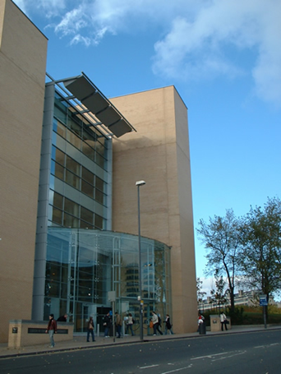
Leeds Met Library and CSE
Libraries: Library and student IT support,
Student-facing systems: VLE, Turnitin
Research support: Repository
Skills for Learning
130 staff, 2 campuses
c25,000 students, 3,000 staff

Slide 13
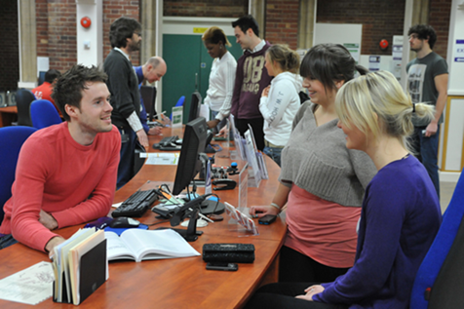
Leeds Met Library and CSE
Charter Mark, December 2001
CSE, February 2009
Reaccredited 2013 with Full Compliance and 7 Compliance Pluses
University CSE project: 2010, achieved 2013, now 14 Compliance Pluses

Slide 14
Adding Value
Knowing our students
Listening to our students
Ensuring quality
Delivering services
s

Slide 15
Knowing our Students
Role of Academic Librarians
Specialist support / front line staff
Journey mapping / surveys
Systems data
Impact assessments
Sharing all this information !!!

Slide 16
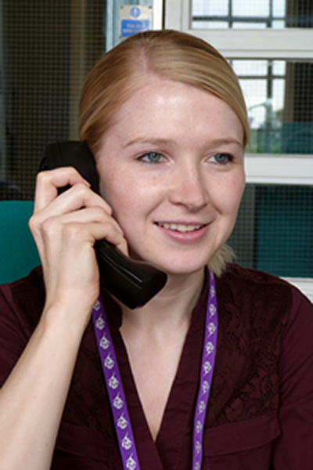
Listening to our Students
Listening framework
Systematic collection
Anytime, anyplace, anywhere!
Listening effectively

Slide 17
Delivering Services
24/7 and self services
Ease of access and use
Learning on the go
Transforming learning spaces
Specialist / customised support
Developing skills / graduate attributes

Slide 18
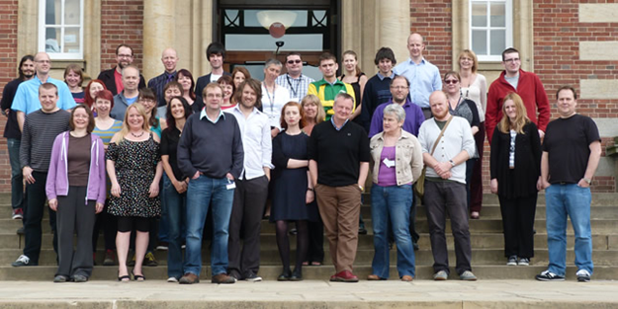
Ensuring Quality
Staffing / training
Customer focussed culture
Learning from best practice
Monitoring performance
Dealing effectively with problems

Slide 19
Adding Value?
Independent validation
Adding value to our staff
Adding value to our profile
Adding value to our students

Slide 20
Adding Value?
“others think they listen but they don’t – you actually listen and act upon what you hear” (former SU President)
“so proud of my results this semester, thank you @leedsmetlibrary” (Twitter comment)
“Sue is an amazing member of the library team! Sue is a person who really goes away and thinks about how she can help you, and then does so” (Golden Robes “Hidden Heroes” winner)
“Generally staff at the library are brilliant, so helpful! And they genuinely seem to enjoy what they're doing. If I can nominate the entire library staff - then please accept this as my nomination” (Golden Robes nomination)

Slide 21
Any questions?
Helen Loughran
Planning and Marketing Manager
Libraries and Learning Innovation
Leeds Metropolitan University
h.loughran@leedsmet.ac.uk
JISCmail list: CSE-STANDARD

