Slide 1
sex work, legislation and the managed area
Portal 2 – Valve Corporation
Dr. Erika Laredo

Slide 2
Leeds- an innovative approach
From 1st October 2014, the Leeds Strategic Prostitution Working Group were granted approval to initiate a 12 month pilot scheme of a Managed Area to address the issue of street sex work through a partnership model.
Non-enforcement of the soliciting legislation was the driving principle of the scheme

Slide 3
Why? To improve:
community harmony after a decade of complaints,
a failed cycle of sanction and enforcement focused policing, with poor relations between sex workers and the police and
low levels of sex workers of reporting crimes committed against them to the police.

Slide 5
The Managed Area
The Managed Area is a designated area of streets away from residential housing that centres around the business industrial area where street sex work was already occurring.
The core rules are that the Area operates from 7pm until 7am and between those times there will be no cautions or arrest for loitering, soliciting or kerb-crawling.
The area is policed for the safety of sex workers and other laws will be enforced e.g. those relating to violent crime, robbery, sexual offences, public disorder.
The Managed Area symbolizes a model where sex workers are considered alongside the needs of residents.
The Managed Area approach has meant that street sex work has returned to the political and multi-partnership agendas in Leeds with a positive, pragmatic, action focused way and fostered better community cohesion

Slide 6
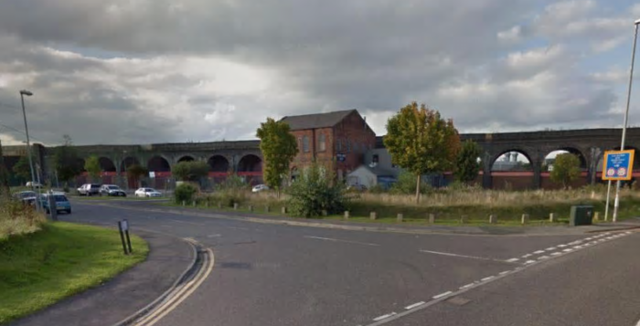

Slide 7
Sex in the city: Is Leeds ‘managed approach’ an innovation?
A key outcome has been improved relationships between sex workers and the police
This is both the policy on non arresting and particularly the role of the Sex Work Liaison Officer dedicated to the protection of sex workers.
There have been reduced enforcement activities in the whole area as the police focus on welfare and protection based policing.
Sex workers feel there has been a reduction in police presence generally in the MA leading to less improvements in feelings about safety as fear of crime and violence remain high.

Slide 8
Ugly Mugs
The second main outcome has been significant evidence of increased Ugly Mug reporting
From 1st April 2014 up until March 31st 2015, 73 reports of which only 4% were not shared at all.
A further 46% were shared anonymously and an increase to 50% were reported with full details to the police.
In first quarter of 2015/2016 100% of ugly mugs reports made were formally reported to the police.

Slide 9
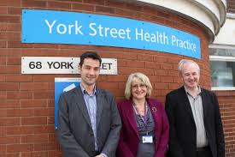
Services supporting sex workers
Outreach workers from across the third sector and statutory services evaluated that there has been increased access to services and higher take up of social and health care interventions
Greater engagement with outreach in the MA than previously.
The Sex Work Liaison Officer acts as an excellent communication point for messages to be given to women who are transient and difficult to contact.
Greater awareness of the emergent needs of migrant women in street sex work.

Slide 10
Voices of the sex workers
"I work here because we're not allowed to anywhere else, but that doesn't mean it's safe here. At least with regulars you know who you're with and what their intentions are. I mean, I don't think many people would have the balls to punch us up on the street, but it has happened. There's a lot of violence."
“You get a lot of lads driving round here, just eyeing us all up, and that's gone down a bit since the police presence has stepped up. But it hasn’t stopped– not really.”
“There's so much violence that nobody really sees, unless you're here every night, all night”

Slide 11
What about the residents?
Before 2014 there was some prostitution in this area, but it was mostly poor local girls who had hit rock bottom. Now it’s become a magnet for sex workers from all over the UK, as well as abroad. They used to keep a low profile but now they flaunt it because they know the police won’t do anything.
Sometimes, getting home late, I’ve had prostitutes trying to get into my car
‘It brings so many undesirable people to our area,’ she says. ‘It’s awful to find people doing things in cars late at night. Why should we have to put up with such things?’

Slide 12
Save Our Eyes
A closed private group for the reporting and collecting of evidence in regards to the "managed approach" in Leeds. We accept the managed approach but will not tolerate sex workers and drug use in residential areas. If a sex act is taking place please report it to the duty police officer on this number 07534309568. Please also complete or online reporting form for every incident, even if it is just a girl loitering out of the area or hours. Please also report all littering of used condoms and needles to the council. A special email link can be found in the group. We welcome any pictures you may have and any details of events. We are in contact with the police regarding these issues and together can hopefully keep your street and area free of sex workers.

Slide 13
Questions?

