Slide 1
Exploring the Emotional Responses of Undergraduate Students to Assessment Feedback: Implications for Instructors
Jennifer Hill
Susan Smith
With:
Kathy Berlin, Julia Choate, Lisa Cravens-Brown, Lisa McKendrick-Calder
ISSOTL 2023
Railway Museum, Utrecht, 8-11 November 2023
Notes:
15 minutes total
ISSOTL ICWG Atlanta, October 2019.

Slide 2
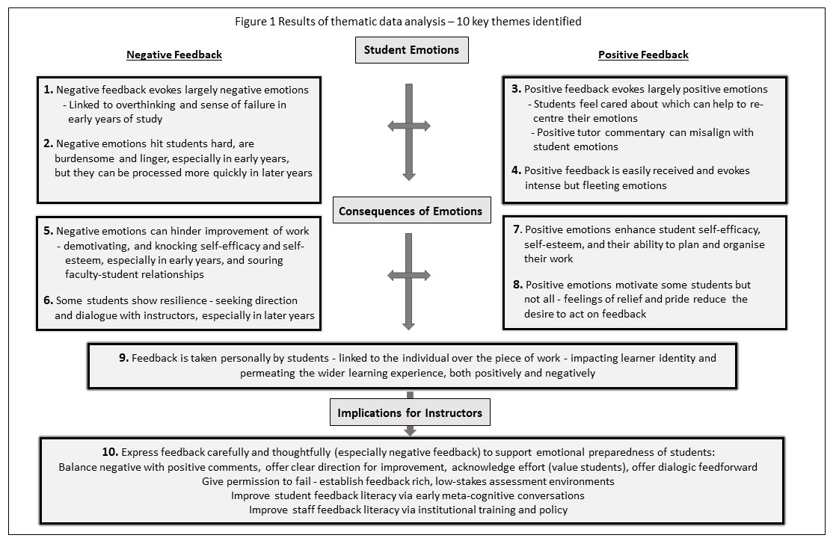
Introduction
receiving feedback is inherently emotional for students, exposing their capabilities as learners & determining how they act upon feedback (Hill et al. 2021)
Teaching & Learning Inquiry (2021) 9(1)
Notes:
Assessment feedback should be an integral part of learning in HE, but students can find this process cognitively and emotionally challenging.
We investigated the emotions experienced by undergraduate students in relation to assessment feedback, exploring if these emotions informed their learning attitudes and behaviours.
Variety of strong emotions evoked:
Negative – stress, frustration, disappointment, sadness, anger, embarrassment, shock
Positive – happiness, relief, excitement, pride
Quotes (if wanting to cite an example)
If I get negative feedback, I just keep beating myself up about it (Interview year 1) … negative feedback is always there in the back of your mind eating away at you (Interview year 3). Negative feedback does take a toll on self-confidence. I tend to overthink. Is this the right field that I want to go into? Is this the right major? (Interview year 1). It’s hard to differentiate negative feedback as not being directed at you. Your work is an extension of you, it’s really hard to separate the work and the comment from you (Interview year 2).
With positive feedback, you’re like great I can completely do this and it does help you continue to work (Interview year 2). When I get positive feedback, it makes me feel good, but I don't act on it as much as negative feedback (Interview year 1). If [instructors] put the effort in to read through your work and give you those nice comments, they actually care. To know that you’re doing well … can rebalance how you’re feeling (Interview year 2)

Slide 3
instructors would do well to consider how to manage students’ responses to feedback so they feel capable of learning from instructor commentary
based in social constructivist approaches (Boud & Molloy 2013), our premise was that:
instructor - student dialogic feed-forward can promote not only cognitive sense-making, but the positive foregrounding of affective emotions, supporting wellbeing
Notes:
This is one of the first studies to investigate the impacts of instructors and students working together to consciously regulate students’ emotions in order to support positive learning behaviours and wellbeing.
We define relational feed-forward as a dialogic form of assessment communication through which meanings are negotiated, and confusions and expectations are clarified. It is future-oriented, referring to instructor commentary that either impacts upon an upcoming assignment, or is given post-assignment with specific direction on how it can be applied to future work.

Slide 4
Methods
collected qualitative data longitudinally over 2019-20 academic year
Phase 1: three universities Phase 2: two universities
convenience sample of modules adopting a relational feedback intervention
Note small sample size
Teaching & Learning Inquiry (2021) 9(2)
Notes:
Universities of similar size and mission (one module, i.e. individual unit of study, per institution) - sampling from across different years of study, subject/major, and country in order to ascertain similarities and differences
Phase 1 of research, undertaken as modules began - aimed to investigate the emotions encountered by undergraduate students in relation to written assessment feedback.
Phase 2, undertaken post-feed-forward intervention as modules concluded - examined the role of instructor-student relational feed-forward, enacted as a dialogue relating to ongoing assessment, in dissipating student anxiety, enabling productive learning behaviours, and supporting wellbeing.
2019-20 - Covid-19 arrived on global stage. The data from the first-year module were gathered in semester 1 before Covid-19 affected students. The data from the second- and final-year modules were gathered in semester 2 and, whilst these modules were completed in terms of teaching and feedback delivery before the constraints of the pandemic came into force, our end of unit research interviews occurred as the pandemic took hold. As a consequence, respondent numbers at the end of the module were reduced below what we might have anticipated.
Ethical approval was obtained from all institutions prior to commencement of data collection.

Slide 5
Feed-forward approaches
Two-stage personal development plan for first-year Health Sciences students
Essay draft and final submission for second-year Geography students
students met their instructor to discuss work in progress ahead of submission of final assignments for summative grading
the instructors set the scene for honest feedback interactions, outlining meeting purpose and setting expectations for dialogue focused on learning
meetings were purposely friendly and open, with instructors demonstrating a receptive and respectful attitude to work of all standards
Notes:
Between stages one and two, students were invited to attend a face-to-face 15-minute appointment with the instructor. Of 39 students enrolled in the class, all but four attended the one-on-one session. Students had seen their grade prior to the meeting without any feedback.
Students wrote a considered draft of their essay, which they were encouraged to discuss in an individual 30-minute face-to-face meeting with the instructor. Only two of the 30 students did not attend a session with the instructor. Students received no grade or feedback prior to the meeting.
For both modules, students selected when to meet with the instructor, and after this they revised their work before submission for summative grading. Each session ended with the co-creation of an action plan for improvement.

Slide 6
Survey instruments
Students were recruited to one of two activities:
Phase 1 (start of module)
6 small group semi-structured interviews (40-60 minutes) (n=24)
6 personal reflective diaries captured electronically (n=6)
- analysed inductively using thematic
analysis
Phase 2 (close of module)
4 small group semi-structured interviews (40-60 minutes) (n=14)
5 personal reflective diaries captured electronically (n=5)
- analysed inductively using thematic
analysis
Notes:
All researchers coded a single transcript and diary to confirm inter-rater reliability, followed by paired coding, and final group verification.
All interviews were conducted by research assistants who did not teach on the modules.
The small sample of students who took part were self-selecting, suggesting they were interested in exploring the implications of feedback. Their responses may not be representative of the full cohorts. Given our sample sizes, our results might best represent entry level students.
A sub-set of phase one students (following natural attrition) took part in phase two, allowing them to reflect on any evolution in their feedback emotions and behaviours.

Slide 7
Findings from phase 2
Six over-arching themes were identified with respect to relational feed-forward and student emotions, learning behaviours and wellbeing:
Students’ emotions as they anticipated instructor commentary
The impact of relational feed-forward on students’ emotions
Students’ relationships with the instructor
Students’ assessment attitudes and behaviours
The role of the instructor in managing feedback emotions
The impact of relational feed-forward on wellbeing
Notes:
Face-to-face dialogic feed-forward was a new form of assessment feedback for the students. Consequently, we examine students’ responses to relational feed-forward as an initial encounter in their learning journeys.

Slide 8
Findings from phase 2
anticipating instructor feedback made the students feel ‘anxious’ and ‘nervous’ above all other emotions:
‘I felt a bit nervous, kind of vulnerable … my tutor was going to judge me and tell me face-to-face what she thought about my work. This opens you to criticism and that’s quite scary’ (Year 2)
on receiving instructor commentary:
students who progressed worse than they expected
negative feelings of disappointment and embarrassment
students who had made good progress
positive feelings of relief, happiness, reassurance
Notes:
Receiving commentary was a moment of reckoning for students, offering a judgement about their performance, and the uncertainty associated with this exposed their vulnerability.

Slide 9
Findings from phase 2
talking with the instructor about draft work helped the students to process and deal with their emotions in a positive manner, both short- and long-term:
‘Once I started talking to her, it calmed me. I was like, okay, we're talking about this, we're getting it out in the open, I can improve this’ (Year 1)
derived from six central aspects of the relational feed-forward encounter:
The open and supportive environment prompted student questions
Talking clarified the tone of instructor comments
The instructor offered constructive critique, giving students a sense of direction
The dialogue pertained to the work in progress rather than personal ability
The dialogue directed student attention to assessment as a process
The instructor focused student attention on the assessment rubric
Notes:
‘I tend to avoid feedback because I am afraid of criticism. But I felt I could be open in this meeting and ask for help when I didn’t understand’ Year 2
4. ‘Having the tutor comments before final grading, I recognize more that it is about the work and not about me. Because it’s in sort of a dynamic process that can still be changed’ Year 2
5. ‘Talking to the instructor made me feel emotionally better as I could accurately understand reasonings and next steps. It helped to build my emotional resilience’ Year 1

Slide 10
Findings from phase 2
students believed the assessment dialogue forged a closer bond between themselves and their instructor:
‘During the meeting it wasn't just about the assignment, it was more like building a bond between us … I feel like I am more connected to her. She's not just my teacher. She's like not ‘up there’, but like someone I can go to. It made me feel she truly wants me to succeed’ (Year 1)
demonstrated that the instructor cared about them:
‘I saw her as much more human, and kind of on my side. She treated me like I was not just a number on a piece of paper. I was an individual and she made me feel like that, as though she appreciated my efforts’ (Year 2)

Slide 11
Findings from phase 2
the students were keen for instructors to help them manage their emotions related to assessment:
‘If the instructor disregarded the way their students felt about certain assignments and how they did, then the student would just not care either’ (Year 1)
students made clear that talking about feedback helped them to deal with their emotions, promoting their wellbeing:
‘I didn’t feel so alone with my work, with a tutor waiting to criticize it. I felt more like we were a team, trying to make me the best that I could be. This made me feel capable and strong, and not isolated and doubting myself … Being confident in yourself and being able to talk with your tutor definitely helps with wellbeing’ (Year 2)
Notes:
The students offered ideas about what instructors could do to help them with the emotions they experience related to feedback:
- instructors giving balanced critique and offering more personal feedback encounters
- more relational feed-forward on work in progress
- informal chats before or after lectures
For larger groups, students discussed screen-casting of personalized feedback for students who might record and send a response back to their instructor.
Talking with the instructor appeared to remove the isolation and confusion often experienced by students with respect to assessment feedback. It reduced or resolved problems before they festered and impacted upon their mental health.

Slide 12
Discussion
instructor-student relational meetings supported students to process and manage the affective aspects of their assessment tasks
negative emotions arising from feedback did not dwell with the students as they had done previously with respect to written commentary
dialogue helped the students feel positive about their work in real time, boosting their confidence to act on instructor commentary
the relationship with the instructor [‘mattering’ students] is important in encouraging students to seek wider learning support
Hill & West (2020) AEHE 45:1 82-97

Slide 13
Implications for instructors
incumbent upon instructors to explore pedagogies that might mitigate negative emotions (develop our assessment and feedback literacy)
we recommend students are prepared early in their university experience with information about feedback theory and practice - from pre-arrival information, through induction, to development over the first year and onward
to scale up relational feed-forward, develop first-year curricula specifically around assessment, in which students are taught feedback literacy as an intended learning outcome
position relational feed-forward as an act of care, enabling self-regulating learning attitudes and behaviours, supporting mental health and wellbeing
Notes:
First year is the time to shape students’ conceptions and to prepare them for the receipt of instructor commentary, the emotional responses that are likely to accompany it, and how they might act effectively to improve their work.
Instructors need to give students permission to fail and a feedback-rich, low-stakes assessment approach can help. This may increase the confidence of students to use their feedback by turning what can be strong emotional responses into productive learning behaviours.
Having metacognitive conversations about feedback literacy early in the learning journey will help students to manage their emotional experiences of feedback intelligently.
Might scale up by dividing larger numbers of students amongst a greater number of instructors (e.g. a ratio of 20:1) to undertake assessment, with a clear aim of building assessment skills and feedback recipience. For a core module, a single staged assignment with a feed-forward meeting might replace multiple smaller summative assignments, essentially requiring comparable instructor resource. Personal tutoring might be absorbed into this module to offer a larger resource envelope and this also ensures that conversations between academic staff and students are meaningful as they are directly relevant to ongoing assessment.

Slide 14
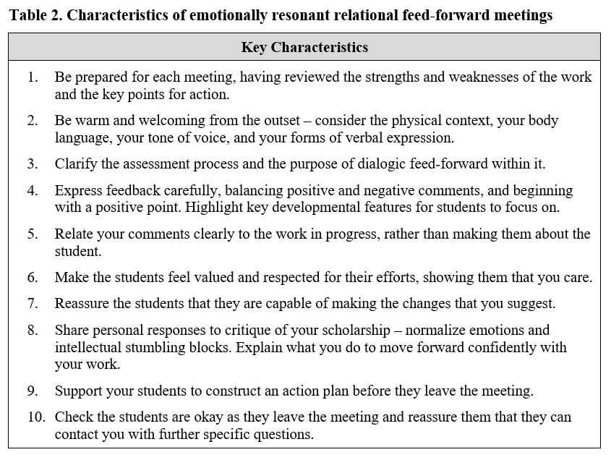
Implications for instructors
Notes:
Based on work of Carl Rogers in the field of humanistic psychology.
Rogers (1959) postulated that, for a person to develop, they require an environment that is genuine (open and self-disclosing), accepting (offers unconditional positive regard), and empathetic (receptive).
Transferred to higher education, this means it is crucial for instructors to demonstrate patience and understanding with respect to students’ draft work, not withdrawing positive regard if a student has made mistakes.
Offering unconditional positive regard in a low-stakes environment enables students to experiment and learn from their mistakes. As such, we see the early stages of self-actualization in our students (Maslow 1962) as they both recognize and believe they can achieve their potential through the assessment task. This leads to them experiencing positive emotions and a sense of wellbeing.

Slide 15
Any questions?
Email: jhill18@glos.ac.uk or S.V.Smith@leedsbeckett.ac.uk

