Slide 1
Assessment & Feedback as Emotional Labour: Managing Processes Productively in the Neoliberal Academy
Jennifer Hill
Kathy Berlin
With:
Susan Smith, Julia Choate, Lisa Cravens-Brown, Lisa McKendrick-Calder
ISSOTL 2023
Railway Museum, Utrecht, 8-11 November 2023
Notes:
10.00-11.30 (1.5 hours)
ISSOTL ICWG Atlanta, October 2019.

Slide 2
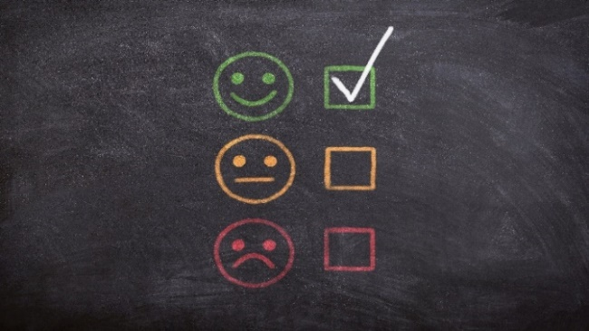
Workshop aims
1. To explore your emotional responses to assessment & feedback processes
2. To understand how we might, as a community of SoTL scholars, productively manage the emotional labour, promotional reward and professional development involved in assessment and feedback
Notes:
10.05-10.07

Slide 3
Context - staff wellbeing and assessment
Instructors have a dual responsibility in assessment (Myyry et al. 2020):
- acting formatively as a teacher and mentor
- fulfilling a summative role of judging achievement and awarding grades
This tension can be problematic for students and instructors, provoking a range of emotions
Nevertheless, studies focusing on instructors’ emotions associated with assessment and feedback in HE are scarce (Zhao et al. 2022)
Notes:
10.07-10.10
In her opinion piece, Spaeth (2018) identifies feedback as emotional labour performed by instructors as they balance the need to demonstrate care for their students with a lack of time emerging from increased quality control. She notes that consciously giving feedback to promote positive emotions in students, helping them to improve their learning, requires significant emotional work by the instructor.
Myyry et al. (2020) discovered a higher number of expressions of negative emotions (frustration, anxiety, shame, and boredom), compared with positive emotions (joy, compassion, hope, and pride) in instructors related to assessment. More than half of instructors experienced anxiety related to assessment, often linked to the act of communicating negative feedback and poor grades to students. Some were angered by students lacking motivation to seek and act on feedback. A frequent positive emotion expressed by instructors was enjoyment, related particularly to using novel assessment methods and witnessing student success, and responding well to formative feedback.

Slide 4
Workshop ice breaker activity
In small groups consider the question …
What assessment and feedback methods do you adopt generally – and why?
Share your thoughts with the room
Notes:
10.10-10.20 (10 mins)

Slide 5
Our recent research – emotions and feedback
We explored the emotional responses instructors experience through the giving and receiving of assessment feedback
We examined whether the instructors attempted to manage dialogic feed-forward encounters to help shape the emotions experienced by themselves and their students
- Instructor: the academic staff member responsible for coordinating and teaching students in a particular unit
- Dialogic feed-forward: an interactive exchange about the quality of student work
Teaching & Learning Inquiry (2023) 11
Notes:
10.20-10.30 – 10 mins to cover our research (9 slides!)
Assessment dialogue between instructor and student can promote not only cognitive sense-making in students (Carless & Boud 2018), but the foregrounding of emotions through encounter, discussion, and normalisation (Hill et al. 2021a; Ryan and Henderson 2018).
Our research questions were:
1. What emotions do instructors experience related to giving summative written feedback and dialogic feed-forward?
2. Do instructors consider the emotional responses of students as they give summative written feedback and undertake dialogic feed-forward?
3. Do instructors manage their dialogic feed-forward encounters to reflexively shape the emotions experienced by themselves and their learners?
4. Do instructors believe that the dialogic feed-forward encounters alter instructor-student relationships on the course?

Slide 6
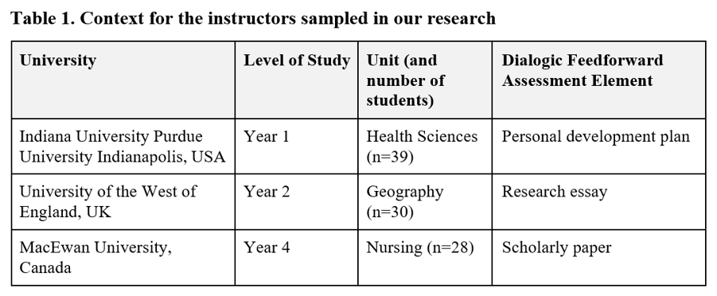
Methods
Qualitative data collection with instructors from three universities who had administered a dialogic feed-forward intervention over 2019-20 academic year
Notes:
Part of an ISSOTL ICWG – convenience-based sample. Specific focus on instructor emotional responses to the introduction of a novel form of dialogic feed-forward compared with written summative feedback commonly provided for such assignments.
The instructors were experienced university teachers and they comprised three of our research team.
Yr 1 - 15-minute, face-to-face meeting between two submission of an electronic personal development plan (students knew grade but no feedback). Discussion using rubric about current standards and improvement.
Yr 2 - 30 minute meeting about an essay draft (students did not know grade). Discussion using rubric about current standards and improvement.
Yr 4 - scholarly paper marked using a grading rubric. Students received their paper with narrative comments and their grading rubric with comments and a mark. Then invited to meet with the instructor for 20–30 minutes to discuss their paper, feedback, and areas for future writing growth.

Slide 7
Individual semi-structured interviews conducted online by a member of the research team who had not undertaken a dialogic intervention
Each instructor questioned about the emotions encountered with respect to summative written feedback and their dialogic feed-forward intervention
Interviews were recorded and transcribed verbatim - 26,000 words
Transcripts were manually coded and analysed inductively using thematic analysis
Core themes were identified, discussed and synthesized into final themes post-coding
Notes:
Interviews lasted around 60 minutes and secured rich, detailed narratives.
Ethical approval was obtained from all institutions prior to commencement of data collection.

Slide 8
Summary of findings
Five key themes:
Summative written feedback aroused largely negative emotions in instructors because they felt distanced from their students
Instructors experienced a broad range of emotions related to dialogic feed-forward encounters, emerging from their proximity to students
Dialogic feed-forward, as an affective encounter, was emotionally challenging for instructors
Dialogic feed-forward built strong learning relationships between students and instructors, strengthening students’ sense of belonging
Dialogic feed-forward was transformational for instructors as educators

Slide 9
1. Negative emotions related to delivery of summative written feedback
My biggest feeling was frustration because I was writing so much ... thinking “this is so good for the students, I’ve taken such care.” Then I would think “but I’m not going to know what happens.” It’s like a fracture exists between me giving [feedback] and
the students receiving it
With written feedback, I just give it to the students. If I make them happy, sad, angry, hurt, I never see it, so it never has
any impact on me
Notes:
Overriding sense of dissatisfaction delivering written feedback. Frustration coupled with disappointment and sadness that written feedback was not going to lead to learning: “I just felt that I wasn’t going to achieve anything ... It felt like a waste of my time and a waste of learning.”
Instructor C talked about worry and self-doubt that accompanied her writing feedback for students who had not done well on assignments. She would revisit lower scoring papers and re-read her feedback to ensure it contained “enough positive reinforcement” so that her concern about its reception by the students was reduced.
Written feedback marked the end-point of assessment communication, rather than forming an entry point to conversation about future development. One instructor noted she had to consciously avoid ‘anticipatory hostility’ - writing feedback with feelings of resentment towards students, expecting a lack of proactive feedback recipience.

Slide 10
2. Feed-forward meetings provoked a range of emotions in instructors
My feelings would vary depending on how I thought the student was going to react to the mark. If I thought “this is one where it’s really good, I’ve got lots of positive things to say,” I’d look forward to that meeting, it was exciting ... If I felt “this is poor and I’m going to have to tell this student they’re just failing or just passing,” I automatically worried
I can remember one or two times, where I had feedback meetings that I wasn’t looking forward to, I went and chatted with
a colleague for a few minutes
Notes:
Instructors were either excited to talk with students who had submitted good work, or they were anxious about the discomfort of talking with students who they thought might be disappointed in the grade and formative comments.
Sitting down and talking with the students clarified for the instructors the strong emotional responses that students experience receiving feedback:
‘I realized more than ever just how emotional it was for those students to receive feedback . . . They would go into a meeting usually quite nervous and anxious, and then they either fell short of where they wanted to be, and that would be upsetting for them, or they got the congratulations they expected and that made them confident’
The instructors evolved over the course of the dialogic feed-forward process. They left their early nerves behind and became more confident in the meetings:
“The more I did it, the more I could make my routines for myself, so the emotions kind of went down, they were less intense”
They also put strategies in place to purposely manage the emotions of their students – preparing a welcoming space & asking if students were ready for feedback.

Slide 11
3. Dialogic feed-forward encounters were emotionally challenging for instructors
I’ve got to face maybe six students in a day across a range of meetings. And that was quite an emotional burden; it was definitely a different feeling to marking in the written form - more intense for me emotionally
My body language, my tone of voice, I tried to be careful, consistent and positive with every student
Notes:
Each instructor alluded to the emotional investment involved in delivering dialogic feed-forward, due to it foregrounding the emotions of the participants.
The instructors foregrounded the need to purposely manage/buffer their emotions during the meetings. Felt the need to hide / regulate negative emotions they might be experiencing, recognising that they could adversely impact the conversation, and the feelings and actions of the students.
Instructor C talked very eloquently about the emotional input required to run a successful dialogic feed-forward meeting: “You have to be present in the moment, ready to pick up all those cues, ready to really hear what they’re saying and what they’re looking for. So, you can’t be kind of distracted, you have to be focused.”

Slide 12
4. Dialogic feed-forward meetings developed open / strong relationships
between instructor and student
It became a safe, honest space for students ... they could say what they wanted to say, what their worries were ... you could see students willing to share with you their fears, happiness, anxieties all the way through the meetings
Dialogic feedback really starts a transparent relationship ... they know that I actually care about their learning and I care about what they’re doing ... They’ll connect with me at other times as they’re working on other assignments ... and they participate more in class
Notes:
‘When they came in, and they had this conversation with me, there was this connection and, all of a sudden, they were like “Oh she’s not this mean person who’s out to destroy me” . . . What I started to see was a difference in the classroom with the way the students interacted with me. We started to have more of a community and they were much more comfortable with me, and they didn’t hesitate to stop after class and ask me for additional feedback’ (Instructor B)
All instructors talked about the receptive and honest dialogic meetings building bonds between themselves and their students through establishing a sense of care.
There was a sense that the power differential between instructors and students had narrowed somewhat and there was a greater sense of “togetherness.” This prompted students to behave differently with their learning, seeking further feedback from instructors:
‘Any time you have that relationship, where the students actually feel like you’re invested in them, the dynamics change . . . I found that it really changed the way they related to the course and the way they related to me’. (instructor C)
Because it is an inclusive, self-paced approach, the dialogic feed-forward process reduced students’ imposter syndrome “helping to solidify the fact that they do belong here” (instructor B). All the instructors commented about the meetings developing a greater sense of belonging in the students. Instructor C, for example, said: “The dialogic feed-forward was an excellent mechanism to really create that sense of belonging with our students—to let them know that they have somebody to reach out to if they need it.”

Slide 13
5. Dialogic feed-forward was transformational for instructors
It completely transformed me as a teacher and I never expected it to do that ... it just fundamentally alters who you are as an educator ... I literally saw with new eyes and it was because of the time I spent with the students
Dialogic feedback made me a stronger, better teacher because it really helped put into perspective how the students felt when I was interacting with them ... I pay so much more attention to the feedback that I provide now when I’m grading or giving information back
Notes:
Each instructor was asked at the close of their interview if they had any further comments about their dialogic feed-forward intervention. What emerged was the power of the approach to recalibrate the instructors.
One instructor talked about the “power of the moment” the meetings offered and how being consciously present with her students made her more understanding towards them. As such, she re-worked her unit to be more meta-cognitive throughout so that her students could share their ongoing experiences of their assessment journey.

Slide 14
Workshop discussion and mapping activity
What are your emotional experiences related to:
Preparing your assessment briefs
Explaining your assessments to students (briefs, marking criteria, rubrics)
Marking/grading
Giving feedback to students
Undertaking marking moderation with colleagues
Student responses to their grades/feedback (especially if they question it)
Why do you feel this way?
Notes:
10.30-11.00 (30 mins)
We can ask participants to work through the elements, but focus on those that engender the greatest number of or strongest emotions.
Could add if time:
Are there any approaches that make you feel more positive or more negative emotionally in terms of grading and giving feedback to students? For example:
- Formative versus summative assessment
- Written feedback versus audio/video feedback versus verbal/oral feedback
- Online versus face-to-face feedback
- Personal comments on specific work versus generic feedback to the cohort

Slide 15
Workshop discussion
What impacts, if any, do your emotional experiences related to assessment have on:
- Your assessment and feedback behaviour / practices (e.g. the nature of
your feedback)
- Your teaching practices more widely (e.g. relationships with students)
- Your mental health and wellbeing
Notes:
11.00-11.10 (10 mins 5 + 5)

Slide 16
Workshop discussion
What coping strategies do you adopt to manage your emotions related to assessment and feedback?
What can be done to help you manage the emotional labour related to assessment and feedback?
- e.g. by your department, institution, professional
services staff, Student Union, HE sector
What key guidelines for instructor practice, and wider strategy and policy, would make assessment and feedback emotionally sustainable?
Notes:
11.10-11.25 (15 mins)

Slide 17
Implications for practice
Frustration and disappointment arise from the ‘fracture’ of written feedback – alienation between instructors and students
Through relational feedback dialogue, instructors actively encounter the emotions their students experience when receiving feedback
Instructors surface or suppress feelings of their own, which demands emotional investment (Spaeth 2018)
The need to “care” for students in a time of work intensification can cause instructors to feel overburdened with “extraordinary emotional labour” (Koster 2011)
Notes:
11.25-11.30 for final 2 slides
The distance involved in written commentary and student reception of it could lead to a build-up of anticipatory hostility in some instructors towards their students. This sense of alienation is important, as it can increase the power imbalance between instructors and students, breaking down important social relationships for learning.
Feedback interventions that generate increases in workload are problematic given current resource constraints. We suggest focusing efforts on where they will be productive and equitable for students. Pragmatically, instructors might embed dialogic feed-forward at key points in the curriculum, such as the first year of study, they might use tutorial time, or progressively develop peer-to-peer dialogue.

Slide 18
Possibility of gendered emotional division of labour (Hochschild 1983):
female instructors engaging with emotional investment of assessment
dialogue more than male counterparts
When instructors displayed positive emotions, this developed the relationship between them and their students (Mendzheritskaya & Hansen 2019)
Students tended to use their instructor more as a resource in and beyond the assessment - might reduce attrition and aid progression from year to year
Emotional labour helps to improve student satisfaction and aid retention
Instructors need sustained institutional support: professional development, recognition, and reward if they are to flourish and secure positive outcomes for students
Notes:
All our instructors delivering dialogic feed-forward were women. We suggest that promotion of the SoTL route to progression would be a positive avenue through which to recognize this skill and effort.
If instructors are to secure future-facing sustainable assessment and feedback processes, where students develop motivation, self-regulation, and self-efficacy beyond in-task cognition (Carless et al. 2011), emotional investment by instructors and students is required. Instructors will require expertise beyond their discipline, incorporating specific knowledge and skills in pedagogy and assessment, including sensitivity to emotions (DeLuca, LaPointe-McEwan, and Luhanga 2016). But there is a burden placed on instructors in dealing with the emotions arising from assessment feedback.

Slide 19
Any questions?
Email: jhill18@glos.ac.uk or kberlin@iu.edu

Slide 20
References
Hill, J., Berlin, K., Choate, J., Cravens-Brown, L., McKendrick Calder, L. & Smith, S. (2023) Emotions Experienced by Instructors Delivering Written Feedback and Dialogic Feed-Forward. Teaching and Learning Inquiry, 11(1), DOI: https://doi.org/10.20343/teachlearninqu.11.6.
Hill, J. & West, H. (2022) Dialogic Feed-Forward in Assessment: Pivotal to Learning but not Unproblematic. Teaching and Learning Inquiry, 10, https://doi.org/10.20343/teachlearninqu.10.20.
Hochschild, A.R (19830 The Managed Heart. Berkeley: University of California Press.
Koster, S. (2011) The Self‐Managed Heart: Teaching Gender and Doing Emotional Labour in a Higher Education Institution. Pedagogy, Culture & Society, 19(1), 61-77.
Mendzheritskaya, J. & Hansen, M. (2019) Are Lecturers who show Emotions Perceived as Understanding? How Culture and Teacher’s Display of Emotion are Related to Students’ Judgments about a Teacher’s Personality. Studies in Higher Education, 44, 1793-1802.
Myyry, L, Karaharju-Suvanto, T., Vesalainen, M., Virtala A-M., Raekallio, M., Salminen, O., Vuorensola, K. & Nevgi A. (2020) Experienced Academics' Emotions related to Assessment. Assessment & Evaluation in Higher Education, 45, 1-13.
Spaeth, E. (2018) On Feedback and Emotional Labour. Journal of Perspectives in Applied Academic Practice, 6, 83-86.
Tuck, J. (2012) Feedback-Giving as Social Practice: Teachers’ Perspectives on Feedback as Institutional Requirement, Work and Dialogue. Teaching in Higher Education, 17, 209-221.
Zhao, X, Cox, A., Lu, A. & Alsuhaibani A. (2022) A Comparison of Student and Staff Perceptions and Feelings about Assessment and Feedback using Cartoon Annotation. Journal of Further and Higher Education, 46, 586-604.

