Slide 1
Tourism Destination Climate Action: The enabling environment
Dr Kyriaki Glyptou, Dr Elisa Burrai, Dr Jane Turner & Professor Chris Cooper
ATLAS 2024

Slide 2
Our research focus
Aim:
Engagement with and implementation of climate actions of global tourism destinations
Objectives:
To understand the state of play in the climate action for the Glasgow Climate Declaration (GCD)
To examine the level of development of climate action across a sample of signatory destinations
To identify the issues involved, challenges and enablers in developing climate actions
To elicit the barriers to climate action planning amongst a sample of non- signatory destinations (primarily from the Global South)

Slide 3
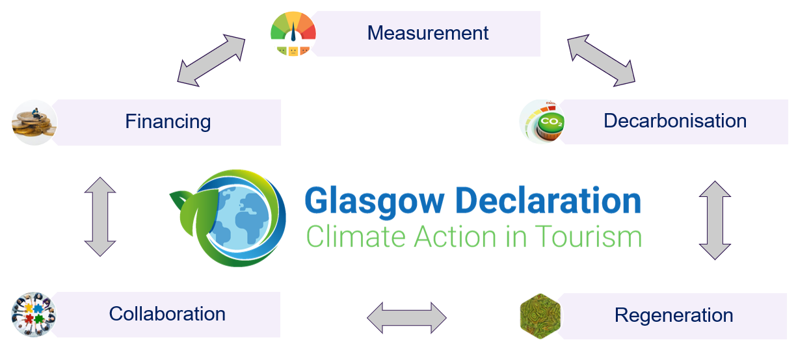
Context: the Glasgow Declaration
A global commitment to halve emissions by 2030 and reach Net Zero as soon as possible before 2050

Slide 4
The challenges
What to measure & how
Limited influence of DMOs
Lack of understanding of tourism ecosystems
Lack of long-term plans
Gap integration – climate action plans with policies
Lack of understanding on funding and cost projects
Limited/lack of capacity
Communication
Underestimation of climate action
Lack of diversified economy

Slide 5
Methods
Collaborated with the Travel Foundation as a gatekeeper;
Deductive approach to develop interview questions on themes of financing, communication and collaboration;
Desk research to develop a profile of destinations for data collection;
Data collection May - November 2022
17 individual interviews with DMOs from Global North destinations
7 group interviews with 12 participants from Global South destinations
Deductive thematic analysis of data

Slide 6
Participants
17 DMO Signatories: National, Regional, Local Level, North & South America and Europe
7 DMO Non-Signatories (group interviews)
National, Regional Level
Focus on Global South, including South America and Africa
Chile
Gambia
(Southern) Ghana
Honduras
Kenya
Mexico
Barbados Tourism Marketing Inc | NBTC
Catalana De Turisme | Oregon Coast
Destination Vancouver | Town of Vail
Develop Athens | Turisme de Barcelcona
Goteburg and Co. | Turismo de Portugal
Innovation Norway | Vancouver Island
Lake Tahoe, USA | Visit Cairngorms
Ministry of Tourism, Panama | Visit Gloucestershire
 | Visit Scotland

Slide 7
Findings
Understanding the scope and sphere of influence
The enablers and barriers for the development of climate action plans
The influence of the market
COVID and other contextual issues
Communication and communicating the climate action plans

Slide 10
Learning from others
Repository of resources: templates, communication examples, training videos, example climate action plans
Help with communication for different audiences and terminology
Facilitated workshops for all collaborators
Access to specific expertise e.g. finance
Traditional stewardship practices
A climate action plan mentor
Happy to share examples of good practice: case studies, facilitated networking
Destinations in Global South (who are ahead in adaptation and regeneration) could share knowledge
Shared experience of decarbonising (switch to low carbon energy sources)

Slide 11
Reflections for the Global South
Terminology: appropriateness of the term ‘Global South’ – crude description and much variation
Climate targets (i.e. those included in the GCD) are often seen as created in / by the Global North: needs adapting and communicating in a way that is meaningful locally
Fairness and Equity: Scale of responsibility to decarbonise versus shared responsibility in respect of funding technology locally
Knowledge exchange and transfer: need for stronger regional vision, networks and support mechanisms. Local realities need to be understood in relation to mitigation and adaptation
Specific help: technical assistance, organisational / governance issues, climate disaster assistance / recovery fund for tourism companies to help organisations recover

Slide 12
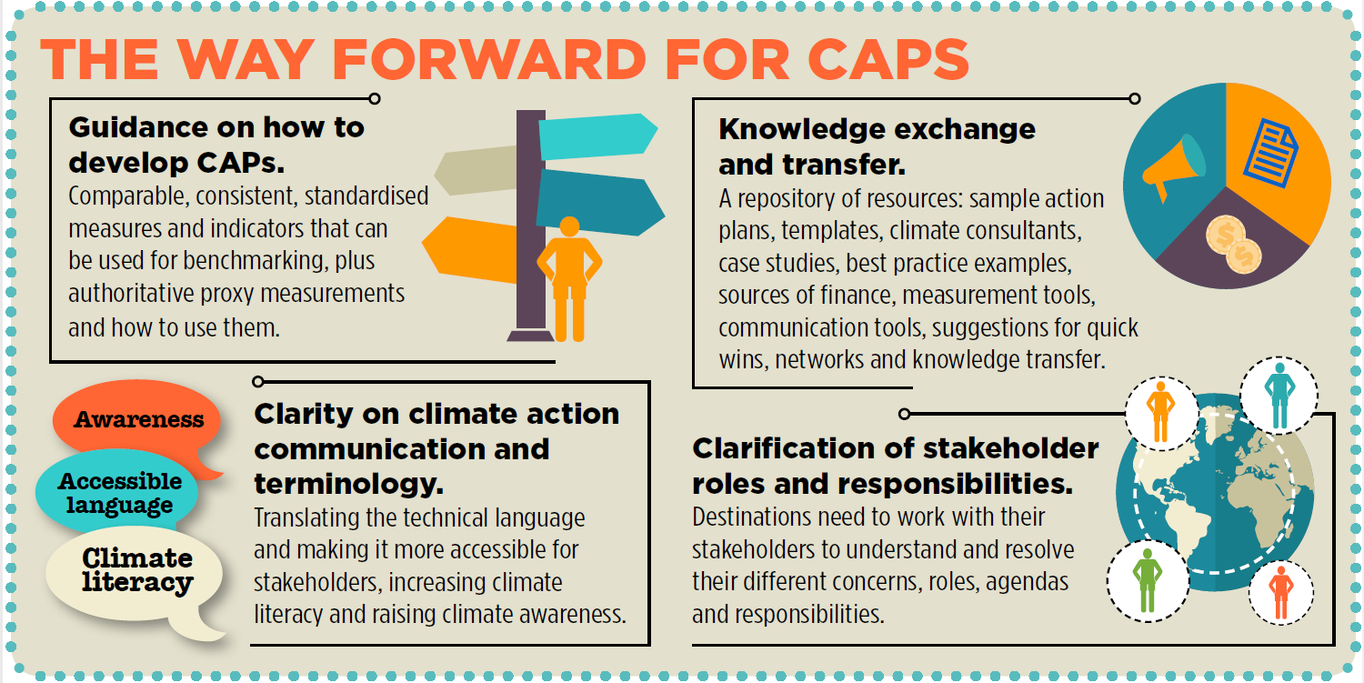

Slide 13
Follow up research
Knowledge exchange and good practice between / among destinations
How to exchange knowledge (types of channels; shared resources)
What knowledge to be exchanged (Climate Action Pathways)
How to identify and share good practice (certification schemes)
Communication of climate change and action amongst stakeholders
What channels are most appropriate?
By whom and how (material; frequency; terminology)
Other areas of interest (for research and / or practical use)

Slide 14
Any questions?
For further information contact:
Dr Kyriaki Glyptou
k.glyptou@leedsbeckett.ac.uk

