Slide 1
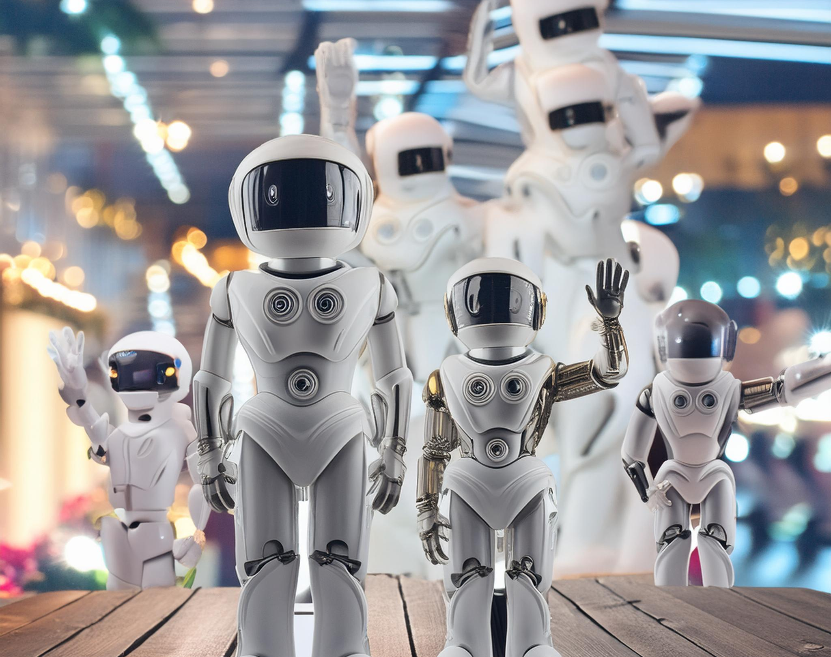
Don’t Panic: A Year in AI
Erin Nephin, Liz Mann, and Liesl Rowe

Slide 2
What a year it’s been…
Initial guidance released 18 April 2023
University Principles adopted 16 January 2024
Acknowledgement form approved 16 January 2024
Many, many training sessions for staff and students
Library webpage developed and linked in all 2024/25 VLE modules

Slide 3
University Principles
In short, if you are using tools responsibly and ethically in a way that supports your research and learning, it’s likely okay.
There are some restrictions for specific assessments/courses and around the scale of use of translation and paraphrasing/editing software.

Slide 4
An ongoing experiment
Text & images
Refining input = more refined output
"...you may ask a question today and get a slightly different answer than the previous day" (Florida State University, 2024)
Hallucinations

Slide 5
Streamlining web content
Microsoft Sway - "Automated Copyediting"
Findings & additional accessibility research - "CILIP Digital Technology Group“
Presented overall findings at ALN conference (June 2024) – Conference paper “Don’t Panic: A Toolkit for Using Generative AI Effectively”.

Slide 6
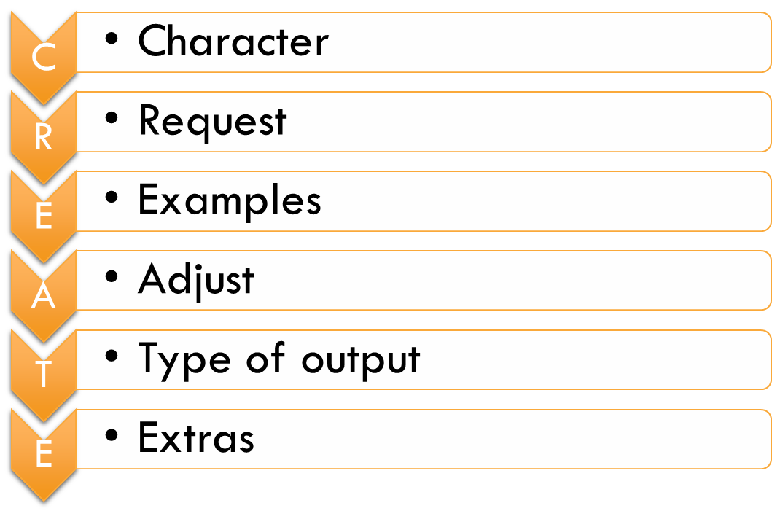
Birss (2023)

Slide 7
From text to image (and back again)
Free vs subscription
Dall-e, Midjourney, Adobe Firefly
Stock images & public domain

Slide 8
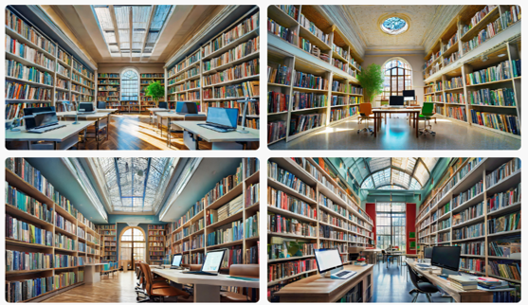
Generate an image of a library…
1.
AR = 1:1 Traditional, wood grain, book heavy
AR = 16:9 Modern but needs LBU spin
2.
Source: Adobe Firefly

Slide 9
“Please come up with a list of prompts to feed Adobe Firefly in order to generate photo realistic images of the inside of a university library, with laptops, PCs, and books. The colour scheme should include purple.”

Slide 10
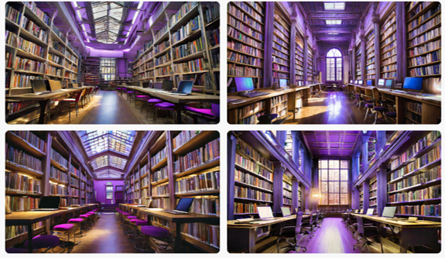
3.
3. AR = 16:9 LBU purple, too strong
4. AR = 16:9
...
Source: Adobe Firefly

Slide 11
Try it yourself!
Option A: Enter your own prompts into a text to image AI.
Option B: Ask ChatGPT to rewrite your prompts
Option C: Ask ChatGPT to write a list of prompts from scratch
Test various methods. Which do you prefer?

Slide 12
Copyright and AI
Generative AI is trained by being "fed" large amounts of data, used to generate answers
Various legal issues: if copyrighted work is part of the AI training data, is that a "copy" under copyright purposes?
Some AI terms and conditions mean that everything uploaded into the AI becomes part of the training set

Slide 13
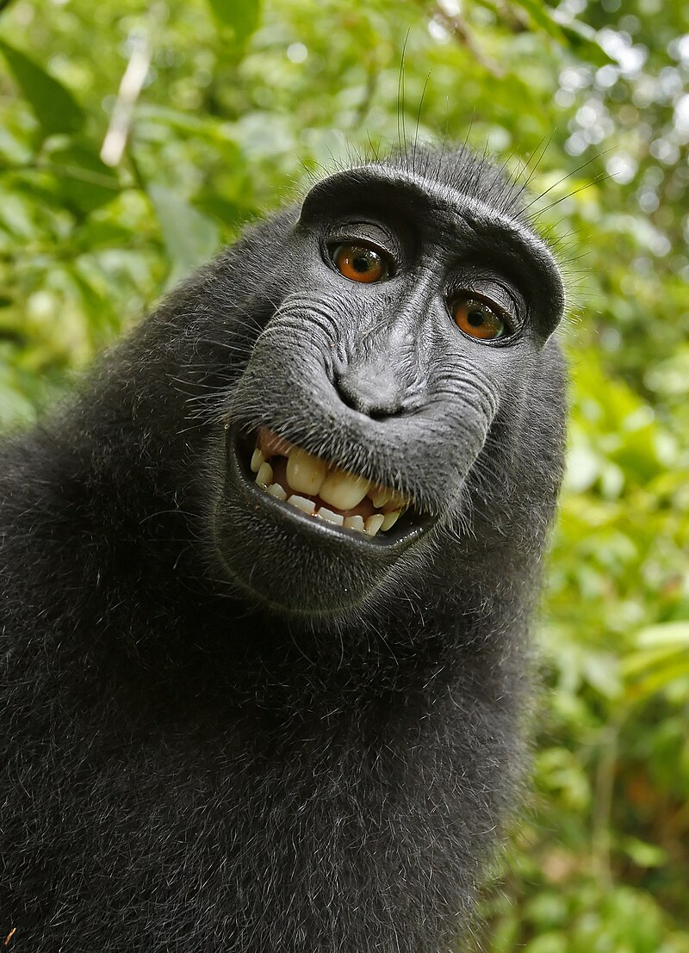
Who owns AI created works?
The AI, but it’s not human: can’t own copyright
The generator: they didn’t create it, but they coached the AI into producing a good result
The company who produces the AI as they supplied the training set
The content creators whose work was used in the training set
All of the above?

Slide 14
What to do when using AI?
As a user of AI, we need to consider the following questions:
What AI software am I using? Who created it/what is the dataset?
What purpose am I using this AI for?
What happens to information I input into the AI?
Have I cross-checked the output from the AI is accurate and reliable?

