Slide 1
Attitudes and Behavioural Intentions in COVID-19 Campaigning in the UK: The Influence and Perceptions of the Colour Blue
Martina Topic, Alan Shaw, Mirela Holy, Ralph Tench and Marija Geiger Zeman
Leeds Beckett University / VERN University / Ivo Pilar Institute of Social Sciences
UK/Croatia
M.Topic@leedsbeckett.ac.uk

Slide 2
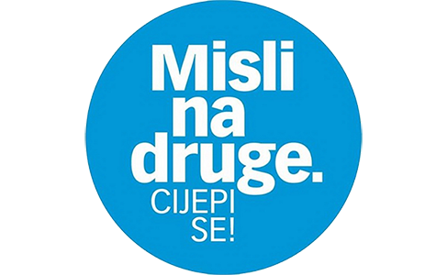
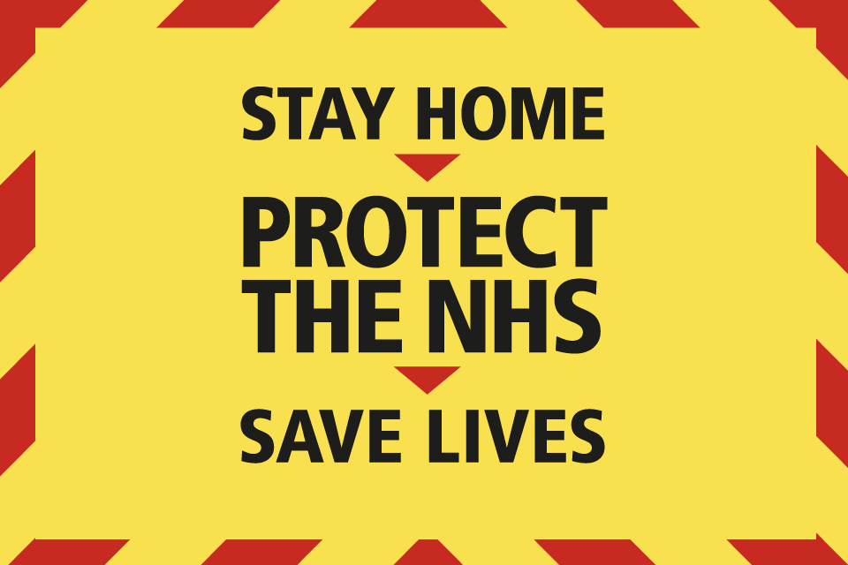
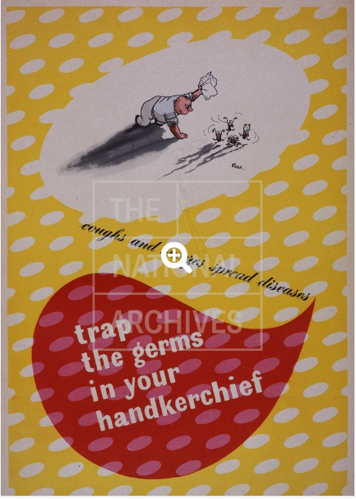
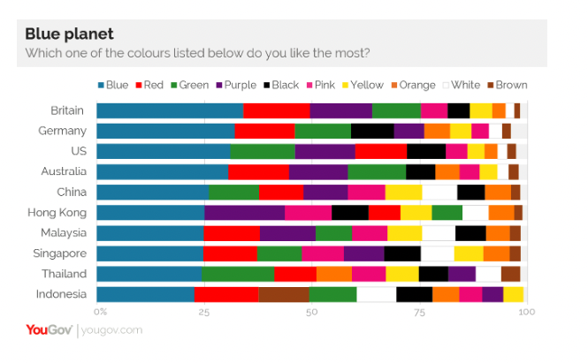
Aim & Purpose

Slide 3
The study...
An analysis of the use of colours during the recent COVID-19 pandemic and within the context of historical health campaigning in the UK.
Red and yellow vs blue – focus of the analysis
Literature review – MH & MGZ
Campaign analysis – RT
Survey design and analysis – AS
History of UK Comms, Behavioural theory & coordination/editing – MT
A large survey of UK adults

Slide 4
Cultural Differences and Colours
Amsteus, Al-Shaaban, Wallin and Sjöqvist (2015) – perception of colour changes in different contexts
WHITE – India (unhappiness) vs purity, health and peace in the West / China death and mourning
RED – death & afterlife in Celtic culture / excitement, danger and love in the West / a good luck, celebration and summoning in China (also wedding invitations, red and black) (Madden et al, 2000)
RED also passion and anger (Colour psychology, n.d.)
RED as love and happiness in USA, China, Korea and Japan (Jacobs et al, 1991)
RED – symbolises higher social status, wealth, power and victory (UK, China) (Wu et al, 2018)
YELLOW – purity and happiness in USA, China, Korea and Japan (ibid)
BLUE: truthfulness, calmness, reduction in crime when streetlights are blue (Dreher, 2018; Wolchover & Dutfield, 2022)

Slide 5
Colours and Meanings
Fine et al (1998, pp. 446-447) – a three-layer model of analysis of meanings and symbolism of colours:
“First-Order Symbolism” - denotes objects of a certain colour, where the colour typifies the object (e.g., red strawberries, blue sky, green grass, yellow lemon).
“Second-Order Symbolism” - means socially produced objects that conventionally “require’ certain colours, which provide them culturally consensual meanings”. It is important to point out that “nothing in the objects themselves requires this colour” (e.g., the red colour of fire trucks) (1998, p. 447).
“Third-Order Symbolism” - means connecting colours with objects, institutions, organizations, corporations, events, emotions, people, etc. who do not actually possess that colour, more precisely it is not a colour based on physical reality but on cultural symbolism rooted in history, culture, tradition, etc.

Slide 6
Colours and Meanings
Colours as codes in social and cultural context
Existing research: impact of colours in advertising, product packaging, logos, marketing psychology, buying decisions, etc.
Madden et al, 2009: associating colours with words:
Similarities - the student associated red with love, and blue with high quality.
Differences - students from Japan, China and South Korea associated purple with expensive, and students from the USA with inexpensive (Madden et al, 2000, p. 92).

Slide 7
UK and Colours in Campaigning
UK – the most popular colour is BLUE (YouGov, 2015)
History of Comms – bright colours – RED and YELLOW
e.g., the Coughs and Sneezes behavioural campaign in the 20th century (Ministry of Information)
COVID-19 campaign – red and yellow (PHE (Public Health England), NHS, PM (Prime Minister’s) press briefings:
https://images.nationalarchives.gov.uk/assetbank-nationalarchives/action/viewAsset?id=23382&index=10&total=29&view=viewSearchItem
https://images.nationalarchives.gov.uk/assetbank-nationalarchives/action/viewAsset?id=23381&index=9&total=29&view=viewSearchItem
https://images.nationalarchives.gov.uk/assetbank-nationalarchives/action/viewAsset?id=23369&index=1&total=29&view=viewSearchItem
https://images.nationalarchives.gov.uk/assetbank-nationalarchives/action/viewAsset?id=23383&index=11&total=29&view=viewSearchItem

Slide 8
UK and Colours in Campaigning
A traffic sign (red and yellow) campaign for the COVID-19
https://nottsccg.nhs.uk/covid-19/covid-19-vaccinations/
https://www.theguardian.com/world/2020/apr/27/public-to-submit-questions-for-uk-covid-19-coronavirus-press-conference
Easing the restrictions: https://news.sky.com/story/boris-johnson-plans-televised-press-briefings-as-part-of-government-media-shake-up-12020016

Slide 9
Method
An experimental survey design – views and perceptions of colours in receiving messages
Survey questions – views on vaccination attitude towards COVID-19 vaccines (Healthwatch UK, 2022)
Six hypotheses:
H1a-c: Different colour palettes to a health advert will create different perceptions to the said advert.
H2: The behaviour information relayed in a health advert will have a positive impact on the attitude to the health advert.
H3: The social influence associated with a health advert will have a positive impact on the attitude to the health advert.
H4: The hedonic aspect of a health advert will have a positive impact on the attitude to the health advert.
H5: The economic impact associated with a health advert will have a positive impact on the attitude to the health advert.
H6: The health advert’s falsity will have a negative impact on the attitude to the health advert.

Slide 10
Method
Scales associated with health advert repeated three times using different colour palettes

Slide 11
Method
How does this advert's colouring make you feel? (1-5)
Does this advert colouring encourage you to get vaccinated? (1-5)
Do you like this advert’s colour pallet? (1-5)
The advert's colouring is visually pleasing? (1-5)
Questions on receipt of COVID-19 vaccination
Questions on advertising generally

Slide 12
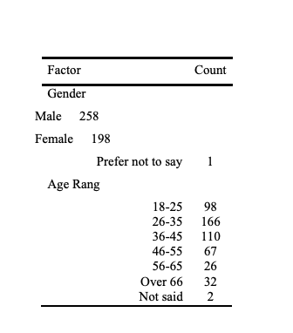
Method
A comparison of these attitudes was tested by comparing means through a one-way ANOVA using SPSS Version 27. The remaining five hypotheses were tested using SMART PLS structural equation modelling.
UK adults – purchased sample via Qualtrics
N = 458

Slide 13
Findings
A one-way between subjects ANOVA was conducted to compare the effect of different colour health adverts (a Red and Yellow advert, a Blue and White Advert, and a Green and White Advert) on the following dependent variables: the advert’s colour portraying a sense of calm (Col1), the colour being appropriate for the health advert (Col3) and the colour being one reason to get vaccinated (Col4).
In relation to how participants felt that the advert made them feel calm: the Red and Yellow advert (N458) had a mean score of 2.26 (SD = 0.849). The Blue and White advert (N458) had a mean score of 3.73 (SD = 0.722) and the Green and White advert (N458) had a mean score of 3.31 (SD = 0.768)
The one-way analysis of variance showed that the effect of colour in portraying a sense of calm was significant F(2,1371) = 433.47, p = <.001. A post hoc analysis using Tukey HSD criterion illustrated a significant difference in all three means, confirming H1a.

Slide 14
Findings
In relation to how participants felt that the colour of the advert was appropriate: the Red and Yellow advert (N419) had a mean score of 3.37 (SD = 1.042). The Blue and White advert (N438) had a mean score of 3.45 (SD = 0.953) and the Green and White advert (N421) had a mean score of 2.99 (SD = 0.897)
The one-way analysis of variance showed that the question regarding the appropriateness of the colour of the advert was significant F(2,1275) = 27.774, p = <.001. A post hoc analysis using the Tukey HSD criterion illustrated a significant difference between the means of the Green and White advert compared with the Red and Blue adverts, partially confirming H1b.
In relation to the perception that the advert helped convinced an individual to get vaccinated: the Red and Yellow advert (N458) had a mean score of 2.90 (SD = 1.227). The Blue and White advert (N458) had a mean score of 3.21 (SD = 1.128) and the Green and White advert (N458) had a mean score of 2.78 (SD = 1.156)

Slide 15
Findings
The one-way analysis of variance showed that the effect of colour in portraying a sense of calm was significant F(2,1371) = 433.47, p = <.001.
The one-way analysis of variance showed that the question regarding the advert encouraged participants to get vaccinated was significant F(2,1371) = 17.322, p = <.001. A post hoc analysis using the Tukey HSD criterion illustrated a significant difference between the means of the Blue and White advert compared with the Red and Yellow and Green and White adverts, partially confirming H1c.
A Multi-Group Analysis was completed using SMART PLS to identify if there were any differences between males and females and also between age groups. No significant differences were identified between any of the groups, demonstrating a unanimous response to our research question.

Slide 16
First conclusions
The analysis is still ongoing as the data above analyses hypotheses 1, a-c and authors are currently analysing data to test other hypotheses. However, respective to hypothesis 1, the current data shows that the colours have an impact on messaging and that colours can also influence vaccination. In our case, results were significant both in the sense of calmness and behavioural intention regarding vaccination.
The results are particularly significant for the colour blue, which has already been known as a favourite colour internationally and in the UK (YouGov, 2015). This colour is generally associated with calmness, reduction in crime and truthfulness (Dreher, 2018; Wolchover & Dutfield, 2022; Williams, 2019; Jacobs et al, 1991) and calmness was confirmed in our study where the colour blue in campaigning showed the most significant results respective of calmness and behavioural intentions in regard to vaccination.

Slide 17
References
Amsteus, M., Al-Shaaban, S., Wallin, E. and Sjöqvist, S. (2015). “Colours in Marketing: A Study of Colour Associations and Context (in) Dependence”. International Journal of Business and Social Science, Vol 6 No 3, pp. 32-45.
Color Psychology (n.d.). Red Color Psychology: Symbolism and Meaning. Retrieved from https://www.colorpsychology.org/red/
Color Psychology (n.d._a). Yellow Color Psychology: Symbolism and Meaning. Retrieved from https://www.colorpsychology.org/yellow/
Dreher, D. E. (2018). “Surprising Research on the Color Blue”. Psychology Today, 29 October. Retrieved from https://www.psychologytoday.com/gb/blog/your-personal-renaissance/201810/surprising-research-the-color-blue
Fine, G., Montemurro, Bonnie Semora, A. B., Stalp, M.C., Claussen, D. S. and Sierra, Z. (1998). Social Order through a Prism: Colour as Collective Representation. Sociological Inquiry, Vol 68 No 4, pp. 443-457.
Jacobs, L., Keown, C. and Worthely, R. (1991). “Cross-Cultural Colour Comparison: Global Marketers Beware!” International Marketing Review, Vol 8 No 3, pp. 21-30.

Slide 18
References
Madden, T. J., Hewett, K. and Roth, M.S. (2000). “Managing Images in Different Cultures: A Cross-National Study of Colour Meanings and Preferences” Journal of International Marketing, Vol 8 No 4, pp. 90–107.
YouGov (2015). Why is blue the world's favourite colour? Retrieved from https://yougov.co.uk/topics/lifestyle/articles-reports/2015/05/12/blue-worlds-favourite-colour
Williams, C. (2019). It’s good to be blue: Why color matters in healthcare marketing. Retrieved from https://www.writergirl.com/color-in-healthcare-marketing-why-it-matters-to-your-brand/
Wolchover, N. and Dutfield, S. (2022). “The meaning of colors: How 8 colors became symbolic”. Live Science, 28 January. Retrieved from https://www.livescience.com/33523-color-symbolism-meanings.html
Wu, Y., Lu, J., van Dijk, E., Hong Li, and Schnall, S. (2018). “The Colour Red Is Implicitly Associated With Social Status in the United Kingdom and China”. Frontiers in Psychology, Vol 5 October 2018.

Slide 19
Any questions?

