Slide 1
Nonviolence from the margins
Protection and organising in Mindanao
Prof. Rachel Julian, Leeds Beckett University

Slide 2
Unarmed Civilian Protection
UCP has been practiced, in its modern form, for over 35 years across the world and this demonstrates that this method can save lives, prevent displacement, and change the behavior of armed actors

Slide 3
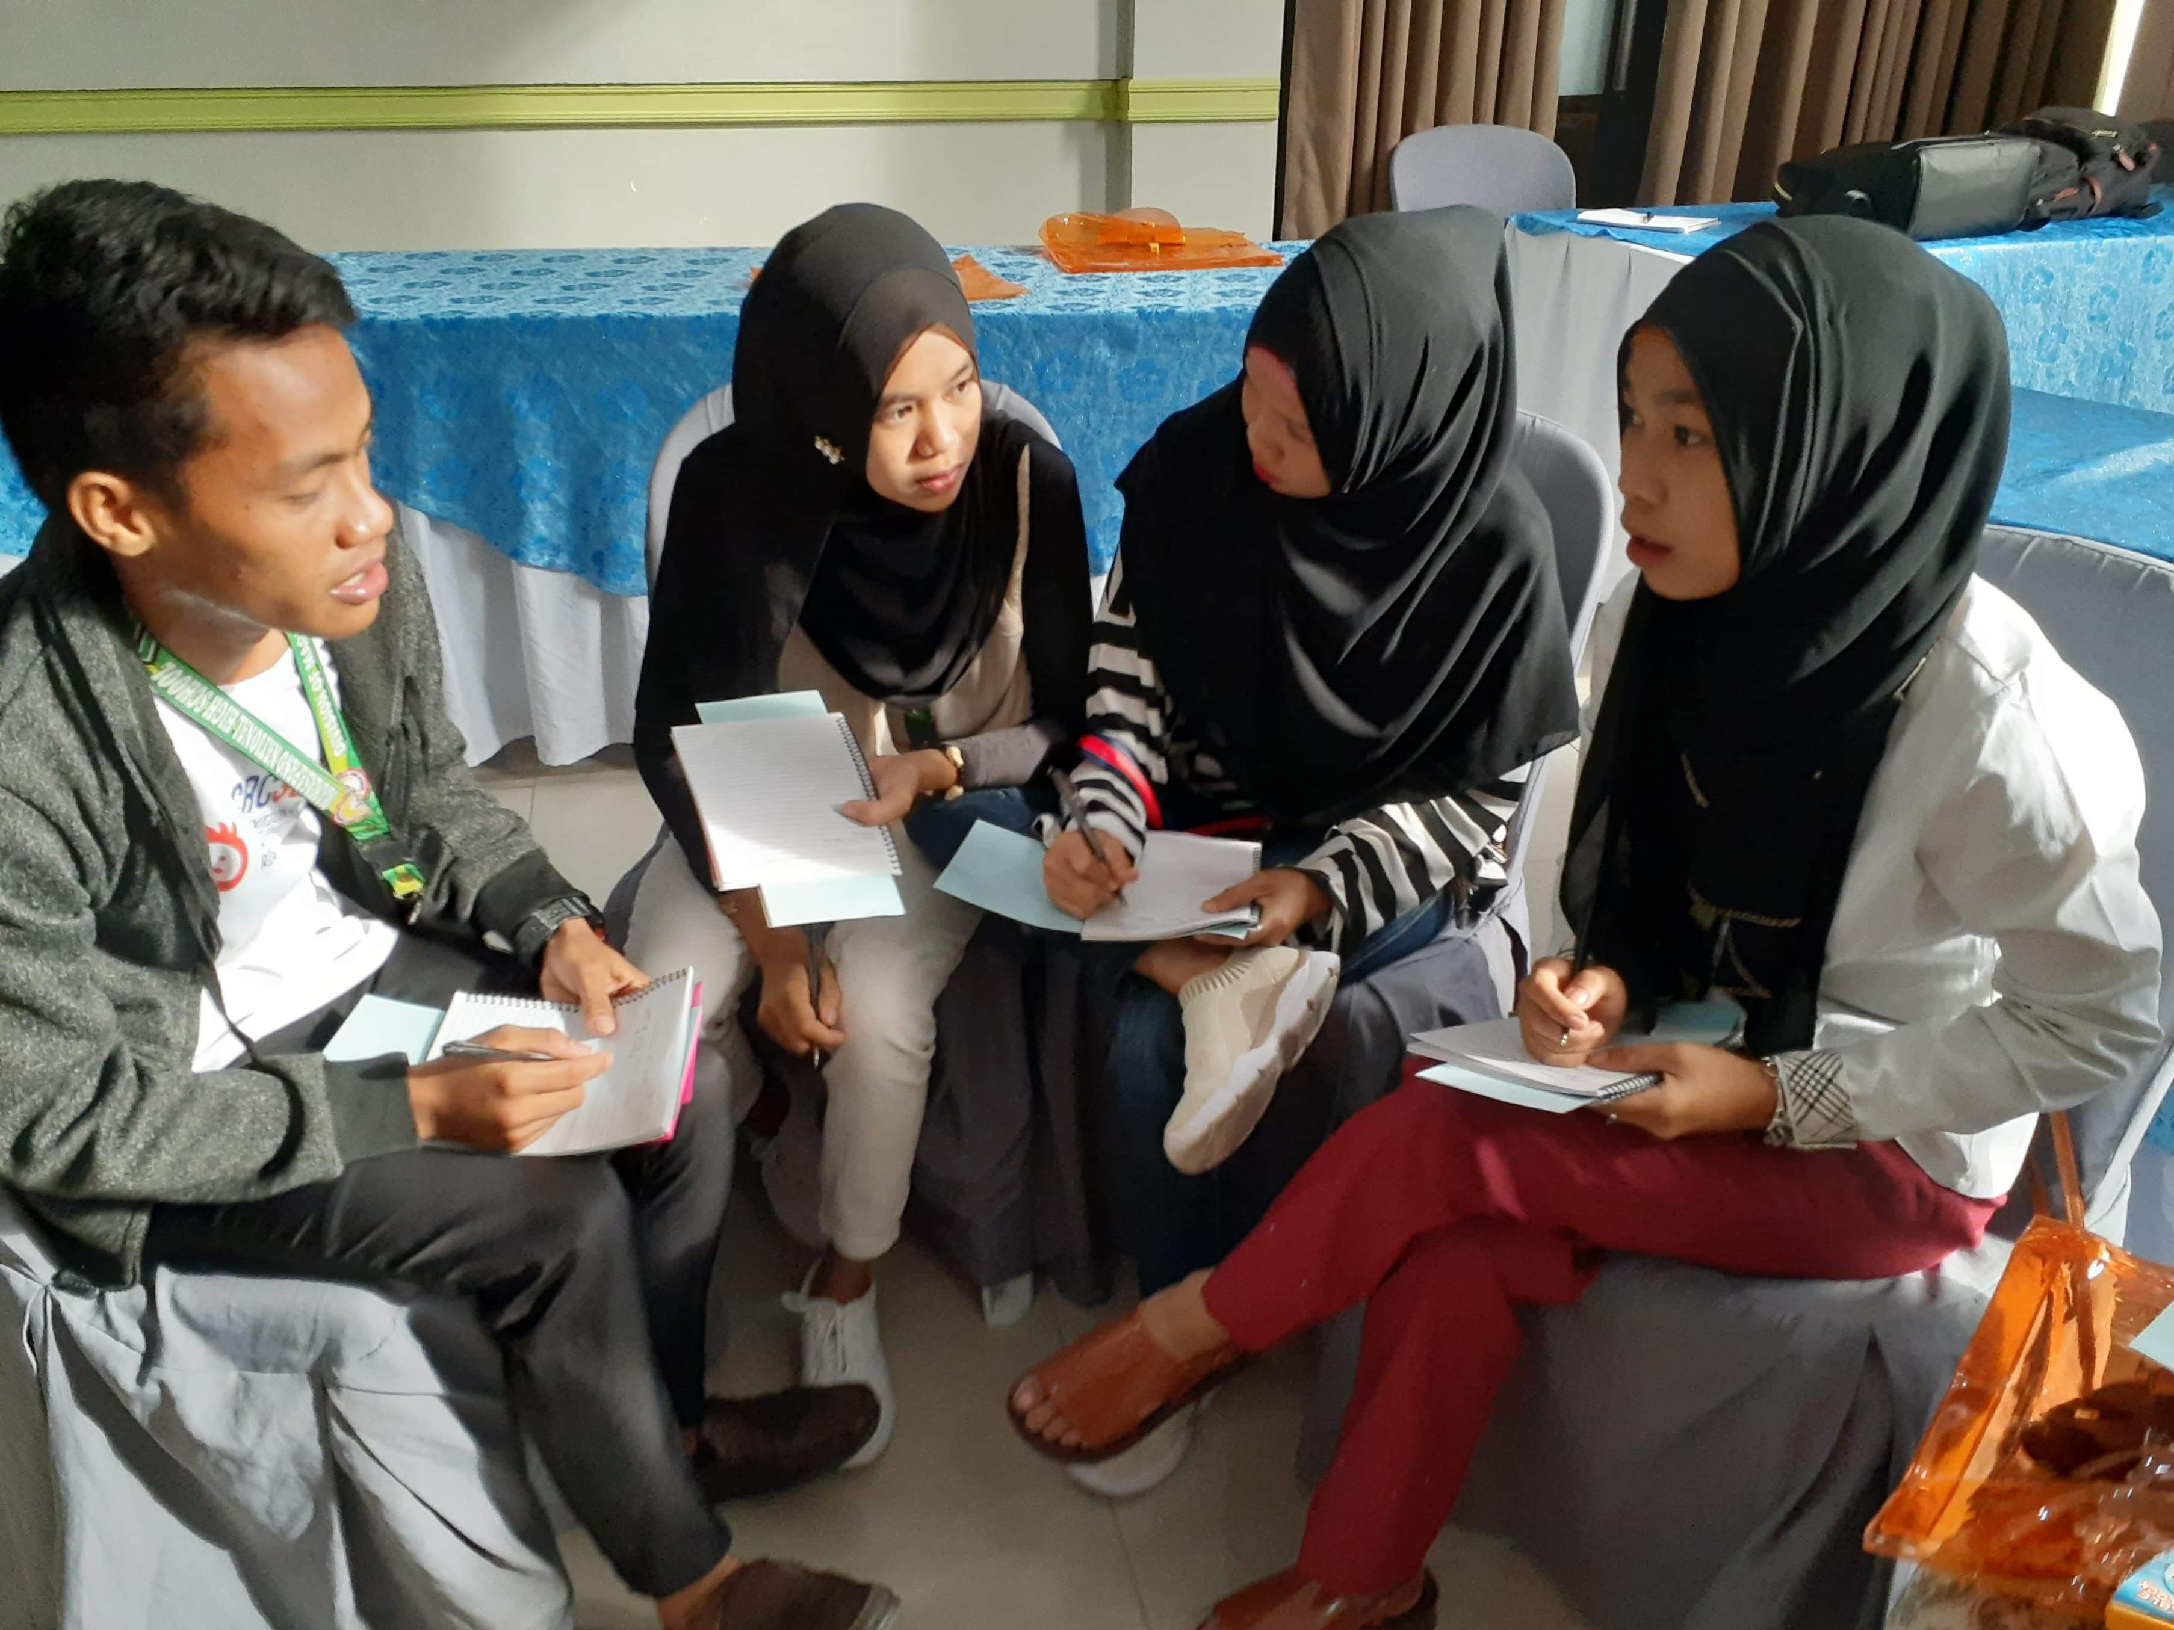
Mindanao

Slide 4
Mindanao

Slide 5
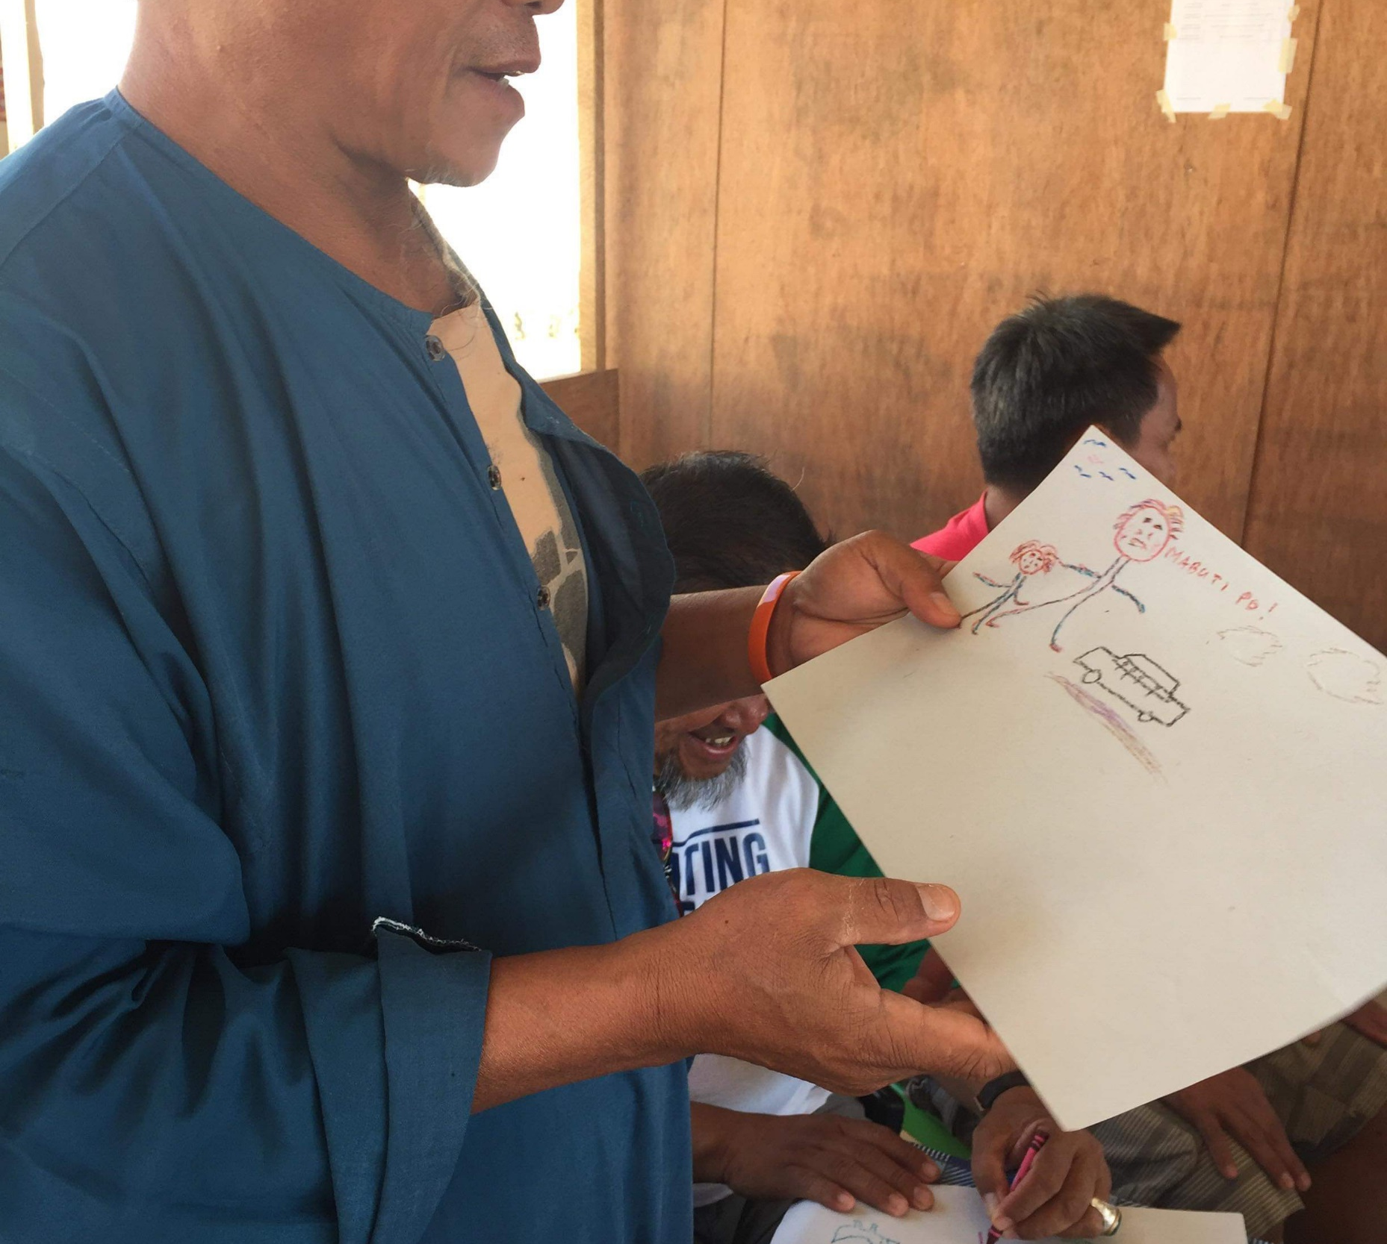
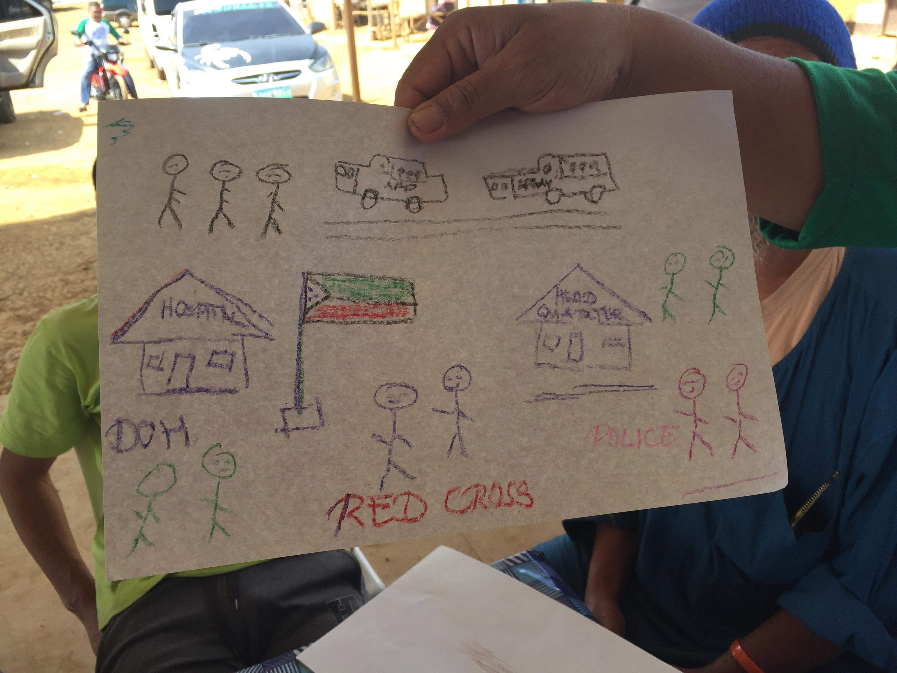
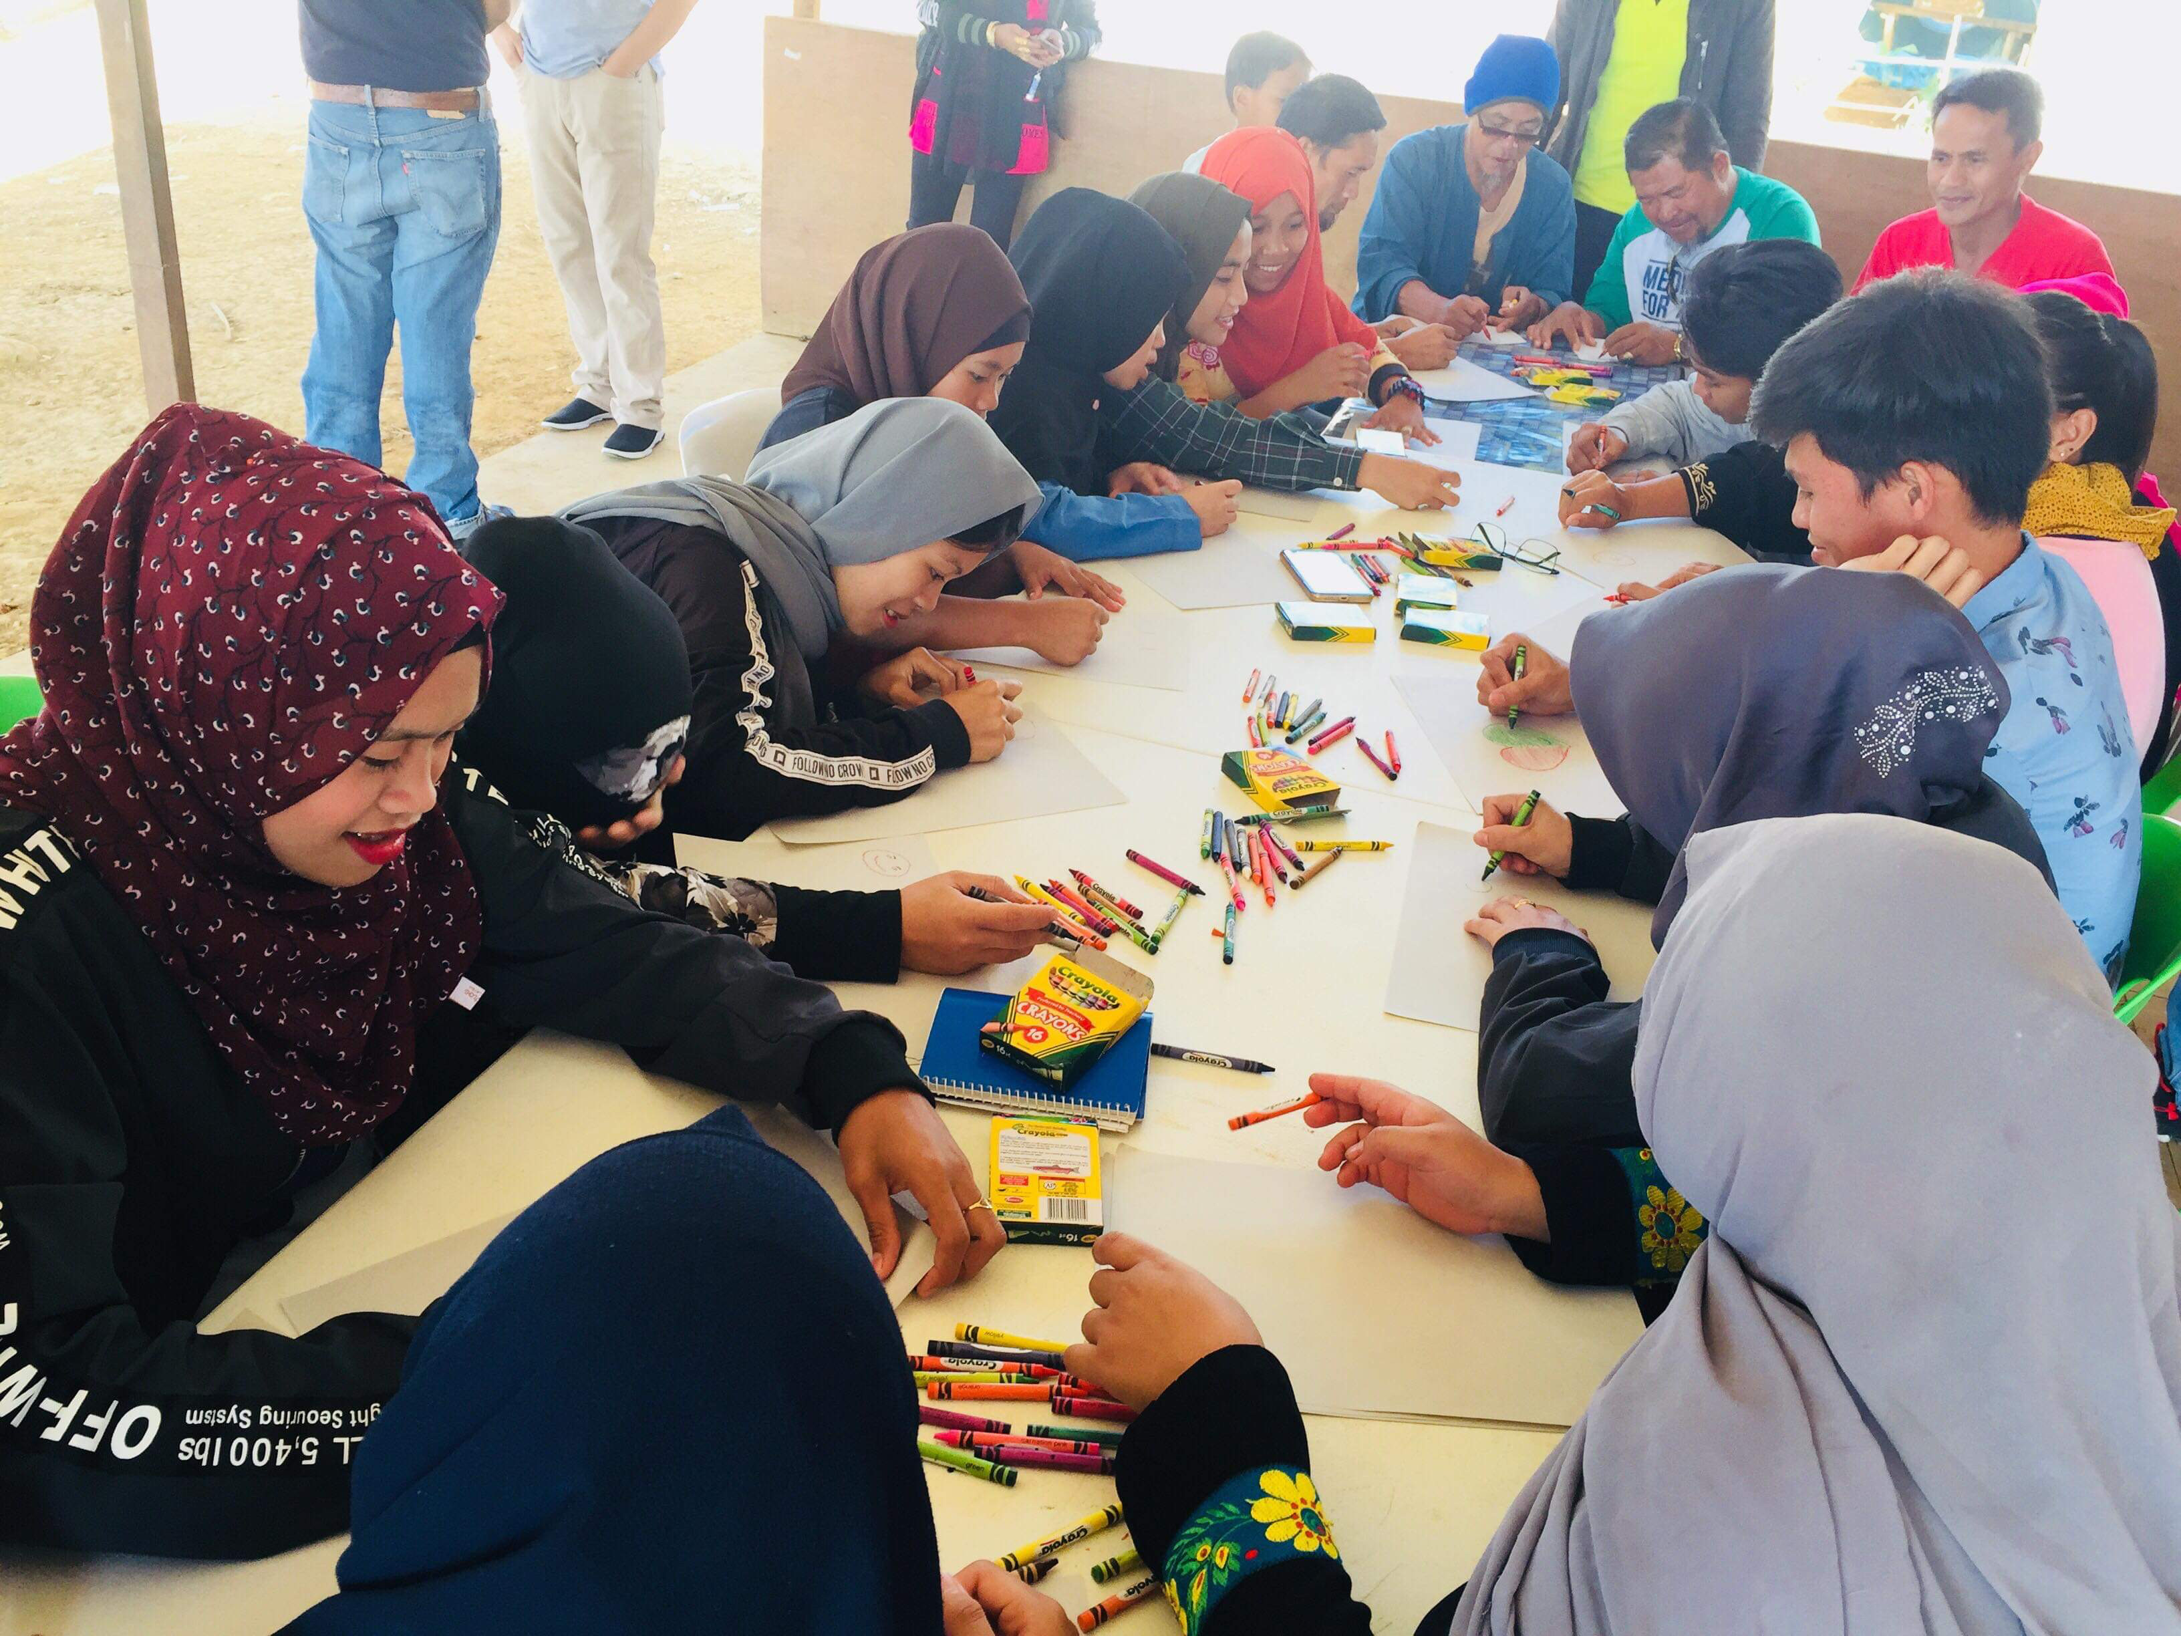
Mindanao

Slide 6
Nonviolence
UCP is nonviolent. It explicitly uses nonviolence as the underlying values, process and lens to explain how it works.
1
Nonviolent approaches are under-represented in security, protection and conflict management research.
2
By exploring the relationship with nonviolence theory we can present the transformative influence in both practice and theorical developments of protection, especially those in which community organising is used.
3

Slide 7
Reject violence, value people
“With one hand we say to one who is angry, or to an oppressor, or to an unjust system, “Stop what you are doing. I refuse to honor the role you are choosing to play. I refuse to obey you. I refuse to cooperate with your demands. I refuse to build the walls and the bombs. I refuse to pay for the guns. With this hand I will even interfere with the wrong you are doing. I want to disrupt the easy pattern of your life.’ But then the advocate of nonviolence raises the other hand. It is raised out-stretched – maybe with love and sympathy, maybe not – but always outstretched… With this hand we say, “I won’t let go of you or cast you out of the human race. I have faith that you can make a better choice than you are making now, and I’ll be here when you are ready. Like it or not, we are part of one another.”
Barbara Deming.
This helps us to understand some of the power of nonviolence in relation to violence. By framing the behaviour separately to the people who commit it, space is provided for individual behavioural change, and allows for the complexity that perpetrators of violence may also be victims of violence, and change is possible.

Slide 8
Witness
In nonviolence, by believing that people make choices about harming others,
that people are more than the violence they threaten to carry out,
and that armed actors can choose to change their behaviour UCP creates space for nonviolent solutions to emerge.
People, even armed actors, are deterred from carrying out morally unacceptable actions (like killing civilians) when they are being watched

Slide 9
Re-humanise, recognise humanity
Nonviolence calls on all actors in a conflict to recognise both the differences between them, and the shared unity we have with others.
When unarmed civilian peacekeepers bear witness to the activities of armed actors, they are challenging them to act in accordance with the nonviolent principle that we all human and have equal worth.

Slide 10
Using the rights means to achieve ends
Creating the space for peace and human rights work to flourish and grow is part of a nonviolent vision and response to violent conflict because, as Gandhi argued, means must be consistent with ends if you want to build long term peace.
As a consequence of modelling peaceful means to achieve peaceful ends, UCP offers an alternative to the ‘us and them’ thinking of violent conflict.
In nonviolence, to reduce ‘othering’ encourages thinking of ‘we’, as one of the small steps to overcoming divisions.

Slide 12
Conclusion
Through using participatory methods, and by listening to people when they explain what they do (and why) to protect other civilians we can see that…
Nonviolence is used in methods and practices
Nonviolence helps explain why unarmed civilian protection works
Nonviolence is necessary if we’re going to create the transformative long term peace.
Including nonviolence as a lens when we study violence is not counterintuitive…it helps us understand.

Slide 13
Thank you!
Rachel Julian
r.julian@leedsbeckett.ac.uk

Slide 14
References
R. Julian, and C. Schweitzer, “The Origins and Development of Unarmed Civilian Peacekeeping.” Peace Review. Vol. 27, Issue 1 (2015) pp 1- 8
Liam Mahony and Enrique Eguren Unarmed Bodyguards. International Accompaniment for the Protection of Human Rights. (West Hartford: Kumarian Press 1997
Michael Nagler, “Six Principles of Nonviolence”, Open Democracy (27th July 2017) available: https://www.opendemocracy.net/en/transformation/six-principles-of-nonviolence/ (accessed July 28th 2019) ;
B.Deming, On Revolution and Equilibrium (New York: Grossman Publishers, 1971);
CPT, “Gandhi’s Principles of Nonviolence”, available: <https://www.cpt.org/files/PW%20-%20Principles%20-%20Gandhi.pdf> (accessed on July 28th 2019)
R. Julian, B. Bliesemann de Guevara, and R. Redhead, (2019) “From Expert to Experiential Knowledge: Exploring the Inclusion of Local Experiences in Understanding Violence in Conflict.” Peacebuilding. Vol. 7. No.2 (2019) pp210-225.
G. Engelbrecht and V. Kaushik, “Community-based Protection Mechanisms”. Peace Review Vol 27. No.1 (2015) pp43-51
Data collected from current USIP funded research title: ‘Impact of civilians monitoring the Philippines Framework and Comprehensive agreements.’ 2019-2020. (Report forthcoming with United States Institute for Peace)

