Slide 2
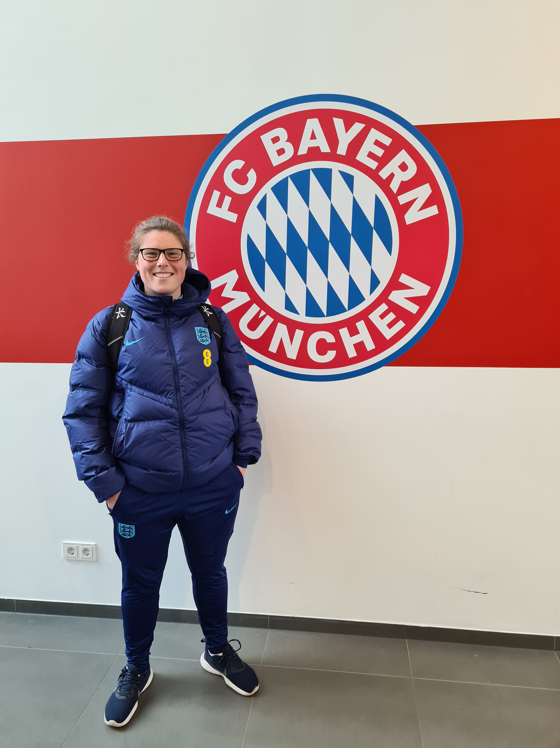
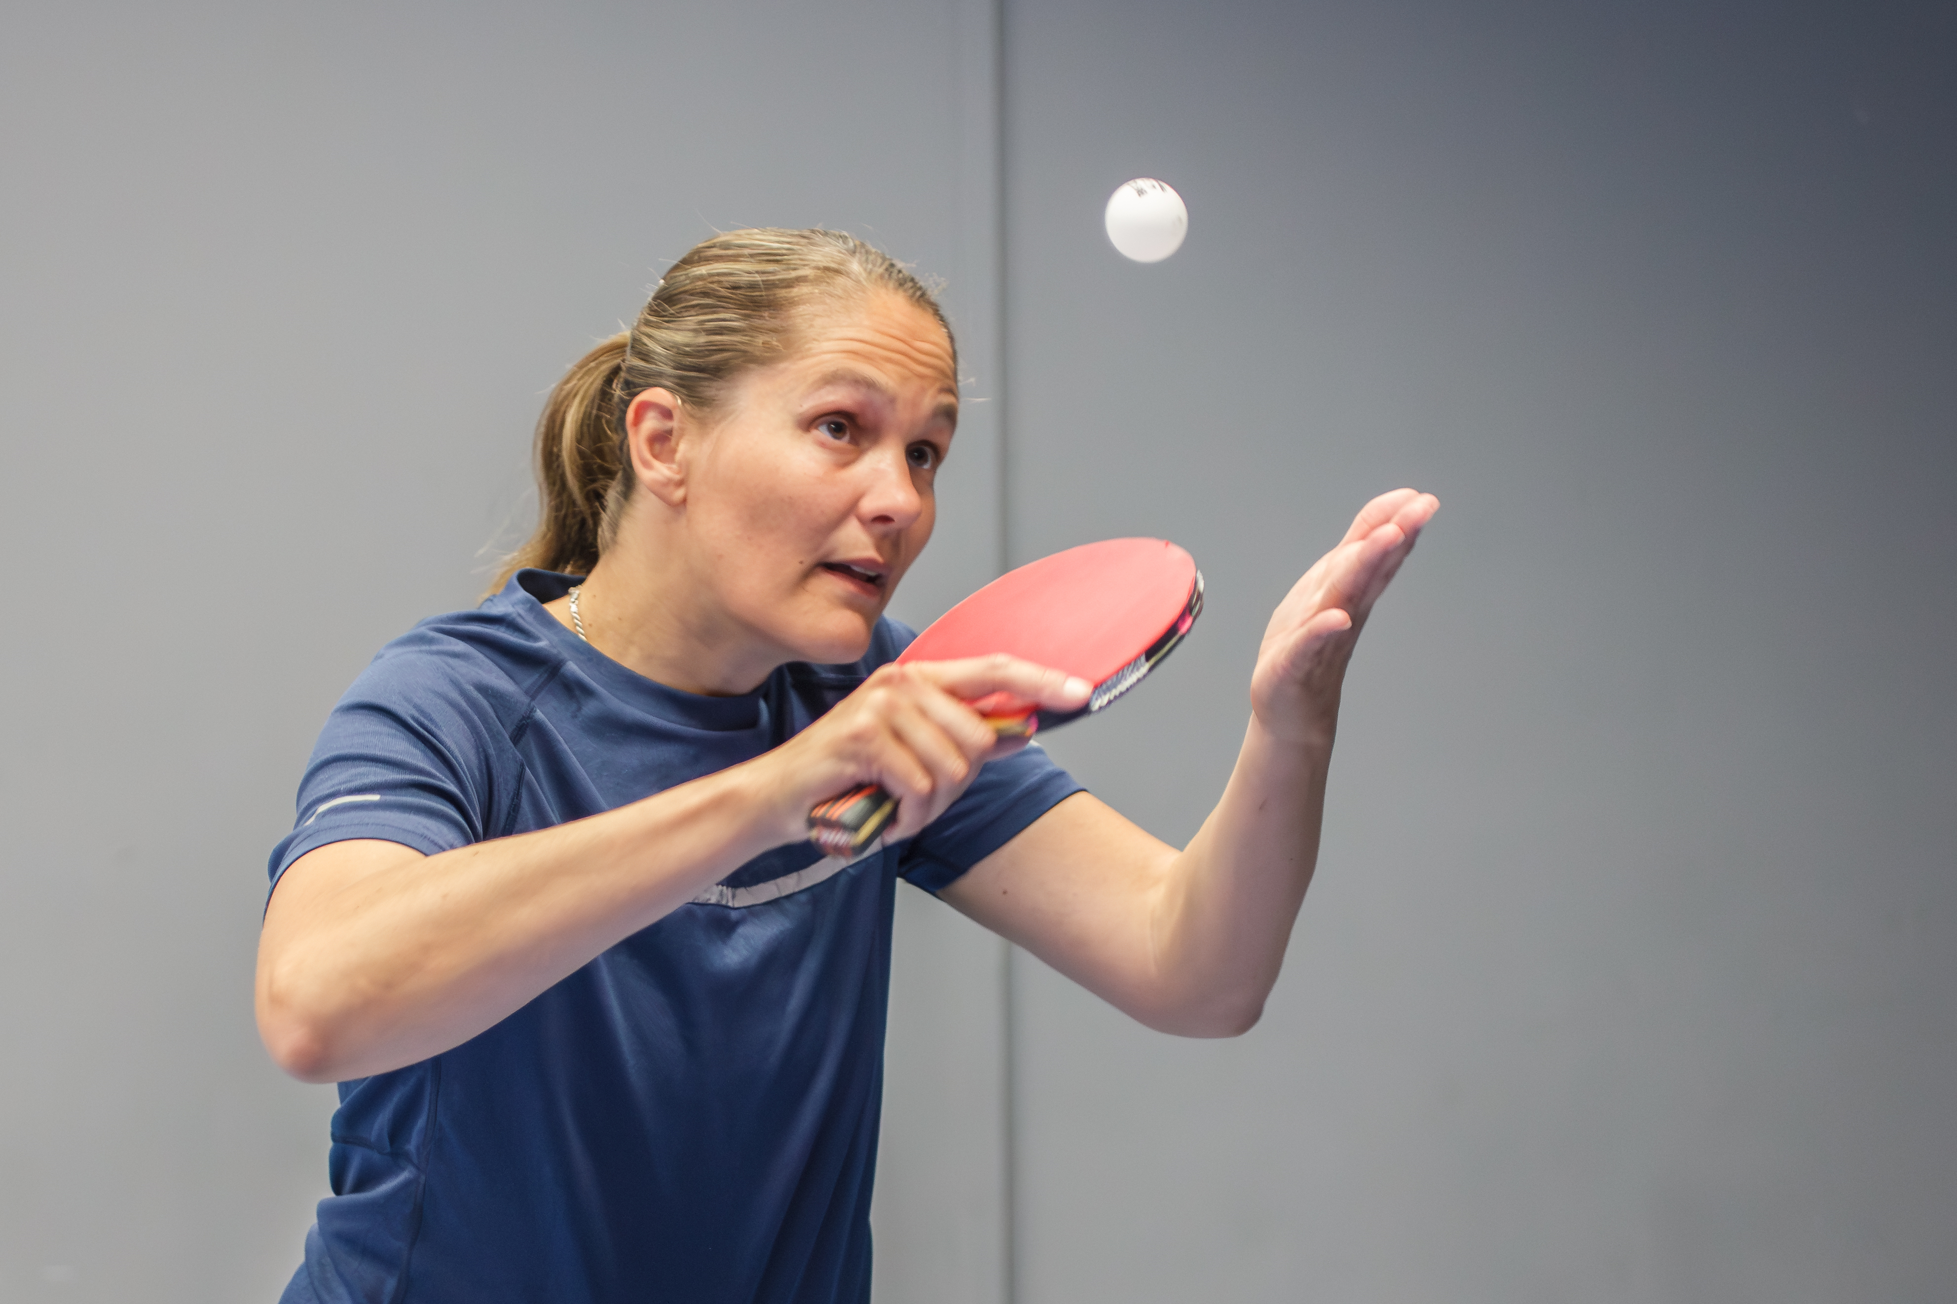
ICOACHGIRLS
Overview | First results and insights
Dr. Ruth Brazier
Leeds Beckett University
Dr. Irene Faber
Windesheim University of Applied Sciences

Slide 3

Project overview

Slide 4
Background
Women and girls face challenges to participate in sport and physical activity.
Girls are four times less likely than boys to engage in organized sport.
By not participating, girls are missing out in all the potential physical, mental, social and professional benefits of regular physical activity.
Importantly, early negative experiences of sport during the primary school years contribute to girls’ lower levels of activity.

Slide 5
Aims
ICOACHGIRLS (ICG) is an Erasmus+ funded project and has two key objectives:
To increase physical activity and sport participation among primary school age girls
To increase the number, competence and confidence of female coaches.

Slide 6
Physical Literacy
ICOACHGIRLS will aim to positively influence primary school age girls across these three domains and support them to become more physically active over the long term.

Slide 7
ICG Timeline
Evaluation Reports ICG Pilot Programme
Evaluation Reports Full ICG Programme
Pilot ICG Programme & Evaluation
Full ICG Programme
Coach Development Courses
Kick-off ICG Project
Practical Guides
2023
2024
2025

Slide 8
First results and insights
Three guides are designed to support the creation of the ICOACHGIRLS programs:
(Re)Introduce Girls in Sports and Physical Activity
Girls in Sport – Best Practice Guide
Women in Coaching – Removing Barriers to Start and Stay

Slide 9
The making of…
Systematic literature searches and grey literature sources/hand searches were conducted
Guide 1 included 10 reviews and 2 other studies.
Guide 2 included a scoping review of over 30 practical programmes and projects
Guide 3 included 20 articles with various study designs.

Slide 10
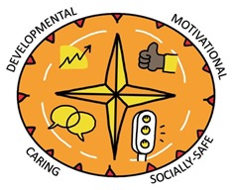
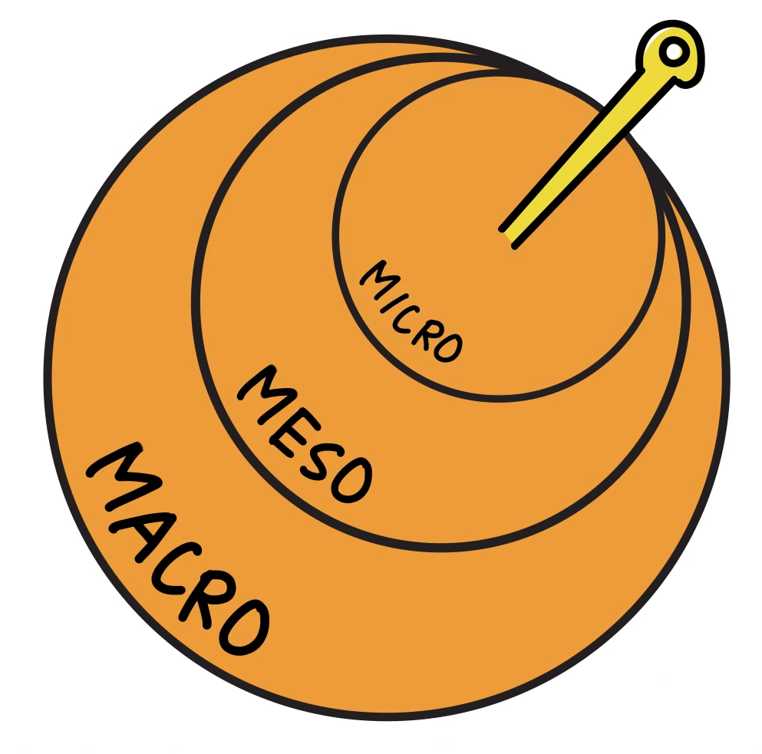
Theoretical framework
‘on the ground’
‘at the club’
policy-makers
The Youth Sport Compass

Slide 11
(Re)Introduce Girls in Sports and Physical Activity
DEVELOPMENT-ORIENTED
1. Focus on competence
2. Provide non-competitive activities
MOTIVATIONAL
3. Provide high support
4. Offer a variety of activities and variations
5. Use role-models
CARING
6. Promote friendships and social connections
7. Help coaches to understand girls’ needs
SOCIALLY SAFE
8. Create a positive, inclusive and welcoming environment
9. Provide girls only opportunities
10. Be aware of issues related to body image and act accordingly

Slide 12

1. Focus on competence
Physical competence is one of the key aspects of physical literacy (alongside knowledge and motivation). Girls that are more skilled and perceive themselves as (highly) competent are found to have higher levels of participation, experience sport and physical activities as fun/enjoyable, and are more likely to continue participating in sport or physical activities.
Thus, ICOACHGIRLS should focus on developing girls' fundamental movement skills to support their perceived competence. This should be backed up by encouragement and support from those around them, including coaches, peers and parents. Ideally, girls will feel competent across a range of movement and activity types.
Recommendations
MICRO LEVEL
Acknowledge that girls have different needs
Provide opportunities for learning
Develop girls’ fundamental movement skills/competence
Emphasize on development instead of performance/winning
Help girls to understand the value of sport and physical activity
MESO LEVEL
Educate coaches about motor learning and skill acquisition
Educate parents about the value of sport and physical activity
MACRO LEVEL
Promote physical literacy at local and national policy
The Youth Sport Compass

Slide 13
9. Provide girls only opportunities
Exercising together with boys, especially during childhood and adolescence, is a common barrier for girls to participate in sport and physical activity. Many girls feel insecure and are discouraged by the negative behavior of boys (e.g., teasing, taunting, and name calling).
Moreover, because boys tend to be encouraged to participate in sport more regularly, their competence is likely to be higher - thus girls may get sidelined and be excluded within mixed environments. However, highly competent girls have been shown enjoy playing with boys, stating it was more fun as boys provided higher levels of competition. The opposite is true for the less confident girls - as the demographic of ICOACHGIRLS is girls who are inactive, they are likely to fit into this latter category.
Thus, girls only opportunities in sports and physical activity is important within ICOACHGIRLS, to encourage more girls to start and stay in sports and physical activities.
Recommendations
MICRO LEVEL
Acknowledge that girls have specific needs
Create girls only opportunities
MESO LEVEL
Educate coaches about girls’ preferences and needs
Promote girls only opportunities
MACRO LEVEL
Promote girls only opportunities
The Youth Sport Compass

Slide 14
Girls in Sport – Best Practice Guide
1. This Girl Can TM
2. PowerPlay TM
3. Girls Active
4. UEFA Disney Playmakers TM
5. Her Time to Play TM
6. Coaching Her
7. Weetabix Wildcats TM
8. Dads and Daughter’s: Active and Empowered TM
9. Gaelic 4 Girls
10. Keep Up With the Girls
11. Adolescent Girls Get Active

Slide 15

UEFA Playmakers
“Playmakers brings together the latest research on the benefits of play-based learning and the magical power of Disney storytelling” (UEFA)
UEFA Playmakers aims to deliver a fun and safe introduction to football, for girls aged 5-8 years old. Sessions are hooked onto classic Disney tales, inspiring girls to move by putting them at the centre of their favourite characters and films, such as The Incredibles, Moana and Frozen:
In doing so, the centres focus on the MICRO and MESO level, and promise to develop:
Friendships
Health and Confidence
Life Skills
Movement Competence
A Love of Football
DEVELOPMENT-ORIENTED
Focus on competence – by focusing on fundamental movement skills (with and without a ball) and aiming to develop girls’ confidence and competence.
Provide non-competitive activities – although Playmakers is themed around football, the activities are entirely uncompetitive, instead focusing on co-operative play, individual improvement and fun.

Slide 16

Her Time to Play
Her Time to Play is a national initiative supported by the Women’s National Basketball Association (WNBA), which aims to:
“champion change on behalf of girls and women and provide them with ways to connect, collaborate, and actively engage with the game of basketball and one another.”
Her Time to Play focuses on the MESO level, in that they encourage organisations to develop their environment to be more girl-friendly. The Her Time to Play community offers access to:
Toolkits
Practice Plans
Support for Female Coaches
Support for Female Officials
CARING
Help coaches to understand girls’ needs – coaches are offered toolkits and practice plans to support their delivery for girls. These differentiate between new coaches and more experienced coaches, to support a range of coaches work with a range of girls.

Slide 17
Women in Coaching – Removing Barriers to Start and Stay
DEVELOPMENT-ORIENTED
Focus on empowering female coaches
Provide clear pathways for development
MOTIVATIONAL
Offer support and remove barriers
Use role-models
CARING
Support relationships and networks
Provide mentoring programs
Help administrators to understand female coaches’ needs
SOCIALLY SAFE
Create a positive and inclusive environment
Resist biases and stereotyping

Slide 18
3. Offer support and remove barriers
An overarching theme to get more female coaches involved and retain in sports revolves around appropriate support. Appropriate support from any social agent appears to facilitate a woman’s coaching career. Specifically, developing a sense of relatedness with coaching colleagues is positively received. Moreover, the encouragement from parents is important when starting out on a coaching journey - some coaches interpreted parental support as meaning that coaching was considered a ‘normal’ career for women.
Unfortunately, female coaches face multiple and interwoven barriers that make sustaining a career in coaching challenging. Together, these barriers account for the historic stagnation of the percentage of women coaches. Identifying unique barriers together and developing support for female coaches at different competitive levels, and for female coaches experiencing critical windows across the coaching career (e.g., entering coaching, burnout, getting married, having children, changing jobs from assistant to head coach, revealing their sexual orientation) is recommended to support and create better opportunities for female coaches.
Recommendations
MICRO LEVEL
Encourage women to coach
Provide positive feedback
Consult female coaches about their needs and preferences
Identify and remove barriers together
MESO LEVEL
Encourage and create a supportive environment for female coaches
Develop female friendly and family friendly policies
Identify and remove barriers together
MACRO LEVEL
Create awareness-raising programs that help administrators be more supportive of female coaches’ issues.
Use role-models for administrators to support female coaches
The Youth Sport Compass

Slide 19
6. Provide mentoring programs
Mentoring programs can be a strong tool to develop and empower all coaches, but research suggests this is particularly important for female coaches. Mentoring sessions can play a significant role in their feelings of belonging and support in the field of coaching. Mentorship is important for helping and developing female leaders, building relationships to resist loneliness, and nurturing resilience through community.
Although both woman and men can act as mentors, mentoring programs run by female role models are recommended since it seems that female coaches who are coached by a woman are more likely to persist in the coaching profession, especially in their early coaching careers.
Recommendations
MICRO LEVEL
Acknowledge that female coaches have specific needs
Provide mentoring programs for female coaches
MESO LEVEL
Educate mentors coaches about female coaches’ preferences and needs
Emphasize on the recruitment of female mentors
MACRO LEVEL
Develop and promote mentoring programs
The Youth Sport Compass

Slide 20
Other considerations…
Multicomponent strategy
Tailor-made approaches
Merchandising as helpful start
A change in culture

Slide 21
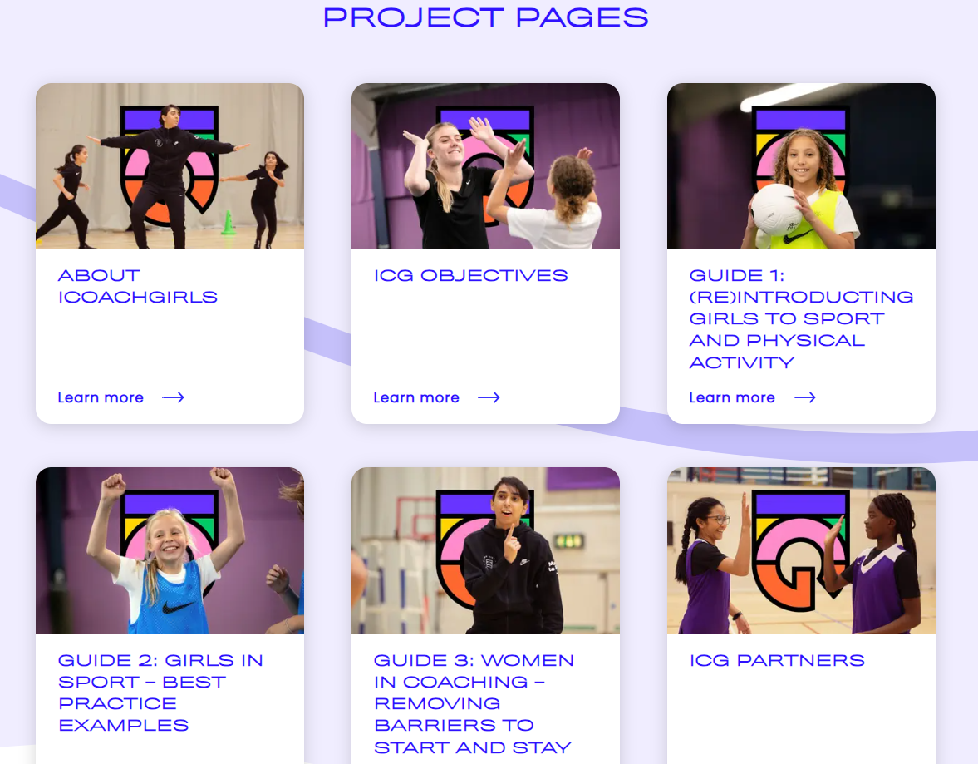

Please visit the dedicated ICOACHGIRLS section on the ICOACHKIDS website for more information and full copies of the guides.
Or email Ruth Brazier:
r.brazier@leedsbeckett.ac.uk

