Slide 1
Identifying Variability In Multidimensional Health Related Characteristics Across Adolescence.
Alan Burton (PhD Candidate at LBU and S&C coach at Queen Ethelburga’s Collegiate)
Prof. Joey Eisenmann (Lakeland University, Plymouth, Wisconsin, USA)
Dr. Ian Cowburn (Leeds Beckett University)
Prof. Kevin Till (Leeds Beckett University)
AB__Coaching

Slide 2
(Historical) global Concerns…
16/06/23 / Alan Burton / LTAD in schools conference 2023
Physical Activity
Motor competence
Fitness
Is our FOCUS appropriate for Children & Adolescents?
Weight Status
Lloyd RS, Oliver JL, Faigenbaum AD, et al. (2015) Long-term athletic development, part 2: Barriers to success and potential solutions. J Strength Cond Res, 29: 1451–1464.
Ogden CL, Carroll MD, Lawman HG, et al. (2016) Trends in obesity prevalence among children and adolescents in the United States, 1988-1994 through 2013-2014. JAMA, 315(21):2292-9.
Sandercock GR, Cohen DD. (2019) Temporal trends in muscular ﬁtness of English 10 year-olds 1998–2014: An allometric approach. J Sci Med Sport, 22: 201–205.
Tremblay MS, Barnes JD, et al. (2016) Global Matrix 2.0: Report card grades on the physical activity of children and youth comparing 38 countries. J Phys Activity Health, 13: S343–S366.
Notes:
There are (historical) global concerns… which bodes the question: is our FOCUS appropriate for children and adolescents?

Slide 3
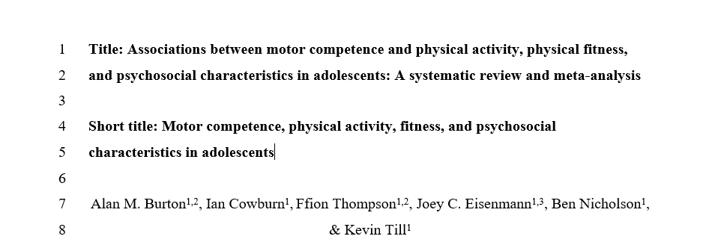
16/06/23 / Alan Burton / LTAD in schools conference 2023
Notes:
Through a recent review conducted by my research team and I, we identified that most of the current evidence assessing health related characteristics (motor competence, PF, PS, PA) of youth is on children…

Slide 4
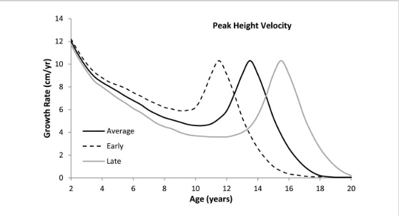
16/06/23 / Alan Burton / LTAD in schools conference 2023
The role of biological maturation
Lloyd et al. (2014) J Strength Cond Res, 28(5): 1454–1464 (adapted from Stratton and Oliver 2013)
Notes:
…even though we know that adolescence present this challenging period of highly variable biological and psychosocial development centered around the adolescent growth spurt (otherwise known as peak height velocity)…

Slide 5
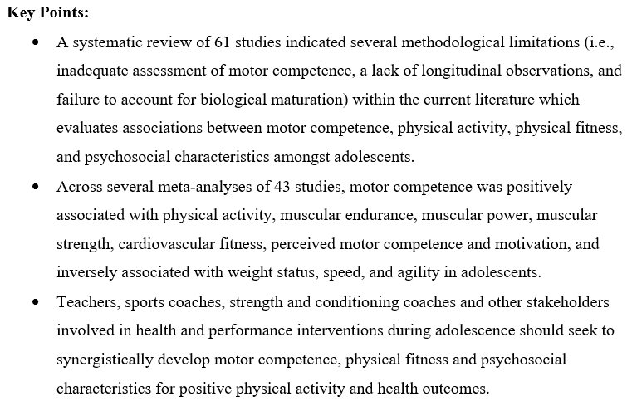
16/06/23 / Alan Burton / LTAD in schools conference 2023
Notes:
We highlighted this within our review, and also identified that previous studies that have evaluated MC, PA, PF, PS characteristics during adolescence inadequately assessed motor competence (by looking at technique or outcome of motor skills, not in combination), few studies that have looked at multidimensional assessment, and numerous studies not account for the effect of biological maturation in their analyses.

Slide 6
16/06/23 / Alan Burton / LTAD in schools conference 2023
To multidimensionally assess health related characteristics across adolescence while accounting for age, maturity, and sex.
Notes:
Aim was to To multidimensionally health related characteristics across adolescence while accounting for age, maturity, and sex.

Slide 7
16/06/23 / Alan Burton / LTAD in schools conference 2023
Notes:
Recruited and collect data for 136 males and 82 females
Across multiple year groups (years 5-9)
And can therefore show variability across all stages of maturity for males and females.

Slide 8
16/06/23 / Alan Burton / LTAD in schools conference 2023
Motor competence
Psychosocial
Dragon Challenge
BREQ-2;
Physical Self-Perception Profile
Multi - Dimensional Assessment
Physical fitness
Physical activity
IMTP;
CMJ;
10m Sprint;
505 agility;
MSFT
Adolescent Physical Activity Recall Questionnaire
Notes:
METHODS – We recruited a state school and feeding primary school, and conducted a cross-sectional case study assessment across four domains…

Slide 9
16/06/23 / Alan Burton / LTAD in schools conference 2023
Example Scatterplot
Notes:
- Although quite a lot of variance in scores.

Slide 10
16/06/23 / Alan Burton / LTAD in schools conference 2023
Motor Competence
There is high variability in process, product and combined Motor competence scores for males and females across stages of maturity.
Notes:
- Although quite a lot of variance in scores.

Slide 11
16/06/23 / Alan Burton / LTAD in schools conference 2023
Process Motor Competence Score
Notes:
This is apparent because technique and outcome of motor competence scores fall slightly during circa-PHV.

Slide 12
16/06/23 / Alan Burton / LTAD in schools conference 2023
Product Motor Competence Score
Notes:
This is apparent because technique and outcome of motor competence scores fall slightly during circa-PHV.

Slide 13
16/06/23 / Alan Burton / LTAD in schools conference 2023
Combined Motor Competence Score

Slide 14
16/06/23 / Alan Burton / LTAD in schools conference 2023
Motor Competence
There is high variability in process, product and combined Motor competence scores for males and females across stages of maturity.
Majority of males (57%) and females (75%) scored lower than the Dragon Challenge “gold” benchmark score.
Notes:
- Although quite a lot of variance in scores.

Slide 15
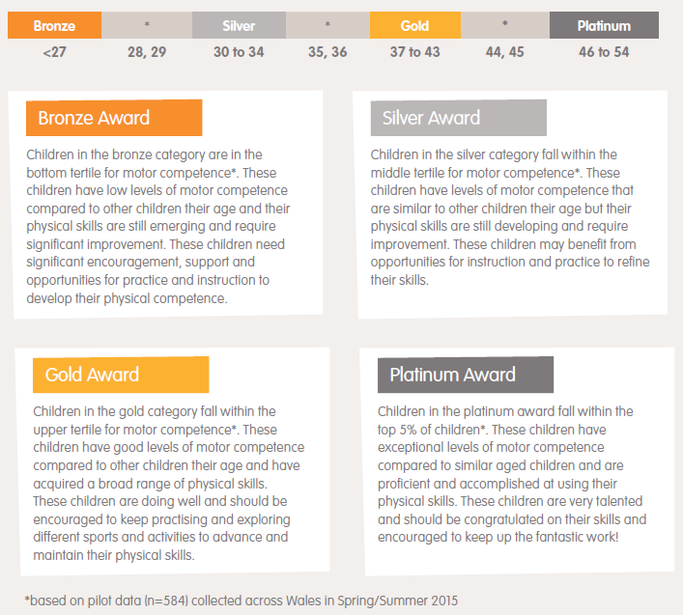
16/06/23 / Alan Burton / LTAD in schools conference 2023
Comparison to benchmark data
Notes:
This means that (for most) in every year group, there is some degree of teaching required on motor skills…

Slide 16
16/06/23 / Alan Burton / LTAD in schools conference 2023
Physical fitness
The variability in absolute strength scores across stages of maturity are likely due to biological maturation… Relative strength is lowest post-PHV.
Notes:
- Although quite a lot of variance in scores.

Slide 17
16/06/23 / Alan Burton / LTAD in schools conference 2023
ISOMETRIC MID-THIGH PULL SCORES
LEAN MASS

Slide 18
16/06/23 / Alan Burton / LTAD in schools conference 2023
Relative strength scores

Slide 19
16/06/23 / Alan Burton / LTAD in schools conference 2023
Physical fitness
The variability in absolute strength scores across stages of maturity are likely due to biological maturation… Relative strength is lowest post-PHV.
Cardiovascular fitness is similar for males and females across stages of maturity, with numerous adolescents covering low distances compared to normative data.
Notes:
- Although quite a lot of variance in scores.

Slide 20
16/06/23 / Alan Burton / LTAD in schools conference 2023
Distance covered in the MSFT

Slide 21
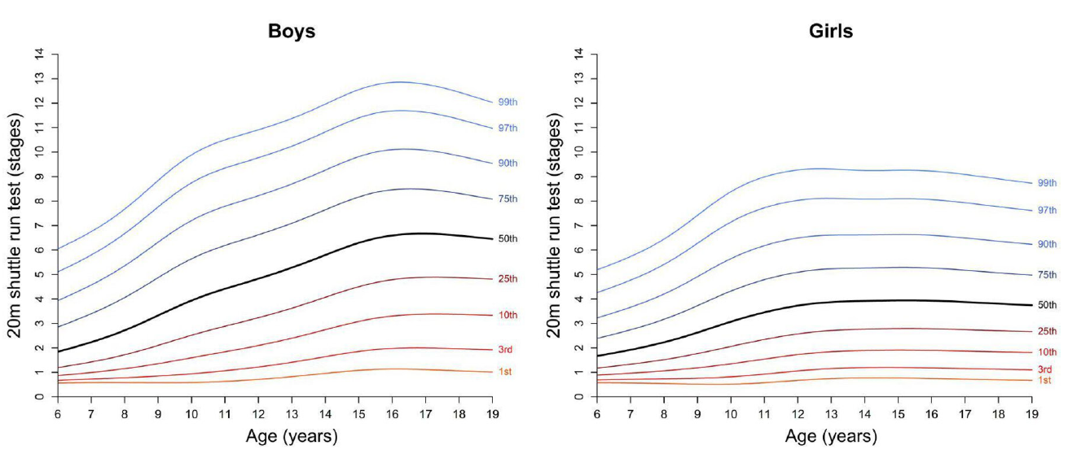
16/06/23 / Alan Burton / LTAD in schools conference 2023
MSFT percentile curves for European children / adolescents
Ortega FB, et al. (2023) Br J Sports Med, 57: 299–310.
Notes:
750m is the lower end of level 5 for males and level 4 females.

Slide 22
16/06/23 / Alan Burton / LTAD in schools conference 2023
Psychosocial
There is large variability in adolescents enjoyment and understanding of importance of physical activity.
Notes:
- Although quite a lot of variance in scores.

Slide 23
16/06/23 / Alan Burton / LTAD in schools conference 2023
INTRINSIC REGULATION SCORES
IDENTIFIED REGULATION SCORES
Notes:
A lot of males and females not intrinsically motivated (lack enjoyment and fun)… how do we shift these up?
A lot of individuals who don’t see the importance of exercise…

Slide 24
16/06/23 / Alan Burton / LTAD in schools conference 2023
Psychosocial
There is large variability in adolescents enjoyment and understanding of importance of physical activity.
Females perceptions of motor competence and strength are lowest post-PHV, while males remains consistent across stages of maturity.
Notes:
- Although quite a lot of variance in scores.

Slide 25
16/06/23 / Alan Burton / LTAD in schools conference 2023
PERCEIVED MOTOR COMPETENCE
PERCEIVED PHYSICAL STRENGTH
Notes:
Males and females perceptions of strength appear similar to their actual relative strength…

Slide 26
16/06/23 / Alan Burton / LTAD in schools conference 2023
Physical activity
Moderate-vigorous physical activity appears lower in females than males across stages of maturity… likely due to females spending less time doing vigorous activities.
Notes:
- Although quite a lot of variance in scores.

Slide 27
16/06/23 / Alan Burton / LTAD in schools conference 2023
Moderate-vigorous physical activity

Slide 28
16/06/23 / Alan Burton / LTAD in schools conference 2023
MODERATE PHYSICAL ACTIVITY
VIGOROUS PHYSICAL ACTIVITY

Slide 29
16/06/23 / Alan Burton / LTAD in schools conference 2023
To summarise, we have a problem…
There is high variability across multi-dimensional health related characteristics during adolescence…

Slide 30
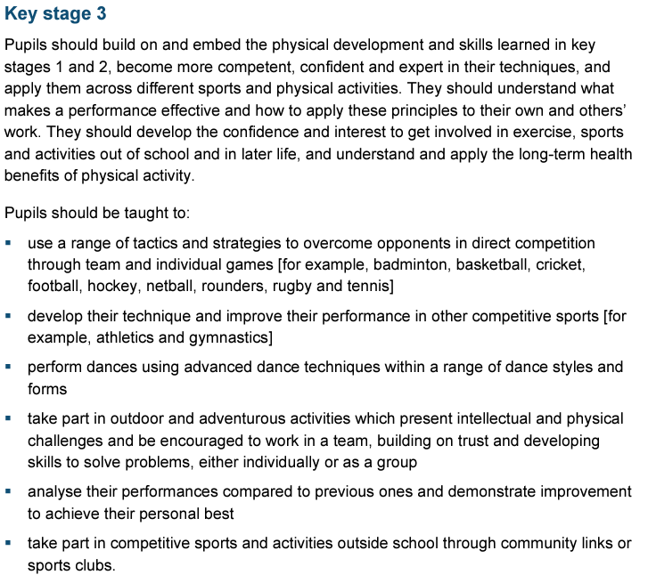
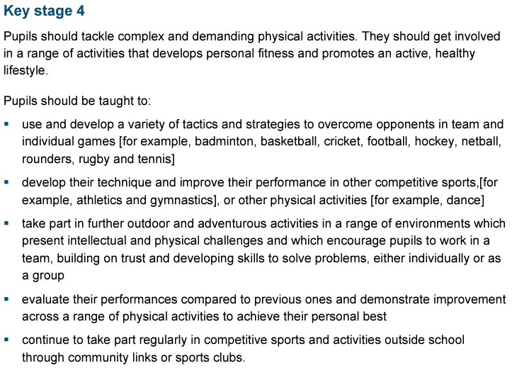
16/06/23 / Alan Burton / LTAD in schools conference 2023
Is our FOCUS appropriate?
Notes:
Ultimately this leads us back to the question “Is our focus appropriate?”… For most schools, the national curriculum is the focus, and in this case study, a one size fits all approach is not going to work to reverse negative health outcomes (due to high variability).

Slide 31
THANK YOU.
AB__Coaching
alanburton1996
A.M.Burton@leedsbeckett.ac.uk
Notes:
It would be great to continue this discussion further. If you’re interested in motor competence, physical fitness and psychosocial assessment come and grab me in between sessions throughout the rest of the day, or get in touch. Thank you!
Thanks for listening.

