Slide 1
Barriers for Women in SMEs Cutting Across Borders: A Systematic Literature Review on the Position of Women in SMEs (2000-2021)
Martina Topić, Anastasia Konstantopoulou, Teela Clayton, Mary Leung, Emma Heron, Karen Vollum-Dix, Christine Carbery, Joy Ogbemudia, Martel Reynolds & Tanbeen Mahtab Leeds Beckett University & Edge Hill University, UK
M.Topic@leedsbeckett.ac.uk / martinahr@gmail.com

Slide 2
We already know that:
Women suffer from discrimination such as the pay gap and glass ceiling, difficulties in obtaining leadership positions (Tabassum et al, 2019, Larkin et al, 2013, Aldoory, 1998, Dubrowski et al, 2019, Place and Varderman Winter, 2013, Tench et al, 2017, Christopher, 2008, de la Rey, 2005, van der Boon, 2003, Growe and Montgomery, 2000, Crawford, 1995, Stanford et al, 1995, Alimo Metcalfe, 1995)
Stereotyping and bias (Mihail, 2006, Weyer, 2007, Topić et al, 2020a, Topić, 2020)
Difficulties in navigating organisational culture often centred on masculinity (Alvesson, 1998, 2013, Bourdieu, 2007).
Organisational studies: masculine practice; gendered organisations;
“…there was never a question that women would be able to move up the company ladder in the way men could, since it remained unfathomable for male executives to place women alongside them in managerial jobs (…) Men were allowed to think of themselves as middle-class so long as women, from their perspective, remained something like the office proletariat, took office jobs to help their families until they married” (Saval, 2015, p. 77-78).
Notes:
), studies in human resource management (HRM) also called for building resilience for women to enable coping with stress and break the glass ceiling. Resilience is a management concept used to manage stress and cope with difficult situations (Tabassum et al, 2019) and embracing this practice also means building an ability to bounce back from hindrances whilst staying efficient and growing despite facing difficult situations or hostility (Cooper et al, 2013). Tabassum, Shafique, Konstantopoulou and Ahmad (2019) argued that resilience is also an ability of an individual to learn from negative experiences and turn them into meaningful actions to move forward, which also means maintaining control and breaking the glass ceiling. In that, authors proposed that managers should offer coaching, mentoring, career counselling, resilience training, role models and building networks to empower women and help them go ahead in their careers and earn promotions.

Slide 3
What we need to learn:
The main research questions for this study were:
• Has the position of women in SMEs been of interest in research?
• What is the role of women working in SMEs?
• Is scholarship on women in SMEs locally specific to certain areas of the world or is it international? If international, are there cultural differences between regions respective of the role of women in SMEs?
SMEs: a large focus of economic policies, investment and development. What is the position of women? Can SMEs advance or reduce already existent gains in women’s rights?

Slide 4
Method
Identified women and gender studies journals for the analysis using the Scimago list of journals (women and gender journals + business and management journals)
Used keywords ‘women’ and ‘SME’
The search was performed between March and May 2021; again in March 2022
Above selection criteria were used to select articles that directly discuss women in SMEs, which included women entrepreneurs.
DECADE | NUMBER OF ARTICLES
2000-2009 | 21
2010-2021 | 89
Total | 110
Notes:
Therefore, this systematic literature review of available literature on women in SMEs is timely, exploring what is already known, identifying possible research gaps and whether the current literature signals a particularly difficult situation for women in SMEs.
In searching for articles, we used keywords ‘women’ and ‘SME’ and the search was performed between March and May 2021. The selection criteria used was to select articles that directly discuss women in SMEs, which included women entrepreneurs. Following these criteria, a total of 106 articles was included in the analysis
Thematic analysis was carried out on each of the two analysed decades and then a final thematic analysis was conducted on both decades combined.

Slide 5
Method
A thematic analysis
“…a systematic approach to the analysis of qualitative data that involves identifying themes or patterns of cultural meaning; coding and classifying data, usually textual, according to themes; and interpreting the resulting thematic structures by seeking commonalities, relationships, overarching patterns, theoretical constructs, or explanatory principles” (Lapadat 2010, p. 926).
Coding by Strauss and Corbin (2002):
(key findings, highlights of the article, theories used, abstracts, keywords and locations of research)
2000-2009
2010-2021
2000-2021
Open coding (identifying themes from each article); Axial coding (contextualising data); Selective coding (most relevant themes across decades and the whole dataset)
Notes:
Therefore, this systematic literature review of available literature on women in SMEs is timely, exploring what is already known, identifying possible research gaps and whether the current literature signals a particularly difficult situation for women in SMEs.
In searching for articles, we used keywords ‘women’ and ‘SME’ and the search was performed between March and May 2021. The selection criteria used was to select articles that directly discuss women in SMEs, which included women entrepreneurs. Following these criteria, a total of 106 articles was included in the analysis
Thematic analysis was carried out on each of the two analysed decades and then a final thematic analysis was conducted on both decades combined.

Slide 6
Findings
JOURNAL | NUMBER OF PUBLISHED ARTICLES
International Journal of Gender and Entrepreneurship | 70
Gender in Management (Women in Management Review) | 34
Feminist Economics | 3
Gender, Work & Organization | 2
Women’s Studies International Forum | 1
European Journal of Women’s Studies | 0
Feminist Review | 0
Feminist Theory | 0
Gender & Society | 0
Journal of Gender Studies | 0
Frontiers: A Journal of Women Studies | 0
Signs | 0
Women Studies Quarterly | 0
Feminist Studies | 0
Hypatia | 0
Total | 110

Slide 7
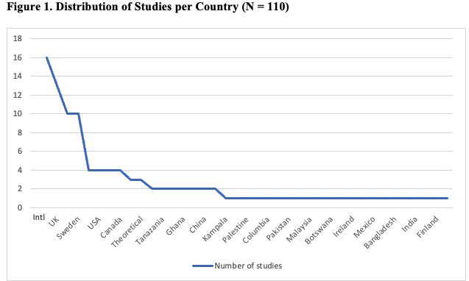
Findings
Whilst the number of countries conducting these studies is high and very diverse, the number of studies per most of the countries remains low, which signals already emphasised interest but also the underdevelopment of this field of research.

Slide 8
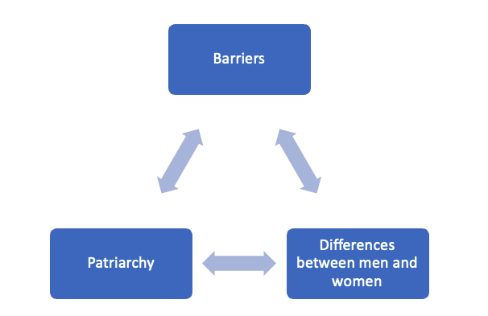
Findings (2000-2009)
Women business owners as a focus
Pressure from family (social roles); gendered work divide in co-owned businesses
Ways of doing jobs & confidence; transformational leadership styles; green business

Slide 9
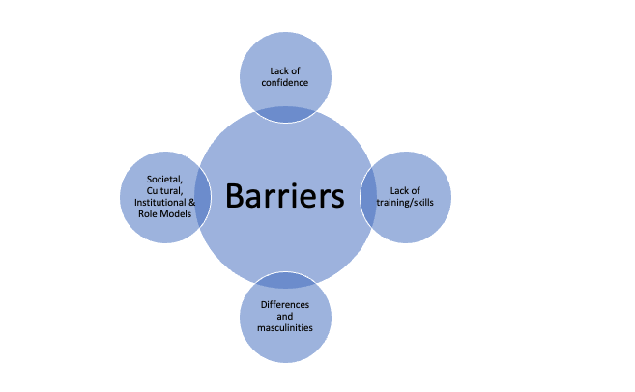
Findings (2010-2021)
Family commitments; social expectations on behaviour (cultural norms); institutional barriers
What should training constitute? Training to increase business success, self-esteem or a victim blame?
Personal characteristics as relevant for success
Different business goals

Slide 10
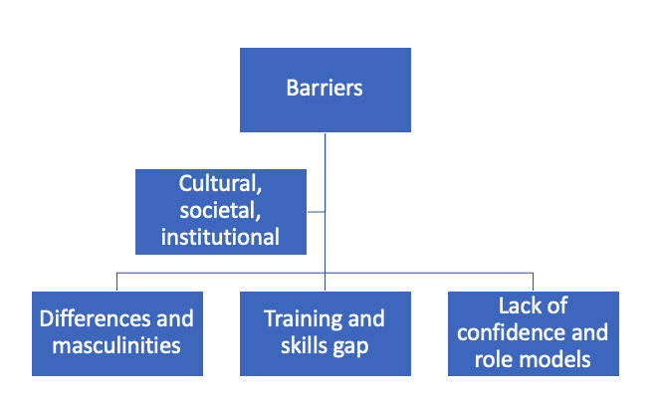
Overall Findings (2000-2021)

Slide 11
What next?
Majority of studies in the existing literature focus on women entrepreneurs and women business owners
A limited number of studies that analyse organisational culture in SMEs
How do women lead SMEs, their leadership styles, and do they present role models for other staff members? Role models appeared in the second analysed period, but this research is far from developed or conclusive even though it is relevant because, if women face barriers and masculinities, the question automatically emerged, on what kind of women role models they have, if any. Also, for women employees, what is their position in SMEs and is SME culture different, either for better or worse, than organisational culture in corporations? How do they see management and leaders respective of diverse genders in leadership positions in SMEs? What about masculinity in SMEs as organisations?

Slide 12
Any questions?

