Slide 1
Apple Watch Project
Curriculum Co-creation Report

Slide 2
EXECUTIVE SUMMARY?
3-phase project design
Having the watch
Using the watch
Using the watch in PE
Conclusions
Recommendations
Notes:
These are the three activities we ran with the girls.
They will be discussed alongside the Physical Literacy principles to help frame how they can relate to development and experiences within PE.
Important to note that although the sessions were audio recorded this analysis stems purely from the written documents collected from the girls.

Slide 3
PROJECT TIMELINE OVERVIEW

Slide 4
Pre-receiving Apple watch
Surveys
1
Post-receiving Apple watch
Co-design groups
Surveys
2
Post-intervention
Focus groups
Surveys
Teacher interview
3
3 PHASE PROJECT TIMELINE
Notes:
Set up, these next slides are what we found post intervention.
Quantitative surveys were body satisfaction, PE enjoyment, global self-worth, athletic self-worth

Slide 5
PHASE 1- ‘HAVING A WATCH’
Twenty-five females, aged 13-14 years, from an Apple Distinguished, rural, relatively affluent School in North Yorkshire completed three sets of scales:
Self-perceptions
Body satisfaction
Physical Activity Enjoyment

Slide 6
SELF-PERCEPTIONS
 | Really true for me | Sort of true for me |  |  |  | Really true for me | Sort of true for me
1. |  |  | Some teenagers are often disappointed with themselves | BUT | Other teenagers are often pleased with themselves
2. |  |  | Some teenagers don’t like the way they are leading their life | BUT | Other teenagers do like the way they are leading their life.
3. |  |  | Some teenagers are happy with themselves most of the time | BUT | Other teenagers are often not happy with themselves.
4. |  |  | Some teenagers like the kind of person they are | BUT | Other teenagers often wish they were someone else.
5. |  |  | Some teenagers are very happy being the way they are | BUT | Other teenagers often wish they were different.
6. |  |  | Some teenagers do very well at all kinds of sports | BUT | Other teenagers don’t feel that they are very good when it comes to sports.
7. |  |  | Some teenagers think they could do well at just about any new athletic activity | BUT | Other teenagers are afraid they might not do well at a new athletic activity.
 | Really true for me | Sort of true for me |  |  |  | Really true for me | Sort of true for me
8. |  |  | Some teenagers feel that they are better than others their age at sports | BUT | Other teenagers don’t feel they can play as well.
9. |  |  | Some teenagers don’t do well at new outdoor games | BUT | Other teenagers are good at new games right away.
10. |  |  | Some teenagers do not feel that they are very athletic | BUT | Other teenagers feel that they are very athletic.

Slide 7
BODY SATISFACTION
Which figure is most like you now? Which figure would you most like to be?
1 2 3 4 5 6 7 8 9

Slide 8
PHYSICAL ACTIVITY ENJOYMENT
 | When I am active… | Strongly Disagree | Disagree | Neutral | Agree | Strongly disagree
1. | I enjoy it
2. | I feel bored
3. | I dislike it
4. | I find it pleasurable
5. | It’s no fun at all
6. | It gives me energy
7. | It makes me depressed
8. | It’s very pleasant
9. | My body feels good
10. | I get something out of it
11. | Its very exciting
12. | It frustrates me
13. | It’s not interesting
14. | It gives me a strong feeling of success
15. | It feels good
16. | I feel as though I would rather be doing something else

Slide 9
‘HAVING A WATCH’ RESULTS
Insert results here demonstrating any changes between girls not having and having the watch- Baseline to pre-intervention results

Slide 10
PHASE 2- ‘USING THE WATCH’
A ‘most used watch feature’ task
Planning an Athletics PE lesson with the watch on a template
Planning a PE lesson without any structure
Focus groups audio recorded and analysed using content analysis

Slide 11
MOST USED WATCH FEATURES
>90%
75-89%
50-74%
<25%
Workout**
Alarm/Clock**
Sleep
Messaging/Phone
Activity
Heart Rate
Calculator
Music
Music
Games
Mindfulness
* Downloadable app
** 100% rating
Notes:
We asked the girls in their groups to list the top 10 features of the watch that they were currently using.
We asked them to rank them from 1-10 with 10 being the best, however some girls did not follow that ranking system. Due to this we decided to list the best features and work out the percentage of groups that listed that feature. The higher the percentage, the more important that feature was deemed to be.
Note:
Workout and Alarm/clock were both 100%
Equilab is a downloadable app that they use to track their horse riding
Movement features tend to rate the highest alongside functional apps that can be used across lessons and outside of school such as the calculator and music.
When discussing the workout and fitness/activity apps they tend to focus more on specific features i.e. how many steps did they take, what did their heart rate do at different points, how many calories did they exert etc.

Slide 12
MOST USED WATCH FEATURES-
TEACHER
“I never realized you could do walk-in-talkie with it and I’ve never used the sleep function, which I’ve used. The girls were teaching me a lot more, how to use the rings; they’ve just on it, they knew things straight away and they were keen to show me what they’d learnt. There’s lots of different apps that they’re using that i don’t use, such as the equestrian apps, which track what they’re doing on a horse. I want a newer, better one now!”.
Notes:
We asked the girls in their groups to list the top 10 features of the watch that they were currently using.
We asked them to rank them from 1-10 with 10 being the best, however some girls did not follow that ranking system. Due to this we decided to list the best features and work out the percentage of groups that listed that feature. The higher the percentage, the more important that feature was deemed to be.
Note:
Workout and Alarm/clock were both 100%
Equilab is a downloadable app that they use to track their horse riding
Movement features tend to rate the highest alongside functional apps that can be used across lessons and outside of school such as the calculator and music.
When discussing the workout and fitness/activity apps they tend to focus more on specific features i.e. how many steps did they take, what did their heart rate do at different points, how many calories did they exert etc.

Slide 13
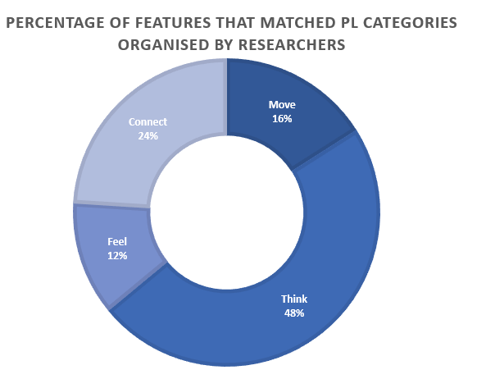
APPLE WATCH FEATURES
& PHYSICAL LITERACY
Think | Move | Connect | Feel
Alarm/Clock Heart Rate Calculator Games Siri Calendar Timer Stopwatch Noise Reminders Torch Weather | Workout Activity Equilab Water Lock | Messaging/ phone Walkie Talkie Find My Personalise Apple Pay Maps | Sleep Music Mindfulness
Notes:
We asked the girls in their groups to associate the best watch features identified with the 4 physical literacy principles. Within the written documents collected there was not enough data to accurately portray how the girls thought the features worked with physical literacy, however the audio recording have captured some in depth conversations that have portrayed this.
DM, TVR, AB then organised the 25 identified features of the watch into the dominant PL categories. Important to note that there is cross over but dominant was chosen by researchers.
Think proved to be the most important as the girls used them an an information source to help them in school or make informed decisions.
Connect was next, both with the watch and with themselves.
Move did not have many fit into however they are the apps that were said to be best in the previous slide.
Some of them we discussed not being features or necessary applicable such as apple pay and siri but they allow the girls to go out with friends get home safe, get information and connecting with watch and peers is assisted through these features. i.e. may not go out for walk if they don’t have some of these features.

Slide 14
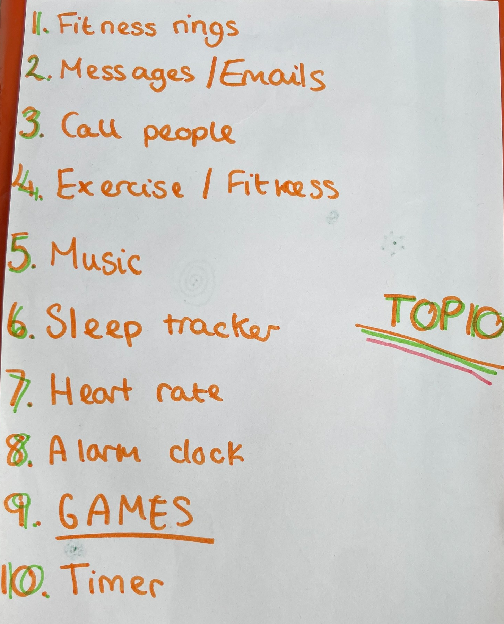
EXAMPLES OF GIRLS RATING OF
WATCH FEATURES
Notes:
Photos of girls sheets during the ranking task

Slide 15
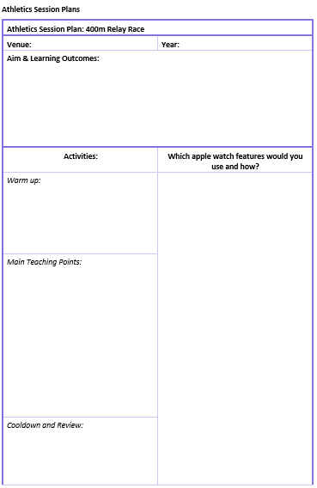
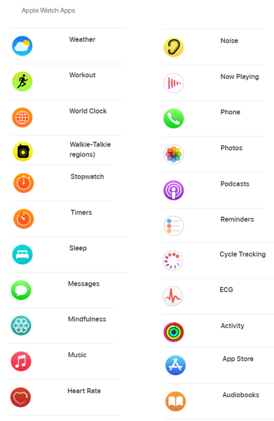
PLANNING AN ATHLETICS PE
LESSON WITH THE WATCH
Notes:
Photos of girls sheets during the ranking task
Girls were presented with the following two documents after a 15-minute break from task 1
They were asked to think about how they could use the watches in either a 400m relay, shot putt, or high jump lesson
They were then asked to apply the principles of PL into their lesson plans and how their chosen watch features matched this.

Slide 16
EXAMPLES OF WATCH FEATURES
INTEGRATED INTO LESSON PLANS
Watch Feature | How it could be used
Workout and Fitness | Using a workout throughout to track, suggestions to track different aspects of the lesson i.e. warm up, main activity, cooldown. Understanding how many steps they have taken, their pace, their heart rate during different activities, the number of calories they have burnt, understand your speed, track progress, motivation to push harder,
Stopwatch and Timer | Record progress and create comparisons for their performance
Music | Motivation, especially during running events
Heart Rate | Help with pacing, understanding when they are warm, understanding how it effects their breathing
Mindfulness | Help to slow down breathing and heart rate as well as providing an opportunity for reflection.
Camera | Take photos of performance to help remember and for comparisons
Walkie-Talkie | Communicate with friends, offer support and motivation, especially during running, not shouting across the field.
Sleep | Understand if sleep effects their performance, look at it first or after and see how they feel.
Weather | Tactical advantage, especially in throwing sports understanding which direction the wind is blowing. Also understanding rain expectations to help prepare.
Clock | Keeping an eye on the time so they know where they are in the lesson
Notes:
Apps and how they wanted to use them. More stuff did come up during the discussions that perhaps was not written down which can be fed back at a later date after audio recording analysis i.e. the idea of integrating this with ipads and work they need to do
The key for the unstructured sessions were that they moved away from traditional goals, but they were more interested in understanding processesd within their body and how they can work with them and build this into other lesson plans.

Slide 17
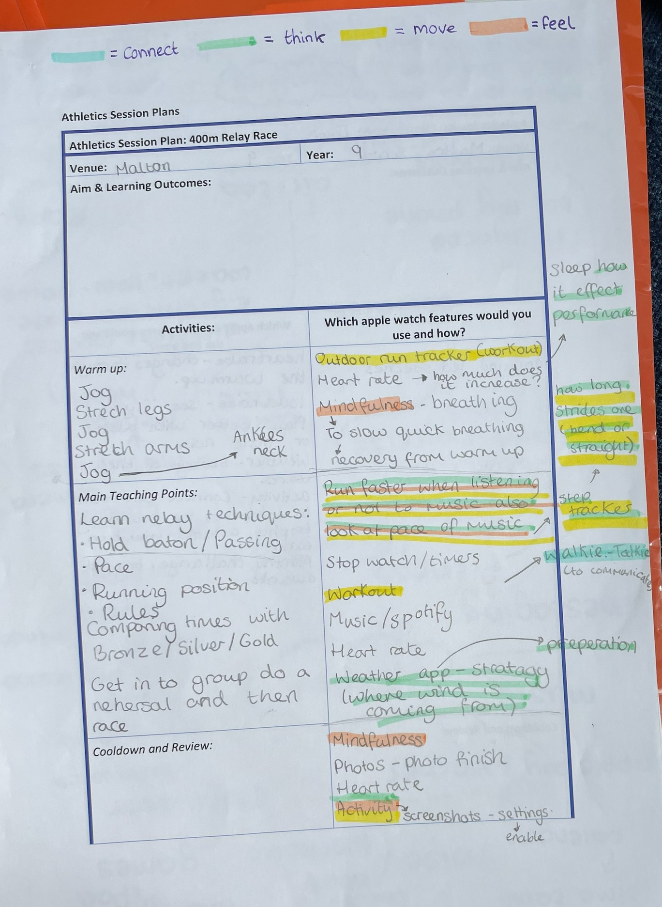
CONCLUSION AND EXAMPLE
OF LESSON PLAN CREATED
Girls want to use the features of the watch to enhance their understanding of the internal and external processes that inform their own performance in PE, as opposed to platonically participating in PE. This usage has the potential to increase harmonisation between the watch and internal motivation.
When using the PL statement to understand how they use the watch, ‘Think’ is the most prominent trait that they use, with ‘Move’, ‘Feel’ and ‘Connect’ al mentioned.
Notes:
Photos of girls sheets during the lesson plan task
Overall, it seems that the girls want to use the features of the watch to enhance their understanding of the internal and external processes that are required to successfully engage in PE and increase their performance as opposed to platonically participating in PE. This usage has the potential to increase harmonisation between the watch and internal motivation. All aspects of PL have been incorporated with move understanding how they move and how to better themselves, increasing their understanding for thinking, understanding how they feel in body and mood, and communicating with each other and motivating each other.

Slide 18
PLANNING A PE LESSON
WITHOUT ANY STRUCTURE
PE Lesson Activities Chosen
Tennis
Rock Climbing
Rounders
Cricket
Netball
Walking
Notes:
Girls were presented with blank pieces of paper and asked to create a PE lesson plan that integrated the watch, but it was emphasised that they could be as creative as they wanted.
They were not restricted to specific activities or outcomes and instead focus on how the watch can help them get more from their PE experiences
They were then asked to apply the principles of PL into their lesson plans and how their chosen watch features matched this.

Slide 19
PLANNING A PE LESSON
WITHOUT ANY STRUCTURE

Slide 20
PLANNING A PE LESSON
WITHOUT ANY STRUCTURE
Watch Feature | How it could be used
Music and Heart Rate | how music can effect their heart rate and motivation
Specific Coaching apps | looking for apps that can give them information on speed of hits, direction, etc to help coach them through movements
Voice Note | ability to connect to the teacher iPad to record and store, but teacher can prompt students to reflect on their activities and they can talk into the watch
Workout, Fitness, and Calculator | Set group challenges i.e. group tries to walk 90,000 steps or set a monthly class challenge that they work towards. Steps is the most common, using calculator to add up. But also want to use the connect features to compete and connect to friends and try to get trophies (watch built) first.
Siri | using Siri to pick teams to make it fair i.e. random number generator.
Noise | understanding how noise effects your play, do you do better in loud or quiet places
Goals | the goals for the session, although some technical/tactical were mentioned, they were interested in building soft skills such as confidence, focus, effort, and changing away from ‘normal’ PE goals to things like go and search for these 5 flowers. Watch would be used to help direct attention and motivation
Notes:
For this there was a lot of overlap with the previous activity and every one of the features was mentioned. What we found in this section was that they came up with some newer ways of using the apps or integrating different apps and features together. Therefore everything presented on this slide is new alongside the previous slide.

Slide 21
CONCLUSIONS
Overall, the PL principles are apparent, with ‘Connect’ and ‘Think’ most prominent with ‘Move’ closely followed behind.
The girls express a desire to work together and change the outcomes away from traditional curriculum outcomes.
It appears they want to think and understand more about what they are doing in PE, which could relate to the idea that teenage girls tend to focus more on their academic involvement as they progress through the school years.
Some apps/ideas are not currently available but worth exploring alternatives or ways of making it work.

Slide 22
APPLE WATCH –
WHAT’S MISSING?

Slide 23
Battery life
Long time to set up
Increases screen time
Connect to wifi on its own
Improve zoom in and out function
Must have iPhone
Want to connect to the ipad
Play music from the watch
Make the watch lighter
Enable home control to be able to work with smart lights
Add a camera
Add social media such as snapchat and TikTok
Watch films on them
Charging time
Come with a wall plug
APPLE WATCH –
WHAT’S MISSING?

Slide 24
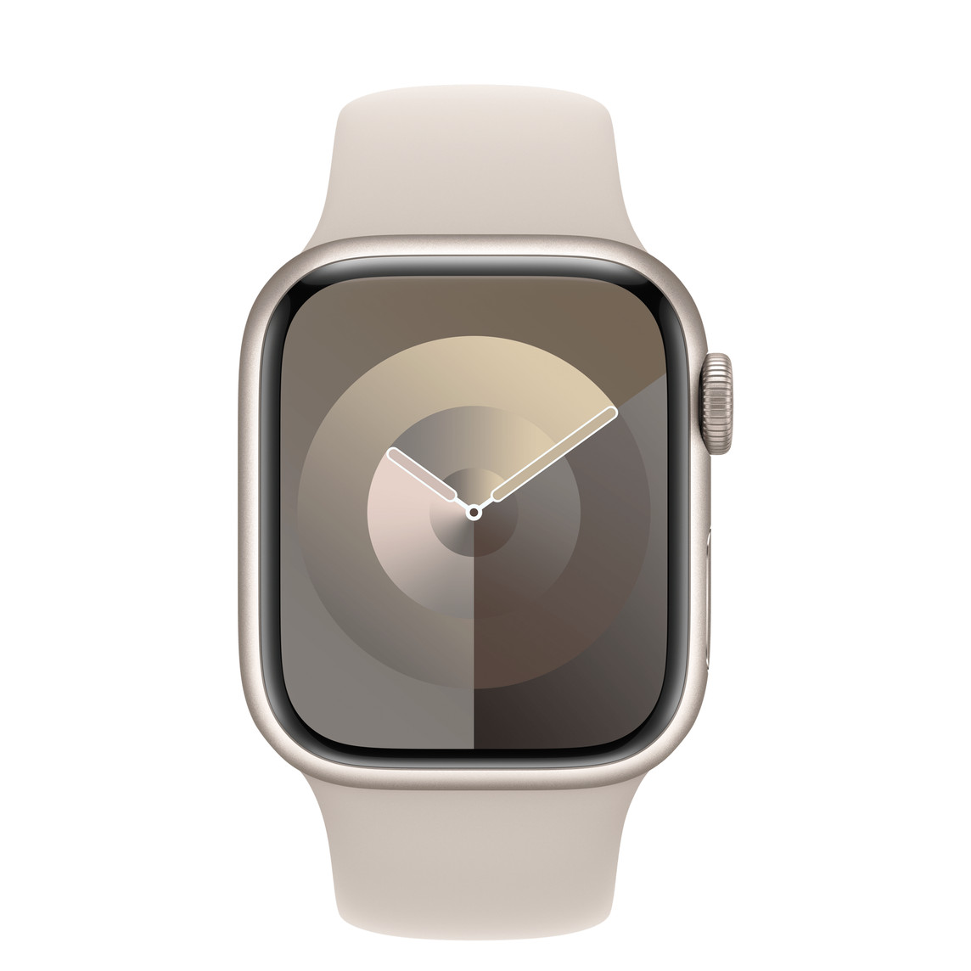
PHASE 2-
FUTURE RECOMMENDATIONS
Provide:
iPad compatibility with both the phone and Ipad was requested the most
Non-SE versions of watches
The ability to build more social media access into watch
A camera and screenshot facility
Coaching specific apps that can monitor and provide feedback for specific types of movements
A wall plug
Notes:
The school is an apple accredited school herefore it is all run on ipads and there is some frustration around the lack of connectivity to the ipad. Even though only 4 do not have an iphone, they want the watch to connect with he ipad due to the ipad being integrated into the lesson but them not allowed to have their phones out.

Slide 25
PHASE 3- ‘USING THE WATCH IN PE’
Insert more quotes from girls within the themes
Insert quotes from teacher

Slide 26
GIRLS SELF-WORTH & ENJOYMENT
Notes:
Self worth has gone up, supports mental health, motivation. Slight decrease in global but it was rising again. Athletic was promising, mix with inclusivity as they were able to get involved, when perhaps they could not.
PE enjoyment went up, academic interest was higher, more interested in sessions and what they had to do. Tried a bit harder

Slide 27
BENEFITS- GIRLS
Increased Motivation
Additional Education
Inclusivity
Mental health
Improve everyday routines
“[The Apple watch] makes me feel like I want to be more active than I was before because it’s telling me that I’ve [achieved] that. It’s that sense of accomplishment”
Notes:
Motivation – want to engage in more PA, they would use the weather app to be more prepared, they would choose to walk to school, try to closed their rings, get the steps up in PE. They would also focus on the achievements and improvements they experienced u.e ran quicker, recovered quicker, slept better etc over time.
Additional Education – watches provided the opportunity to learn more about things that wouldn’t ordinarily be covered, such as heart rate, recovery rate, eating, calories, steps which means the sessions were engaging especially for those that maybe were not driven by PA. They said they looked forward to how this could relate to other lessons.
Inclusivity – as well as the additional education they were enjoying the connectivity they felt between friends, working together, finding a different way to engage in a PE lesson. They enjoyed the co-creation as it felt like they had autonomy and a choice in what was going on in their lessons and they had to work together for tram challenges. Other features like walkie-talkie they love.
Mental Health – the mindfulness app was beneficial, it did let them understand that movement made them feel better, were more weary of their tiredness i.e. kinder to themselves if they did a lot of movement the day before. It gave them more confidence watching their improvements or achieving goals. Allows them to be more aware of their mood. However they are aware that the watch does not offer a lot to change their mood.
Improve everyday routines – the watch was helpful outside of PE, it allowed them to have alarms, rember to be hydrated, take the mindfulness minute, motivate them to move, they could set reminders to do homework, they found they were more punctual, it was easier to check the time and use it as a watch.
Mix it in with the quantitive data and see how it relates. Self worth has gone up, supports mental health, motivation. Slight decrease in global but it was rising again. Athletic was promising, mix with inclusivity as they were able to get involved, when perhaps they could not.

Slide 28
BENEFITS- TEACHER
“I was Initially excited with the opportunities that the project could bring”
“I’ll be sad when the watches get taken away from me, because it’s something that I can use now to enhance the learning. It’s definitely enhanced and made it easier for me to incorporate more things into the lesson”.
“I’ve still delivered the content that I’ve needed to deliver, so I’ve still, kinda, hit those curriculum checkpoints, it’s just been an added bonus having the watch”.
“It’s made me look at more teaching and how I’ve had other options to bring in aspects that I wouldn’t necessarily be able to do beforehand”.
“ If we didn’t have the watch, I would just be following the scheme of work, like tackling or defence; now I’ve changed that content and how I’ll incorporate the watch”.
“It’s been really exciting for me; I’m glad that I’ve had the opportunity to look at how I teach, to change the way I teach. Having taught for 20 years, you get stuck in a rut of churning the same things out , so it’s refreshed me massively; a little bit of CPD for me. I’m interested to see what the girls see of it”.

Slide 29
BODY SATISFACTION- GIRLS
Notes:
This data reflects that there was no change on the girls’ body satisfaction, which is contrary to previous research demonstrating there is perhaps not a detrimental effect.

Slide 30
BODY SATISFACTION- TEACHER
“I know one of the [research] questions is looking at body satisfaction and body image and thinks like that and we’ve spoken about at length about the difference between being healthy and fit … and we’ve bought in different somatotypes. So, looking at a shot putter, are they less fit than someone who is a sprinter? Actually, they’ve both got very high levels of fitness just in different aspects. So, like Pilates, it doesn’t mean you haven’t achieved anything because you haven’t broken a sweat, it’s just a different kind of fitness. Girls were really interested in that, we could do a whole topic on the different sports and types of fitness. It’s really important for the girls to understand that you can do different steps or levels of activity but that’s fine as everyone’s different; i suppose it’s how you highlight that with the girls”.
“Some of the conversations that I’ve had with the girls over the weeks, I would never have even planned those; that these conversations were going to come up about body image and body types and it’s nice because you can see that they’re interested about that. I don’t think you could ever plan for those conversations. This makes your teaching a little more exciting as you’ve gone down a completely different route and they’ve learned something that they could use in the wider world”.
Notes:
There were lots of positive comments that came from the apple watch usage but also a few things that came apparent that were a source of difficulty/confusion for the girls.
Lack of understanding – refer to the analytics and what they were ‘supposed’ to be aiming and achieving. They did not know how many calories they were ‘supposed’ to burn, what was good, not good, how their movement then effected this. They did not understand their heart rates and why they were different or what that meant. This also meant that sometimes they did not know how to use the watch very well, they didn’t know what all the features did, or when they should use them. So the watch was good, but they only had a superficial understanding and they were aware the watch was making them feel certain ways without them actually undertsdanding the data.
Screen use – the girls did not want another screen to be added to their list. They felt the apple watch being integrated meant that PE could be ‘stop-starty’ and they just wanted to get on with the movements. They also just wanted PE to be a fun movement lesson where they did not have to think about anything. Although they enjoyed the additional things they were learning, they felt PE was becoming more of a ‘lesson’ as opposed to an opportunity to be outside, move, be away from screens. They suggested using the watches at the start and the end of the session but also acknowledged the difficulty in having accurate data for that.
Negative affects – some girls experienced negative effects. They found that they would begin comparing themselves to their peers, especially in HR and recovery breath. They also found that they started competing against each other again instead of focusing on their individual improvement. Some girls expressed feeling sad, obessive, and jealous as a result of the apple watches and comparisons. They also found that the rings would dictate how they felt and if they had not moved then they would start to feel ‘lazy’. Because of this, they began to lose interest in the watch and mainly wore it for school because they ‘had to’ this is not all girls, just some.
Technical limitations – lack of ipad connectivity o access data, battery life, does not offer ways to improve mood bar breathe, not understanding some of the technical terms, not being able to wear it for certain activities and it irritating their skin on their wrist were all listed as barriers to the girls not being able to enjoy the watch fully. i.e. wanted to monitor sleep but it had to be on charge over night. Cannot wear oit for some sports outside of PE.
Variable experiences – on the whole it was a positive experience, and the girls do want to keep the watches, but there are personalised experiences to be mindful of. Some girls had more negative exoeriences due to their previous PA enjoyment, or lack of watch connectivity. But most girls really enjoyed the watches and opportunities. However, it was common oplace that they wanted continuous movement not stop and starting to use the watches in a session. Could be that a workout is tracked and they can log it at the ned for example not part way through.
Link to quant data,
Although some negtiive affect is expressed, the quant data reflects that there was not change on their body satisfaction, which is contrary to previous research demonstrating there is perhaps not a detrimental effect. Relate it back to the PA enjoyment, and we can see that it is on the up, these are things to be mindful of.

Slide 31
LIMITATIONS- GIRLS
Lack of understanding
Screen Use
Negative affects
Technical Limitations
Variable experiences
“…we spend too much around screens, but the fact that we are in school from nine until four on screens, every single lesson, all lesson. Having PE – I actually don’t like PE that much – but going outside, having fresh air, running around, it’s nice”
Notes:
There were lots of positive comments that came from the apple watch useage but also a few things that came apparent that were a source of difficulty/confusion for the girls.
Lack of understanding – refer to the analytics and what they were ‘supposed’ to be aiming and achieving. They did not know how many calories they were ‘supposed’ to burn, what was good, not good, how their movement then effected this. They did not understand their heart rates and why they were different or what that meant. This also meant that sometimes they did not know how to use the watch very well, they didn’t know what all the features did, or when they should use them. So the watch was good, but they only had a superficial understanding and they were aware the watch was making them feel certain ways without them actually undertsdanding the data.
Screen use – the girls did not want another screen to be added to their list. They felt the apple watch being integrated meant that PE could be ‘stop-starty’ and they just wanted to get on with the movements. They also just wanted PE to be a fun movement lesson where they did not have to think about anything. Although they enjoyed the additional things they were learning, they felt PE was becoming more of a ‘lesson’ as opposed to an opportunity to be outside, move, be away from screens. They suggested using the watches at the start and the end of the session but also acknowledged the difficulty in having accurate data for that.
Negative affects – some girls experienced negative effects. They found that they would begin comparing themselves to their peers, especially in HR and recovery breath. They also found that they started competing against each other again instead of focusing on their individual improvement. Some girls expressed feeling sad, obessive, and jealous as a result of the apple watches and comparisons. They also found that the rings would dictate how they felt and if they had not moved then they would start to feel ‘lazy’. Because of this, they began to lose interest in the watch and mainly wore it for school because they ‘had to’ this is not all girls, just some.
Technical limitations – lack of ipad connectivityt o access data, battery life, does not offer ways to improve mood bar breathe, not understanding some of the technical terms, not being able to wear it for certain activities and it irritating their skin on their wrist were all listed as barriers to the girls not being able to enjoy the watch fully. i.e. wanted to monitor sleep but it had to be on charge over night. Cannot wear oit for some sports outside of PE.
Variable experiences – on the whole it was a positive experience, and the girls do want to keep the watches, but there are personalised experiences to be mindful of. Some girls had more negative exoeriences due to their previous PA enjoyment, or lack of watch connectivity. But most girls really enjoyed the watches and opportunities. However, it was common oplace that they wanted continuous movement not stop and starting to use the watches in a session. Could be that a workout is tracked and they can log it at the ned for example not part way through.
Link to quant data,
Although some negtiive affect is expressed, the quant data reflects that there was not change on their body satisfaction, which is contrary to previous research demonstrating there is perhapos not a detrimental effect. Relate it back to the PA enjoyment, and we can see that it is on the up, these are things to be mindful of.

Slide 32
LIMITATIONS- TEACHER
“Individual activities, like athletics, allows for more free-flowing approaches to using the watch, whereas team activities can be more stop-start. I don’t think it grabbed the attention of the girls the same in games”.
“The only problem we had is when it rained and we had to use the water screen, which affects some heart rate data”.
“The biggest problem I’ve had is the charge of the watch and sometimes the watch has died during the lesson. But we don’t know whether that’s the fault of the watch or whether they’ve charged them effectively enough”.
“One of the barriers as well was it would be lovely for them to have a phone so they could look at data on their phones as they were going through… it would have been better if iPads were compatible”.
“It’s been too short, I could have taken my foot off the pedal and allowed more time for reflection; we could have grown more if we had more time and really embed that learning. It would be lovely to do three lessons on anxiety; I think I’ve powered through it too quickly and maybe they haven’t come away with anything, maybe they have. In future, if we were doing it over a year, I’d use it in lessons that were more suited to the watch and drip-feed one element, maybe over a six-week block and really embed that learning and they might be more used to that”.

Slide 33
PHASE 3 CONCLUSIONS
Girls global self-worth and enjoyment increase when the girls wear the watch and are supported in using the watch in PE
There is a slight decrease in athletic self-worth during this phase
There is no change in body satisfaction; this goes against some previous reporting of detrimental impact
The girls see overwhelmingly positive benefits in using the watch, reporting psychological and social advantages
Limitations are predominantly related to technological issues in using the features of the watch
Notes:
The school is an apple accredited school herefore it is all run on ipads and there is some frustration around the lack of connectivity to the ipad. Even though only 4 do not have an iphone, they want the watch to connect with he ipad due to the ipad being integrated into the lesson but them not allowed to have their phones out.

Slide 34
PHASE 3- RECOMMENDATIONS
Understand what affects reporting of body satisfaction from using the watch
Address technical limitations reported
Explore how the watch could be used to support the teaching of games more effectively
Explore why ‘athletic self-worth’ declines slightly when using the watch

