Slide 1
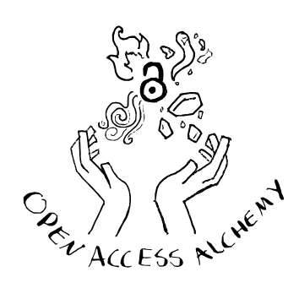
Open Access Alchemy
A collaboration between Leeds Beckett University and Springer Nature

Slide 2
Phase 1: The Wizard’s Awakening
Draw your wizard card
Determine who goes first
Phase 2: The Enchanted Marketplace
Gather APC funding
Set up the marketplace
Choose journal cards, each player choosing one on their turn
Phase 3: The Wizard’s Conclave
Each wizard draws a wildcard
Calculate your influence score
The Pitch: roll the d20 to publish
Total up your scores for the round
Complete these phases x3

Slide 3
So how does this work in the real world?
Authors choose which style of publishing they want based on what journals they submit to
3 main kinds: fully open access, hybrid, and subscription-based
No single open-access model is perfect for everyone
Various factors might impact the styles of publication available to authors

Slide 4




Thank you

