Slide 1
Get To Know Nii Lamptey Welbeck
ICSA –UK, Institute of Chartered Treasury - UK
BA (Business and English), MSc (Banking and Finance)
Ministry of Justice – UK, Home Office (UKBA) – UK, Ministry of Health - Ghana
Professional Affiliations
Academic Qualifications
Professional Outline

Slide 2
FINANCING LOCAL AUTHORITIES IN GHANA: CAN DECENTRALISING CONTROL OF NATURAL RESOURCES ENHANCE SERVICE DELIVERY AND LOCAL ECONOMIC DEVELOPMENT?
By
Nii Lamptey Welbeck
(PhD Candidate, Leeds Business School)
Director of Studies – Prof Junjie Wu / Dr Moade Shubita
Supervisor – Dr Albana Rasha
20th November 2024

Slide 3
PRESENTATION FLOW
Background to the study
Statement of the problem
Research objectives
Research questions
Literature review
Research methodology
Conclusions and implications
Findings and discussion

Slide 4
Background of the study
The growing pressure and structural financial constraints
Across developing nations, local governments are increasingly faced with a gap between their spending needs and available funds.
Ghana being one of these nations, lack the fiscal autonomy to generate sufficient funds internally due to limitations in revenue collections capacity, tax autonomy and dependence on central government transfers.
The challenge with fiscal decentralisation framework in Ghana
While local authorities have the power to levy taxes, they remain highly dependent on DACF due to limited taxable assets. This funding gap creates disparities in infrastructure and service provision between urban and rural areas
Is fiscal decentralization of natural resources the answer?
Granting local authorities' greater fiscal discretion regarding natural resources and increasing their share of "own-source revenues" could empower them to drive local development independently.
A shift toward "fiscal federalism" would enable local governments to optimize local resources, like land and mineral royalties, for development purposes, closing funding gaps and reducing reliance on central government grants and transfers.
Ghana’s District Assemblies Common Fund (DACF) provides essential funding for local governments, but disbursements are often delayed, causing funding challenges, particularly for smaller districts.

Slide 5
Problem statement
Lack of Local Authority Over Natural Resources
Natural resources in Ghana are considered state-owned, leading to a disconnection between local communities and the management of these resources (Hinneh, 2017).
Limitations of Existing CREMA Policy
Although the Community Resource Management Area (CREMA) concept aims to promote conservation, it does not address how revenues from natural resources could directly support local-level development. CREMAs also lack a strong legal foundation, as it currently rely only on policy documentation rather than enforceable legal provisions for local fiscal benefits (Hinneh, 2017).
Gap in Research on Natural Resources as Local Funding Sources
Limited research exists on using natural resource revenues as a primary funding source for local authorities in Ghana.
This disconnect often results in environmental degradation, as locals lack a sense of ownership or responsibility for preserving resources within their communities.
While previous studies examine local government financing and natural resource management, they rarely explore how local natural resources could be leveraged for community development (Barrett & Scott, 2008; Kazentet, 2011; Hoffmann et al., 2016; Mogende & Kolawole, 2016; Araji, 2018; Murray et al., 2018).

Slide 6
Research objectives Research questions
To explore the challenges in the current framework of natural resources management that affect local development
To ascertain the extent to which the central government can decentralise the management of natural resources towards local revenue generation
To examine the capacity of local government structures in managing natural resources for local-level development
To explore how less endowed districts can benefit from the fiscal gains of decentralised natural resources
What are the challenges of the current framework of control of natural resources that affect development at the local level?
To what extent can central government decentralise natural resource management as a source of internally generated funds for local authorities?
Do local authorities have the capacity to manage their natural resources?
How can less endowed districts benefit from the fiscal gains of a decentralised natural resource management?

Slide 7
Significance of the study
Practical Implications for Local and Central Governments
offers insights for central and local governments in Ghana to improve fiscal autonomy by leveraging natural resource revenues for LED.
Benefits for Local Economic Development
The research emphasizes the potential of using natural resource revenues to foster local economic development, create jobs, and improve livelihoods.
Findings could help policymakers design strategies for more effective revenue generation and expenditure at the local level, specifically through natural resource management.
It advocates for better resource allocation and fiscal decentralization to empower local governments
Community Empowerment and Participation
The study highlights the importance of community involvement in natural resource management, promoting local governance, deepening democracy, and fostering a sense of ownership among community members.
Academic Contributions to Fiscal Decentralization and Economic Development
The study enriches theoretical discussions on fiscal decentralization, the resource curse, and economic development by exploring the balance between central control and local autonomy, particularly in resource-dependent communities.
It also supports the theory of fiscal federalism and offers insights on the role of local institutions in effective resource revenue management.

Slide 8
Theoretical Perspectives
Theory | Description | Relevance | Study potential contribution to theory
Oates Decentralization Theorem | Argues that local governments are better positioned to provide public goods for specific jurisdictions due to their proximity to local preferences and knowledge of local cost conditions (Oates, 1972) | It suggests that decentralizing resource management to local authorities could improve efficiency, responsiveness to local preferences, and accountability. | study applies the theorem specifically to the context of natural resource control and management. It aims to provide empirical evidence on how fiscal decentralization can improve resource allocation, promote sustainable resource management, and foster social cohesion.
Tiebout’s Local Good Provision Model | Posits that local governments are best equipped to meet the preferences of their communities. Relies on assumptions of citizen mobility and local government competition, which encourage local governments to tailor services to residents' needs (Tiebout, 1956; Boadway & Tremblay, 2012). | Helps in examining how fiscal decentralization in Ghana could empower local governments to manage natural resources effectively, reduce dependency on central funding, and better meet local preferences. | the study validates Tiebout’s predictions of efficient resource allocation. examines the potential of local governments to foster competition for investment, attracting resource-based industries and supporting long-term sustainability.

Slide 9
Theoretical Perspectives…
Theory | Description | Relevance | Study potential contribution to theory
Tragedy of Commons Theory | The theory posits a situation in which individuals, acting in self-interest, deplete or degrade shared resources, leading to negative outcomes for the collective. In common resource systems, users may overexploit resources if individual benefits exceed collective costs (Hardin, 1968) | addresses potential risks of overexploitation and the need for sustainable management practices, and how fiscal decentralization of natural resources can help mitigate the tragedy of the commons by empowering local authorities and communities to manage resources based on local interests, knowledge, and needs | showing that local governments with significant resource revenue have stronger incentives for sustainable management, the study adds evidence that decentralization can prevent resource depletion. It also proposes frameworks for avoiding the tragedy of the commons, suggesting that local oversight and responsibility-sharing can foster cooperation and sustainable resource use.
Theory of Local Economic Development (LED) | LED emphasizes using local human, institutional, and fiscal resources to create jobs and develop a sustainable local economy (Blakely & Bradshaw, 2002). LED combines local capacity (social, economic, technological, political) and resources (natural resources, location, labor, infrastructure, etc.) to enhance economic resilience. | provides a framework for understanding how local governments can leverage natural resources to drive economic development. It supports examining whether MMDAs have the capacity to control and manage resources effectively to generate fiscal gains. | The study demonstrates how local control of natural resources can boost efficiency, build institutional capacity, stimulate local businesses (e.g., SMEs), and enhance infrastructure development and job creation. It also underscores the importance of community participation in fostering social capital, equity, and inclusive development.

Slide 10
Research methodology
Method | Choice | Justification
Philosophy | Interpretivism Ontology Epistemology | Helps to delve into the issues by closely interacting with the participants to familiarise and interpret the issues better Help develop ideas base on facts upon which knowledge is derived to create a policy framework for a decentralised system of natural resource control and management
Research Strategy | Inductive approach | An approach that fosters the establishment of reality, hence associated mostly with ontology and epistemology. Through this strategy, social facts would be gathered from government officials, local government officials, traditional leaders and other stakeholders through their actions, feelings, thoughts and experiences as they exist
Research Method | Qualitative | A method of research that is identified with the philosophical stance of the researcher The method seek to build understanding and discover meaning that is immensely practical in controlling natural resources and fiscal decentralisation in Ghana through a face-to-face, open-ended interview and dialogue with stakeholders
Research design | A case study design | has considerable ability to generate answers to the question “why?” as well as the “what?” and “how?” questions. -Suits large samples, providing a broad overview of the population. With numerous natural resources existing in Ghana, it would be a challenge covering entirely all, hence the use of this design to deal with only selected mineral resource and areas/MMDAs as cases.

Slide 11
Methodology Cont.…
Methods | Choice | Justification
Population | Three groups, namely, Central Government Officials, Local Government Officials, Traditional Leaders, and stakeholders. | These groups of participants are deemed appropriate to provide accurate and valid information needed to satisfy the research objectives
Sampling method | Purposive Sampling Snowball Sampling | Selection of participants that have the requisite knowledge of control and management of natural resources With snowball sampling, upon identifying a participant or informant, is guided by the same participant or through a social network to locate other potential participants to contribute to the study.
Data collection method | Face-to-face interview | provide in-depth insight into participants’ experiences and meanings into fiscal decentralization, control and management of natural resources
Method of analysis | Thematic analysis | to establish the relationship between the experiences of participants and variables and the meaning of the phenomenon of natural resource control and decentralization Develop common themes that identified across participants through a comparison of the experiences and perceptions of individual participants and groups.

Slide 12
Analysis and findings
Fiscal decentralization of natural resource
Practice and implementation of fiscal decentralization
Framework challenges
Natural resource management framework
Local government capacity to manage
Benefit to less endowed local governments
Local government autonomy
Fiscal independence
Revenue sources
political interference
ineffective decentralisation
land and natural rights
Lack of policy coherence and integration
Stakeholder involvement
Revenue generation and distribution
Legal and institutional framework
Financial capacity and revenue mobilization
Administrative and human resource capacity
Natural Revenue distribution
Inter governmental collaboration
Private-public partnership
Community participation
Government williness to decentralize
thematic network/mapping

Slide 13
Theme 1: Implementation and practice of fiscal decentralisation
Practice and implementation of fiscal decentralisation
Local government autonomy
Revenue sources
Fiscal independence
Decision-making power
Administrative autonomy
Local governance structure
Levies and fines
Bills and rates
DACF
International donors
Budget control
Local financial management
Intergovernmental fiscal relations

Slide 14
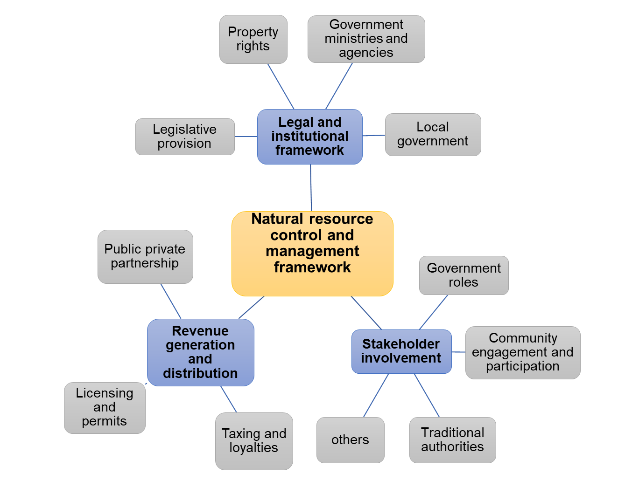
Theme 2: Natural Resource Control and Management Framework

Slide 15
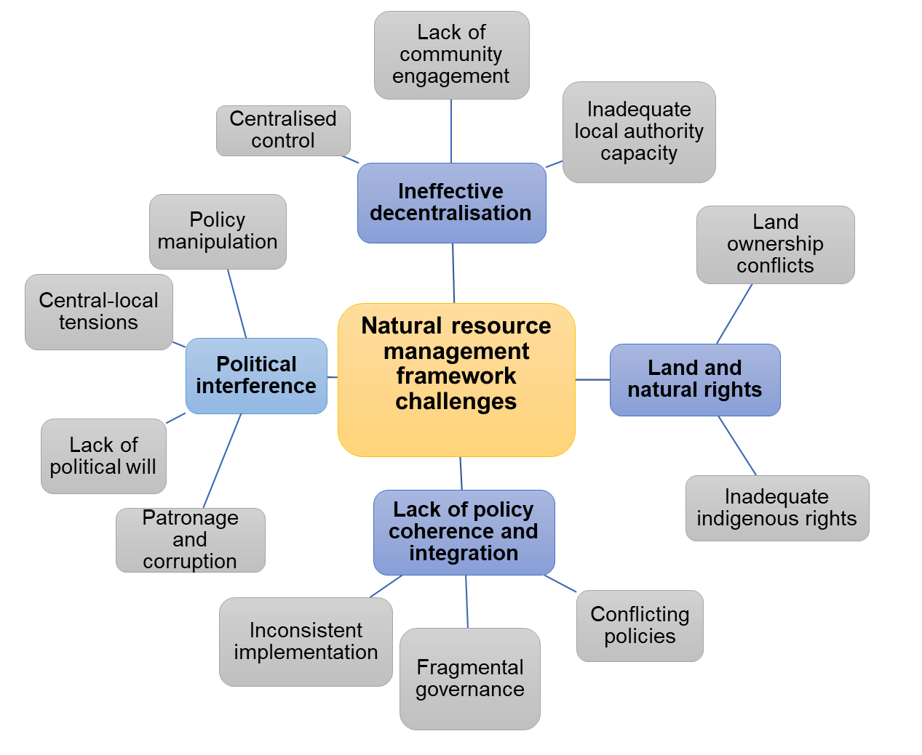
Theme 3: Challenges with the existing framework

Slide 16
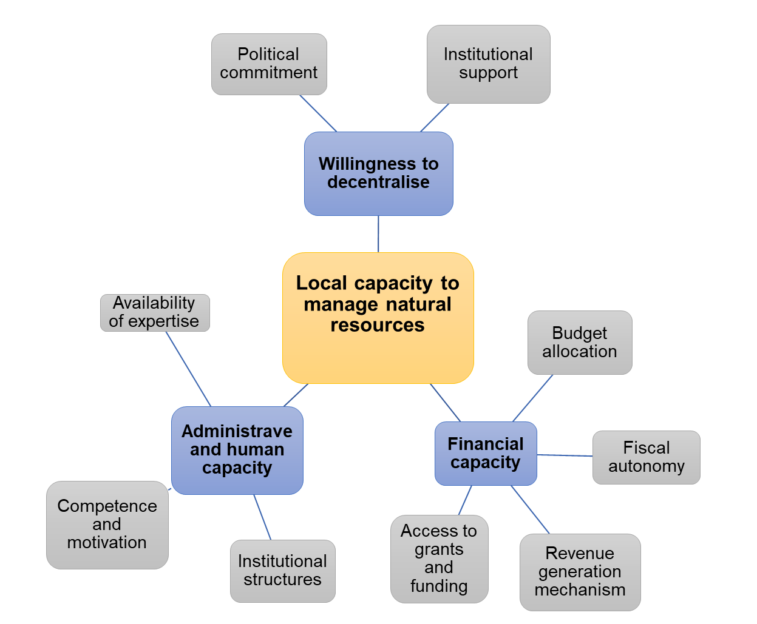
Theme 4: Local assemblies’ capacity to control and manage natural resources

Slide 17
Proposed Policy Framework for decentralisation of Natural Resource Control in Ghana
Decentralized NR control and management system for fiscal gains
Legal and institutional Framework
Stakeholder involvement
Capacity building and technical support
Revenue generation and distribution
Monitoring and accountability
Addressing political interference

Slide 18
Conclusions Objective 1: To explore the challenges in the current framework of natural resources management that affect local development
Guidelines for resource exploitation, conservation, and environmental preservation are provided the 1992 constitution of Ghana and other legal instruments as the main Framework for resource control and governance of natural resources
These legal frameworks, however, do not explicitly outline institutional practises or participation in resource control, management and exploitation of natural resources
The frameworks or regulations guiding the control of natural resources in Ghana are not well institutionalized. Major challenges with the framework include
Ineffective decentralization
Land and natural rights
Political interference
Lack of policy coherence and integration

Slide 19
Conclusions Objective 2: To ascertain the extent to which the central government can decentralise the management of natural resources towards local revenue generation
The government of Ghana is unwilling to fiscally decentralise the control and management of natural resources. Although the necessity and desire for decentralised natural resource management were emphasized
The unwillingness is caused by the concentration of power in the mining sector, political factors, and worries about revenue control.

Slide 20
Conclusions Objective 3: To examine the capacity of local government structures in managing natural resources for local-level development
The local assemblies are readily prepared administratively to manage and control natural resources.
The infrastructure readily exists, and systems are well in place.
Legally, the MMDAs have the capacity to manage and control the resources. The study also points out that the MMDAs have the office set tools and instructional infrastructure to deliver.
The MMDAs also have the available human resources to manage, control and exploit natural resources.
Regarding financial capacity, it is concluded that the local assemblies are not ready but assistance from the central government will be significant.

Slide 21
Conclusions Objective 4: To explore how less endowed districts can benefit from the fiscal gains of decentralised natural resources.
The study shows that MMDAs less endowed in natural mineral resources in Ghana barely benefit from fiscal gains from these resources.
since such resources are not identified in their localities, they do not have any benefit to share from the royalties paid to MMDAs with the resources. They could only benefit directly from government expenditures or development works with expenditures from the mineral operation taxes.
It is ideal to design a transparent and fair revenue-sharing formula that takes into account the specific needs, challenges, and developmental gaps of less endowed districts.

Slide 22
Contributions to theory
contributes to the Oates decentralisation theory, explaining that the allocation of responsibilities and resources between different levels of government, particularly focusing on the decentralisation of governance.
Further contributed the Oates theory by examining the extent to which local governments have control over their financial resources.
has expanded on Oates’ theory by considering the challenges and limitations of decentralisation, including potential risks related to local autonomy, political capture, and inequities in resource distribution
validates the “tragedy of the commons” theory, emphasizing that citizens would like to benefit from what belongs to them. It's important to note that the impact of decentralisation on the Tragedy of the Commons varies depending on the specific context, the strength of local governance structures, and the capacity for effective enforcement and monitoring.
To mitigate the Tragedy of the Commons, careful planning, capacity building, and stakeholder engagement are often essential components of decentralised resource management strategies
The impact of natural resource decentralisation on local economic development depends on how it is managed, the strength of local governance, and the strategies in place to promote responsible and sustainable resource utilization.
Effective resource management, diversification efforts, capacity building, and attention to equity and environmental conservation are key considerations to ensure that resource decentralisation contributes positively to local economic development.

Slide 23
Implications on Policy and Practice
Fiscal decentralisation of natural resources implemented in local assemblies could foster competition among them, promoting efficiency and accountability
The decentralisation of natural resources is a panacea to increasing productivity and human capital development in local assemblies.
Effective practice of fiscal decentralisation where the central government gives responsibility to the local authority or provinces to generate funds internally and use such funds could assist in improving human development.
The proposed framework for decentralizing natural resource management and control for fiscal gains in this study, should be well considered and implemented for better local economic development
The central government should willingly decentralise natural resource management and control and assist the local assemblies in terms of building capacity and financially to control the resources to their benefit.

Slide 24
Limitations and Future Research One of the study's major limitations is the inability to obtain enough information on issues such as the percentage of revenue derived from natural resource exploitations given to the local assemblies. The participants seem to have identified such disclosures as a bit sensitive and, hence did not respond much to it. There was also a challenge in accessing information on how local assemblies with less endowed natural resources can benefit from fiscal decentralization of the resources. It would be important for this objective to be well explored in further research using other research methods. This study used the qualitative research approach through the induction, abduction and retroduction strategies. It would therefore be interesting to validate the findings using the quantitative research method as well.

Slide 25
Conclusions and Recommendations of the Research
FINANCING LOCAL AUTHORITIES IN GHANA: CAN DECENTRALISING CONTROL OF NATURAL RESOURCES ENHANCE SERVICE DELIVERY AND LOCAL ECONOMIC DEVELOPMENT?
Fiscal decentralization of natural resources towards local economic development
Fiscal decentralization framework and its associated challenges in Ghana
Government willingness towards fiscal decentralization of natural resources and capacity of MMDAs to embrace
Benefits of less – endowed districts in the fiscal gains of decentralised NRM

Slide 26
Current issues of Natural Resource challenges in Ghana https://www.graphic.com.gh/features/opinion/the-political-feasibility-of-addressing-illegal-mining-in-ghana-stop-galamsey-now.html Galamsey Challenges In Ghana - Search News (bing.com) Conduct comprehensive research in galamsey-affected areas to identify the socio-economic drivers – APDC-Ghana to gov’t (modernghana.com) New Abirem: 20 people including 2 Chinese nationals arrested over involvement in galamsey (modernghana.com) Galamsey: EPA challenges CSIR's 300-year soil reclamation timeline - MyJoyOnline AG orders EPA to lay L.I. on mining in forest reserves in Parliament for revocation – MyJoyOnline Environmental Protection Agency to soon become an Authority - MyJoyOnline AGA, EPA plants over 2,000 trees in Obuasi to save degraded lands - MyJoyOnline Illegal mining affects food production - CSIR - MyJoyOnline We failed as MPs for passing LI.2462 which allows mining in forest reserves - Appiah-Kubi - MyJoyOnline The unseen costs of galamsey on Ghana - Ghana Business News Ghana's Gold Mine Dilemma: Protests and Promises (devdiscourse.com) A call for reflection and unity in Ghana’s fight against galamsey and Ghana's democratic journey (modernghana.com) Unlicensed Gold Mining in Ghana: A Boon and a Bane (devdiscourse.com) CONIWAS expresses worry over increasing effects of galamsey (modernghana.com) Galamsey: Counting the costs - Graphic Online Work together to address galamsey challenge — UN tells Ghanaians (modernghana.com) Ghana’s Galamsey, Self-Destruction by Design (modernghana.com)

Slide 27
