Slide 1
In & out of the LibGuides box: developing the Leeds Beckett Library website
Mike Ford, Helen Loughran and Debbie Morris
Libraries and Learning Innovation
Leeds Beckett University
Notes:
Hello and welcome to the presentation from Leeds Beckett University Library which we have called:
In and out of the box – developing the Leeds Beckett Library website.

Slide 2
Project to enhance the look, feel and appeal of the Library website
Improve the look and feel (within University brand)
Review structure
Develop new content
Rationalise pages
Add visual content
Support 24/7 self service access
Ensure mobile enabled
Notes:
Our project to re-develop our Library website was led by my colleague Helen Loughran (Planning and Marketing Manager) and myself and Mike was our technical lead.
Staff from across the Libraries and Learning Innovation service were also on the team, including content owners and Disability advisors.
Our re-development also coincided with University name change migration from Leeds Metropolitan to Leeds Beckett University.
– in many ways made it easier to ‘start again’ (e.g. changing URLs – more memorable)

Slide 3
Library Online Website pre-September 2014
Notes:
Text-heavy;
not very visually appealing;
not mobile-responsive (separate mobile site = duplication of work & keeping both current)

Slide 4
Key Dates
Research Phase: November 2013 – January 2014
Development Phase: February – May 2014 (LibGuides2 announced early May)
Implementation Phase: June – September 2014 (launch 1st September)
Review Phase: October – December 2014
Future = customisation and further integration with VLE / expansion of LibAnswers
Notes:
Research - Looked at other sites / articles / blogs / best practice
Initial User testing – Focus Groups – how users were accessing the site
Development – the site structure began to evolve / reduction of text-heavy content, many evidence-based decisions (mainly AW Stats)
LibGuides 2 – leap of faith!
Go Live day – few technical hitches, slight delay due to Springshare time differences, but live by 2nd Sept
Reviewing – surveying students online and in person, use of management information in decision making
LibAnswers – as part of our help service - now populating FAQs e.g. used in introduction of Microsoft 365

Slide 5
Why LibGuides?
Previous website developed in house
More effective content management system
Academic Librarians already using LibGuides1 for 12 months
Mobile compatibility & responsive pages
Notes:
Popular CMS with increasing usage, collaboration, interactivity and integration possibilities
CMS makes it simpler for Library Staff to upload and edit non-text based content

Slide 6
Springshare LibApps in use
LibGuides2 – main webpage system
CMS module – improves flexibility of content, customisation and access/permissions
LibCal2 – online bookings system for staff & rooms
LibAnswers/LibChat – help & FAQs system
Notes:
Our Library is increasingly using Springshare range of products to improve not only web presence but efficiency of service overall.

Slide 7
What worked out of the box?
LibGuides CMS (but can do lots without this)
Framework - based on Bootstrap responsive web framework (getbootstrap.com)
Templates – to create look & feel & assist staff
Syndetics book cover enhancements
Databases A-Z – used LibGuides system
Notes:
CMS – enables easier customisation (more templates)

Slide 8
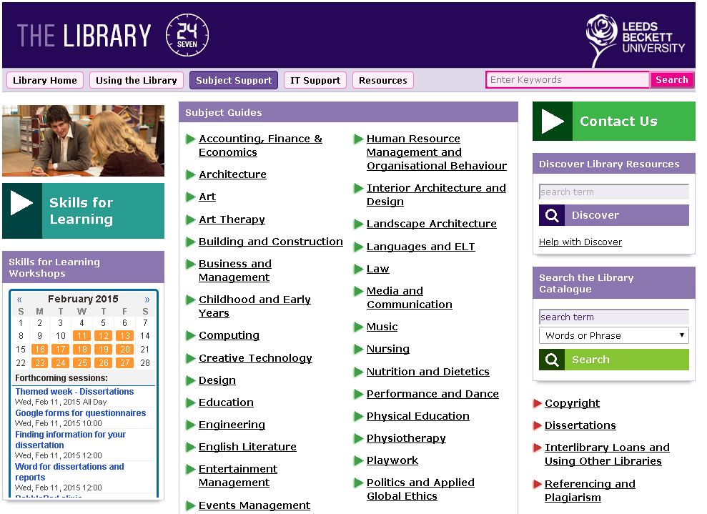
Not in the box!
3 column layout
Images – hard to customise, expected to be easier, difficult to format/size
Newsfeed – had to customise extensively
Contact Us box – hard to customise if you have developer skills, easier if you are happy with ‘out of the box’ look & feel
Lists widget – easy to generate (basic html) but had to customise look & feel to tie in with site

Slide 9
Working outside of the box…
Notes:
Use live site to demo each point?
Custom CSS developed in Chrome Developer Tools (F12)

Slide 10
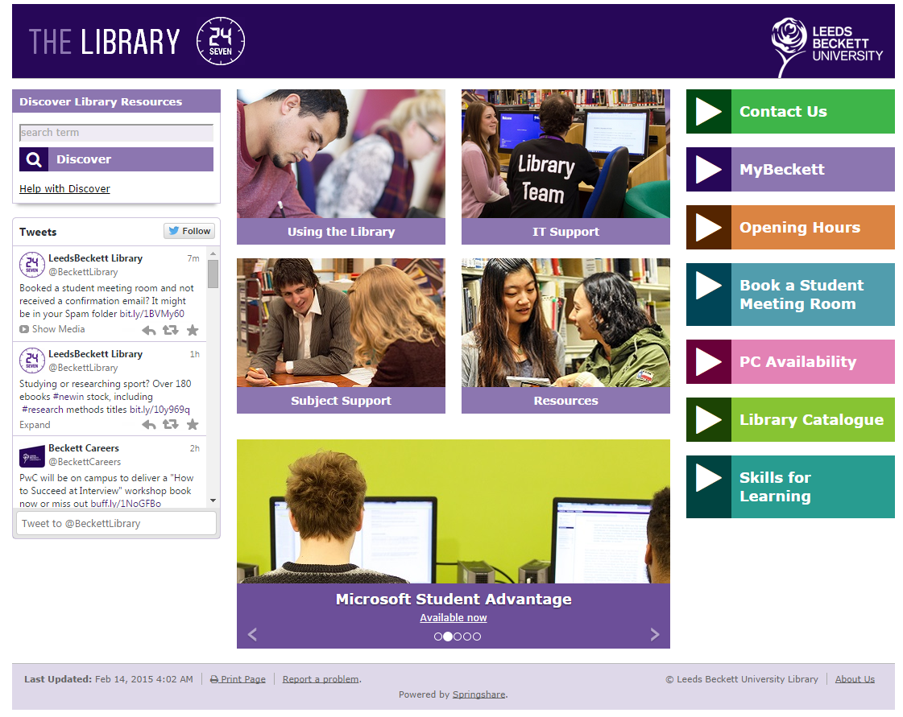
Home Page
Not LibGuides standard page
Action buttons
Image gallery
‘Discover’ Box
Twitter feed
Notes:
Homepage – not a LibGuides standard page
Action Buttons – styled from VLE
Search boxes – code from Resource Discovery/LMS providers
Image Gallery – standard widget customised with a lot of CSS to produce news feed

Slide 11
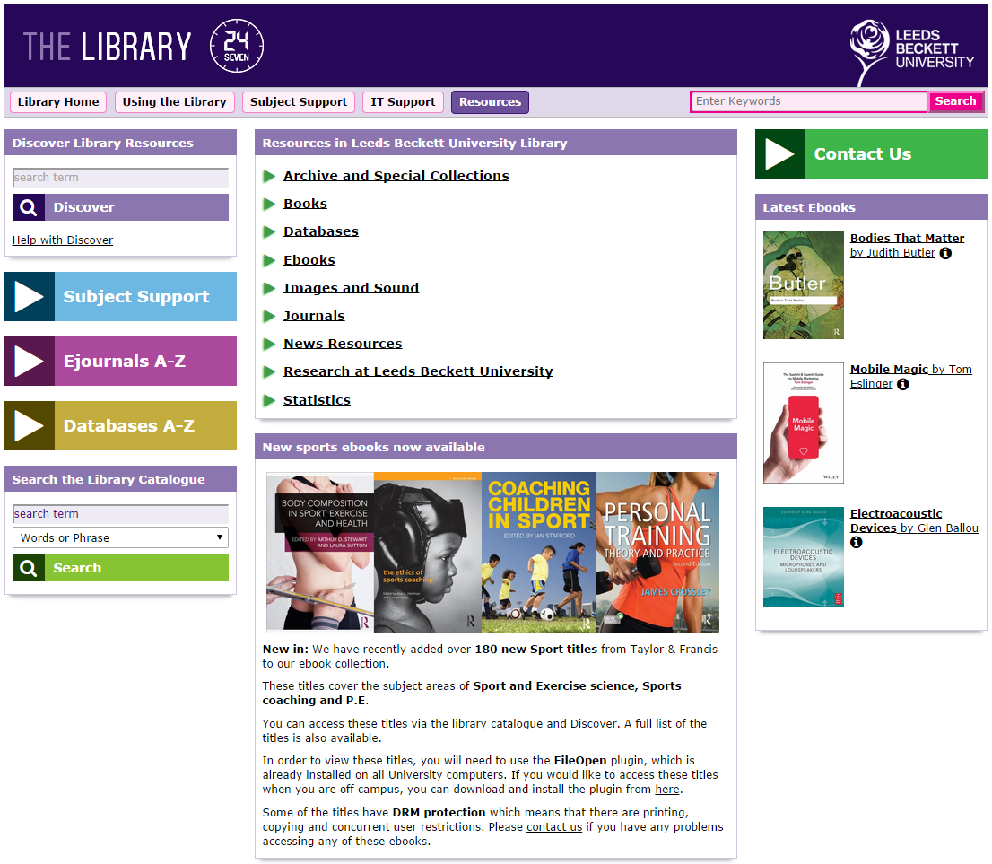
Landing Page
Custom template
CSS
Notes:
FontAwesome

Slide 12
Closing the box: lessons learned
Responsiveness of Springshare
User Forum – Springshare Lounge
Don’t be afraid to ask Springshare!
Read the documentation
New skills learned by all involved
Give yourself enough time
Be brave & adaptable – prepared to change course!
Notes:
Seize an opportunity (decision to go with LibGuides2)

Slide 13
Contacts
Mike Ford
Electronic Information Developer @mg_ford
m.ford@leedsbeckett.ac.uk
Helen Loughran
Planning and Marketing Manager
h.loughran@leedsbeckett.ac.uk
Debbie Morris
Library Systems Team Manager @debbiemn
d.morris@leedsbeckett.ac.uk

