Slide 1
The more things change: synergy and dissonance in Open Access and Open Education
Nick Sheppard
Kirsty Bower

Slide 2
Synergy & Dissonance
Nick:
Repository Developer
Kirsty:
Academic Librarian
OA – a historical perspective
Finch, RCUK and HEFCE
Institutional development and infrastructure
New paradigms?
Support for OER and OA
HEFCE & the changing role of the Librarian in an HE institution
Dissemination of research
Altmetrics vs JIF?

Slide 3
A historical perspective
First secretary of the Royal Society
The Philosophical Transactions of the Royal Society of London (Phil Trans)
Established principles of scientific priority & peer review
Evolved in the age of print
Modern scholarly journals do not pay authors for their articles
Henry Oldenburg
Source http://commons.wikimedia.org/wiki/File:1665_phil_trans_vol_i_title.png
This image is in the public domain because its copyright has expired.
Source: http://commons.wikimedia.org/wiki/File:Henry_Oldenburg.jpg
This image is in the public domain because its copyright has expired.

Slide 4
Serials crisis
C19th and C20th
Number of universities/ associated research output increased
Market with established creative source & pattern of consumption
Unsustainable price rises of traditionally published journals
1990 - Stevan Harnad introduced Psycoloquy, the first peer-reviewed scientific journal on the internet
Paved the way for free academic publishing on the web after 1993

Slide 5
Seismic shift
The Finch report (2012)
Emphasised gold over green
5 year "transition period“
Average APC ≈ £1800
Robbing Peter to pay Paul?
Criticised by OA advocates
Influence of publishing lobby?
Market forces will drive APCs down (won't they??)

Slide 6
RCUK policy (April 2012)
RCUK-compliant journals
Offer suitable gold OR suitable green option
Creative Commons-Attribution (CC-BY)
RCUK OA block grants
Establish institutional publication funds
Expect primary use to be payments of APCs
Preference is gold OA
Decision lies with authors and institutions

Slide 7
HEFCE bombshell (April 2013)
“to be eligible for submission to the post-2014 REF, authors’ final peer-reviewed manuscripts must have been deposited in an institutional or subject repository on acceptance for publication”
Applies to journal articles and conference proceedings accepted for publication after 1 April 2016
Urge HEIs to implement now
Where there is an embargo, authors can comply by making a ‘closed’ deposit on acceptance
Various exceptions

Slide 8
A sector reacts
Institutional
infrastructure and workflows
policy development
Knowledge transfer
Pure gold journals
Hybrid journals
Double dipping?
Funders cover APCs?
New paradigms of scholarly communication
PLOS
Open Library of the Humanities
Institutional publishing

Slide 9
Paradigm shift?
Is green a long term solution?
Maintains subscription model
Embargoes aren’t OA
Licencing for reuse
Is gold sustainable?
New serials crisis?
Books and monographs
What might a new paradigm look like?
Open Library of the Humanities
Institutional/library publishing
PKP - Open Journal System e.g. http://journals.ed.ac.uk/
Eprints e.g. HOAP
Role of academic libraries
“outside in” vs “inside out” (Lorcan Dempsey)
Managing (and disseminating) “institutional assets”

Slide 10
A question of infrastructure
Repositories – Eprints, Dspace etc
“CRIS” model – Pure, Symplectic, Converis etc
Jisc supported infrastructure
SHERPA services
http://www.opendoar.org/
http://www.sherpa.ac.uk/romeo/
http://www.sherpa.ac.uk/juliet/
http://www.sherpa.ac.uk/fact/
Publications Router
RIOXX - http://rioxx.net/
Open Mirror
CORE (COnnecting Repositories)
Jisc Monitor

Slide 11
What about OER?
HEFCE policy serves to emphasise OA?
Synergies
Repositories
Managing (and disseminating) “institutional assets”
Creative Commons
Impact (metrics)
Dissonance
Institutional resource and support focussed on OA?
Are we also seeing commercialisation in this space?
CC-BY vs CC-BY-NC
MOOCS

Slide 12
OER at Leeds Beckett
JISC Repositories Start-up (2007)
Prioritised set of needs
Research (OA)
Teaching &Learning (OER)
Unicycle - phase 1 ukoer project (2009)
“Blended” repository
Local deposit to IR
Harvest to Jorum
HEFCE = IR now focussed on OA
What now??

Slide 13
Jorum Window?
Customisable web interface to Jorum
Tailored to your institution
OER at the University of Leeds
http://leeds.jorum.ac.uk/

Slide 14
Librarian 71001 Lego Minifigures Series 10 (2014) [online image]. Available from https://www.flickr.com/photos/brickdisplaycase/11837083773/ Accessed 31 March 2015.
CC-BY-NC-ND
Notes:
Role is academic liaison, developing collection but also we deliver sessions on finding information using library resources, critiquing and evaluating information, referencing to both small and large groups
Increasing move towards larger classrooms and lecture style delivery e.g. 300+ students. Not only makes me consider different ways of delivering in the classroom but also how to reach students that may have dozed off at the back, and then few months down the line realise how important the session was but may only have PowerPoint slides/ Web pages to refer to Learning styles
Increase in online and distance courses
Out of these circumstances – necessity rather than choice due to timescales & lack of technology (or time to learn how to use the technology) that we turned to OER’s in faculty of HHS. Online tutorials/ quizzes – out of 300 we had about 40% participation. Relied upon academic staff pointing students towards online materials
Recently joined Leeds Beckett

Slide 15
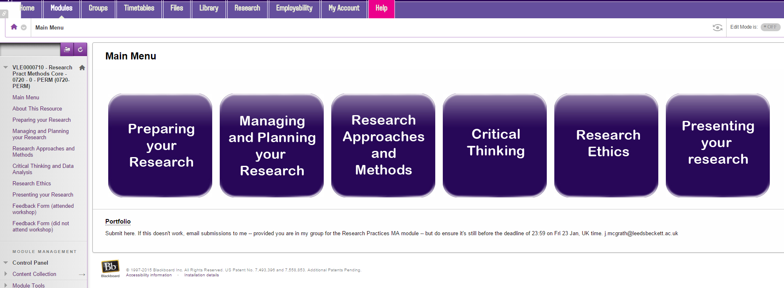
OER Advocacy: Core content modules
Notes:
Intro to Marketing
Intro to strategic management
Research practice methods
Project management
Idea is the core content modules contain tutorials, teaching materials that academic staff can repurpose for themselves

Slide 16
OER Advocacy: Subject pages Guides
Notes:
We also promote OER’s to students via our Subject pages

Slide 17
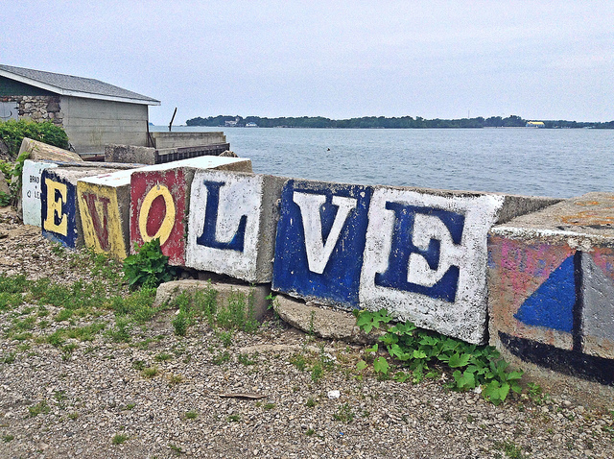
Put-In-Bay, Ohio (South Bass Island) (2014) [online image]. Available from https://www.flickr.com/photos/shell24_7/14678684844/ Accessed 31 March 2015
CC-BY-NC-ND
Notes:
Attention moved away from OER’s to Open Access availability of journal articles. HEFCE states that in order for research to be considered for the REF submission (i.e. our uni research status & funding implications) research has to be published in an OA subject or institutional repository within 3 months of acceptance for publication (authors final submission). We still continue with traditional services e.g. delivering information skills sessions, search strategy, finding resources, good quality info- HEFCE – seismic change – our submission to the ref depends upon our academics producing good quality open access research which in turn affects our research status & also funding for research. Also, in time of competition amongst HE institutions, research is the shop window so high stakes;. HEFCE mandate stressed ac librarians involvement with Research “Can’t afford to let this slip!” Emphasis now as well as traditional services, but we now have to encouraging staff to provide information in an OA manner & be far more active in promoting research.
Reflected in institutional structures e.g. Leeds, York, Huddersfield

Slide 18
How have we been doing this?
Notes:
RTW
Early career researchers
Twilight Sessions for researchers in HSS
Key members of staff
Faculty rep library updates

Slide 19
Notes:
Libguides,our content management system, and Symplectic Elements, infrastructure supporting uni repository, working together around selected theme days e.g. Mental Health awareness week, Eating disorders week, the general election etc. Research tagged by Librarian, coding to link the two together, auto display of open access institutional research outputs & links to author versions, self archived in Eprints available along green oa publishing route

Slide 20
Notes:
Highlight links to external and local organisations too Tweets from @BeckettLibrary and @BeckettResearch including targeted tweets to organisations & key academic staff.

Slide 21
Notes:
We are piloting a project whereby we choose celebration days or events where we can tweet a link to our research outputs in this area which are listed in a Libguide

Slide 22
Twitter analytics
Notes:
Just to follow on from this. We did have quite a good response from people about this.
The initial tweet got 709 impressions – see file attached
We tweeted it to 5 members of academic staff resulting in 3 RT, 2 favourites and 1 reply (see attached)
One academic RT as a MT resulting in 3 RT and 3 favourites

Slide 23
Twitter analytics

Slide 24
Response from Academic Staff

Slide 25
Instagram
Notes:
The Instagram resulted in 7 likes, including one from WDD. – see attached.
We got 22 hits on the Bitly link 18 from twitter and 4 unknown. 20 in UK , 1 in Ireland and 1 in Mauritius (Ieaun Ellis)
I can’t get into all the stats on FB, but it looks as though we got 1 like.

Slide 26
Bibliometrics vs Altmetrics
Notes:
Traditionally taught sessions around finding journals to publish in using WoS and WoK Journal Impact Factors and Scopus but now outdated as need to look beyond Journal level but article level
Articles that are open access get cited more often than subscription ones even though they may be in the same Journal
Libguide http://libraryguides.umassmed.edu/altmetrics
http://www.slideshare.net/BaltimoreNISO/carpenter-lets-remove-alt-from-altmetrics-uksg Old metrics

Slide 27
References & bibliography
Suber, P. Open Access Overview. Available at: http://www.earlham.edu/~peters/fos/overview.htm [Accessed 17 November 2014]
Guédon, J.-C. (2001) In Oldenburg’s long shadow: librarians, research scientists, publishers, and the control of scientific publishing. Available at: http://eprints.rclis.org/6375/ [Accessed 17 November 2016]
Budapest Open Access Initiative (2002) Available at: http://www.soros.org/openaccess/read.shtml [Accessed 17 November 2014]
Yiotis, K. (2005) The Open Access Initiative: a new paradigm for scholarly communications. Information Technology and Libraries 24(4). Available at: http://ejournals.bc.edu/ojs/index.php/ital/article/view/3378 [Accessed 17th November 2014]
Monbiot, G. (2011). The Lairds of Learning | George Monbiot. [online] Monbiot.com. Available at: http://www.monbiot.com/2011/08/29/the-lairds-of-learning/ [Accessed 17 Nov. 2014].
Accessibility, sustainability, excellence: how to expand access to research publications: Report of the Working Group on Expanding Access to Published Research Findings (June 2012) Available at http://www.researchinfonet.org/wp-content/uploads/2012/06/Finch-Group-report-FINAL-VERSION.pdf [Accessed 17 November 2014]
RCUK Policy on Open Access (April 2012) Available at http://www.rcuk.ac.uk/research/openaccess/policy/ [Accessed 17 November 2014]
HEFCE (2013) Policy for open access in the post-2014 Research Excellence Framework Available at http://www.hefce.ac.uk/pubs/year/2014/201407/ [Accessed 17 November 2014]

