Slide 1
Leeds Beckett University
Talking Tablets: Piloting Skills Building through Collaboration
Jennifer Wilson and Eric Howard

Slide 2
The Academic Librarian
The wider Library
Graduate attributes and Digital Literacy
Evaluation of IL support
Digital tools for IL
Collaboration
User Experience
Advocacy

Slide 3
Graduate Attributes
Use appropriate e-tools to locate, access, evaluate, utilise and cite diverse information sources that facilitate learning and critical inquiry of their subject and adhere to the standards of academic honesty in their use of that information
Access, store, organise and retrieve information and media relevant to their subject from multiple digital sources for practical application and integration into existing knowledge
Evaluate and select digital tools based on their appropriateness to specific tasks related to specific areas of practice
Effectively create and publish content in multimedia formats to communicate opinions and ideas of their subject area through a range of channels
Use critical thinking skills to plan and conduct research, manage projects, solve problems and make informed decisions using appropriate digital tools and resources
Proficiently manage group interactions and engage in online communities and professional subject or interest groups using multiple technologies
Analyse the capabilities and limitations of current and emerging technology resources and assess their potential to address personal, lifelong learning and career needs with respect to their subject interests.

Slide 4
Evaluation of IL support
Libguides
Adobe Connect / Google hangouts
Apps
Databases
VLE

Slide 5
Using digital tools for information literacy
Training staff and students
Use of VLE and e-portfolio tool
Access to information, anywhere
Information management tools
Digital information access skills
Search, evaluate, analyse, use, and reference digital information
Digital communication
Social and professional networking
Video conferencing
Email and text
Online communities
Delivery
Flexible learning opportunities

Slide 6
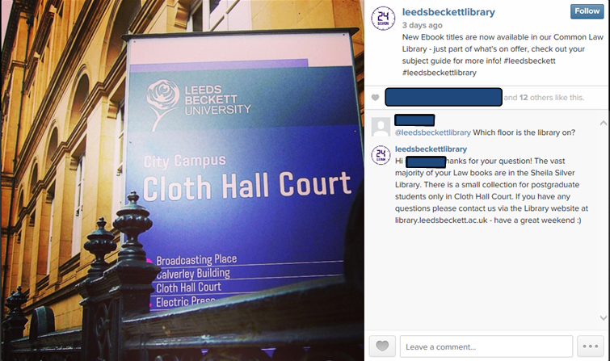
User experience
Testing and troubleshooting
Easier way to see what user sees
Skills building
Social media queries

Slide 7
Collaboration
Document sharing
Cross-campus meetings
Google+ communities across the University
Growing staff confidence

Slide 8
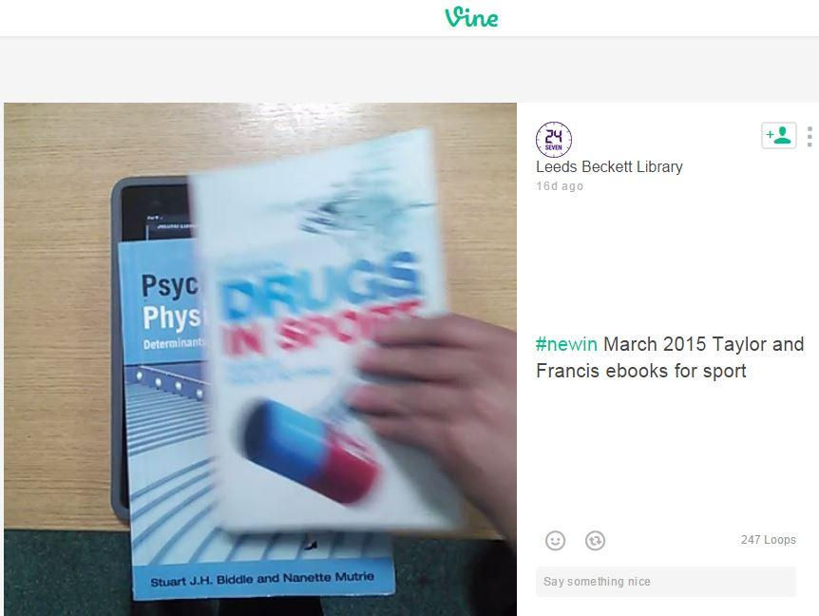
Advocacy
Pop-up Library
Capturing feedback
Promotion

Slide 9
Conclusions
Budget project
Enhanced customer experience
Staff skills development
Jennie: J.L.Wilson@leedsbeckett.ac.uk
Eric: E.Howard@leedsbeckett.ac.uk
beckettlibrary
leedsbeckettlibrary

