Slide 1
Digitisation Rachel Thornton Leeds Beckett University

Slide 2
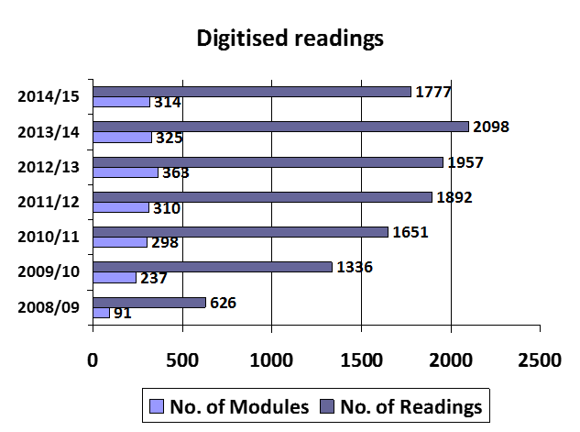
Digitised readings
Leeds Beckett University
Notes:
Leeds Beckett University began offering a Digitisation Service in 2008/09. It is a centralised service based in the Library. Staffing consists of myself full-time and a part time admin assistant to help with scanning (vacant since Christmas) with back-up from other colleagues to cover any absence.
The service is promoted via myself, the Academic Librarians, the VLE support team and via the Library website etc.
The graph shows the number of modules actively using digitised readings during each academic year and the number of readings in use.
Up until the current year there has been a steady increase in demand with the peak number of modules in 2012/13 and most readings in 2013/14. However this year we’ve seen a decline in both –possibly as a result of the Library investing more extensively in e-books. Or the modules that are using readings are already catered for (most readings are carried over each year)

Slide 3
Workflow
Notes:
We actually have two extensive workflows –one for new requests and one for the annual renewal process.
I’ve distilled the workflow for new requests down to these simple five stages.
We scan in-house and use our VLE (Blackboard) to store the readings. All files are stored in module folders and we keep back-up copies on a secure server which mirror the VLE.
Files are stored in two main folders: Current and Archive. Tutors are not sent the file itself but rather a link to the file, to add to their module.
Originally we stored the readings within a closed area of our Repository. Tutors were sent a public URL to add to their VLE module. The only authentication was when the student logged into the VLE.
When the online reading list system Rebus was introduced, we had to change systems otherwise public URLs added to an online reading list would be open access. We therefore migrated the files to the VLE enabling us to add authentication to the links.

Slide 4
Request
Direct
Dedicated email
Via Resource List (Rebus)
Checks
All required information (module & bibliographic)
Existing readings
Catalogue
CLA Title Search Tool
Notes:
Requests are sent direct to myself, to digitisation@leedsbeckett.ac.uk or via our Online Resource List Rebus:list (PTFS) –early stages. All the usual checks are undertaken (a manual process by the Digitisation team).

Slide 5
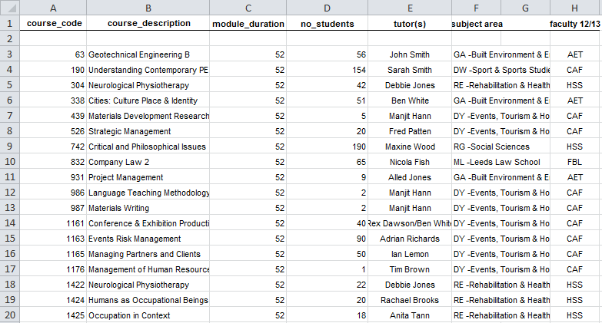
Data recording
Master spreadsheet of all modules
Notes:
This master spreadsheet contains the information which is copied into the course-codes tab of the CLA Digital Copy Record Form.
Each academic year has its own tab. Most modules are carried over after confirmation from the tutors.

Slide 6
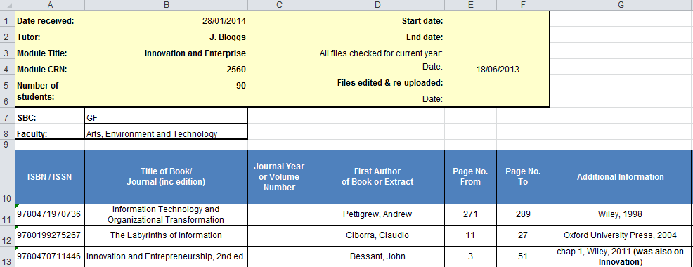
Data recording
Individual module progress spreadsheet
Notes:
Each individual module also has its own spreadsheet –the module progress spreadsheet. Uses same columns as CLA Digital Copy Record Form but also additional ones which are completed as the request is processed.
Class no, CLA or ©, BL CFP, Source, Filename, Uploaded, Tutor sent Link, Date request completed.

Slide 7
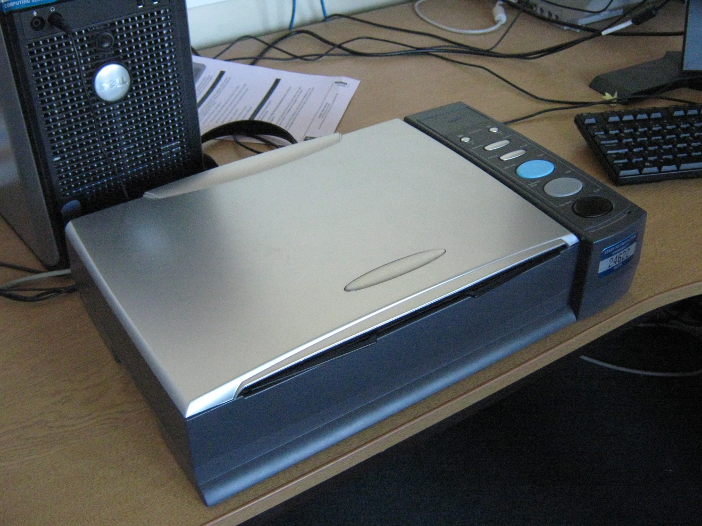
Scan
Plustek OpticBook 3600 Scanner
Notes:
This is our book scanner –small, lightweight but robust. It scans to tif, png or jpeg then we use Adobe Acrobat Pro to combine the files into a PDF which is then OCR-ed before the Copyright Notice is added and then a level of security (to prevent the Copyright Notice from being removed).

Slide 8
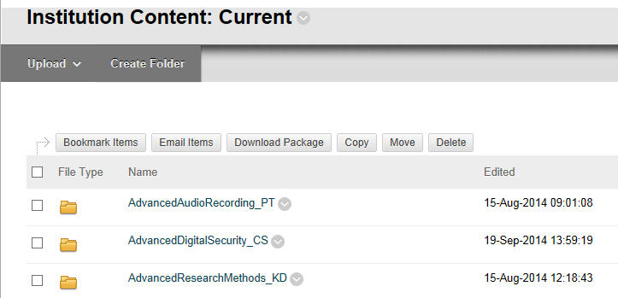
Upload
Blackboard Content Collection
Notes:
The finished PDF files are uploaded to the Content collection area in Blackboard –this area is not searchable unless you have administration rights. The Current folder for all files in use. These are stored in module subfolders. Back-up files are stored in academic years and contain PDF files, cover sheets, module progress sheets. Just PDF files in VLE (streamlined version).
Authentication is added to the readings to prevent open access. Most authentication is at folder level but it can also be added at file level if a reading is being used on more then one module (prevents duplication of files). Permissions are added –this where we make the file only available to staff and students attached to the module in the VLE (dependent on the Course Reference Number (CRN) –which is recorded on the CLA Digital Record Form).

Slide 9
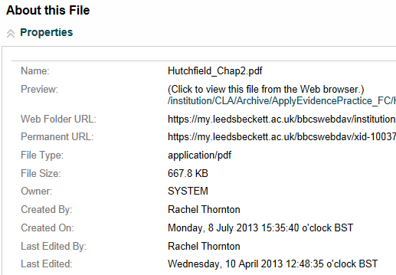
Delivery
Permanent URL
Notes:
There are two possible links to send to staff. Each file has a Permanent URL which remains constant unless the file is deleted. So we can update the file, rename it, move it from one module folder to another but this link remains the same. To stop access to a file, remove the permission.
So, overall a very manual and time-consuming process, heavy on the administration. Probably wouldn’t be suitable to a larger service. Hoping to use the CLA’s Digital Content Store in future to reduce the record-keeping and improve efficiency.

Slide 10
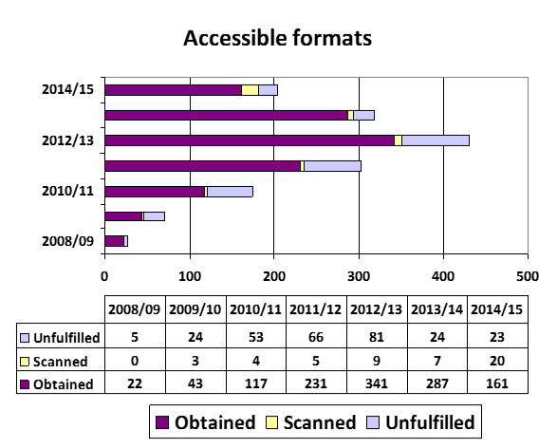
Accessibility requests
Notes:
Another area covered by the Digitisation Service is accessibility requests for print impaired students –where we obtain or create an electronic file on behalf of a student who is unable to access our print copies.
This graph is for the same time period as the previous graph and shows out of a total number of requests how many we obtained direct from a publisher, how many we scanned ourselves and how many we were unable to provide.
At the start we didn’t really do much in-house scanning –we didn’t have the time as the Digitisation Service was so busy. Now we have more time and also more incentive if we can share files either amongst ourselves (Open Rose Group) or upload to Load2Learn. We would definitely scan a book if it was under 200 pages. For larger books we ask the student if it is still needed or if they can be specific about which chapters are needed (not ideal).

Slide 11
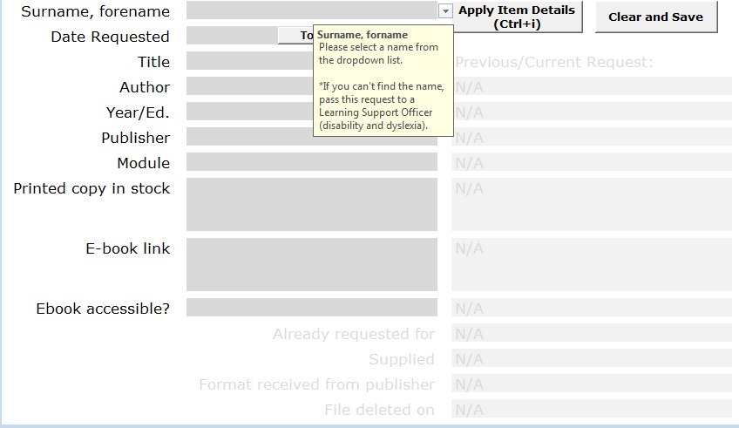
Alt formats spreadsheet
Notes:
How it is managed –when a student registers with Disability Services and indicates that accessible formats are required, s/he meets with our Library Learning Support Officer to discuss requirements and submit a reading list.
Items are bib checked and added to alt formats spreadsheet. Each part of the process has a tab. This is the first tab. The spreadsheet can check whether a file has been requested before as may be able to re-use it. If e-book in stock and it is accessible, the request goes to the completion stage. If not, goes to the next stage where I allot it a reference number and send off request to publisher. The final tab is when we receive a file and check it for accessibility.

Slide 12
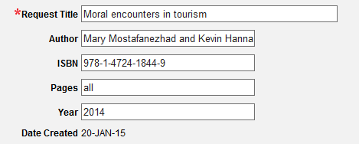
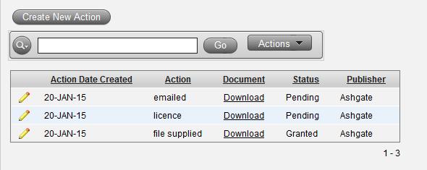
Copyright Tracking Database
Notes:
Details of each request are also recorded in my Copyright Tracking Database which enables me to upload all correspondence including licence agreements from the publisher. The file itself not generally uploaded but kept on a secure server. The file may need to delete after course ends. Storage of files depends on the licence agreement with the publisher.
When a file is received, this is recorded on the spreadsheet & in the database and moves to next stage where it is checked for accessibility and then sent out to the student (using Google Drive). If no file is sent, decide whether to scan inhouse.

Slide 13
Rachel Thornton Leeds Beckett University r.thornton@leedsbeckett.ac.uk 0113 812 7472

