Slide 1
Continuing to Discover!
Leeds Beckett University Library’s usage of feedback and statistical data to develop EBSCO Discovery Service
Libraries and Learning Innovation,
Julie Cleverley – Journals and Electronic Resources Manager

Slide 2
Feedback that led to impetus for Resource Discovery
‘make journals easier to find’ (2010 annual student survey)
‘problems finding journals (need one access point) but amount of info that is available is good’ (2010 exit polls)
‘online journals hard to navigate, and the process of actually finding a journal article difficult.’ (2009 focus group)
Notes:
In 2012 we purchased EBSCOs’ Resource Discovery Tool in order to improve the overall discoverability of print and electronic resources for students and staff.
The impetus for implementation was in response to feedback over recent years which had included requests to make it easier to find information, particularly journal articles.

Slide 3
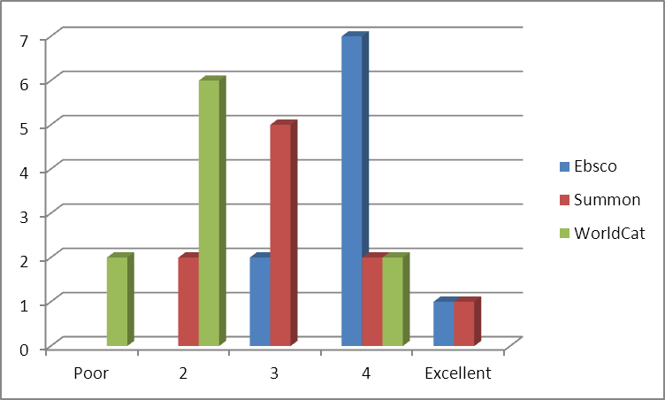
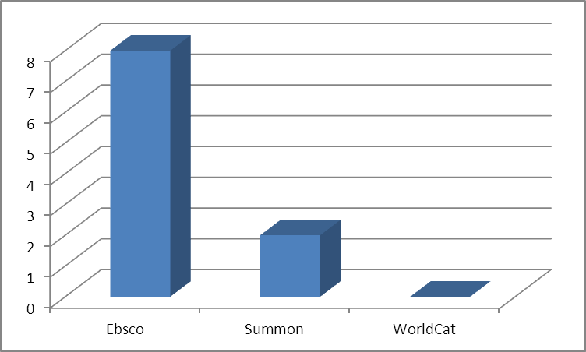
Focus Groups
How would you rate the systems overall?
Which system did you prefer?
Notes:
To inform our initial decision over which system to go with we used user feedback. We utilised feedback from academic staff, library staff and students who were asked to evaluate and comment on the systems after attending demos as part of the tender process. As you can see EBSCO scored highly in our evaluations.

Slide 4
Comments on Discover
I like the fact it is very clear what kind of resource we are looking at (journal article, book etc.) (Student)
I think students will find it easy to use, and it is attractive.(Student)
EBSCO seems to tick these boxes as it has enough complexity (e.g. saving to folder, citation, clear limiters) and relative user-friendliness (but not so like Google it could well be Google).
(Academic Staff)
Notes:
In the focus groups we had a number of positive comments about EDS

Slide 5
Staff feedback on name
Suggestions included:
Library Search
One Stop Search
Doctor Discovery’s Never Ending Magical Knowledge Box
The “Not just a book lover so uncover discover” search tool
…And the winner is “Discover”
Notes:
Our library staff voted on the name of the service. Above are some of the examples!

Slide 6
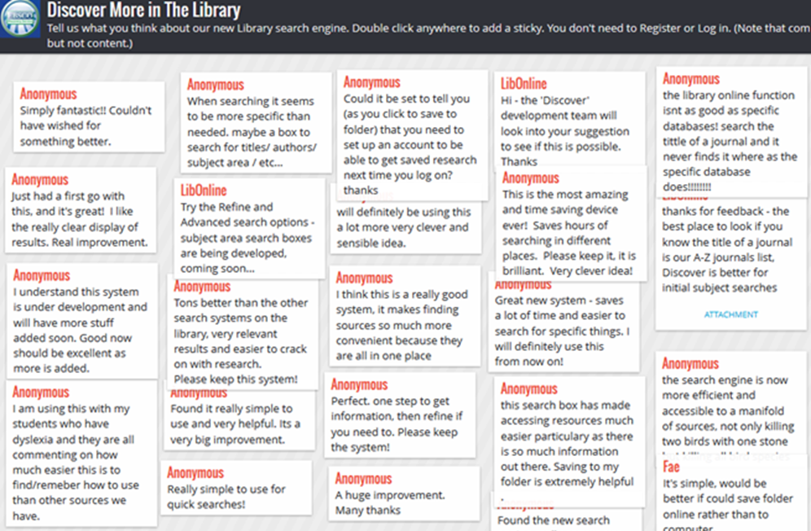
Comments from Padlet
Perfect. one step to get information, then refine if you need to. Please keep the system!
Simply fantastic!! Couldn't have wished for something better.
This is the most amazing and time saving device ever! Saves hours of searching in different places. Please keep it, it is brilliant. Very clever idea!
Notes:
We initially did a soft launch of Discover 4 months. In this period we utilised user feedback from students and staff to inform the look and feel. These included amending the look and feel of the site renaming facets and headings and adding local links.
We also used wallwisher to raise awareness and gather views on the new "Discover" search service.
I am using this (Discover) with my students who have dyslexia and they are all commenting on how much easier this is to find/remember how to use than other sources we have
(Discover) is the most amazing and time saving device ever! Saves hours of searching in different places. Please keep it, it is brilliant. Very clever idea!
this search box has made accessing resources much easier particularly as there is so much information out there. Saving to my folder is extremely helpful
Perfect. one step to get information, then refine if you need to. Please keep the system!
Simply fantastic!! Couldn't have wished for something better.

Slide 7
Subject specific boxes
Notes:
Following liaison with our academic librarians we created EDS profiles for each of our subject areas and added subject specific databases to those profiles.
We put these on our Academic Librarian’s resources pages. This improved the ease of searching for resources in a particular subject students and accessibility to subject specific databases.

Slide 8
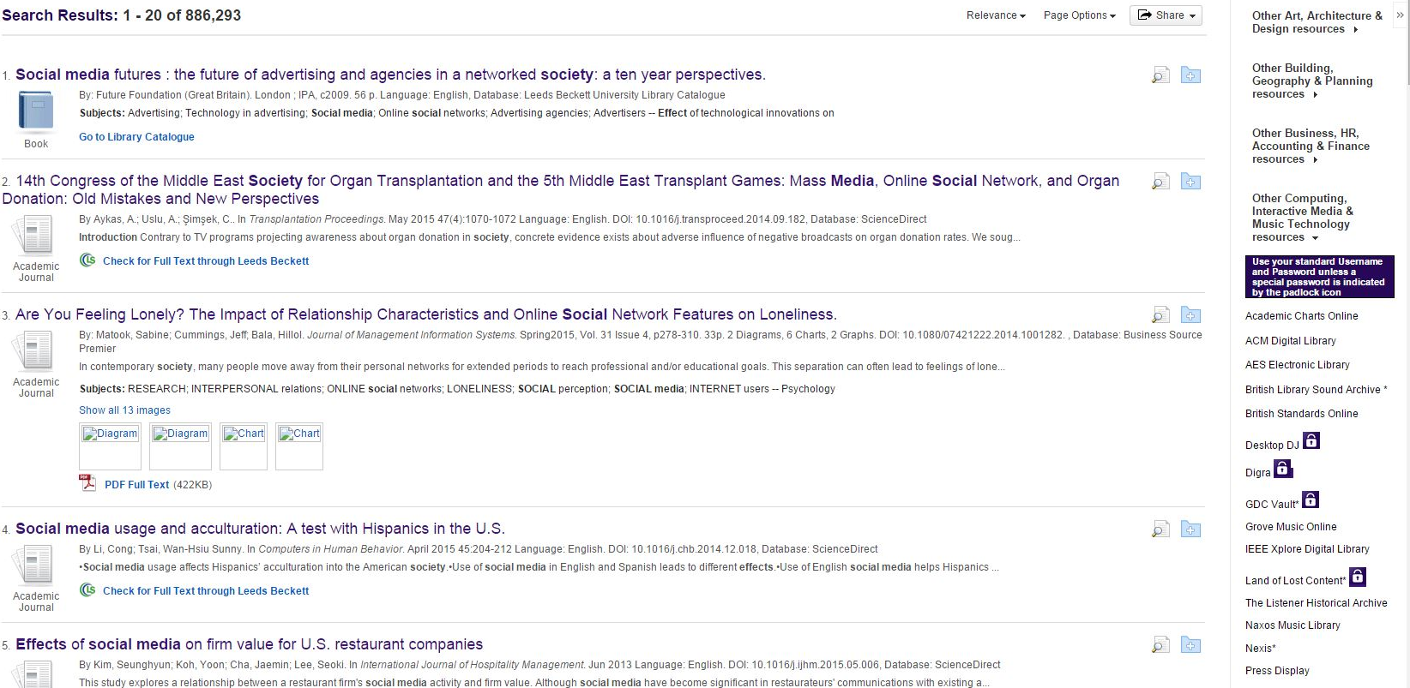
Databases not on Discover
Notes:
As with all discovery systems you cannot get 100% of all your libraries content to be searchable. After consultation with our academic Librarians we created a databases not yet on discover page which listed the databases that were not searchable through Discover.
Last year we utilised a widget to put a list of these databases on the results page.

Slide 9
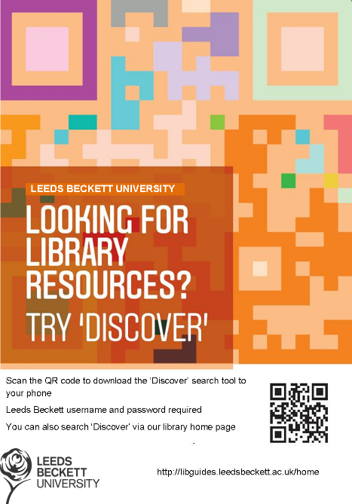
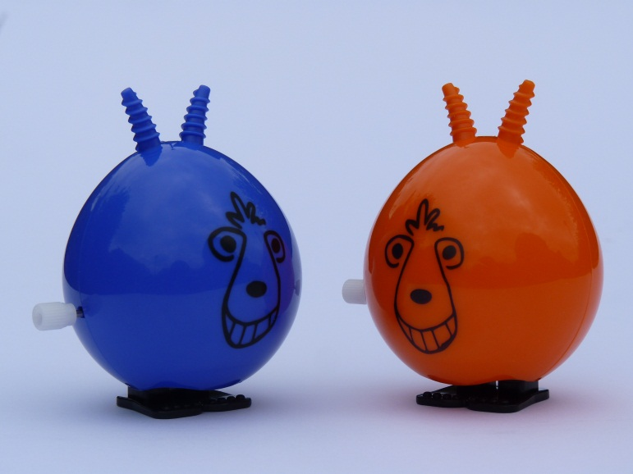
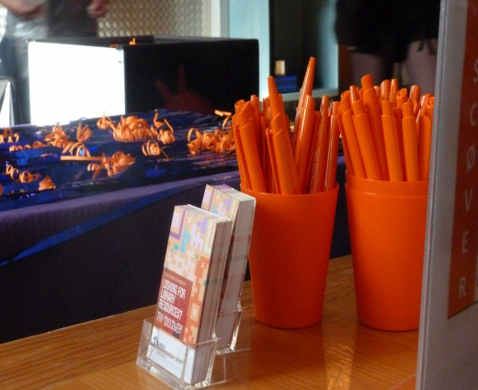
Marketing Materials
Notes:
We undertook a marketing project to raise awareness and usage of Discover by Library staff, academic staff and students and to increase usage of specific databases accessed via Discover
The Library worked with the University’s marketing department to create a set of marketing materials. These were brightly coloured, predominantly orange, to contrast with our normal branded colour of purple. Recoils, posters, pens and business cards with a QR code linking directly to the service via mobiles (see attached image) were used to promote the service (see accompanying photos).

Slide 10
Promotion to staff and students
Discover training hours and Skills for Learning workshops
Promotional materials given away at the Library Help and Information Point
Publicity including news items on the library website
Student library inductions
University wide new staff induction sessions
University’s annual Course Leader Conference in summer 2012
Notes:
We promoted discover to staff and students at training hours and inductions and encouraged feedback and suggestions on how to improve the service.

Slide 11
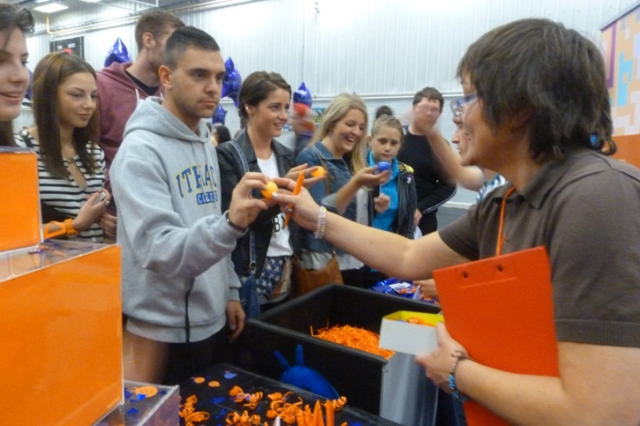
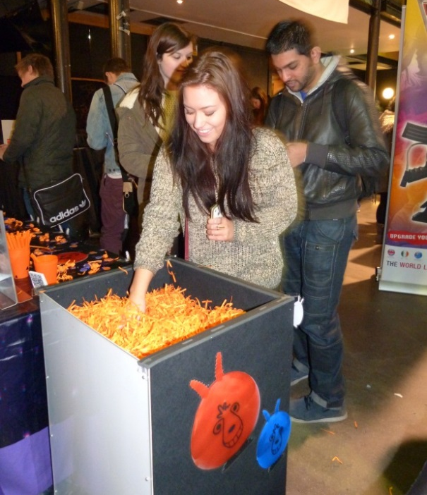
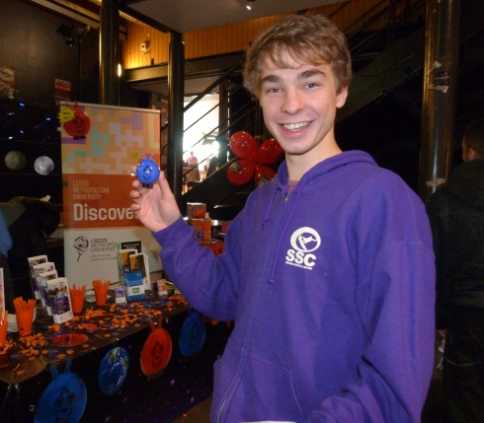
Promotion: Freshers Fair
Notes:
The Library have promoted Discover at the annual Freshers’ Fair, held on each campus. This is a good way to get out to the students and even if they just go away knowing the name discover it’s a start.
The theme for 2012 was Discover your Library! This involved a lucky dip with wind-up space hoppers as the prize (a somewhat tenuous link between space and discovery but which proved highly popular and neatly picked up on the retro orange colour!). Over 1500 students also took away pens and business cards.

Slide 12
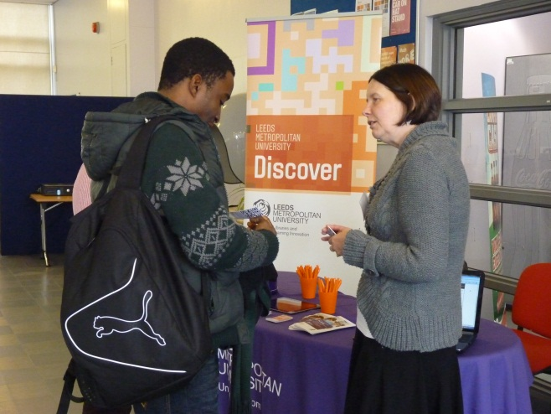
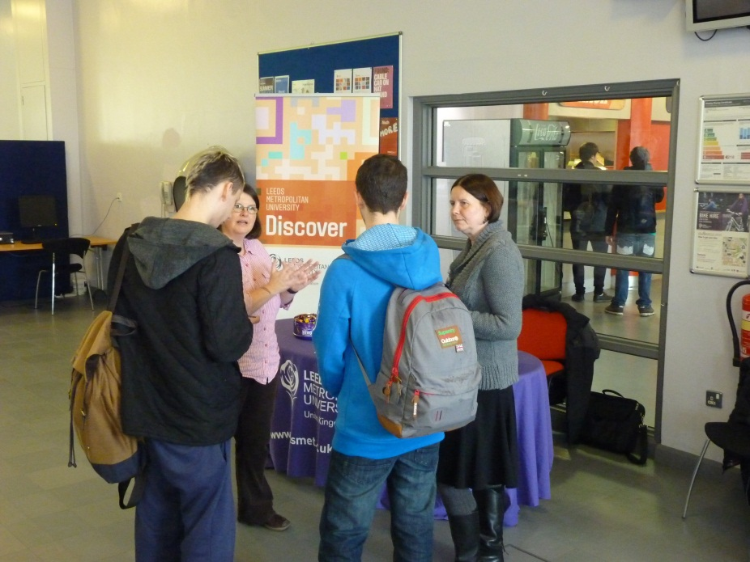
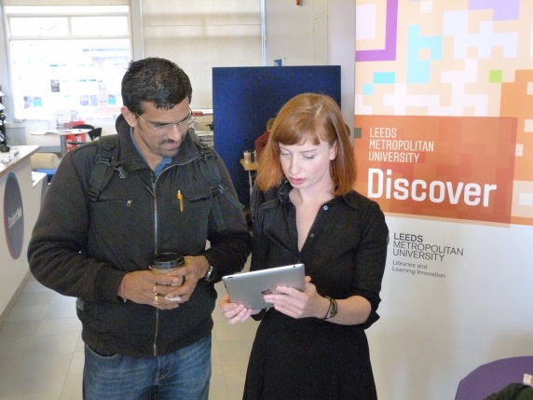
Promotion: Roadshows
Notes:
We undertook Discover roadshows taking the service out of the Library to Faculty buildings across the campuses, and encouraging students to access the service on their mobiles with approximately 250 students attending.

Slide 13
Evaluating impact
Anecdotal evidence was collected at roadshows
2013-14 Reading lists more closely related to the Library collections.
No comments in University’s 2014 internal student survey about difficulties of accessing journal articles, in comparison to earlier feedback.
Discover mentioned in course reviews, teaching sessions and one-to-ones: "a brilliant tool which made searching for specific work much easier and less time-consuming".
Praised by the Students’ Union Executive as an example of how the Library listens to and responds to the needs of students.
Notes:
We avoided using surveys on the Discover service as the university already runs a number of those and we wanted to avoid survey fatigue. Rather we collected anecdotal evidence during the roadshows. Many students said they had already heard of the service at Freshers’ and through Library inductions and were already finding it useful.
Academic Librarians reported that reading lists being submitted for 2013-14 are more closely related to the Library collections, suggesting that academics are finding it easier to find resources.
There were no comments in the University’s 2014 internal student survey about difficulties of accessing journal articles, in comparison to earlier feedback. This was a key indicator that we have been able to improve the student experience.
Discover is frequently mentioned by both academic staff and students in course reviews, teaching sessions and one-to-ones and has been overwhelmingly positive “"a brilliant tool which made searching for specific work much easier and less time-consuming". It was also praised by the Students’ Union Executive as an example of how the Library listens to and responds to the needs of students.

Slide 14
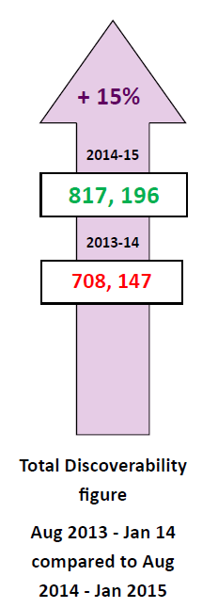
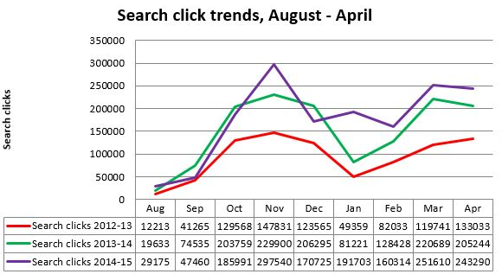
Discover usage - search click trends
Search clicks are the number of times any Discover search button has been clicked.
This includes:
The Discover search box on MyBeckett (the VLE)
The quick access points on the Library website
Search buttons within Discover itself
Notes:
As well as feedback we have spent a lot of time gathering and collating statistics to see how Discover is working for us. We publish statistical dashboards biannually to promote the high usage of our Discover service to stakeholders.
The graph here shows our search click tends comparing August to April over the last 3 years. Search clicks are the number of times any Discover search button has been clicked.
We have these sent by EBSCO monthly. We use search clicks as it gives a more realistic viewpoint of our discover usage. Because searches are run across all resources simultaneously, one search is logged for each resource in the EDS profile. For example, if you have 10 EBSCOhost databases and a user runs 25 searches in EDS, the usage statistics would show 250 searches instead of 25 searches.
The search click total includes:
The Discover search box on MyBeckett (the VLE)
The quick access points on the Library website
Search buttons within Discover itself
The surges reflect the academic year and show a marked increase in search clicks.

Slide 15
Discover usage - subject profiles
Subject profiles ranked by number of full text requests, August 2014 – April 2015
 | Total
EBSCO Discovery Service - Health (eds_hea) | 1332
EBSCO Discovery Service - Business (eds_bus) | 1331
EBSCO Discovery Service - Tourism and Languages (eds_tou) | 789
EBSCO Discovery Service - English and History (eds_eng) | 648
EBSCO Discovery Service - Social Sciences (eds_soc) | 630
EBSCO Discovery Service - Film, Media and Performing Arts (eds_fil) | 481
EBSCO Discovery Service - Human Geography, Housing and Planning (eds_hum) | 461
EBSCO Discovery Service - Music and Creative Technology (eds-mus) | 406
EBSCO Discovery Service - Computing, Built Environment and Engineering (eds_com) | 369
EBSCO Discovery Service - Art (eds_art) | 349
EBSCO Discovery Service - Finance and Law (eds_fin) | 332
EBSCO Discovery Service - Education and Childhood (eds_edu) | 307
EBSCO Discovery Service - Events Management (eds_eve) | 84
EBSCO Discovery Service - Sport and PE (eds_spo) | 81
EBSCO Discovery Service - Hospitality and Retailing (eds_hos) | 53
Total full text | Aug 2013 – April 2014 | Aug 2014 – April 2015 | % change, 2014-2015
Main profile | 520546 | 575483 | 10.55
Subject profiles | 4117 | 7567 | 83.80
Total | 524663 | 583050 | 11.13
Subject profile vs main profile - % of total full text
2013-2014: 0.78% subject, 99.22% main
2014-2015: 1.30% subject, 98.70% main
Notes:
We have been investigating where our users are accessing Discover from
We have a number of subject specific profiles in Discover and recently we have been reporting on their usage. This is to inform our academic librarians so they can see the usage for their subjects.

Slide 16
Discoverability Key Performance Indicator
KPIs help an organisation to define and measure progress towards its goals.
Discoverability of resources Increase in "Discoverability Statistics" from Discover - full text requests (PDF or HTML) and abstract views
Notes:
This last year we have developed and been evaluating a set of Key Performance Indicators (KPIs) which we can use to track our progress and achievement of our strategic objectives. KPIs help an organisation to define and measure progress towards its goals.
We have also recently created a Discoverability Key Performance Indicator in relation to a need for more accurate e-resource service standards.
Discoverability of resources is a new measure to reflect user activity in Discover.
Discoverability of resources Increase in "Discoverability Statistics" from Discover - full text requests (PDF or HTML) and abstract views.
This is a Key Performance Indicator which links in with our strategic objective of:
Discoverability and accessibility:
We will work with our suppliers and stakeholders to optimise the discoverability and accessibility of the resources and content which we purchase, ensuring that students and staff are able to obtain the widest range of resources to support the curriculum at the time and point of need, and through the platforms and devices of their choice.

Slide 17
Discoverability Key Performance Indicator
Discoverability is a new measure to reflect user activity in Discover. This needs a broader approach than traditional search and download figures.
Discoverability of resources is one of LLI’s key performance indicators for 2014/15 (5.2).
2014-15
(2013- 14)
+ 9%
583050 full text requests (524,663) 762,882 abstract views (650,614)
2014-15
1,345,932
2013-14
Total Discoverability
1,345,932 (1,175,277)
1,233,664
Total Discoverability figure
Aug 2013 – Apr 2014 compared to Aug 2014 – Apr 2015
Notes:
We are evaluating our Discoverability KPI annually and hope to see an increase. This year when comparing Aug 2013-14 with Aug 2014- April 2015 we have seen a 9% increase.
Discoverability is a new measure to reflect user activity in Discover. This needs a broader approach than traditional search and download figures.
Discoverability of resources is one of LLI’s key performance indicators for 2014/15 (5.2). Our KPIs are measurable standards. Report on a semester basis.
We add the figures for full text and abstracts so it might be possible we are double counting. However this is just an institutional annual comparison and we’re not benchmarking. If an industry standard is introduced we would have to re-evaluate.

Slide 18
Guides and FAQs
Notes:
We originally envisaged Discover would be an search engine and a lot of our users do use it this way. However through user feedback from library staff working on the frontline service, academic staff and students we recognised that a number of our users wanted to do more with it than just a quick keyword search. We had originally written document help guides on using Discover but with our implementation of libguides for our library website we were able to develop a libguide with a set of FAQs on Discover including details of how to refine. We also developed a Discover versus google guide on the benefits of using Discover over google following a request by our Disability Support Officer who had had feedback from her students who were using google rather than discover. She wanted a clear visual representation of the benefits of using Discover rather than just wordy statements. This was well received by students with disabilities.

Slide 19
Library Shorts
http://youtu.be/YNnjZTt_F64
http://youtu.be/xlfeXbOeDWk
http://libguides.leedsbeckett.ac.uk/resources/discover
Notes:
Based on user feedback we have created short videos on how to search Discover which includes accessing it through the university VLE MyBeckett thus reflecting the fact we recognise students are going to the VLE first rather than accessing Discover from the library website.

Slide 20
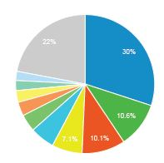
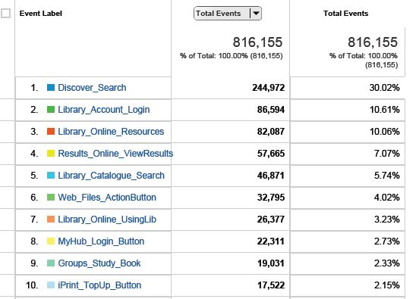
Discover on the VLE Aug 2014-May 2015
Notes:
Using google analytics we have been evaluating how many users are accessing Discover via the Virtual Learning environment
Of all the button-clicks that we measure on mybeckett, the Discover search button on the library tab gets 30%. (244,972 since august 8th)
Library account login gets 10% (86.594)
Catalogue search gets 6% (46,871)

Slide 21
Future plans/Wishlist
Investigating apps in EBSCO Orbit including LibGuides: Recommended Research Guides
Search terms transferable to external websites
Single sign-on
Search terms used in Discover to inform promotion, current awareness and information skills training.
Comparison of search clicks via different places (library website, subject profiles and VLE)
Daily search click results to evaluate impact of inductions
Google analytics for Discover
Notes:
We will investigate some of the apps in EBSCO Orbit as a possible follow on from the databases not on Discover
LibGuides: Recommended Research Guides
Use EDS as a portal into relevant research guides.
Search terms transferable to external database sites
Single sign using active directory or shibboleth – means will automatically login to EDS folder – will avoid issue of results only saving to a temporary folder. Wouldnot need ot authenticate
Analysing the search terms that are being used in Discover to inform promotion, current awareness (so many people searched for this term, that kind of thing) and information skills training.
Comparison of search clicks via different places (library website, subject profiles and VLE)
Daily search click results to evaluate impact of inductions
Google analytics in Discover – applying GA to our EDS profile

Slide 22
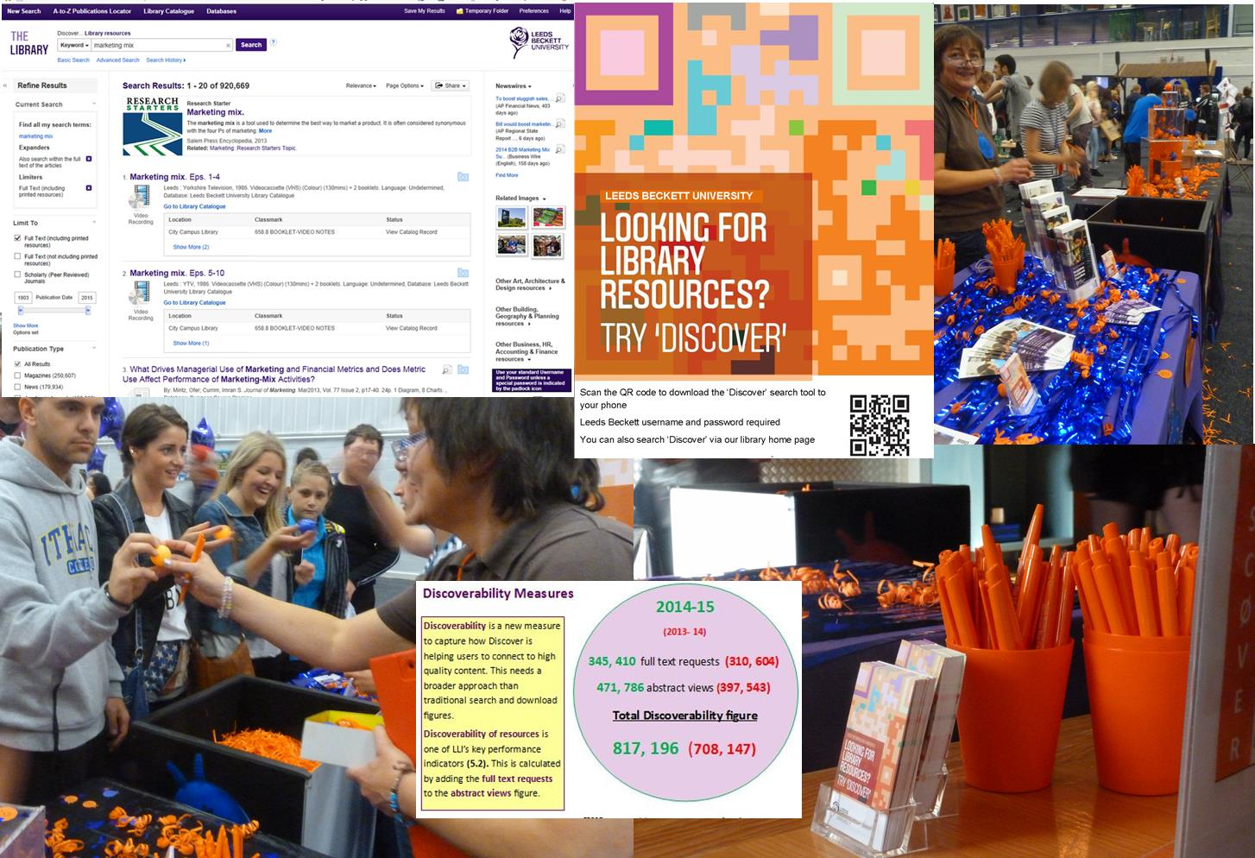
Questions?
J.Cleverley@leedsbeckett.ac.uk

