Slide 1

Embedded and visible: balancing the university library in the digital age
Jo Norry
Director of Libraries and Learning Innovation
Leeds Beckett University
@JPNLeeds
NoWAL Conference, 15 July 2015

Slide 2

The Conundrum
What makes for a successful University Library?
Relevance
Value
Integration
Embeddedness
And Visible
https://commons.wikimedia.org/wiki/File:Rubiks_cube_by_keqs.jpg

Slide 3
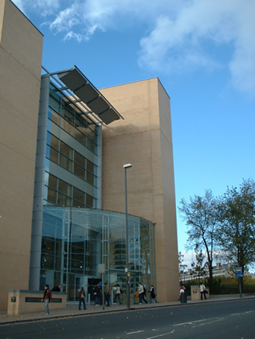
How we see ourselves
Central: heart of the campus, large buildings
Embedded: integral part of courses, services, processes
Valued: Well loved by students, positive student feedback
Important : Large staff and budget
Relevant: Skills embedded into courses, research support
Essential: vital element of University operation

Slide 4
How others (may) see us
Expensive: Large budget, lots of staff, virtual content
Easy to manage: Well run, straightforward
Space hungry: Large buildings (sometimes empty)
Old fashioned: Books not digital; won’t open access mean it’s all free?
Peripheral: Not critical to highest priorities, not problem-driven
Difficult to evaluate: Not one of University KPIs, 1 NSS question
Invisible: Online; mixed in with other services
Librarians = people who work in a Library

Slide 5
So why has this happened?
Technological
  Digital information and content
  Online services and help
  End user systems (and Google)
  E-learning, blended learning and distance learning
  Changing research workflows
Economic
  Value for money / Fees
  Value and impact / Transparency and accountability
Political
  Organisational trends: convergence, devolution
  Deeper structures
  Public libraries’ fate?

Slide 6
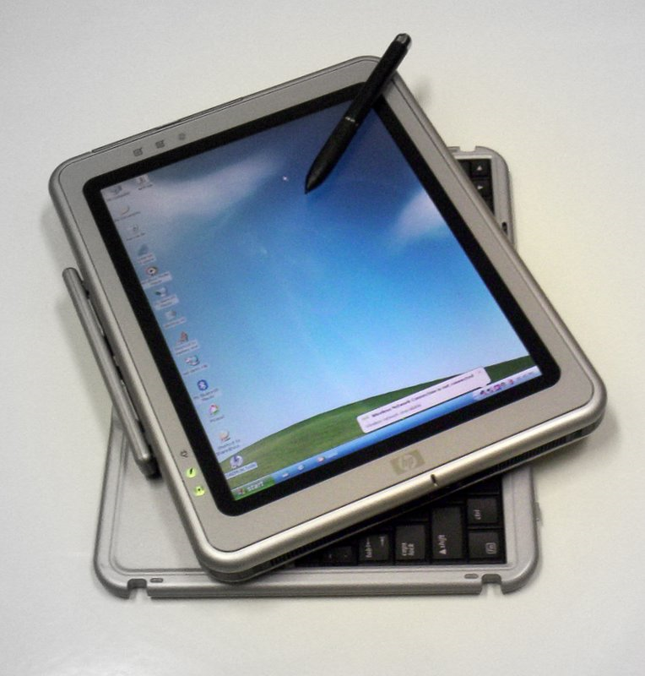
Digital visibility
Service portfolio and structures
VLEs and learning technologies
Student skills
Support
Research
Library as a platform and a brand
https://en.wikipedia.org/wiki/Microsoft_Tablet_PC#/media/File:HP_Tablet_PC_running_Windows_XP_(Tablet_PC_edition)_(2006).jpg

Slide 7
Service portfolio
Libraries and Learning Innovation
Libraries
IT support for students
Virtual learning environment
Portal
Learning & research technologies
Skills for Learning: academic writing, maths, statistics, IT skills

Slide 8


VLEs and learning technologies
Virtual Learning Environment
Content
Support
Development
Collaboration
Learning technologists / instructional designers
Educational developers
Distance learning development
Expertise
Digital rights; copyright
Intellectual property rights

Slide 9
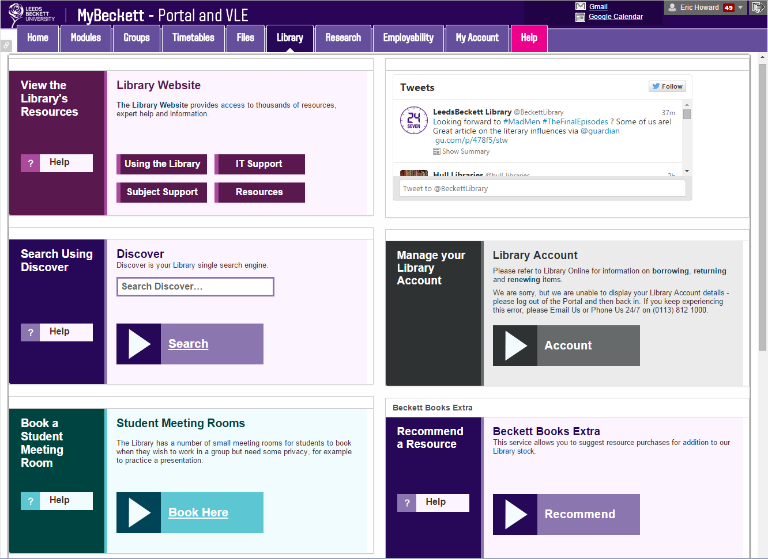

Typical Student Layout
Slide: Barbara Becker, Leeds Beckett University

Slide 10
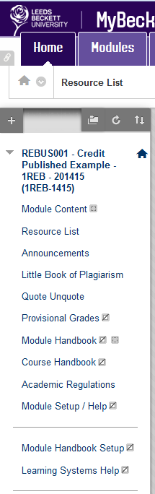
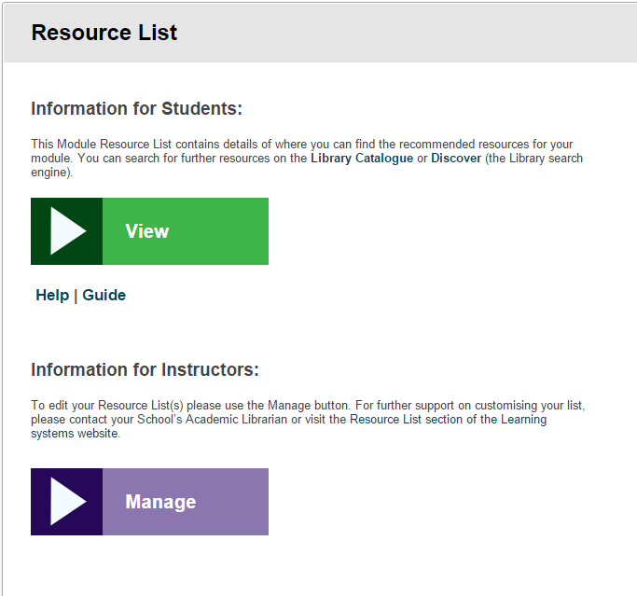
Slide: Barbara Becker, Leeds Beckett University

Slide 11

Library Survey Results - Semester 1 2014-15
Q: How do you access Library information?
A: 80% of respondents access Library resources via Blackboard Learn
Slide: Barbara Becker, Leeds Beckett University

Slide 12

Student skills
Information skills
Information literacy Digital literacy
Graduate attributes and employability
Digital identity and digital wellbeing
Academic skills
Academic writing
Referencing
IT
Maths

Slide 13
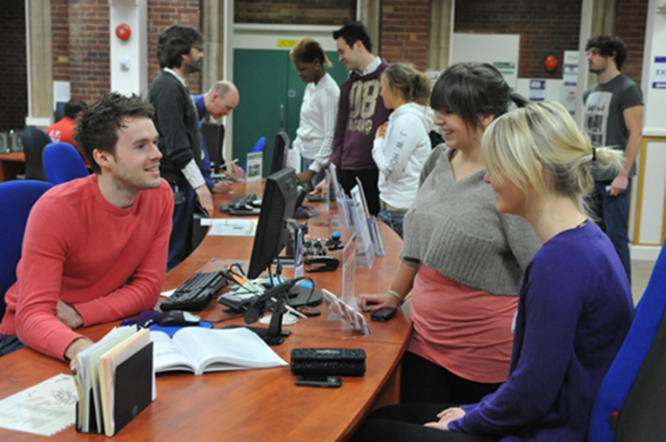

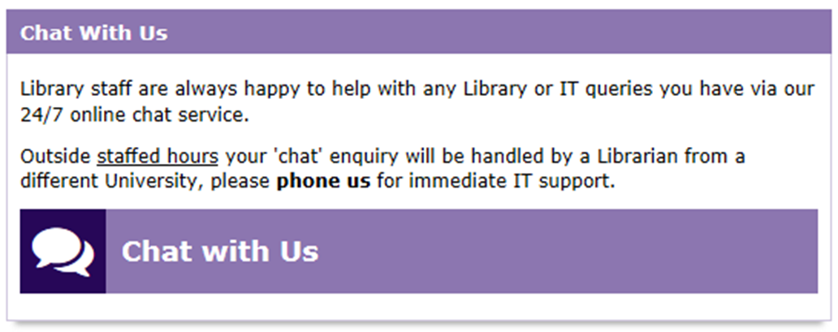
Support
Integrated IT support
Online chat and social media
Customer service

Slide 14
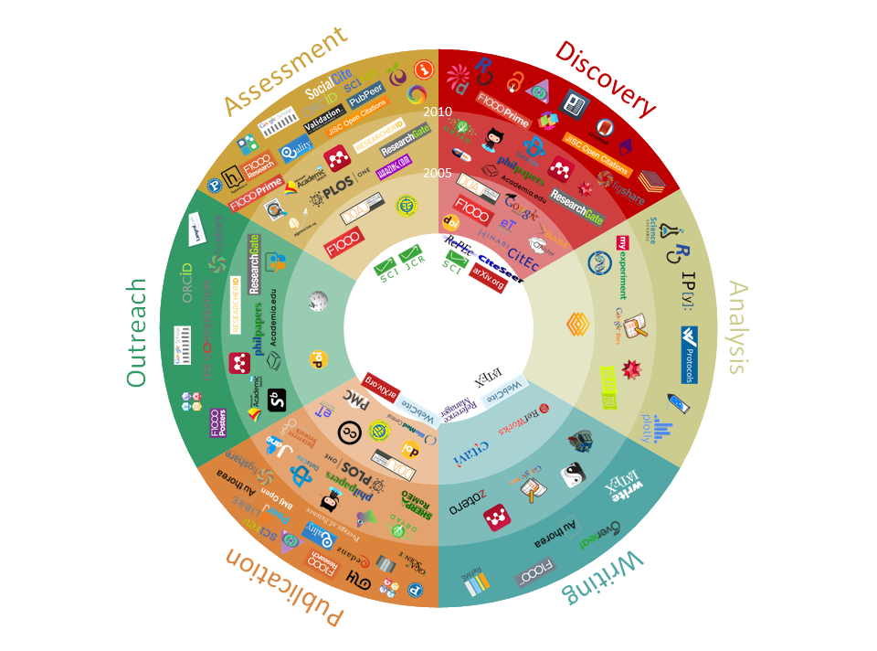
Research: Scholarly communications
University of Utrecht, 101 innovations in scholarly communication, Bosman & Kramer, Innoscholcomm.silk.co

Slide 15
Research
Research workflows
Open access
Bibliometrics
Research data management
Research bids
Research visibility
Repositories
Current Research Information Systems
Research Excellence Framework
Social media

Slide 16
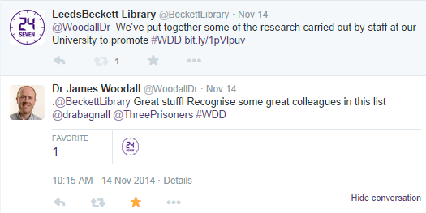
Research visibility: Twitter
Slide: Nick Sheppard, Leeds Beckett University

Slide 17

Research visibility: Instagram
Slide: Nick Sheppard, Leeds Beckett University

Slide 18

Teaching and learning visibility
Recognition and parity
Teaching qualifications / PG certificates
Higher Education Academy Fellowships
Teacher Fellow Networks
National Teaching Fellowships

Slide 19

https://commons.wikimedia.org/wiki/File:Breaking_long.png

Slide 20
Teaching Excellence Framework
“Teaching at the heart of the system”, Jo Johnson, 1 July
Set of measures to drive up standards in teaching
Outcome-focused criteria and metrics
Learning gain: improvement in knowledge, skills and work-readiness that students demonstrate over time
What outcomes do libraries deliver?
What metrics could we use?

Slide 21
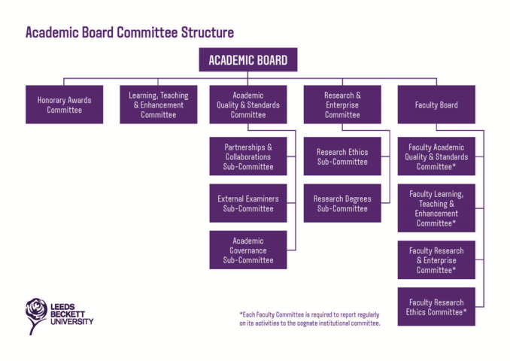


Where (else) to be visible
Deliberative committees
Working groups and projects
Conferences and events
Quality assurance and enhancement
Access Agreement
Strategy for Access and Student Success (SASS)

Slide 22
The embedded visible university library
Be everywhere and be easy to work with
High profile tasks of clear value
Library as a byword for…..
  Trust and quality
  Responsiveness and flexibility
  Collaboration and partnership

Slide 23
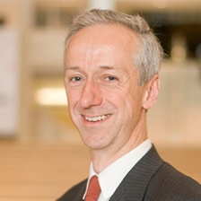

“The most powerful and resilient network of all”
Roly Keating, Director of British Library
http://www.bl.uk/aboutus/governance/blboard/memberslist/rkeating/
Notes:
Speaking at the Hay Literary Festival in May 2015
“When we talk about libraries, I’m told about the old values, the traditional values of these institutions. Some believe they are being replaced by new ones about being more open and connected and virtual. Our belief, passionately, … is that it’s about both. And that’s the great richness of what a library is and can be…”
“With all our fascination of and love for the internet in the age of data, these values of trust, freedom, authentication, and the values and idea of the library predated the internet and if we get it right may yet outlast it. And in some ways they are the most powerful and resilient network of all, if we continue to believe in them.”

Slide 24
