Slide 1
LEEDS BECKETT UNIVERSITY
Extending and measuring reach and impact of research output: #openaccess, social media and “alternative metrics”
Nick Sheppard
Repository Developer

Slide 2
Open Access
Open Access (OA) means that items of scholarly work are made available online, in a digital format, at no charge to the reader and with limited restrictions on re-use.
Gold and Green models
Hybrid
Finch and RCUK (2012)
HEFCE
Research Data Management

Slide 3
HEFCE bombshell (April 2013)
“to be eligible for submission to the post-2014 REF, authors’ final peer-reviewed manuscripts must have been deposited in an institutional or subject repository on acceptance for publication”
Applies to journal articles and conference proceedings accepted for publication after 1 April 2016
Urge HEIs to implement now
Where there is an embargo, authors can comply by making a ‘closed’ deposit on acceptance
Various exceptions
Deposit on acceptance delayed until April 2017

Slide 4
Trends and initiatives
Broader online infrastructure
Mendeley / Figshare / academia.edu / ResearchGate
Plain English communication
Blogs / social media
Measuring impact
Case studies
Metrics
Trad / Article level / alternative
Books & monographs
OAPEN-UK
University presses and library publishing
Open Journal System (OJS)
UCL – fully OA university press
Open Library of the Humanities
ORCID
Etheses
EThOS

Slide 5
Jisc services
Jisc Publications Router
Jisc Monitor
RIOXX
dcterms:dateAccepted
rioxxterms:apc
rioxxterms:version_of_record
Sherpa/RoMEO/Juliet/FACT
IRUS-UK
OAPEN-UK
OA button

Slide 6
OA and impact
Fundamentals of research?
Creating, using, sharing and accessing information
Increases efficiency of research process
Evidence of increased citation
The Open Access Citation Advantage Service - http://sparceurope.org/oaca/
As scholarly communication moves increasingly online, more indicators have become available: how many times an article has been bookmarked, blogged about, cited in Wikipedia and so on. These metrics can be considered altmetrics – alternative metrics of impact. (Piwowar 2013)
Notes:
Research can be easily disseminated online amongst communities of researchers and interested lay people, via social media for example, and it is clearly beneficial if that research is freely accessible on the open web rather than restricted by subscription access.

Slide 7
Bibliometrics
“the branch of library science concerned with the application of mathematical and statistical
analysis to bibliography; the statistical analysis of books, articles, or other publications.”
(Oxford English Dictionary Online)
Citation count & h-index
Journal Impact Factor (JIF)
Other impact measures
Knowledge transfer
Activities (presentations, consultancy, review)
Prizes
Public engagement / education
Policy documents
Media
TV and radio
Blogs/social media

Slide 8
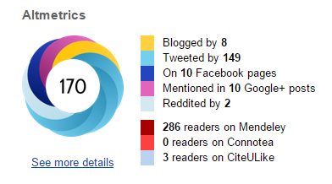
Alternative metrics
Article level metrics
frontiers in Psychology http://journal.frontiersin.org/article/10.3389/fpsyg.2013.00058/abstract
PLoS One http://journals.plos.org/plosone/article?id=10.1371/journal.pone.0121708
Repositories
IRUS-UK
Statistics at Leeds Beckett
The end of JIF?
Various flavours
Plum analytics - http://www.plumanalytics.com/
Impact story - https://impactstory.org/
Altmetric - http://www.altmetric.com/

Slide 9
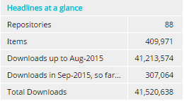
IRUS-UK
COUNTER compliant download stats
88 participating UK repositories (September 2015)
Plug-ins for EPrints and Dspace
Bespoke implementation for other platforms
Authenticate via UK federation http://www.irus.mimas.ac.uk/

Slide 10
Repository (Northern Collaboration - 15/25 members are IRUS participants) | Date starts | Total no. of unique items downloaded | Downloads to August 2015
University of Salford USIR | July 2012 | 12,905 | 2,287,232
University of Huddersfield Repository | July 2012 | 8,718 | 1,013,630
ORO – Open University | Nov 2012 | 9,793 | 2,072,079
Lancaster EPrints | May 2013 | 7,252 | 991,173
Edge Hill Research Archive | July 2013 | 580 | 43,135
SHURA (Sheffield Hallam) | Sept 2013 | 2,589 | 622,537
University of Cumbria - Insight | Sept 2013 | 236 | 10,057
WRRO (York, Leeds, Sheffield) | Oct 2013 | 15,514 | 1,388,727
TeesRep – Teesside University | May 2014 | 952 | 147,175
ChesterRep – University of Chester | May 2014 | 1,138 | 86,751
Manchester eScholar | June 2014 | 16,422 | 727,662
University of Hull, Hydra | Sept 2014 | 5,439 | 209,485
LJMU Research Online | Dec 2014 | 951 | 4,398
Leeds Beckett University | Jan 2015 | 1,194 | 16,361
CLOK (UCLAN) | May 2015 | 1,930 | 40,267
 |  | 85,613 | 9,660,669

Slide 11
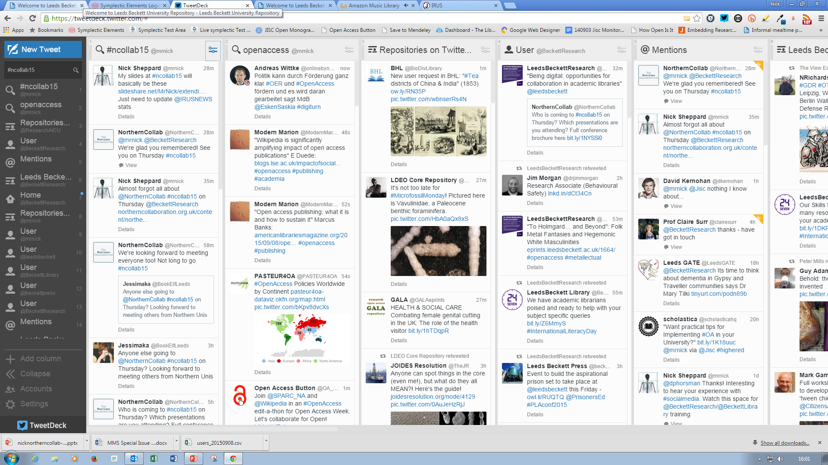
Online networks
https://twitter.com/BeckettResearch/lists/leeds-beckett-university/members

Slide 12
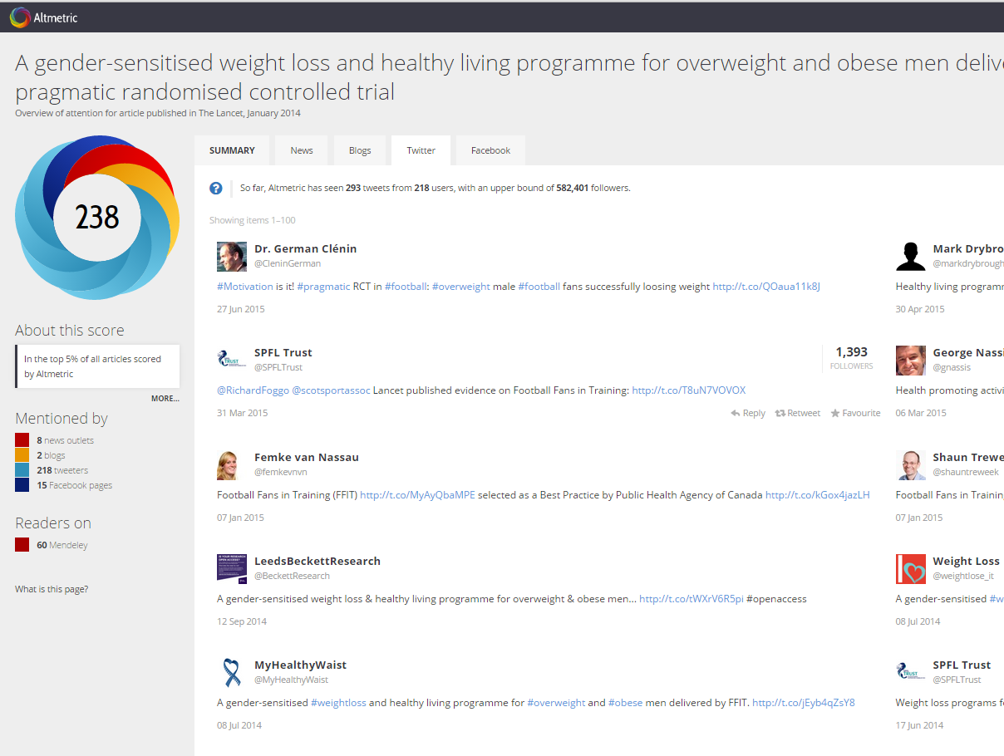

Slide 13
Notes:
Libguides,our content management system, and Symplectic Elements, infrastructure supporting uni repository, working together around selected theme days e.g. Mental Health awareness week, Eating disorders week, the general election etc. Research tagged by Librarian, coding to link the two together, auto display of open access institutional research outputs & links to author versions, self archived in Eprints available along green oa publishing route

Slide 14
Notes:
Highlight links to external and local organisations too Tweets from @BeckettLibrary and @BeckettResearch including targeted tweets to organisations & key academic staff.

Slide 15
Notes:
We are piloting a project whereby we choose celebration days or events where we can tweet a link to our research outputs in this area which are listed in a Libguide

Slide 16
Twitter analytics
Notes:
Just to follow on from this. We did have quite a good response from people about this.
The initial tweet got 709 impressions – see file attached
We tweeted it to 5 members of academic staff resulting in 3 RT, 2 favourites and 1 reply (see attached)
One academic RT as a MT resulting in 3 RT and 3 favourites

Slide 17
Twitter analytics

Slide 18
Response from Academic Staff

Slide 19
Instagram
Notes:
The Instagram resulted in 7 likes, including one from WDD. – see attached.
We got 22 hits on the Bitly link 18 from twitter and 4 unknown. 20 in UK , 1 in Ireland and 1 in Mauritius (Ieaun Ellis)
I can’t get into all the stats on FB, but it looks as though we got 1 like.

