Slide 1
LEEDS BECKETT UNIVERSITY
Leveraging a Library CMS and Social Media to promote #openaccess (OA) to institutional research output
Nick Sheppard
Research Services Advisor

Slide 2
Open Access
Open Access (OA) means that items of scholarly work are made available online, in a digital format, at no charge to the reader and with limited restrictions on re-use.
Gold and Green models
Hybrid
Finch and RCUK (2012)
HEFCE and REF

Slide 3
Research Excellence Framework (REF)
Assess quality of research in UK HEIs
36 Units of Assessment
Selected outputs
Impact case studies
Inform grant allocation

Slide 4
HEFCE bombshell (April 2013)
“to be eligible for submission to the post-2014 REF, authors’ final peer-reviewed manuscripts must have been deposited in an institutional or subject repository on acceptance for publication”
Notes:
Applies to journal articles and conference proceedings accepted for publication after 1 April 2016
Urge HEIs to implement now
Where there is an embargo, authors can comply by making a ‘closed’ deposit on acceptance
Various exceptions
Deposit on acceptance delayed until April 2017

Slide 5
Traditional bibliometrics
“the branch of library science concerned with the application of mathematical and statistical
analysis to bibliography; the statistical analysis of books, articles, or other publications.”
(Oxford English Dictionary Online)
Citation count & h-index
Journal Impact Factor (JIF)
Other impact measures
Knowledge transfer
Activities (presentations, consultancy, review)
Prizes
Public engagement / education
Policy documents
Media
TV and radio
Blogs/social media

Slide 6
OA and impact
Fundamentals of research?
Creating, using, sharing and accessing information
Increases efficiency of research process
Evidence of increased citation
The Open Access Citation Advantage Service - http://sparceurope.org/oaca/
As scholarly communication moves increasingly online, more indicators have become available: how many times an article has been bookmarked, blogged about, cited in Wikipedia and so on. These metrics can be considered altmetrics – alternative metrics of impact. (Piwowar 2013)
Notes:
Research can be easily disseminated online amongst communities of researchers and interested lay people, via social media for example, and it is clearly beneficial if that research is freely accessible on the open web rather than restricted by subscription access.

Slide 7
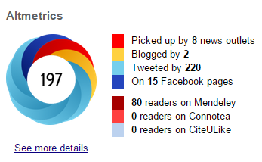
Alternative metrics
Article level metrics
frontiers in Psychology http://journal.frontiersin.org/article/10.3389/fpsyg.2013.00058/abstract
PLoS One http://journals.plos.org/plosone/article?id=10.1371/journal.pone.0121708
Repositories
IRUS-UK
Statistics at Leeds Beckett
The end of JIF?
Various flavours
Plum analytics - http://www.plumanalytics.com/
Impact story - https://impactstory.org/
Altmetric - http://www.altmetric.com/

Slide 8
Leeds Beckett University
26,000 students, 2,900 staff
Growing research profile - Research Institutes and Research Centres - some areas of longstanding excellence, e.g. Sport - newer areas also high profile, e.g. Retail, Men’s Health - positive outcome in the REF (Unit 26) - increasing numbers of research students
Enterprise activities
Looking ahead to REF2020
Notes:
Unit 26: Sport and Exercise Sciences, Leisure and Tourism

Slide 9
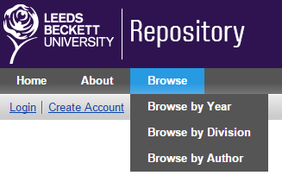
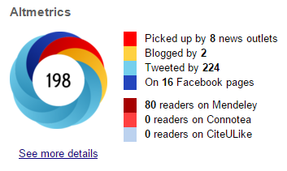
Infrastructure
Publication management software
Upload AAM* to repository
Bibliometrics (Citations, “Alternative metrics”)
__________________
Flexible API
Reporting of research outputs
Publication feeds to staff-profiles
Bespoke feeds (subject/keyword)
Aggregate data from multiple sources
LibGuides
*AAM – Authors’ Accepted Manuscript

Slide 10
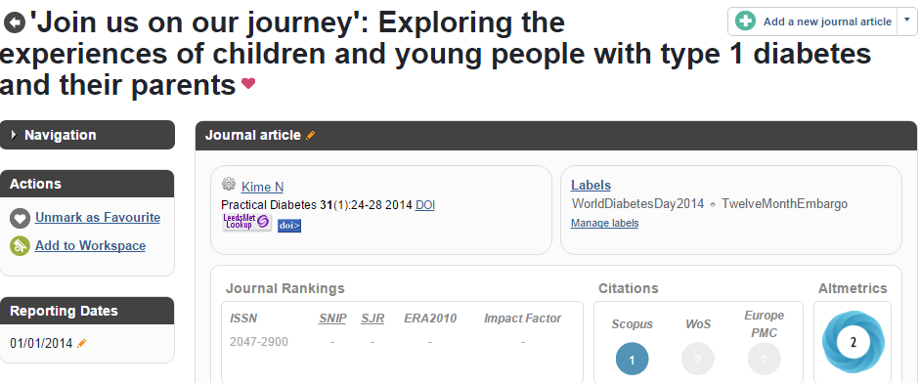
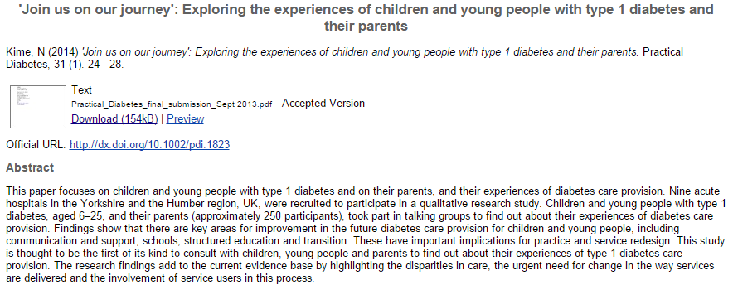
LibGuides
Notes:
Symplectic Elements:
Publication management software
Syncs with citation databases
Repository integration
Flexible API
LibGuides:
Springshare
CMS for libraries
Flexible widget support
Elements API

Slide 12
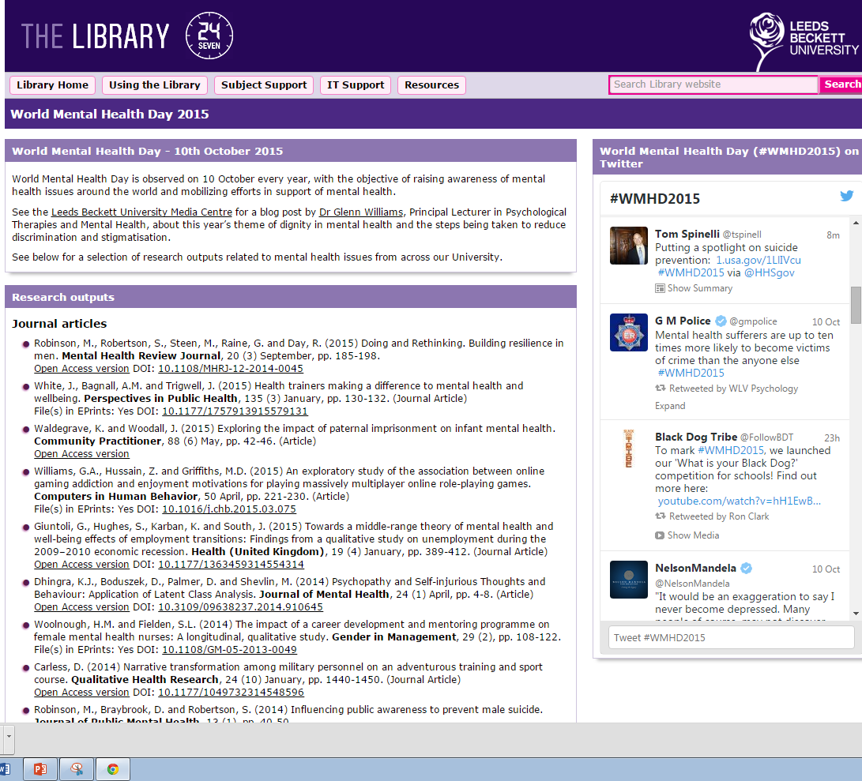
Notes:
Libguides,our content management system, and Symplectic Elements, infrastructure supporting uni repository, working together around selected theme days e.g. Mental Health awareness week, Eating disorders week, the general election etc. Research tagged by Librarian, coding to link the two together, auto display of open access institutional research outputs & links to author versions, self archived in Eprints available along green oa publishing route

Slide 13
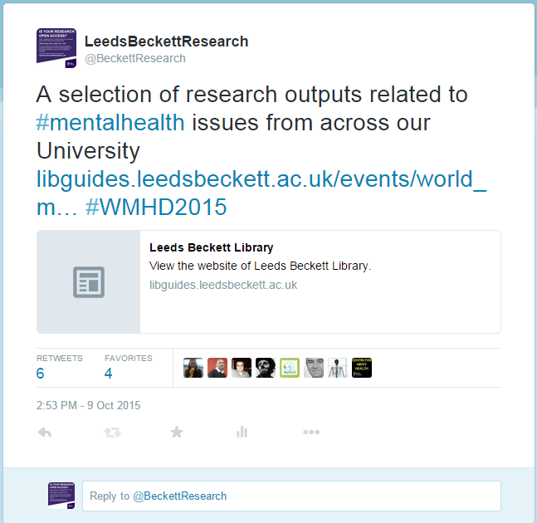
Tweet activity
Twitter analytics - https://analytics.twitter.com/
Notes:
We are piloting a project whereby we choose celebration days or events where we can tweet a link to our research outputs in this area which are listed in a Libguide

Slide 14
Other examples
Prison Research Network
International Women’s Day 2014
General Election 2015
Eating Disorders Week 2015
Men's Health Week 2015
50 years of Speech & Language Therapy
University Mental Health Awareness Day 2015
Dementia Awareness Day 2015

Slide 15
Online networks
https://twitter.com/BeckettResearch/lists/leeds-beckett-university/members
Notes:
240 members

Slide 16
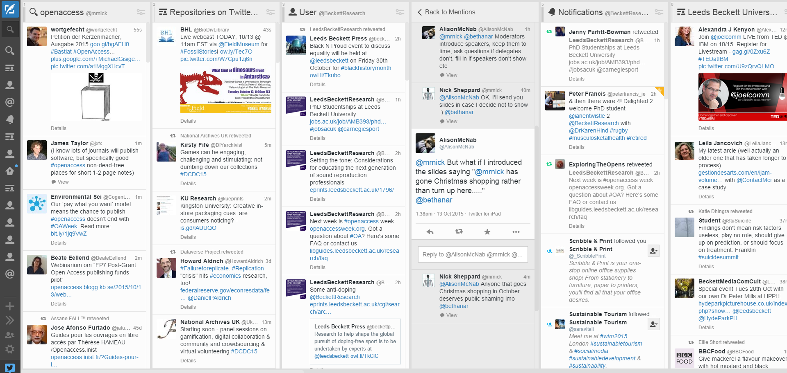
Keeping an eye on things…

Slide 18
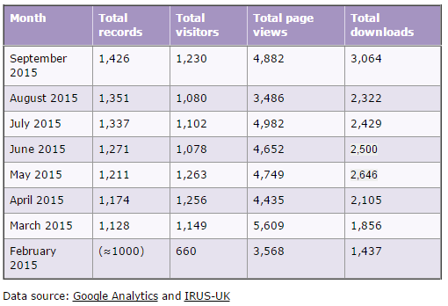
Key Performance Indicators
Notes:
Repository visitors, content & downloads
Google Analytics
IRUS-UK
Top ten articles
All time
Monthly
Altmetric scores
Top 10 by faculty
Twitter analytics

Slide 20
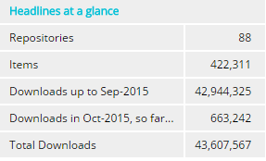
IRUS-UK
COUNTER compliant download stats
88 participating UK repositories (October 2015)
Plug-ins for EPrints and Dspace
Bespoke implementation for other platforms
Authenticate via UK federation http://www.irus.mimas.ac.uk/

Slide 21
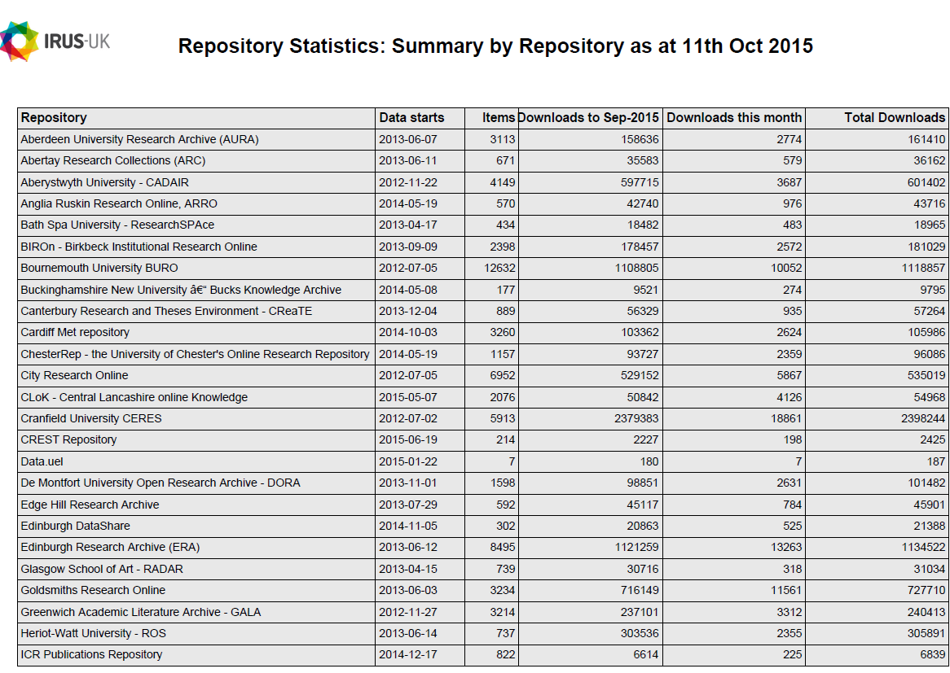

Slide 22
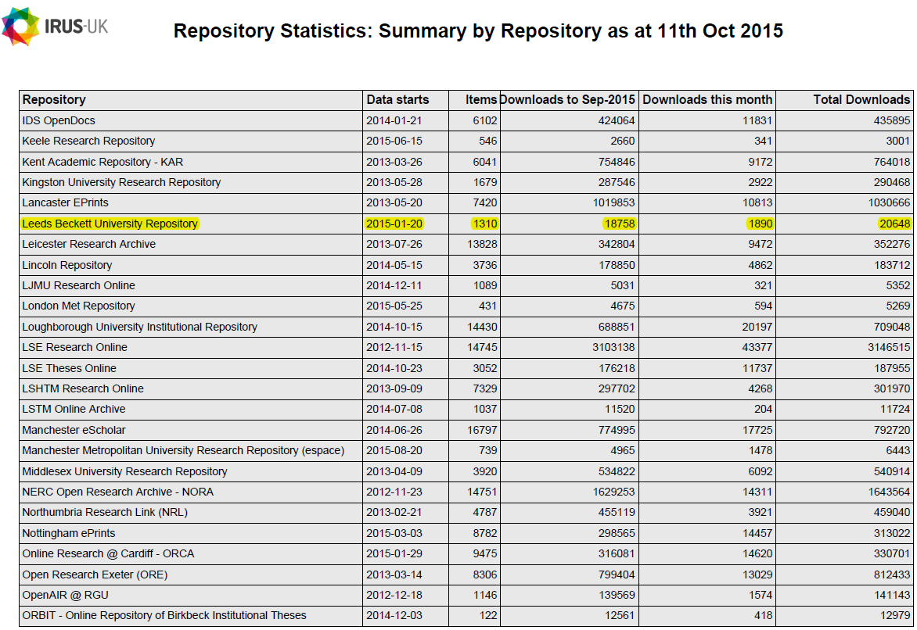

Slide 23
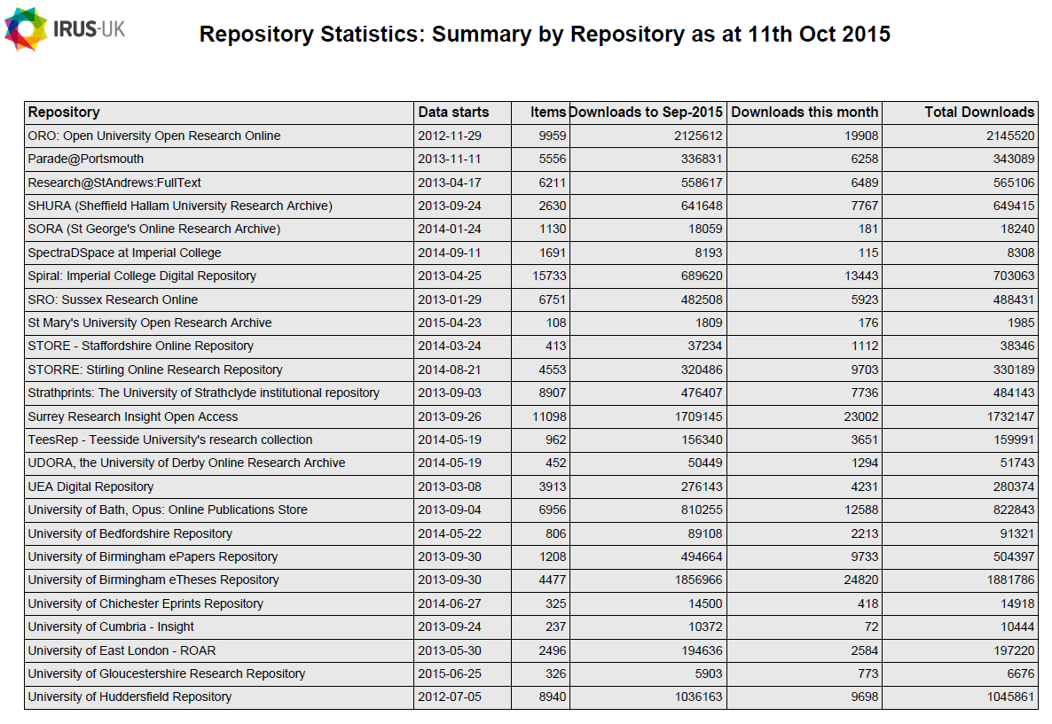

Slide 24
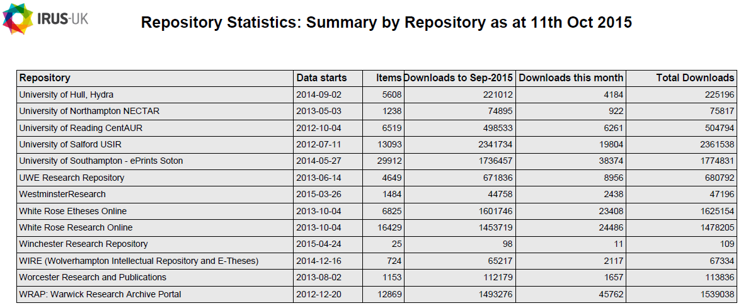

Slide 25
