Slide 2
A librarian's road map to open access
Nick Sheppard
Research Services Advisor
Technical Officer UKCoRR

Slide 3
Research Services Advisor
Disclaimer: not a real Librarian
Began working at Leeds Metropolitan University in 2007
Repositories Start-up project (Jisc)
Technical Officer for UKCoRR (UK Council of Research Repositories)
http://ukcorr.org
Research Services Advisor (2015)
Research Services team
OA advocacy & training, policy compliance
Technical infrastructure
Research Data Management (RDM)
Notes:
UKCoRR is an independent body for repository managers, administrators and staff in the UK that:
Promotes repository management as a recognised and respected profession
Provides a forum for discussion and exchange of experience
Represents the views and concerns of those who work with repositories in organisational, policy and strategic development
‹#›

Slide 4
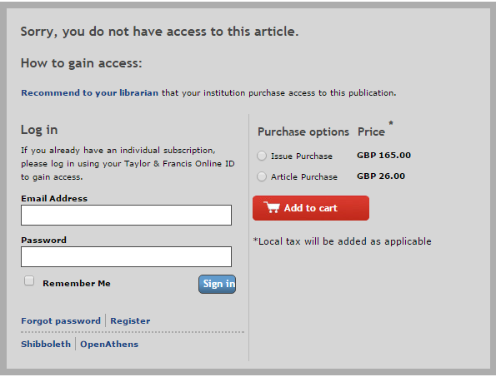
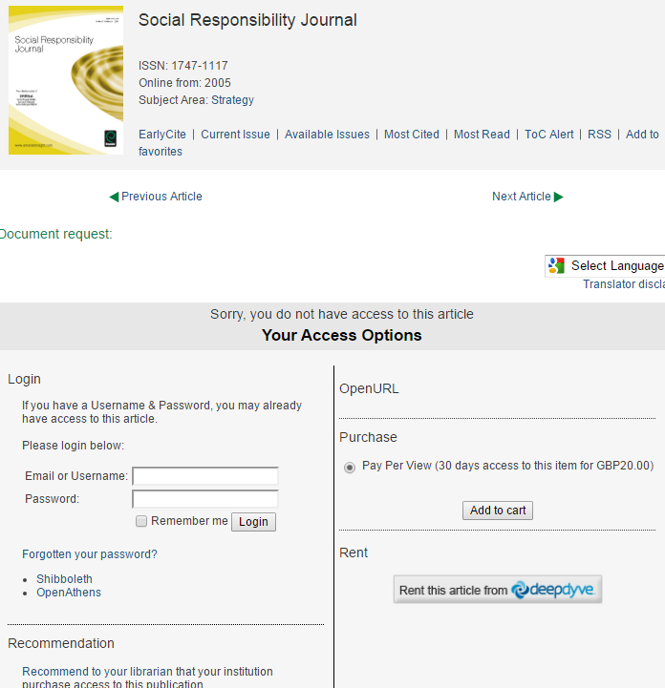
Academic dissemination: the problem with the status-quo

Slide 5
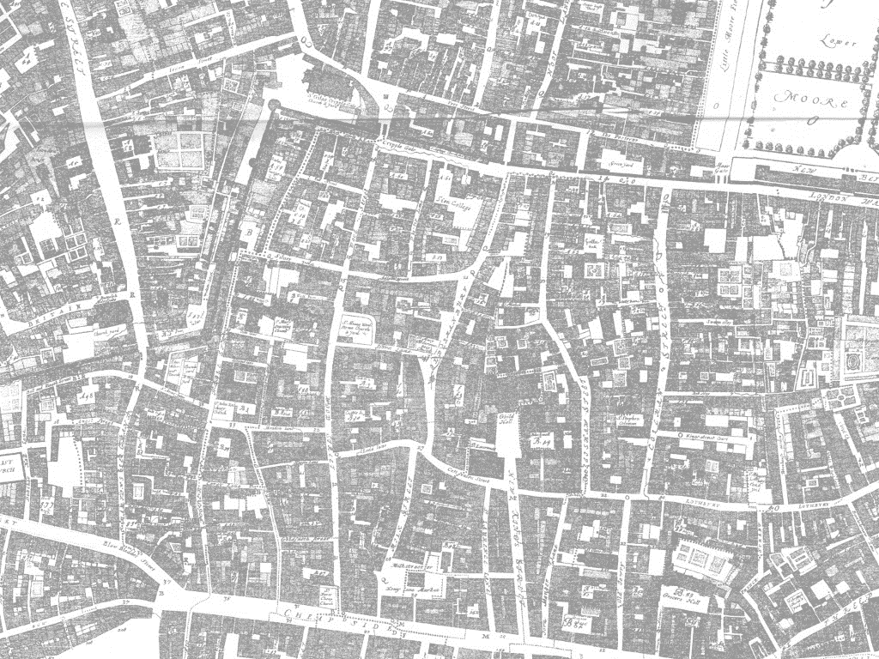
Language
~100,000yrs
Writing
3500-3000 BCE
Proto-science
900 BCE - 500 CE
Printing press invented
~1440 CE
Caxton brings printing to Britain
~1476 CE
Henry Oldenburg inaugurates Phil.Trans
1665
Universities /research output increases
C19th-C20th
“Serials crisis”
1970s
Psycoloquy – 1st online scientific journal
1990
Stevan Harnad's “subversive proposal”
1994
Budapest Open Access Initiative
2002
Finch report and RCUK OA policy
2012
HEFCE announce policy for OA in post-2014 REF
2014
Mainstream social media
2000-future
1st April 2016
Academic social media
2007-future
Altmetrics: a manifesto
2010
Babbage works on Difference Engine
1823-1842
Universal Turing Machine
1937
WWW invented
1989
Eprints software released
2000
Background detail from Scanned copy of reproduction in "Maps of Old London" (1908) of Ogilby & Morgan's Map of London https://commons.wikimedia.org/wiki/File:City_of_London_Ogilby_and_Morgan%27s_Map_of_1677.jpg (public domain)
Notes:
Oldenburg - 1st secretary of the Royal Society.
Credited with establishing the principles of scientific priority & peer review
Innovative use of print technology; parallels with www today
System of scholarly communication existed for hundreds of years, evolved in the age of print at a time when scholarly output was relatively small.
Number of universities and associated research output increased in the 19th and 20th centuries, commercial publishers became interested in a market with an established creative source and pattern of consumption.
1970s - journal prices began to rise faster than inflation, having a negative impact on serials collections in libraries
Stevan Harnad – cognitive scientist founded Psycoloquy in 1990
Subversive proposal led to the creation in 1997 of Cogprints, an open access archive for self-archived articles in the cognitive sciences

Slide 6
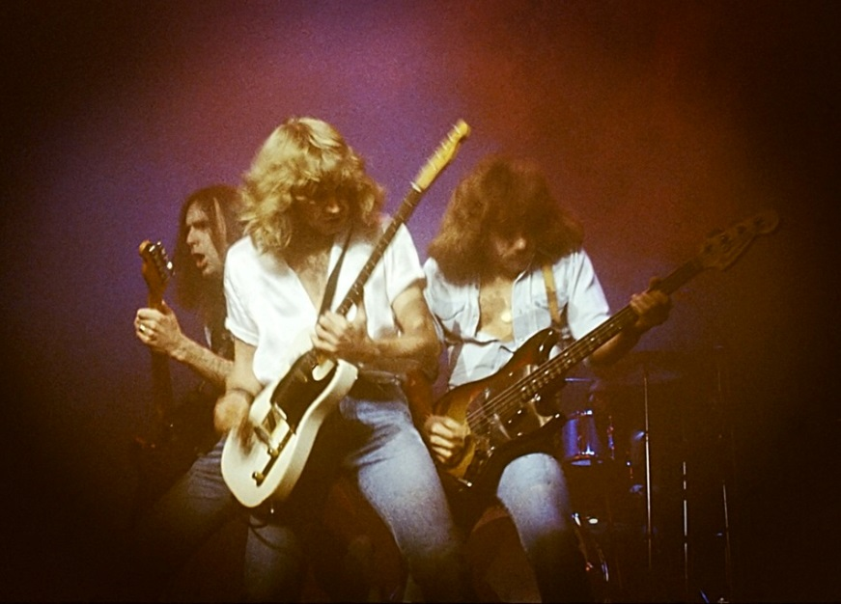
The problem with Status Quo
1978*
2005
*Status Quo at the Hammersmith Odeon in 1978
Public domain - http://commons.wikimedia.org/wiki/File:Status_Quo1978.jpg

Slide 7
Stevan Harnad’s subversive proposal (1994)
“If all scholars' preprints were universally available to all scholars by anonymous ftp (and gopher, and World-Wide Web, and the search/retrieval wonders of the future), NO scholar would ever consent to WITHDRAW any preprint of his from the public eye after the refereed version was accepted for paper "PUBLICation." Instead, everyone would, quite naturally, substitute the refereed, published reprint for the unrefereed preprint.” http://eprints.soton.ac.uk/253351/
“one of the seminal texts of the open access movement” Richard Poynder June 2014
By Rock1997 (Own work) [GFDL (http://www.gnu.org/copyleft/fdl.html) or CC BY-SA 4.0-3.0-2.5-2.0-1.0 (http://creativecommons.org/licenses/by-sa/4.0-3.0-2.5-2.0-1.0)], via Wikimedia Commons
Notes:
Internet posting by Stevan Harnad on June 27 1994
Called on academic authors to archive their articles online to make available to all scholars by anonymous ftp
*search/retrieval wonders of the future*
led to the creation in 1997 of Cogprints, an open access archive for self-archived articles in the cognitive sciences

Slide 8
Budapest Open Access Initiative (2002)
“An old tradition and a new technology have converged to make possible an unprecedented public good…Removing access barriers to this literature will accelerate research, enrich education, share the learning of the rich with the poor and the poor with the rich, make this literature as useful as it can be, and lay the foundation for uniting humanity in a common intellectual conversation and quest for knowledge.”
http://www.budapestopenaccessinitiative.org/
Recommended two complementary strategies:
Self-archiving (green)
Open-access journals (gold)
Notes:
Coined the term Open Access
a public statement of principles relating to open access
arose from a conference convened in Budapest by the Open Society Institute on December

Slide 9
Royal Society of Chemistry librarian survey 2015
The role of libraries in open access publishing (click to access full report)
Notes:
Familiarity with OA
Familiarity with Gold & Green
Understanding of Gold & Green
Understanding of funding body OA requirements
Ability to communicate OA
Main sources of information
Access to up-to-date information
Gold OA budgets
Publisher communication
OA preferences (Green/Gold)

Slide 10
Straw poll...
All taken into consideration, what is your preferred model of OA?
Green
Gold
Unsure
Notes:
‹#›

Slide 11
Are you familar with the concept of “hybrid” OA?
Notes:
‹#›

Slide 12
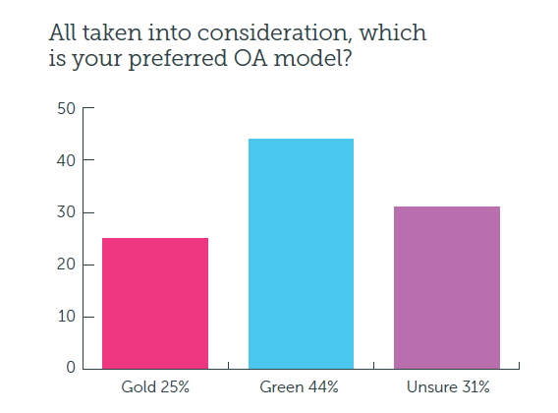
OA preferences
Notes:
The majority of librarians preferred the Green model - but many were unsure

Slide 13
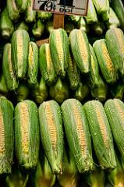
Green, Gold & hybrid
Gold is seen as expensive
Average APC ~ £1800
Creative Commons (full reuse)
Will market forces drive APCs down?
Green perpetuates subscription model
Perpetuates subscription model
The embargo period
The licence problem
Hybrid
Offer the choice of paying APC
Provide immediate OA (CC-BY)
Only some articles OA
Double dipping?
© Kay Gaensler, https://www.flickr.com/photos/gaensler/5981308836/ CC BY-NC-SA 2.0 (https://creativecommons.org/licenses/by-nc-sa/2.0/
Notes:
Inertia
Confusion around models
green vs gold
gratis vs libre
Legal right to self-archive?
How do I do it?
software / infrastructure
workflow
Version of record
Citation / pagination
Disciplinary differences
STEM vs HSS
Politics and commercial interests
‹#›

Slide 14
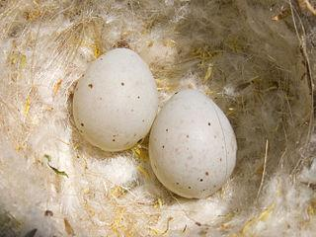
The Finch report (2012)
Emphasised gold over green
5 year “transition period”
Robbing Peter to pay Paul?
Criticised by OA advocates
© Benjamint444 Eggs of the European Gold Finch (Carduelis carduelis) CC-BY-SA https://commons.wikimedia.org/wiki/File:Gold_Finch_eggs.jpg
https://creativecommons.org/licenses/by-sa/3.0/deed.en
Notes:
Very political
Economic/commercial interests (of commercial publishers)

Slide 15
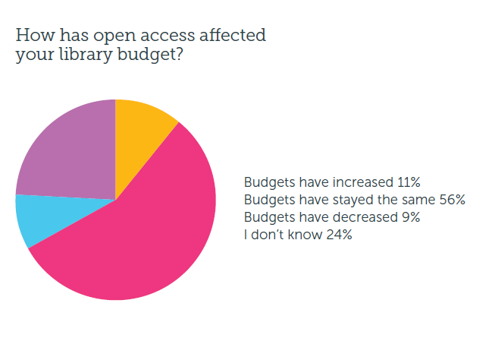
Budgets
‹#›

Slide 16
Funding gold OA
A new market is emerging for OA article publication. Open APC data makes this market as transparent as possible, and therefore of most benefit to customers (institutions). Institutions and authors can then benchmark the APC costs they face against those faced by others, or for other journals. There is no legal reason not to do this.
https://www.jisc.ac.uk/guides/implementing-open-access#step8
Institutionally allocated funds for gold OA
Hybrid or gold only?
Share article-level APC data
Jisc Monitor project
http://bit.ly/1DxZ8D6
aggregate APC data from institutions
Jisc Collections aggregated APC data 2014
http://bit.ly/1TEHVT8 (figshare)
Jisc total cost of ownership
Notes:
‹#›

Slide 17
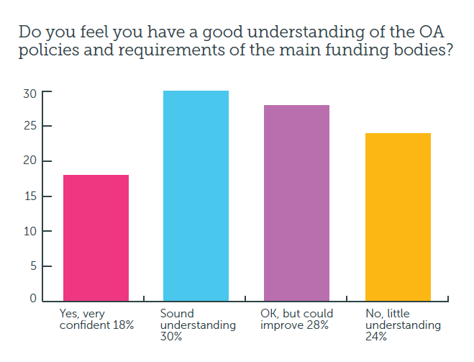
Understanding of funding body OA requirements
Notes:
48% of librarians felt they had a sound or confident understanding of funding body policies regarding OA.This increased to 65% amongst UK librarians.
Over half felt their understanding could improve.

Slide 18
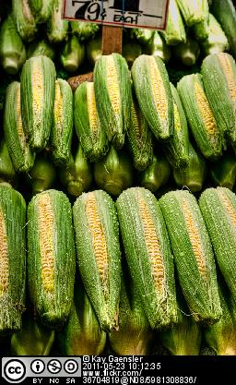
RCUK policy (April 2012)
RCUK-compliant journals
Offer suitable gold OR suitable green option
Creative Commons-Attribution (CC-BY)
RCUK OA block grants
Establish institutional publication funds
expect primary use to be payments of APCs
Preference is gold OA
Decision lies with authors and institutions

Slide 19
Horizon2020
Article 29.2 of the Model Grant Agreement sets out detailed legal requirements on open access to scientific publications: under Horizon 2020, each beneficiary must ensure open access to all peer-reviewed scientific publications relating to its results.
To meet this requirement, beneficiaries must, at the very least, ensure that any scientific peer reviewed publications can be read online, downloaded and printed. Since any further rights - such as the right to copy, distribute, search, link, crawl and mine - make publications more useful, beneficiaries should make every effort to provide as many of these options as possible.
Guidelines on Open Access to Scientific Publications and Research Data in Horizon 2020 (p.4)
Open access infrastructure for research in Europe (OpenAIRE)
National OA Desk (NOAD)

Slide 20
NIH Public Access Policy
To advance science and improve human health, NIH makes the peer-reviewed articles it funds publicly available on PubMed Central. The NIH public access policy requires scientists to submit final peer-reviewed journal manuscripts that arise from NIH funds to PubMed Central immediately upon acceptance for publication.
https://publicaccess.nih.gov/

Slide 21
HEFCE bombshell (April 2013)
“to be eligible for submission to the post-2014 REF, authors’ final peer-reviewed manuscripts must have been deposited in an institutional or subject repository on acceptance for publication”
http://www.hefce.ac.uk/pubs/year/2014/201407/
Notes:
Applies to journal articles and conference proceedings accepted for publication after 1 April 2016
Urge HEIs to implement now
Where there is an embargo, authors can comply by making a ‘closed’ deposit on acceptance
Various exceptions
‹#›

Slide 22
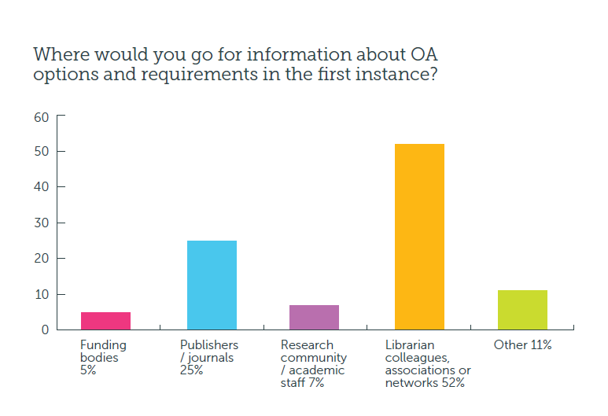
Main sources of information
Notes:
Over half of the librarians would go to librarians, colleagues or professional networks for information first.
A quarter would look to publishers/journals for more information.
10% replied ‘other’ – the majority of these respondents said they would look at SHERPA/ROMEO for information first.

Slide 23
Jisc services
We’re working to develop services, provide support, and influence policy in order to enable UK higher education to realise the rewards of open access (OA).
https://www.jisc.ac.uk/content/open-access
Policy compliance
SHERPA services
Monitor Local (alpha)
Discovery, usage and impact
CORE (Connecting Repositories)
IRUS-UK
Cost management
Jisc Monitor
Metadata and interoperability
RIOXX
ORCID
Notes:
http://www.opendoar.org/
http://www.sherpa.ac.uk/romeo/
http://www.sherpa.ac.uk/juliet/
http://www.sherpa.ac.uk/fact/
SHERPA REF (prototype)
‹#›

Slide 25
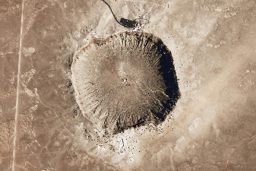
OA and impact
Fundamentals of research?
Creating, using, sharing and accessing information
Increases efficiency of research process
Evidence of increased citation
The Open Access Citation Advantage Service - http://sparceurope.org/oaca/
As scholarly communication moves increasingly online, more indicators have become available: how many times an article has been bookmarked, blogged about, cited in Wikipedia and so on. These metrics can be considered altmetrics – alternative metrics of impact. (Piwowar 2013)
Notes:
Research can be easily disseminated online amongst communities of researchers and interested lay people, via social media for example, and it is clearly beneficial if that research is freely accessible on the open web rather than restricted by subscription access.
‹#›

Slide 26
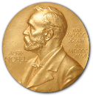
Traditional bibliometrics
“the branch of library science concerned with the application of mathematical and statistical
analysis to bibliography; the statistical analysis of books, articles, or other publications.”
(Oxford English Dictionary Online)
Citation count & h-index
Journal Impact Factor (JIF)
Other impact measures
Knowledge transfer
Activities (presentations, consultancy, review)
Prizes
Public engagement / education
Policy documents
Media
TV and radio
Blogs/social media
Notes:
‹#›

Slide 27
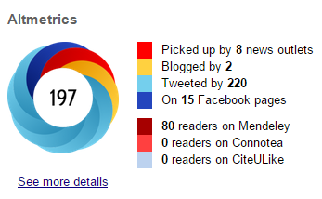
Alternative metrics
Article level metrics
frontiers in Psychology http://journal.frontiersin.org/article/10.3389/fpsyg.2013.00058/abstract
PLoS One http://journals.plos.org/plosone/article?id=10.1371/journal.pone.0121708
Repositories
IRUS-UK
Statistics at Leeds Beckett
The end of JIF?
Various flavours
Plum analytics - http://www.plumanalytics.com/
Impact story - https://impactstory.org/
Altmetric - http://www.altmetric.com/
Notes:
‹#›

Slide 28
Online networks
https://twitter.com/BeckettResearch/lists/leeds-beckett-university/members
Notes:
240 members
‹#›

Slide 29
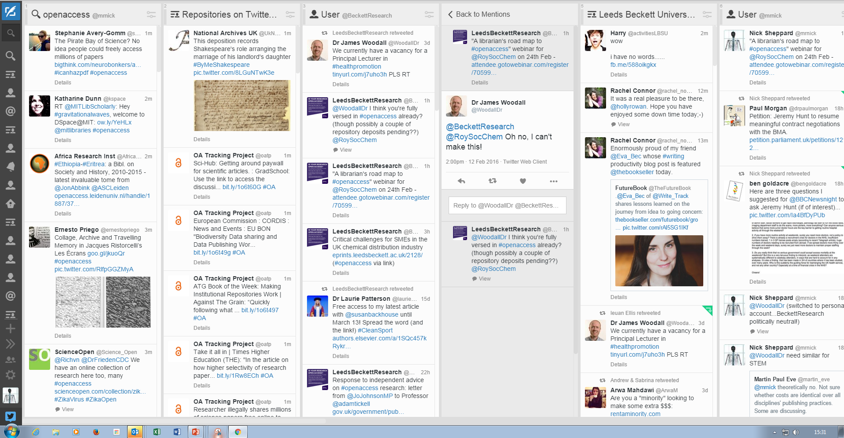
Keeping an eye on things…

Slide 30
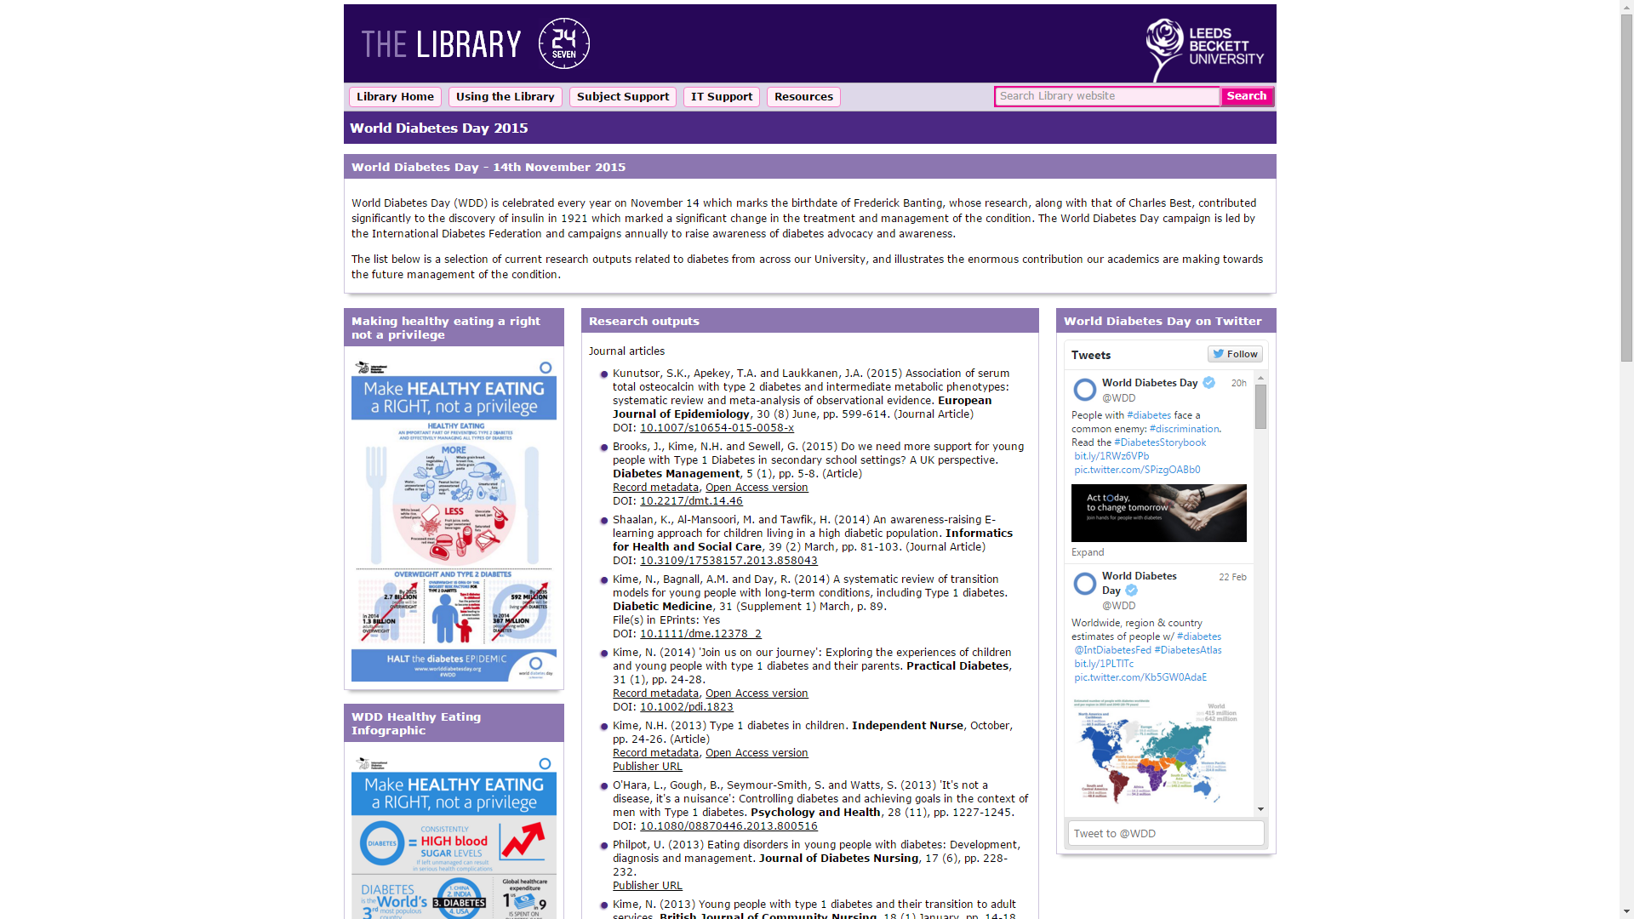
Notes:
The confluence of various technologies and OA make it easy to share research outputs via social media and assess the reach and impact of dissemination.
developed a dedicated series of LibGuides around selected themes comprising a range of relevant information and including institutional research outputs
World Diabetes Day,
links to author versions, self-archived and openly accessible in EPrints where available
disseminated via Twitter from accounts operated by the Library,
targeted tweets to @WDD and individual academics.
an advocacy tool to engage academics in OA.
"altmetrics" as a means of visualising how research is shared and disseminated online and which are potential indicators of impact beyond the traditional readership of scholarly material, especially in conjunction with OA.
‹#›

Slide 31
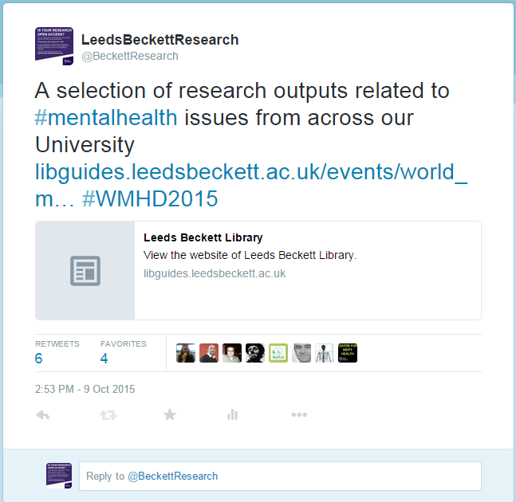
Tweet activity
Twitter analytics - https://analytics.twitter.com/
Notes:
We are piloting a project whereby we choose celebration days or events where we can tweet a link to our research outputs in this area which are listed in a Libguide
‹#›

Slide 32
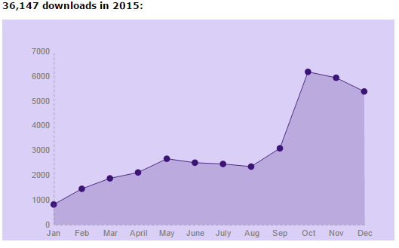
Key Performance Indicators
Notes:
Repository visitors, content & downloads
Google Analytics
IRUS-UK
Top ten articles
All time
Monthly
Altmetric scores
Top 10 by faculty
Twitter analytics
‹#›

Slide 33
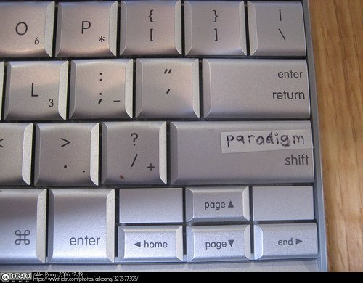
Paradigm shift?
Is green a long term solution?
Maintains subscription model
Is gold sustainable?
New serials crisis?
Books and monographs
What might a new paradigm look like?
Institutional/library publishing?
PKP - Open Journal System e.g. http://journals.ed.ac.uk/
Open Library of the Humanities
https://www.openlibhums.org/
Library consortium model
Extend to STEM?
Network effects
OA and social media
Targetted dissemination
Notes:
Predatory OA journals?
OLH - charitable organisation dedicated to publishing open access scholarship with no author-facing article processing charges (APCs). We are funded by an international consortium of libraries who have joined us in our mission to make scholarly publishing fairer.

Slide 34
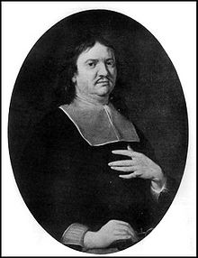
Open Access: to the General Benefit of Mankind
Source: http://commons.wikimedia.org/wiki/File:Henry_Oldenburg.jpg
This image is in the public domain because its copyright has expired.
Oldenburg, H,. (1665) Epistle Dedicatory. Phil. Trans. 1. pp.1-2 doi: 10.1098/rstl.1665.0001
Notes:
Oldenburg - first secretary of the Royal Society
credited with establishing the principles of scientific priority & peer review
before Chemistry was recognised as a discrete science and come under the encompassing banner of “natural philosophy”
‹#›

Slide 35
References & bibliography
Suber, P. Open Access Overview. Available at: http://www.earlham.edu/~peters/fos/overview.htm [Accessed 17 November 2014]
Guédon, J.-C. (2001) In Oldenburg’s long shadow: librarians, research scientists, publishers, and the control of scientific publishing. Available at: http://eprints.rclis.org/6375/ [Accessed 17 November 2016]
Budapest Open Access Initiative (2002) Available at: http://www.soros.org/openaccess/read.shtml [Accessed 17 November 2014]
Yiotis, K. (2005) The Open Access Initiative: a new paradigm for scholarly communications. Information Technology and Libraries 24(4). Available at: http://ejournals.bc.edu/ojs/index.php/ital/article/view/3378 [Accessed 17th November 2014]
Accessibility, sustainability, excellence: how to expand access to research publications: Report of the Working Group on Expanding Access to Published Research Findings (June 2012) Available at http://www.researchinfonet.org/wp-content/uploads/2012/06/Finch-Group-report-FINAL-VERSION.pdf [Accessed 17 November 2014]
RCUK Policy on Open Access (April 2012) Available at http://www.rcuk.ac.uk/research/openaccess/policy/ [Accessed 17 November 2014]
HEFCE (2013) Policy for open access in the post-2014 Research Excellence Framework Available at http://www.hefce.ac.uk/pubs/year/2014/201407/ [Accessed 17 November 2014]
Eve, M.P. (2014) Open Access and the Humanities: Contexts, Controversies and the Future, Cambridge University Press Available OA at http://www.cambridge.org/do/titles/open-access-and-humanities-contexts-controversies-and-future/ [Accessed 24th February 2016]
Sheppard, NE and Bower, K (2015) Leveraging a Library CMS and Social Media to promote #openaccess (OA) to institutional research output. In: Internet Librarian International 2015, 20-21st October 2015, London, UK. (Unpublished) Available at http://eprints.leedsbeckett.ac.uk/1812/ [Accessed 24th Feb 2016]

