Slide 1
LEEDS BECKETT UNIVERSITY
Open Access and impact: from local to global
Nick Sheppard
Kirsty Bower

Slide 2
Leeds Beckett University
26,000 students, 2,900 staff
Growing research profile - Research Institutes and Research Centres - some areas of longstanding excellence, e.g. Sport - newer areas also high profile, e.g. Retail, Men’s Health - positive outcome in the REF (Unit 26) - increasing numbers of research students
Enterprise activities
Looking ahead to REF2021
Notes:
Unit 26: Sport and Exercise Sciences, Leisure and Tourism
REF2014 – 220 staff entered in 11 Units of Assessment
KPI target – 45% of academic staff returnable for next REF

Slide 3
Research Services
2.5 FTE
Infrastructure
Symplectic Elements
EPrints
Advocacy & training
Academic liaison
Administer APC fund
Research Data Management
Infrastructure TBC
ORCiD
Research Support
Journals team
Academic Support
Faculties
CAF | AET
FBL | HSS
Heads of Research Heads of School
Research administrators
Academic staff
Research Office
Notes:
Research Services Group meets monthly – chaired by Associate Director of the Library, Research Services team + reps from Academic Support, URO
Research Data Management SLWG – recommendations to Research & Enterprise Committee

Slide 4
Infrastructure

Slide 5
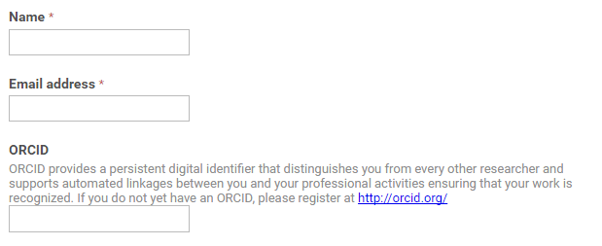
New staff

Slide 6
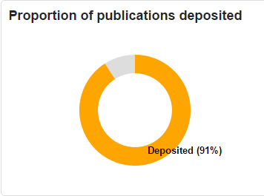
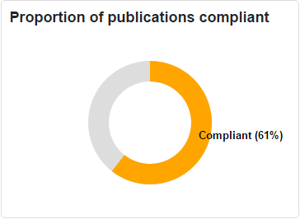
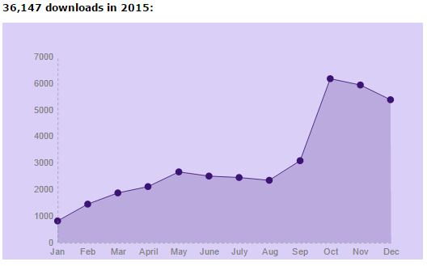
Reporting and KPIs
Outputs by faculty
Proportion OA (by funder/grant)
HEFCE audit
Deposit on acceptance (Apr 2017)
Symplectic OA Monitor
APC spend
Downloads
EPrints reports
IRUS-UK (COUNTER)
Impact
Reach and impact
Bibliometrics (traditional/alternative)
Case studies/examples
Social media
Twitter followers/engagement
Notes:
1:00

Slide 7
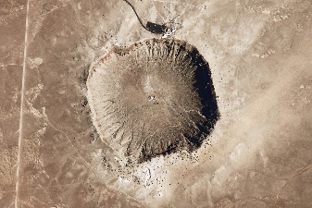
OA and impact
Fundamentals of research?
Creating, using, sharing and accessing information
Increases efficiency of research process
Evidence of increased citation
The Open Access Citation Advantage Service - http://sparceurope.org/oaca/
As scholarly communication moves increasingly online, more indicators have become available: how many times an article has been bookmarked, blogged about, cited in Wikipedia and so on. These metrics can be considered altmetrics – alternative metrics of impact. (Piwowar 2013)
Notes:
Research can be easily disseminated online amongst communities of researchers and interested lay people, via social media for example, and it is clearly beneficial if that research is freely accessible on the open web rather than restricted by subscription access.

Slide 8
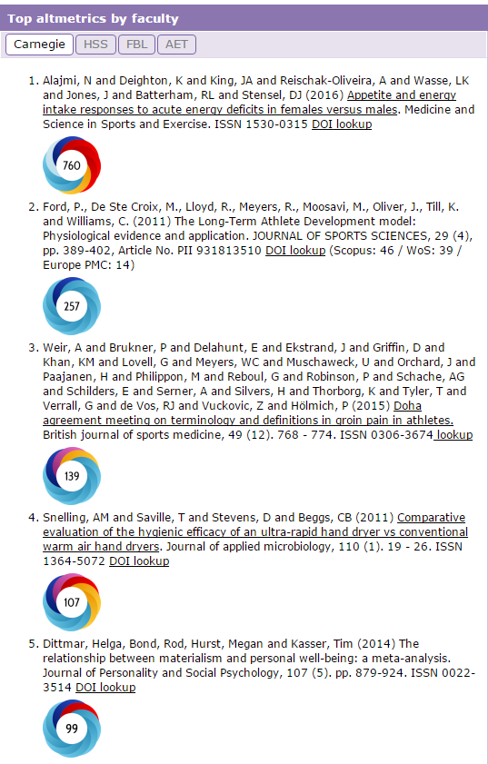
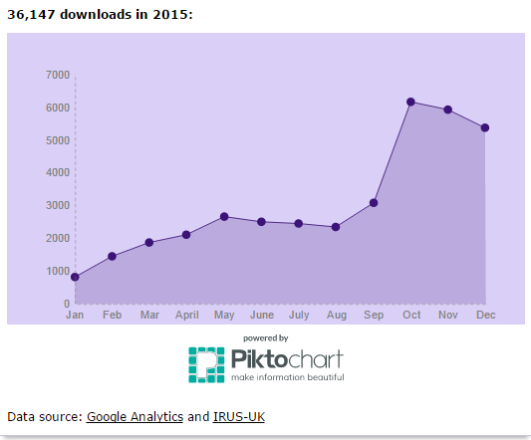

Slide 9
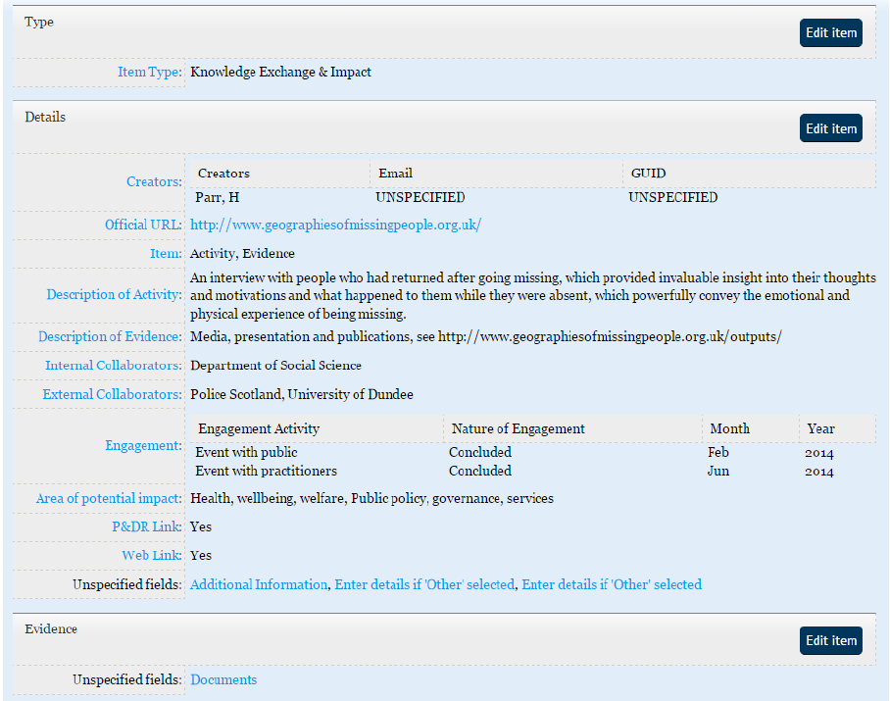
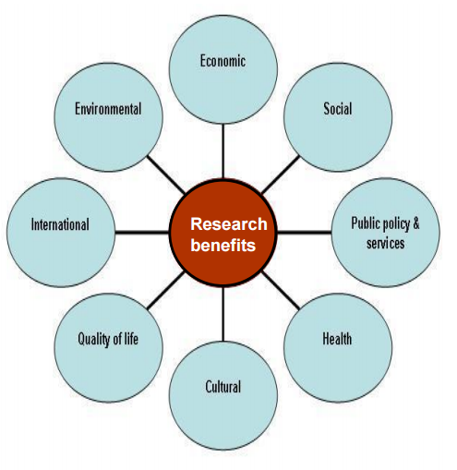
Capturing Impact
Collecting Impact in a Repository – Rose-Marie Barbeau and Michael Eadie, University of Glasgow [slides] (UKCoRR Members’ Day 2015)

Slide 10
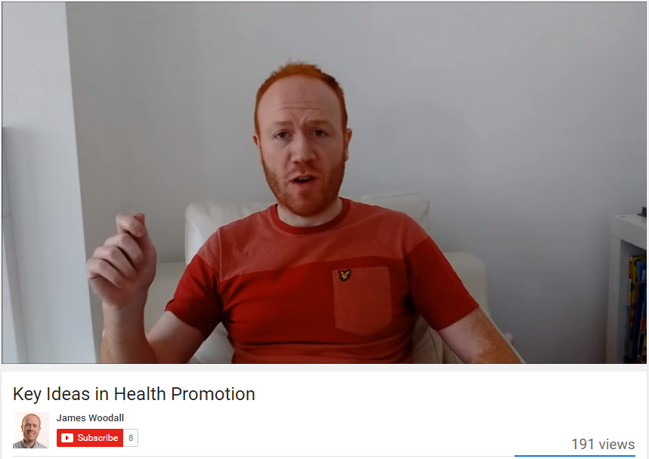
Beyond the journal article
Blogs and vlogs
Podcasts
Animations
Infographics
Social media champions
James’ blog
James’ YouTube channel
James on Soundcloud

Slide 11
Online networks
https://twitter.com/BeckettResearch/lists/leeds-beckett-university/members
Notes:
240 members

Slide 12
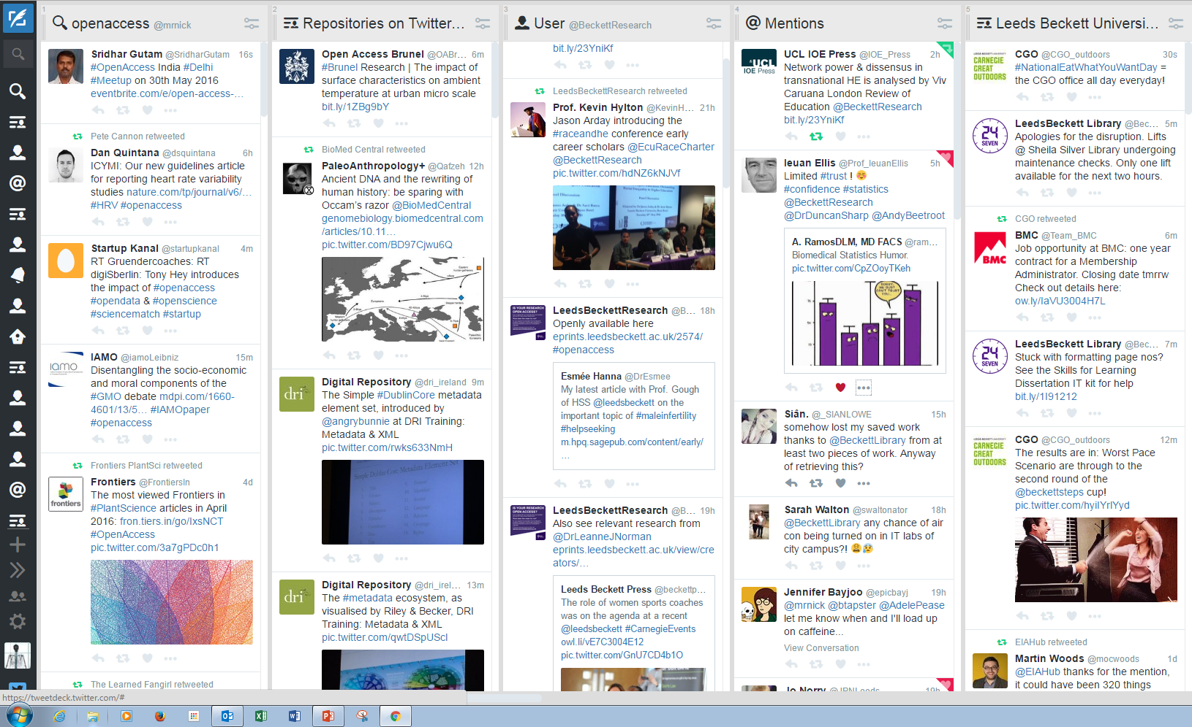

Slide 13
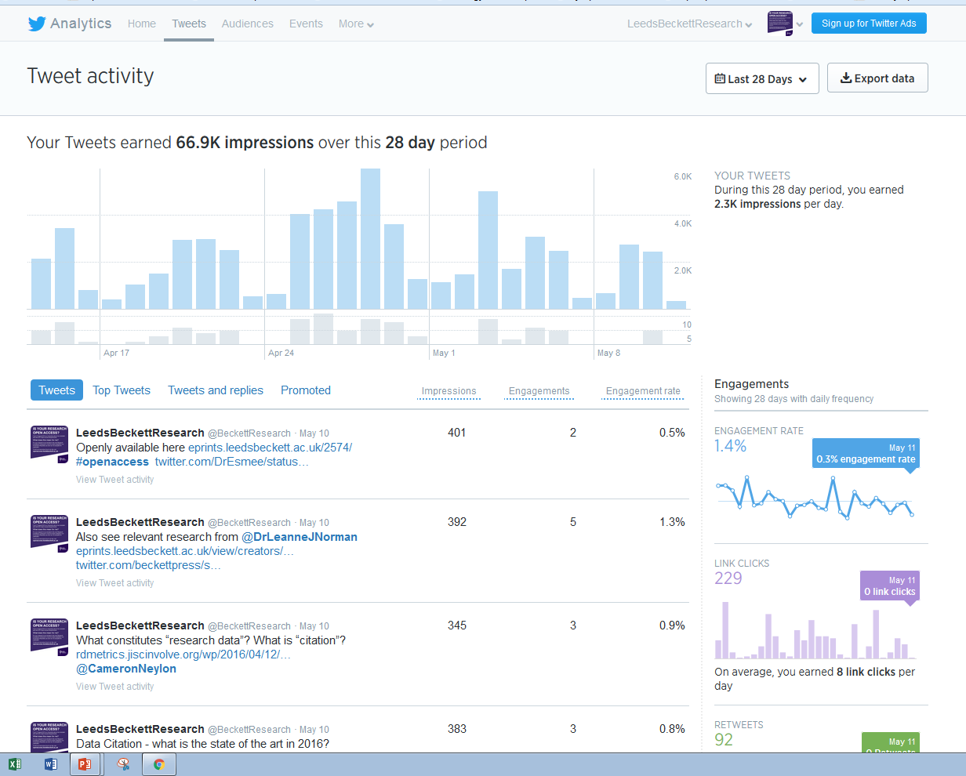

Slide 14
Image taken from http://quotesgram.com/young-guns-movie-quotes/

Slide 15
#focus on……
Notes:
Disengagement with HEFCE and Open Access Mandate and REF submission
Theme, event or research group e.g. Prison Research Network
RTW
Early career researchers
Key members of staff
Individual appointments with new staff
Pop-up stalls for staff around open access

Slide 16
Why use #focuson pages
Promotes the institution to the wider community
Show how research has a ‘real’ impact
Promotes academic staff – KEY!!!!
Encourages use of our repository

Slide 17
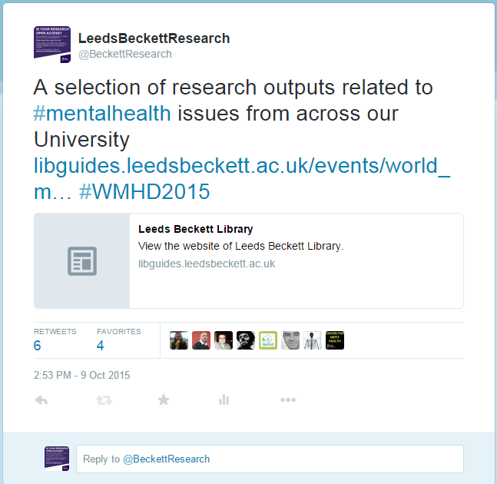
Notes:
We are piloting a project whereby we choose celebration days or events where we can tweet a link to our research outputs in this area which are listed in a Libguide

Slide 18
Response from Academic Staff
Notes:
Really positive on the whole. Some have contacted me to say “My seminal work on XXXXXX isn’t on the webpage” – it’s usually because they haven’t self-archived it in the Repository!!!

Slide 19
Bibliometrics and Altmetrics
Notes:
Andy Tattersall - Kardashian index”, which is a metric similar to the h-index; however, instead of productivity, it measures the “discrepancy between a scientist’s social media profile and publication record.” Certain scientists have very high “K-index” scores–that is, they’re “renowned for being renowned.” For those people, Hall says,”[the K-index] can also be an incentive – if your K-index gets above 5, then it’s time to get off Twitter and write those papers.”

Slide 20
Notes:
Pop-ups
Funding, discoverability

Slide 21
References & bibliography
Suber, P. Open Access Overview. Available at: http://www.earlham.edu/~peters/fos/overview.htm [Accessed 17 November 2014]
Guédon, J.-C. (2001) In Oldenburg’s long shadow: librarians, research scientists, publishers, and the control of scientific publishing. Available at: http://eprints.rclis.org/6375/ [Accessed 17 November 2016]
Budapest Open Access Initiative (2002) Available at: http://www.soros.org/openaccess/read.shtml [Accessed 17 November 2014]
Yiotis, K. (2005) The Open Access Initiative: a new paradigm for scholarly communications. Information Technology and Libraries 24(4). Available at: http://ejournals.bc.edu/ojs/index.php/ital/article/view/3378 [Accessed 17th November 2014]
Monbiot, G. (2011). The Lairds of Learning | George Monbiot. [online] Monbiot.com. Available at: http://www.monbiot.com/2011/08/29/the-lairds-of-learning/ [Accessed 17 Nov. 2014].
Accessibility, sustainability, excellence: how to expand access to research publications: Report of the Working Group on Expanding Access to Published Research Findings (June 2012) Available at http://www.researchinfonet.org/wp-content/uploads/2012/06/Finch-Group-report-FINAL-VERSION.pdf [Accessed 17 November 2014]
RCUK Policy on Open Access (April 2012) Available at http://www.rcuk.ac.uk/research/openaccess/policy/ [Accessed 17 November 2014]
HEFCE (2013) Policy for open access in the post-2014 Research Excellence Framework Available at http://www.hefce.ac.uk/pubs/year/2014/201407/ [Accessed 17 November 2014]

