Slide 1
The Leeds Beckett Library Libguide on Employability and Skills Development: Moving into New Territories of Support
Catherine Parkin, Academic Librarian
Leeds Beckett University
BIALL Conference, June 2016

Slide 2
3 Graduate Attributes
Digital Literacy
Global Outlook
Being Enterprising
Work
Job market
Employability Skills

Slide 3
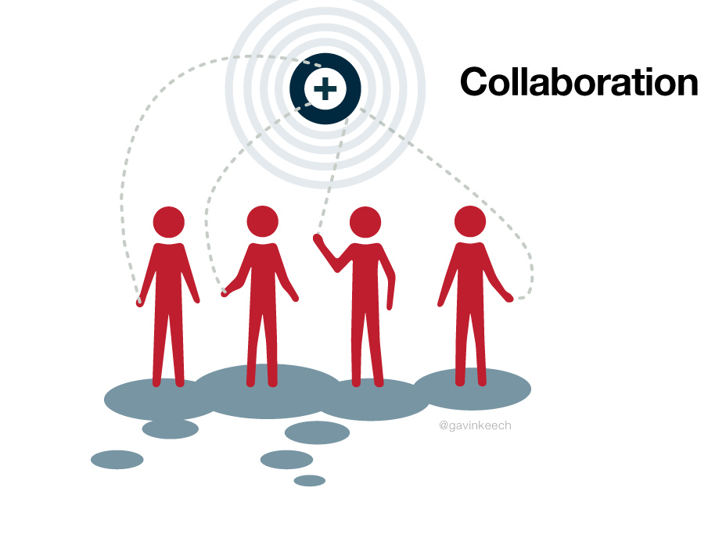
Employability and Enterprise Fortnight
Futures Fest
Librarian involvement!

Slide 4
Employability session for Law
Good quality freely available legal sources available to students after they leave university
How to search these effectively

Slide 5
Digital identity/social media
Discussion with students how their digital identity might represent them
Guidance given on how to manage their social media

Slide 6
The Employability LibGuide

Slide 7
The Employability LibGuide

Slide 8
Steps to Employment

Slide 9
Steps to Employment

Slide 10
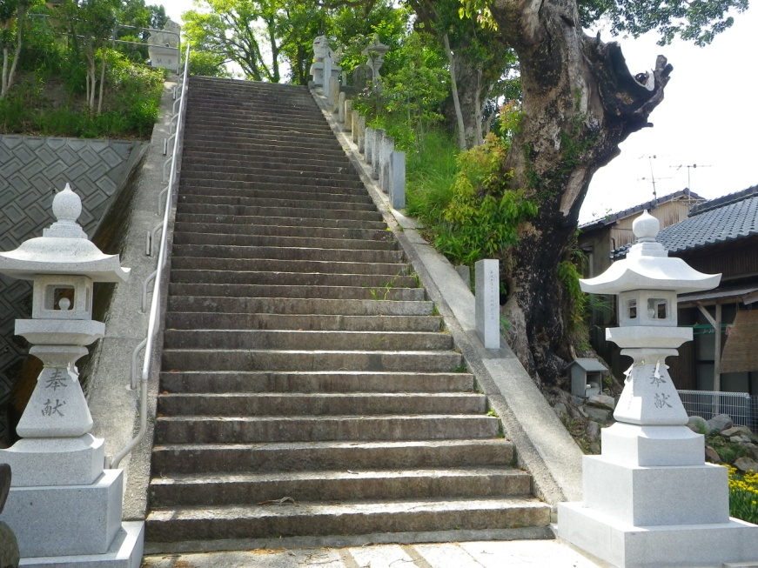
Steps to Employment
Year 1
Develop academic skills
Write a CV
Year 2
Find work experience, develop specific skills useful in your desired career
Learn to sell yourself
Year 3
Start looking at graduate employment programmes
Attend employer presentations

Slide 11
Company Information and Entrepreneurship

Slide 12
Company Information and Entrepreneurship
University offers access to resources that can aid all potential entrepreneurs (NOT just Business students!)
Lists of subscription resources
Freely available resources
Market research reports
Financial information

Slide 13
News and Media

Slide 14
News and Media
Subscription and freely available resources
Broad awareness of current affairs
Job vacancies
Researching prospective employers
Developing an online cv/website using freely reusable images

Slide 15
Professional Networking

Slide 16
Professional Networking
Focus on using social media for professional networking
The Student Guide to Social Media
LinkedIn, Twitter, Facebook

Slide 17
After Leeds Beckett

Slide 18
After Leeds Beckett
Advice on free, quality information resources after University
Alumni scheme
Public libraries
Open access journals
Use of Careers services for 5 years after graduation

Slide 19
Other outcomes
“After Leeds Beckett” pages on each subject guide
Better understanding of graduate employment needs
New collaborative relationships between University departments
Opportunities to support students in areas not traditionally associated with Library skills

Slide 20
Next steps
Development of a skills audit for students
Train careers services staff in Library resources to better support students
Further development of student employability skills (Library training sessions)

Slide 21
References
Davey, A. and Tucker, L.K. (2010) Enhancing higher education students' employability and career management, Library Review, 59 (6), pp. 445 – 454.
Finch, E. and Fafinksi. S. (2014) Employability Skills for Law Students. Oxford: OUP.
Middleton, F. (2015) Digital literacy and employability activities Available from:< http://www.sconul.ac.uk/sites/default/files/Employability_Case_Study_LeedsBeckettJan2015.pdf > [Accessed 6 April 2016].
Wiley, M. (2016) From the library to the workplace How information professionals can support the development of employability skills. SCONUL Focus, 64. pp. 74-80.

Slide 22
References : Images
Analyzing Financial Data (2010) [Online photograph]. Available from: https://commons.wikimedia.org/wiki/File:Analyzing_Financial_Data_(5099605109).jpg [Accessed 4 May 2016].
Business Networking (2016) [Online photograph]. Available from:
http://www.publicdomainpictures.net/view-image.php?image=147288&picture=&jazyk=CS [Accessed 4 May 2016].
Collaboration (2010) [Online photograph]. Available from: https://www.flickr.com/photos/venessamiemis/4756760521 [Accessed 13 April 2016].
Employment (2015) [Online photograph]. Available from: http://www.picserver.org/e/employment.html [Accessed 13 April 2016].
Girl Book Shelves Library Reading (2015) [Online photograph]. Available from: https://pixabay.com/en/girl-books-shelves-library-reading-995187/ [Accessed 6 April 2016].
The Graduates (2010) [Online photograph]. Available from https://www.flickr.com/photos/sakeeb/4647211575 [Accessed 13 April 2016].
Haitaka jinja shrine steps (2011) [Online photograph]. Available from: https://commons.wikimedia.org/wiki/File:Haitaka_jinja_shrine_steps.jpg [Accessed 5 May 2016].
Hand Congratulations Joy (2015) [Online photograph]. Available from: https://pixabay.com/en/hand-congratulations-presentation-648448/ [Accessed 10 May 2016].
Newspapers B&W (2011) (2016) [Online photograph]. Available from: https://www.flickr.com/photos/62693815@N03/6276688407 Accessed 5 May 2016].
Oh Yes its FREE (2008) [Online photograph]. Available from: https://commons.wikimedia.org/wiki/File:Oh-Yes-its-FREE---iStock.gif [Accessed 5 May 2016].
Social Media (2014) [Online photograph]. Available from: https://commons.wikimedia.org/wiki/File:Socialmedia-pm.png [Accessed 13 April 2016].
Success Road Sign Traffic Sign (2008) [Online photograph]. Available from: https://pixabay.com/en/success-road-sign-traffic-sign-479568/ [Accessed 13 April 2016].

