Slide 1
The use and value of group support for young men who are fathers
Dr Esmée Hanna
Centre for Men’s Health, Leeds Beckett University
@DrEsmee #SYD2016

Slide 2
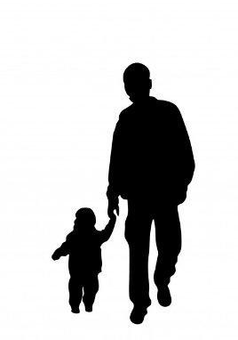

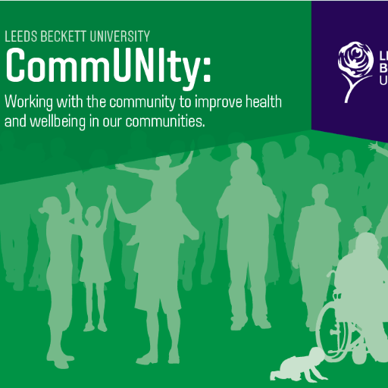
The project….
Supporting Young Dad’s (SYD) research project
Project was funded by an Early Career Fellowship at Leeds Beckett University
Project was a collaborative endeavour with the community organisations who provide group support for young dads
The research builds on the ethos of the CommUNIty initiative at Leeds Beckett

Slide 3
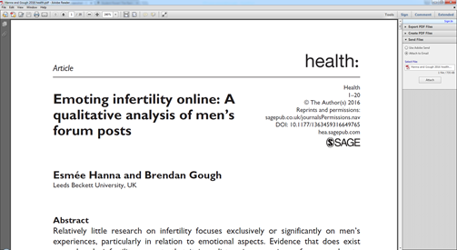

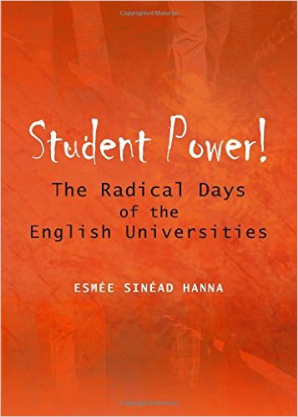


My work…
Research centre focusing on men’s health and gendered analyses of health
Research a variety of areas including wellbeing in fatherhood and men as fathers
Sociologist by background and my previous research has focused on young people…but on a very different topic…..
The main theme in all my work is about giving voices to those who may not be heard in society and producing work which works towards equality in the broadest sense

Slide 4
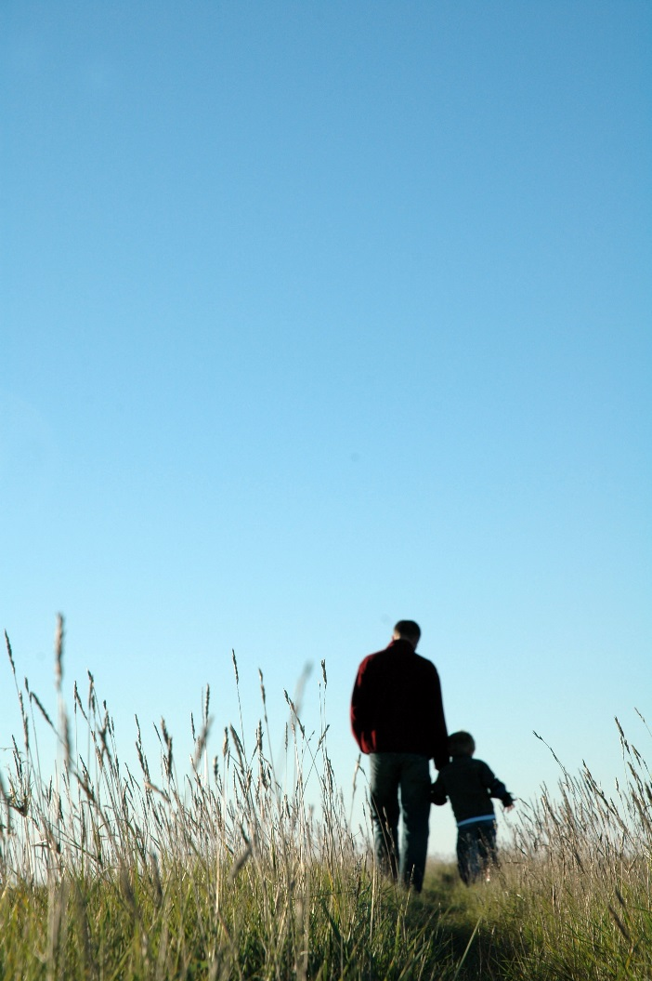
Research about young fathers
We know that the transitions of becoming an adult and a parent can be really difficult (e.g. Neale and Lau Clayton, 2011/Following Young Fathers Research Project)
Young men often suspicious of services or professionals and may have had bad experiences with services in the past (Ferguson, 2016)
Some previous research has suggested that groups are a good way of supporting young men who are fathers
(e.g. Barnados, 2012; Sherriff, 2007)
Important that we capture young men’s views in research so we can find out more about what works (or doesn’t work)

Slide 5
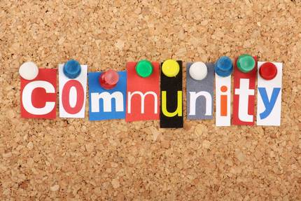

Young Fathers and the third sector
Community groups can often be a valuable source of support and a good way of bringing people together around common interests or identities
However we do not know very much about community based initiatives for young fathers
Some evidence emerging around positive impact of initiatives for fathers, but this is for ‘average’ age fathers rather than younger men
e.g. Salford Dadz research by Robertson et al., (2014,2015)

Slide 6
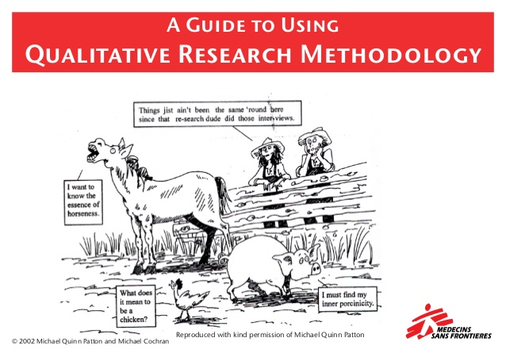
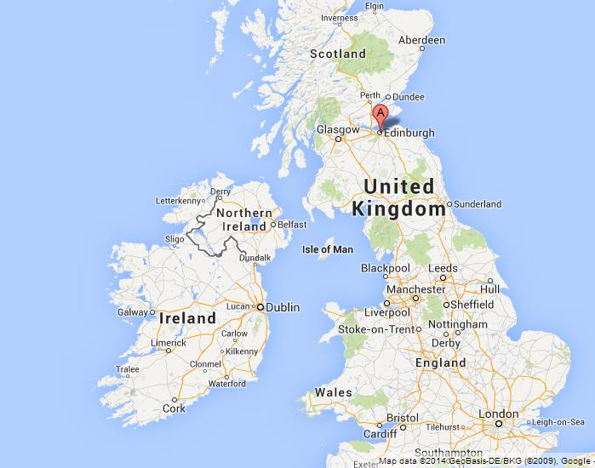

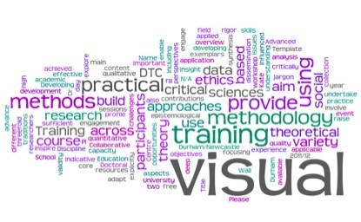
Methodology
Edinburgh
Qualitative research Explored 2 projects
Leeds
Stakeholder Interviews + Participant Interviews
Plus visual methods with participants
Total of 13 interviews conducted (4 Sr, 9 Pt)
Data was analysed for key themes around the use and value of the groups, exploring the experience of the group from the two perspectives

Slide 7



Experience of conducting the research
Working with key stakeholders helped with getting access to talk to the young men
Try to approach research in a reciprocal manner, i.e. not just about researchers getting something
Flexibility important in doing the interviews (individual versus group interviews)
No issue in being a woman asking the young men about their experiences- very enjoyable experience
This research good reminder of importance of asking young people what they want and involving them in research
Notes:
e.g. summer fun day with Leeds group (joint bid)
Regular contact and support of groups- personal investment

Slide 8


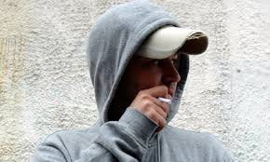

Stakeholders
“Young dads saying the only time they got services was almost like two fold; one was when or get any attention, was one when they were at risk of anti-social behaviour, and the other time when they were deemed to be the culprits as it were of unintended teenage pregnancy. So it was all very negative so what we did was work up a scheme, a project really, to engage specifically young dads, so young dad’s facing young dads” (Stakeholder 1)
Context of working with young dads
Economic situations
CJS
Gender
Stereotypes
The context of young men’s lives were seen as important points for consideration in setting up and running the groups…
“Some of these dad’s lives are pretty crazy, pretty busy lives. Chaotic. As long as we can let them know that we are here, the play group is here at the weekend and through the week and it’s not far from your house. It won’t cost you anything to get, it’s free” (Stakeholder 3)

Slide 9

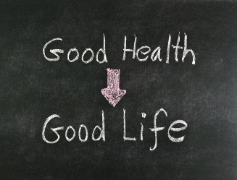
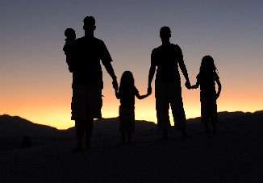
Stakeholders- Value of group work
I think in some incidences the dads can become quite socially isolated, and I think there is a real value in them. Sort of coming together…so they can kind of swap notes on life if you like…its something that can allow them to gradually form friendships and bonds hopefully, which I have seen happen which is wonderful (Stakeholder 2)
Relationships
Wellbeing
Supporting families
Notes:
Improving wellbeing- confidence building was the most noted aspect and was linked to improving young men’s self-esteem
Value to families- positive role modelling or offering direct opportunities for father and child quality time

Slide 10


Stakeholders….
Resources
Facilitation
Challenges
Sustainability
Recruitment
Energy

Slide 11
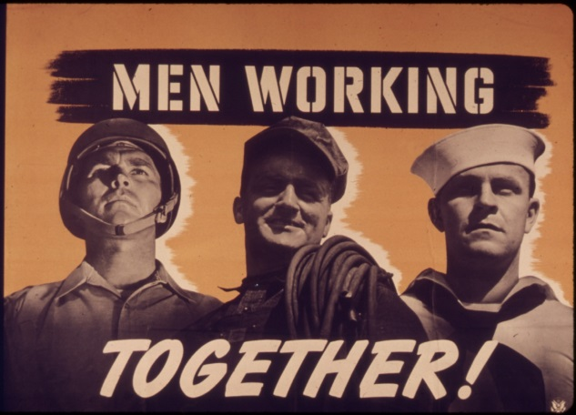

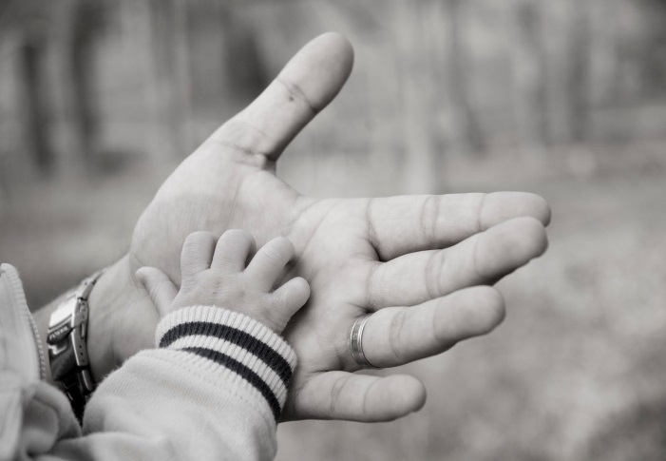

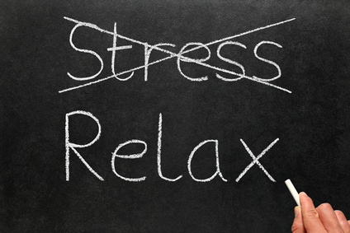
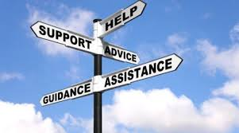
How participants view the groups
Children were at the centre…

Slide 12
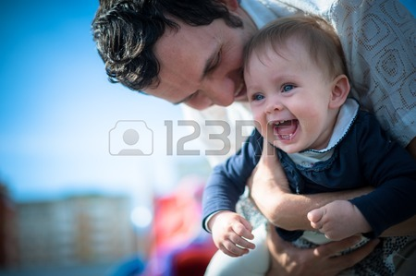
Participants- Contexts
‘Then there’s a mum’s group and my girlfriend goes to like two or three mum’s groups per week, and she’s there all the time and she’s met loads of wee pals in there aye. It’s a shame because there’s hardly anything out there for dads but there’s load of things for mums’ (P2)
‘So there is a lot more for women than men isn’t there. Even thoughts it’s coming up a bit and there is more stuff, there’s still more for women. Generally it should be 50/50 cos kids need their dad’ (P7)
Young men showed a awareness of the landscape of parenting provision as being ‘for mums’.
Young men also said they felt marginalised by society and discussed experiences of material disadvantage.
‘us lads, we are used to being slapped in the face’ (p9)
‘Its kind of a shame really, if there was more people like [Young dads worker] and more places like this then maybe the world wouldn’t be so much as it is right now’ (P3)
Notes:
Image via http://www.123rf.com/ Copyright:
Anna Kondrateva

Slide 13
Participants- What they like about groups
Role modelling
Activities
Welcoming
Advice
New skills
Space for dads
Free
Socialisation
Notes:
Preliminary findings- fieldwork just completed

Slide 14
Impacts on their lives
It is actually quite surprising that it is a guy running it (P5)
I would get stressed all the time, like if things didn’t happen there and then it would niggle at me (p3)
Wellbeing | Parenting
Increased confidence | Bonding opportunities with children
Space to relax/ de-stress | Getting advice from other dads
Learning new skills | Opportunity to role model with dads who run the groups
Time for themselves | ‘If dad’s life is better the kid’s life is going to be better’ (P9)
Something to look forward to | Parenting practices
Before meeting [young dads worker] I was with the kids 24/7. And obviously you get the little time away from them, so you get the time to yourself that you do need at times, and I look forward to having my own time now (P6)
The main thing I was hoping to get out of it was just being able to bond properly with the children. But I’ve gained so much more than that (P8)

Slide 15


What would the young men change?
Not very much that they would like to change….groups viewed very positively
Possible areas for consideration:
    Encourage more young dads to attend
    More time at activities
    More evenings per week
    Opportunities for holidays
Be something like a dads going away for like a week or something with the kids, just like a dunno, a residential thing, like everybody obviously chip in and like a tenner for you and a bairn towards a minibus or whatever and then just obviously go away, book somewhere up the north of Scotland somewhere maybe and take the bairns away for a week and just to have bonfires and BBQ’s if it’s sunny, Scotland could probably rain, just get away for a week or something (P2)

Slide 16
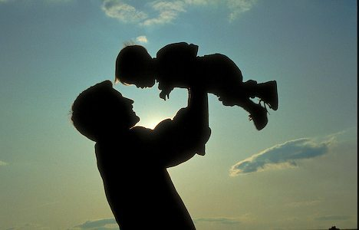
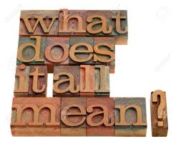
So what does this mean?
Need to be aware of young men potentially feeling excluded in other family settings
Groups can be a really good way of bringing young dads together
Can be positive outcomes in terms of wellbeing, confidence, connectedness and family aspects
Need to think through carefully how groups are organised and features of the group
Group settings can be in different formats as this research has shown
Is resource intensive and challenging work running groups
However, does seem to be a need and those who attend find it beneficial
Groups will however not be for everyone, so they are not the magic bullet
…this is a good place to come to focus on dads (P9)

Slide 17

e.s.hanna@leedsbeckett.ac.uk
: @DrEsmee

Slide 18
Seeing Dads differently Event
12th November 2016, Leeds
More details soon….

