Slide 1
Health Trainers – person centred or target driven?
Jenny Woodward, Judy White &
Dr Anne-Marie Bagnall,
Centre for Health Promotion Research

Slide 2
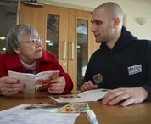
Today
Describe Health Trainer Service (HTS)
Evidence of effectiveness
Key success factors
Current issues
The future?

Slide 3
Data Sources
Synthesis of eight Health Trainer Service evaluations
Data Collection Reporting System (DCRS) – 1377 health trainers, 97,248 clients in 2014
Hosts of Yorkshire & Humber Regional Health Trainer hub
Issue – lack of central database

Slide 4
The Health Trainer Service

Slide 5
Why did the Health Trainer Service come about?
Rising rates of avoidable ‘lifestyle-related’ health issues
Concerns re costs of treatment
Recognition that ‘medical model’ / primary care unable to cope
Belief in potential power of ‘lay workers’
Tackling inequalities a priority

Slide 6
How did the HTS
come about?
Choosing Health: making healthier choices easier (DH, 2004)
Community-based workforce
Offering personalised support to people living in disadvantage
“Support from next door”
Aimed to empower people to take control of their health, to build community capacity and to reduce inequalities

Slide 7
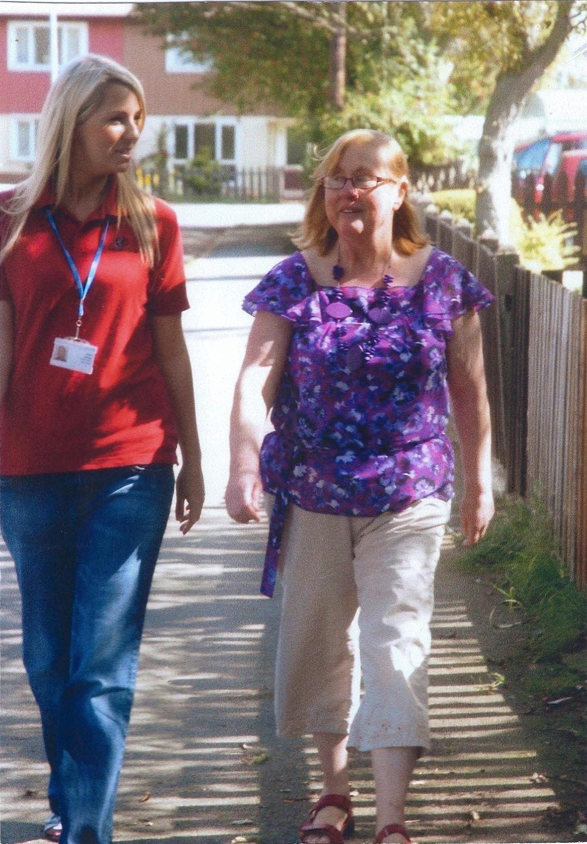
What does a health trainer
do?
One to one support – 6-8 sessions
Tailored / personalised
Help clients to set and monitor their own behavioural goals
Not issue specific
Refer or signpost onto other local services

Slide 8
Who are health trainers?
Aim to recruit people who can provide ‘support from next door’
32% from most deprived areas in England
40% live in same areas as their clients
Two thirds are female, most aged between 26 and 45 years
Some have similar health conditions to their clients

Slide 9
Empowering approach
Psycho-social model – use motivational interviewing, goal setting, action planning
Aim to move clients from being passive recipients of healthcare – to active participants in their health

Slide 10
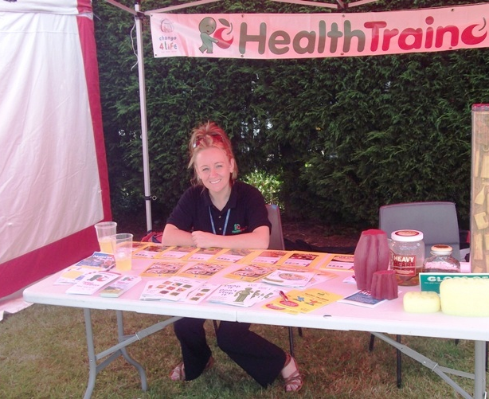
Community Engagement
In accessible places
Actively promote the service
Work with volunteers / champions
Run groups
Work with partners

Slide 11
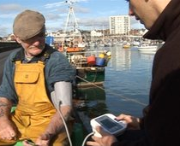
East Riding Fishermen
Fishermen – often poor health
East Riding – 2 Health Trainers based at Harbour Office
Offered free health checks, gave our information and advice

Slide 12
Does it work?

Slide 13
Clients by deprivation
quintile

Slide 14
Who are health trainers supporting?
Demographics
66% White British, 10% Asian / Asian British, 4% Black / Black British
68% women
Most common age between 45 and 55 years or 36 – 45 years
People with particular needs including those;
with Long Term Conditions
with mild/moderate mental health problems
Who are lonely or socially isolated
Have caring responsibilities

Slide 15
Personal Health Plans
More than 59% of clients who saw a Health Trainer, developed a Personal Health Plan (PHP)
13% were signposted to another service
49% of clients who set a PHP achieved their goals fully, 23% part completed

Slide 16
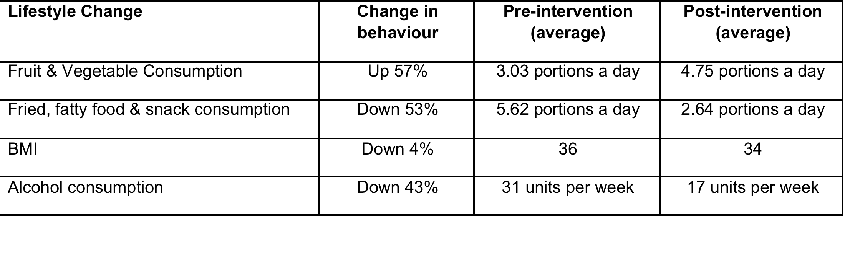
Lifestyle changes (Q1)

Slide 17
Mental Health & Wellbeing
Self-efficacy – increase of 13%
Self-confidence – increase of 25%
Self-reported general health – up 20%

Slide 18
Why does it work?

Slide 19
Clients’ view of HTs
Offer time
Are friendly, approachable, non-judgmental
Have empathy
Understand the issues they face
Understand the local area
Speak the same language

Slide 20
A client from Bradford
“I think it was the way the health trainer came across. She came across friendly, like someone you’d meet like a friend to have a chat with. She was talking to me at my own level and she wasn’t talking to me on a clinical way or in a doctor way if you know what I mean and I just found that easier. I found that I had a rapport with her and that I could tell her things and that I wasn’t worried about telling her anything and I felt that she were easy to talk to.”

Slide 21
The future?

Slide 22
Threats to the HTS ethos
Insecure, short-term funding
Pressure to become ‘target driven’
Pressure to become more issue specific (e.g. weight management)
Tendency to ‘reinvent the wheel’ – new lifestyle services
‘Professionalisation’ of the work-force

Slide 23
Reasons for optimism
Well evidenced service
Skills / abilities much needed in public health
Flexible model
Strong advocates from enlightened primary care and public health individuals / organisations
“GPs are really good at doing the medical stuff… We have less time in our ten minutes to deal with the much wider psycho-social issues and it’s been fantastic having the back-up of the health trainers and their coaching approach to the wider issues.” A Sheffield GP.

Slide 24
References
www.healthtrainersengland.com
White, J. Woodward, J. South, J. (2013) Addressing inequalities in health – what is the contribution of health trainers. Perspectives in Public Health, Vol. 133, No. 4
RSPH Indicators of Change. The adaption of the health trainer service in England. February 2015.
Bagnall, AM. Trigwell, J. White, J. Health Trainers End of Year Review 1st April 2013 – 31st March 2014
RSPH Health Trainers Half Year Review 1st April – 30th September 2013

