Slide 1
Open Access in Practice
Jennifer Bayjoo
@epicbayj
j.b.bayjoo@leedsbeckett.ac.uk
NLPN 4th June MadLab

Slide 2
What are we going to do?
@epicbayj #nlpnopen
About me
Research role
Quick intro to OA
Practical session (whoop!)
Feedback, questions and discussion

Slide 3
Grad Trainee 2013-14 MMU
@epicbayj #nlpnopen

Slide 4
Information Services Librarian 2015-now
@epicbayj #nlpnopen

Slide 5
What does working in Research Services mean?
@epicbayj #nlpnopen

Slide 6
Do you even code though?
@epicbayj #nlpnopen

Slide 7
Open Access (OA)
@epicbayj #nlpnopen

Slide 8
Where’s the money?
@epicbayj #nlpnopen

Slide 9
Green OA
@epicbayj #nlpnopen

Slide 10
Gold OA
@epicbayj #nlpnopen

Slide 11
Research Excellence Framework (REF)
@epicbayj #nlpnopen

Slide 12
Practical Session
@epicbayj #nlpnopen

Slide 13
1. Angry Academic
@epicbayj #nlpnopen
Hi
This journal article is mine but it hasn’t been published yet. I don’t even know when or what the vol/issue number will be and I don’t see why I have to upload it now, this will just be confusing. Please amend your repository rules and don’t search for unpublished journal articles. This isn’t the formal process and I will not accept this upload unless you can give me a good reason.
Thanks,
Harry

Slide 14
2. Student looking for article
@epicbayj #nlpnopen
Dear repository,
I am a ug student at Leeds Beckett University and I am trying to read an article for my course that I saw on the library website. I clicked the link and it said restricted to staff.
Is there any way I can see it or get a copy? Do you have it in paper version?
Musgrave, J and Woodward, S Ecological Systems Theory Approach to CSR: Contextual perspectives from meeting planners. Event Management: an international journal. ISSN 1943-4308
My coursework deadline is next week so any help would be great.
Thanks,
Leslie

Slide 15
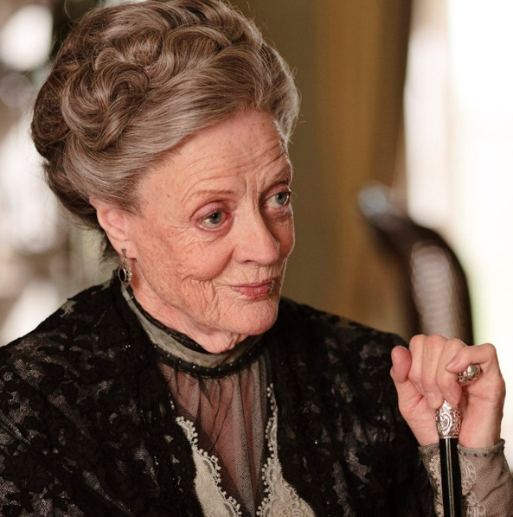
3. Academic wants to delete Twitter
@epicbayj #nlpnopen
You are contacted on the phone by a retiring academic who would like to delete her Twitter account. Your colleagues have helped her in the past and so she thinks you would know about this sort of thing, but she just can’t find the button to click.

Slide 16
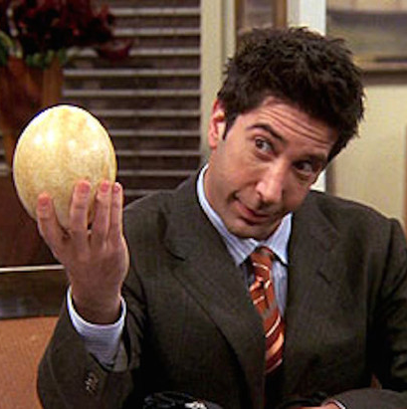
4. New staff copyright query
@epicbayj #nlpnopen
Good afternoon,
I have just started at Beckett and been asked to upload my journal articles. I never did this at my old uni and I have no idea where to start. Wouldn’t this breach publisher copyright? I’m pretty sure they own the articles and I can’t send them around.
Perhaps I have this wrong? Are you the right people to contact? Sorry, I haven’t even been in the library yet so I’m not sure how it all works.
Best wishes,
Ross

Slide 17
What comes next?
@epicbayj #nlpnopen

Slide 18
Head of Library Content and Scholarly Communications
@epicbayj #nlpnopen
Notes:
http://www.swansea.ac.uk/personnel/jobs/details.php?nPostingID=3265&nPostingTargetID=5650&option=52&sort=DESC&respnr=1&ID=QHUFK026203F3VBQB7VLO8NXD&LOV4=7815&JOBADLG=UK&Resultsperpage=20&lg=UK&mask=suext#accept

Slide 19
What have we learnt?
@epicbayj #nlpnopen

Slide 20
Theory vs Practice
@epicbayj #nlpnopen

Slide 21
Communication
@epicbayj #nlpnopen

Slide 22
Dream big
@epicbayj #nlpnopen

Slide 23
Image References
@epicbayj #nlpnopen
Phone by Simon Cousins is licensed under CC BY 2.0.
One Euro Coin by Mike Steele is licensed under CC BY 2.0.
Scream by Mingo Hagen is licensed under CC BY 2.0.
“長跑 Long Run (Marathon)” by See-Ming Lee is licensed under CC BY 2.0.
Any Questions? By Matthias Ripp is licensed under CC BY 2.0.
Images of Harry Potter, Leslie Knope, Lady Grantham and Ross Geller are nicked from the Internet. Yes, I am a bad librarian.
All other images are free of any copyright restrictions and are available from Unsplash.

Slide 24
Any questions?
@epicbayj #nlpnopen
Notes:
15 mins presentation
15 mins task
20 mins feedback
10 mins questions/discussion

