Slide 1
Leeds Beckett University
Libraries and Learning Innovation
The Director’s Cut -
Shelf-ready acquisition of AV – a case study
Eric Jackson
Collections and Acquisitions Manager

Slide 5
marc record specification that we use as standard for DVDs.
=LDR 00956ngm 2200289 i 4500
=001 IN\or\UPC\or\EAN
=003 UK-RwCLS
=005 20130308163540.0
=007 vd\cvaizz
=008 14xxxxp\\\\\\\\xx\|||\\\\\\\\\\\\vleng\d
=024 10$aUPC number
=024 30$aEAN number
=028 40$avideorecording number
=040 \\$aUK-RwCLS$erda$cUK-RwCLS
=082 04$aClass number$bShelving suffix
=245 00$aTitle$h[DVD] :$bother title information /$cdirected by
=250 \\$aEdition statement - e.g. Widescreen version.
=264 \1$aPlace of Publication :$bName of Publisher,$cDate of Publication.
=300 \\$a1 DVD (approximately ??? min.) :$bsound, colour +$eaccompanying materials
=336 \\$atwo-dimensional moving image$btdi$2rdacontent
=337 \\$avideo$bv$2rdamedia
=338 \\$avideodisc$bvd$2rdacarrier
=500 \\$aFilm made in xxxx
=511 1\$aCast details
=538 \\$aDVD, PAL, Region 2.
=650 \0$aSubject
=700 1\$a$efilm director.
(Kate’s scribbled notes)
Would like to see records for recorded music.
Examples of subject headings for music, films, video games, tv progs
082 transferred to 970. Don’t forget filing/nonfiling |b
No |h [GMD]
???500 place or date??
Check LDR field etc Is the format MUSIC or VM – we need VM, (or MM) but not sure how that’s controlled
001 looks like it would make the title control either ISBN, EAN or UPC. Is this in order of preference? Remember update that will make control nos unique.
Would they apply 655s for genre, and would it cost more? And what would be the implications??
Cuttering of popular music/classical music – we’re going for main entry

Slide 6
Specifications for application of DDC and shelving letters to shelf-ready material (AV only)
DDC:
Standard DDC in the 082 field
Edition 23, full version.
Class mark:
DDC as above transferred to a 970 field.
All items to have shelving letters derived from main entry, i.e. the 100, 110, 111, 130, 245 field (in that order). These are to be in subfield |b of the 970 field.
Exceptions:
All computer games on disk, chip etc. are classed at 794.8 plus shelving letters derived from title in the |b subfield of the 970.
700 - 779 and 791 – 792
Works about a specific artist/group of artists have shelving letters derived from the 600/610 field. These have NO |b in the 970 field.
(This includes e.g. film directors, dancers, actors, dancers, choreographers, photographers, etc.)
Works by a specific artist/group of artists have shelving letters derived from the 100/700 field. These have NO |b in the 970 field. The 600/610 field if present takes precedence.
Individual films, TV programs and radio programs have shelving letters derived from the TITLE. These have the |b subfield in the 970
Items about individual films, or tv or radio programs take shelving letters derived from the title of the film or tv/radio program. These have the |b subfield in the 970.
All other material takes shelving letters from the main entry.
800-899
Works about a specific literary author/group of authors have shelving letters derived from the 600/610 field. These have NO |b in the 970
Works by a specific literary author/group of authors have shelving letters derived from the 100/700 field. These have NO |b in the 970 field. The 600/610 field if present takes precedence.
Works BY Shakespeare have no shelving letters, works ABOUT him have shelving letters SHA in the 970, with NO
|b subfield.
All other material takes shelving letters from the main entry.

Slide 9
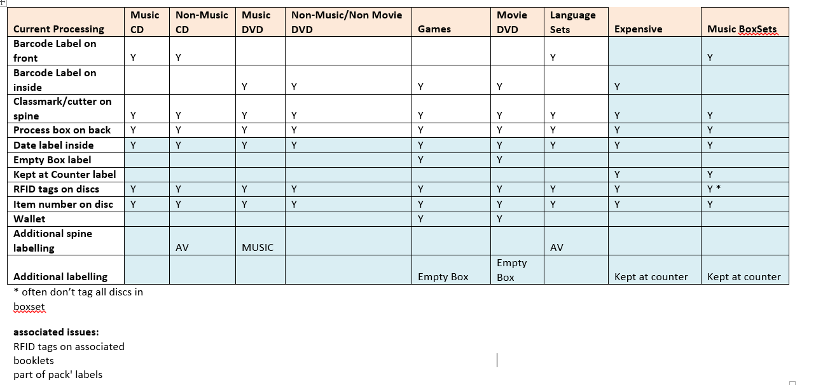

Slide 10
Jewel CD case processing
Current Processing | Music CD | NonMusic CD
Barcode Label on front | Y | Y
Classmark on spine | Y | Y
Process box on back | Y | Y
Date label inside | Y | Y
RFID tags on discs | Y | Y
barcode number on disc | Y | Y
CD inlay stamp | Y | Y
Additional spine label |  | AV
Supplier to process the following
Barcode on front of CD case, not obscuring title or artist name.
Classmark vertically along spine of CD, not on the front of case. Font 12/14.
Process box on rear of CD case, ideally not obscuring track list or the EAN/ISBN.
Date label depending on size of new date label (waiting from Jane P). If they are bigger than the size of a CD may be easier to do in-house.
In-house processing
RFID tag and initialisation
Barcode number on disc.
CD inlay “part of pack” stamp.
AV midas label along spine.

Slide 11
A few lessons learned ….. or reinforced
Take your time/set your own pace
Decide what you really want
Talk to a cataloguer
Change in one procedure can be a good driver for updating and improvement
Outsourcing doesn’t mean you’re out of a job. There might be more useful and interesting ways to spend your time
This year, for the first time, we have no cataloguing backlog

Slide 12
Libraries and Learning Innovation
Eric Jackson
Collections and Acquisitions Manager
e.jackson@leedsbeckett.ac.uk
For further information about the cataloguing aspects of this project, please contact:
Kate Bunting
Senior Bibliographic Services Librarian
k.bunting@leedsbeckett.ac.uk

