Slide 1
LEEDS BECKETT UNIVERSITY
Exploring Leeds Beckett University BME students' experiences of "living at home": sharing practice for inclusive curricular change
Dr Susan Smith
Head of Curriculum Development & Review

Slide 2



Slide 3

Our Attainment Gap 2014-15

Slide 4
Literature indicates that the degree attainment gap is strongly related to the experience of teaching and learning at a university
(Stephenson, 2012; Office for Fair Access [OFFA], 2015.)
Commuting students needs can be inadvertently overlooked.
Issues faced by BME commuting students are identical to those faced by all commuting students.
However, BME students are already coping with a less adequate student learning experience and reduced attainment

Slide 5
Approach
Review and critique of the literature identifying factors which impact on BME student achievement
Mixed methods approach
Audit and analysis of our attainment/access/achievement activity data, Race Equality Action Plan and Race Charter Mark data
Analysis of achievement data and identification of 5 selected courses- (resit rates, living at home, retention rates, placement rates)
Course document analysis
Generation of evidence informed interview schedule
Interview course leaders and key others
The narrative of the students – from student focus groups
Action Plan

Slide 6
Emergent issues from review of course documentation
Lack of clarity about assessment approaches, inclusive assessment formative assessment, group work specifics,
Reading lists and resource lists
Lack of explicit placement strategy- access, opportunity and diversity
Lack of clarity over “sense of belonging”, expectations for all at first year,
Induction as transition etc.

Slide 7
Emergent issues from thematic analysis of interviews - (students)
Inclusive assessment- formative assessment
“I needed to do more practising for my assessments” “I was the first to go to Uni from my family and I didn’t know what sort of level they wanted with my early assessments” (Female, First year)
Why is my curriculum white?
“There were so few black writers on my reading list” (Female, Third year)
The critical mass and the student voice
“I was the only Asian student in my group and didn’t really feel I could speak up” (Female, Third year)
Anonymous marking
“Some scripts are marked online with just a student number attached. I know not everything can be anonymously marked but more could be. ”. (Male, Third year)

Slide 8
Emergent issues from thematic analysis of interviews - (students)
Placement opportunities for BME students
“My Asian friends and I thought we would just go and work straight in the family business- there were jobs for us there” (Male, 3rd year)
Feeling of marginalisation and lack of confidence- induction
“I felt a bit left out at the beginning- the initial Freshers' week helped” (Female, first year)
Collaborative learning issues
“We tended to arrive together in the same car and stuck together in the same group as we sat together” (Female 2nd year)
Help seeking behaviours
“ I only showed my personal tutor my draft essay at the last minute. It felt wrong to show her earlier- I felt a bit of a failure showing her something weak so I left it too late” (Male, 2nd year)

Slide 9
Emergent issues from thematic analysis of interviews - (staff)
Inclusive curricula - overly “white “ curricula - “let’s interrogate our curricula….” “dehumanises those left out….”
Unconscious bias awareness
The important role of induction as transition to learning @Level 4
The proportion of BME students on the course and their voice
Opportunity to share values in a safe learning space – foster critical thinking to allow issues to be explored
Facilitate integration, learning and social opportunities via the teaching and learning approach- collaborative learning
Assessment: inclusive, formative, scaffolded
Anonymous marking

Slide 10
Living at home rates
The living at home rates of BME undergraduate students were analysed
In 2014-15, the living at home rates of the BME students were striking.
Across our 5 courses an average of 53.4% of our BME students lived at home compared to 18% of their non BME student peers and this pattern remains unchanged in 2015-16.
Above the national average for all undergraduate living-at- home students.

Slide 11
But what about the commuting students?
Positives
From the focus group...
Home grown, pre established social and family network- active, positive choice to stay at home.
Time management /compartmentalisation skills.
The negotiation skills of all the students
“No homesickness”
Finances
Travel time can be used productively

Slide 12
Issues
Practicalities of travel
Timetabling gaps - needing to make the most of being on campus
Arriving together and leaving together
Difficulties being on-campus for group projects and learning
Reduced sense of belonging and the impact on retention
The nature of participation
The role of the family

Slide 13
Are these issues familiar to you?

Slide 14

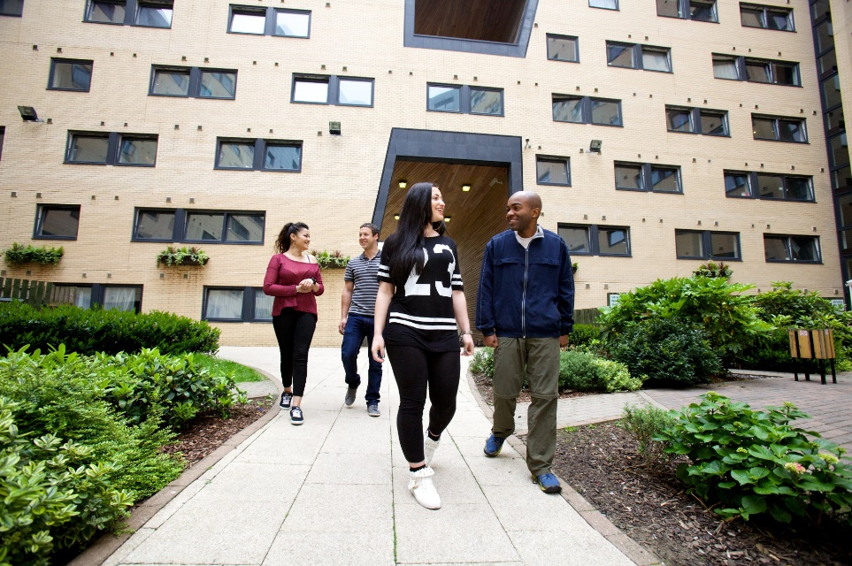

Slide 15
What have we done?
No separate policies and practices – but SU/University consultation necessary. More BME student representatives required.
Induction
Retention
Independent and collaborative learning
Enhancement of the students sense of belonging
Panopto (opt out only)

Slide 16
Induction
Clarity of expectations and attendance at course level
Need to ensure all students build on the different forms of social and cultural capital universities can provide
Expectations around group work and participation
Expectations around “all your own work” and academic integrity
Using online fora
Encourage residentials /trips

Slide 17
Timetabling
Social learning spaces
Piloting CMIS Go
Look at the gaps - so students don’t go home ( first years), have gaps (final years).
Early evening and lunchtime activities- more cross -course invitations
Student wellbeing lunchtime sessions are popular
Explore personalised timetables

Slide 18
Retention
Wellbeing website
Skype appointments with disability team
Skills for Learning
Site licence for assistive software accessible off campus
Money advice team - telephone advice line
Hardship fund - consider where student travelling from

Slide 19
Independent and collaborative learning
Active group work management by the staff
Physical movement in large lecture theatres
Using students own experiences- authentic assessment
Digital interactive gaming input in large lecture theatres
Paired /interactive exercises/sharing of values in the classroom
Active mixed allocation of groups especially in Level 4

Slide 20
Building a sense of belonging
Learn names
Personal tutoring/academic advising- available remotely
Inclusive curricula - multicultural case studies, diverse reading lists, assessments varied
Carefully timetabled course celebrations/activities

Slide 21
Especially for commuters
Lunchtime activities
Student society for commuters - buddy up and share transport
Local students network - events (Sheffield)
Consultation about policies/interventions through the reps
Awareness of Equality Impact Assessments

Slide 22
What do you do already?
What would you like to do?

Slide 23



Slide 24
Write on a postcard please….

Slide 25
Abrahams, J. and Ingram, N. (2013) ‘The Chameleon Habitus: Exploring Local Students’ Negotiations of Multiple Fields’ in Sociological Review Online 18:4.
Archer, L. and Hutchings, M. (2000) ‘Bettering Yourself? Discourses of risk, cost and benefit in ethnically diverse, young working-class nonparticipants’ constructions of higher education’ in British Journal of Sociology of Education, 21:4, 555-574.
Baik, C., Naylor, R. and Arkoudis S. (2015) The first year experience in Australian universities: findings from two decades, 1994-2014, Melbourne Centre for the Study of Higher Education, The University of Melbourne.
Clegg, S., Stevenson, J., and Willott, J. (2009) Staff conceptions of curricular and extracurricular activities in higher education. Journal of Higher Education. Published online August 2009. DOI 10.1007/s10734-009-9269-y.

Slide 26
Dante, A., Fabris, S. and Palese, A. (2013) Time-to event analysis of individual variables associated with nursing students’ academic failure: a longitudinal study. Advances in Health Sciences Education, 18: 1047-1065.
Department for Business, Innovation and Skills (2014) Learning from Futuretrack: studying and living at home (London: BIS).
http://www.hecsu.ac.uk/assets/assets/documents/Futuretrack_BIS_Learning_from_futuretrack_studying_and_living_at_home.pdf (Accessed 11 January 2017).
Guardian (2013) Why I live at home and commute to University https://www.theguardian.com/education/mortarboard/2013/jan/16/live-at-home-and-commute-to-university The Guardian (Accessed January 11 2017).
Guardian (2014) Rise of the live-at-home student commuter. https://www.theguardian.com/education/2014/aug/26/rise-live-at-home-student-commuter. The Guardian (Accessed 11 January 2017).
Helsen, E. (2013) The role of Student Services and Support in attaining commuter students, London: AMOSSHE. http://www.amosshe.org.uk/resources/Documents/AMOSSHEis20-Kingston-The-role-of-Student-Services-and-support-in-attaining-commuter-students.pdf. (Accessed 11 January 2017).

Slide 27
Higher Education Academy and National Union of Students (2011) Student Engagement Toolkit [Internet]. Higher Education Academy and National Union of Students. Available from: https://www.nusconnect.org.uk/campaigns/highereducation/student-engagement/toolkit/resources/ (Accessed 21 December 2016).
Higher Education Statistics Agency (2015) Term-time accommodation of all full-time students. Higher Education Statistics Agency. https://www.hesa.ac.uk/content/view/3312
Loke, G. and Berry, J. (2011) Improving the Degree attainment of Black and Minority Ethnic students. Report. Equality Challenge Unit and Higher Education Academy http://www.ecu.ac.uk/wp-content/uploads/external/improving-degree-attainment-bme.pdf
Newbold, P., Mehta, S. and Forbes, J. (2011) A study of non-traditional and traditional students in terms of their time management behaviors, stress factors, and coping strategies, Academy of Educational Leadership Journal, 15.
National Union of Students (2015) Policy and Practice for students living in the parental home. National Union of Students.https://nusdigital.s3-eu-west-1.amazonaws.com/document/documents/15933/50ae6b302ef91f5639b8f0ef0dd7d4f8/Reaching%20Home.pdf?AWSAccessKeyId=AKIAJKEA56ZWKFU6MHNQ&Expires=1482235410&Signature=mpi%2FxJDFYobrZIAm292Y5XryErU%3D

Slide 28
Office for Fair Access (2015) OFFA Topic Briefing: BME Students - OFFA [Online]. Retrieved from: https://www.offa.org.uk/universities-and-colleges/guidance-and-useful-information/topic-briefings/offa-topic-briefing-bme-students/ (Accessed 9 May 2016).
Pickford, R. (2016) Student Engagement: Body, Mind and Heart – A Proposal for an Embedded Multi-Dimensional Student Engagement Framework, Journal of Perspectives in Applied Academic Practice, Vol 4, No 2.
Richardson, J. (2008a). Degree attainment, ethnicity and gender: A literature review. York. https://www.heacademy.ac.uk/searchn/site/assets%20York%20documents%20ourwork%20research%20J%20Richardson%20literature%20review%20Jan08%20pdf
Richardson, J. T. E. (2008b). The attainment of ethnic minority students in UK higher education. Studies in Higher Education, 33(1), 33-48.
Sage, J., Evandrou, M. and Falkingham, J. (2013) ‘Onwards or Homewards? Complex Graduate Migration Pathways, Well-being, and the ‘Parental Safety Net’’ in Population, Place and Space 19:6, 738-755.
Stevenson, J. (2012). Black and Minority Ethnic Student Degree Retention and Attainment [Online]. Retrieved from: https://www.heacademy.ac.uk/sites/default/files/bme_summit_final_report.pdf
Thomas, L. (2002) ‘Student retention in higher education: the role of institutional habitus’, Journal of Education Policy, 17:4, 423-442.
Thomas, L. (2012) Building student engagement and belonging in Higher Education at a time of change: final report from the What Works? Student Retention & Success programme (London: Paul Hamlyn Foundation).

