Slide 1
Long term usage analysis of PDA titles
Tom Vause
Leeds Beckett University
Notes:
Good morning and welcome.
My name is Tom Vause and I’m an Information Services Librarian at Leeds Beckett University.
I’m part of the Library Online team and I manage the universities eBook collection and am also a cataloguer.
This presentation will investigate long term usage of PDA titles and see if there is any trend present. Are PDA titles value for money?
Universities are now investing significant amounts into PDA and is it now time to see how this effects our collection and are they proving a return on investment?

Slide 2
Leeds Beckett University and PDA
PDA:
Askews & Holts
Coutts
Alexander Street Press
Kanopy
Notes:
At Leeds Beckett University we currently have 4 PDA models of acquisition ongoing. We have PDA eBooks supplied by Aksews & Holts and Coutts via their MyiLibrary platform.
New for this academic year however we are also doing PDA for video resources via Alexander Street Press and Kanopy.
These are new schemes so there is not enough long term usage data for it be part of this presentation.
The this presentation I will be using the usage data from both our Askews and Coutts profiles.

Slide 3
Askews & Holts PDA
Launched March 2015 “History Dissertation” profile.
Created due to NSS feedback.
Profile closed: November 2015. 734 titles purchased.
Replaced with “Super Profile” and “Law”.
February – September 2016. 398 titles purchased.
Super Profile 306, Law 92.
New profiles “Super Profile 2016-17” and “Law 2016-17”.
October – November 2016. 227 titles purchased
Super Profile 2016-17 211, Law 16.
Notes:
Our Askews & Holts PDA profile was launched in March 2015 in response to National Student Survey scores from History students which stated that they didn’t have enough resources for their dissertations.
This profile was closed in November 2015 and replaced with two different profiles : Super Profile and Law.
The Super Profile covers a multidisciplinary range of subjects after discussions with academic librarians and the Law profile contains all the UK law eBooks.
Again these two profiles were updated and relaunched in October 2016.
The profiles were updated and selections were slightly altered after feedback from academic librarians.
History dissertations started with a budget of £5,000 which was topped up with academic librarian funds.
This was then increased the following year but due to focusing on reading list items the funding was increased this year hence the fact the profile was only open between Oct – Nov 2016.

Slide 4
PDA title selection
Titles were selected by working with Academic Librarians to choose Dewey ranges we wanted to make available.
Some exclusions: single user titles, some publishers.
Purchase requirement for Askews & Holts PDA is 5 minutes usage.
Notes:
Selections were made originally due to student feedback in the National Student survey.
However most selections were then made after discussions with academic librarians.
We specifically looked at 3rd year dissertation titles and tried to map out potential Dewey numbers for those titles. Askews has the ability to select titles for the profile via dewey number. This was a time consuming process but we felt it worth doing as it helped create a more focused and relevant profile.
We did add some exclusions to the profiles such as no single user titles, removed some problem publishers, geographically and only included titles published in the last 2 years.
The requirement for making the purchase is 5 minutes access. After that you are asked whether you would like to continue accessing the resource and then the eBook is purchased.
This was originally a concern as not seen as a big enough purchasing trigger.

Slide 5
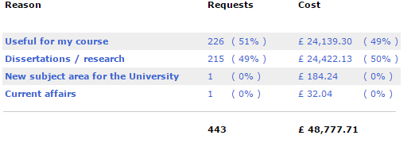
PDA selections
When purchasing a title users are asked:
What faculty they are?
Reason for wanting to view this eBook
Not possible with Coutts PDA but gives a snapshot of usage and interest. Especially as this profile was aimed at History students who are part of the Faculty of Arts, Environment.
Questions have now changed to Schools and only the two most popular options for Reason.
Notes:
When the user stated that they wished to continue accessing this eBook they were asked two questions which we had created.
These were: What faculty are they?
What is the reason you want to access this eBook?
These questions help us identify if we are targeting the right students and whether the resources are relevant to them.
This functionality is not available via our Coutts profile but it does give us an interesting snapshot as to interest of our Askews profile. What is interesting is that this information is for purchases between March – August 2015. This was when only the History Dissertation profile was live.
However only 16% of purchases were from users in the faculty Arts, Environment which History is within.
Does this mean that we selected the wrong titles or that these titles had a broader appeal than we thought?
When looking at the reason for wanting the access this eBook the reasons were split 50:50 between useful for my course and dissertation/research. This demonstrates that there was significant interest from dissertation students which was who the profile was aimed at.
From this academic year due to a restructuring of the university we are now asking what school they are in so will be able to drill down further into these results for more meaningful analysis.

Slide 6
BR2 Usage for all Askews & Holts titles
Notes:
The actual usage data I have is collected in the form of a COUNTER BR2 report.
This graph shows the total BR2 usage for ALL Askews titles.
You can see the launch of the first PDA profile in March 2015 (the blue column)
Following that usage has continued to grow month on month with November 2016 being the most used month ever.
This information of course counts all titles so includes all of our later profiles as well which of course help account for the continuous increase in usage.

Slide 7
Total BR2 usage for Askews PDA titles purchased before Sept 2015
Notes:
This chart is more illuminating in regards to understanding long term PDA usage.
This chart shows ONLY usage for titles bought BEFORE September 2015 so in the first batch of the history dissertation profile.
The blue columns are the only columns which show what could be usage which triggers purchases.
What is interesting is that usage for these titles continues to increase month on month. There is definitely repeat and long term usage of these resources.
The most popular month of usage is January 2016 which is a full 5 months after the last purchase of these resources.
Looking at the 2016-17 usage as well (the grey columns) you can see that usage does not appear to be dropping any time soon.
This graph clearly states that these titles are seen as useful to students and as they are continuing to be useful long after being purchased.
To produce this information was a time consuming process as it was a case of finding the titles within a spreadsheet of all titles and their usage.

Slide 8
Usage of titles 2016/17
Using BR2 stats for September – November.
Of PDA titles purchased BEFORE Sept 2015:
177 have been accessed this academic year (40%)
Most popular: Criminology : a sociological introduction by Eamonn Carrabine (7709 accesses this academic year)
Average cost per use of this title for this academic year = 2p
Average usage per eBook is 140 accesses.
Notes:
What that chart does not show is whether there is a small core of titles which accounts for all that usage.
However, looking at the BR2 usage statistics from September to November we can see that 177 titles out of 443 had at least one access. This is 40% of the titles purchased.
The most popular title was Criminology : a sociological introduction by Eamonn Carrabine which has had 7709 access so far this academic year. This makes it the 3rd most popular title on the Askews platform and it was purchased in March 2015.
This means that over this academic year alone the average cost of each access is 2p.
The average number of eBook accesses per book was 140 and 354 when only counting used eBooks.
This is a lot higher than print usage.
This is a very high amount of long term usage which had proved its value for money and that there has been a high level of user engagement.

Slide 9
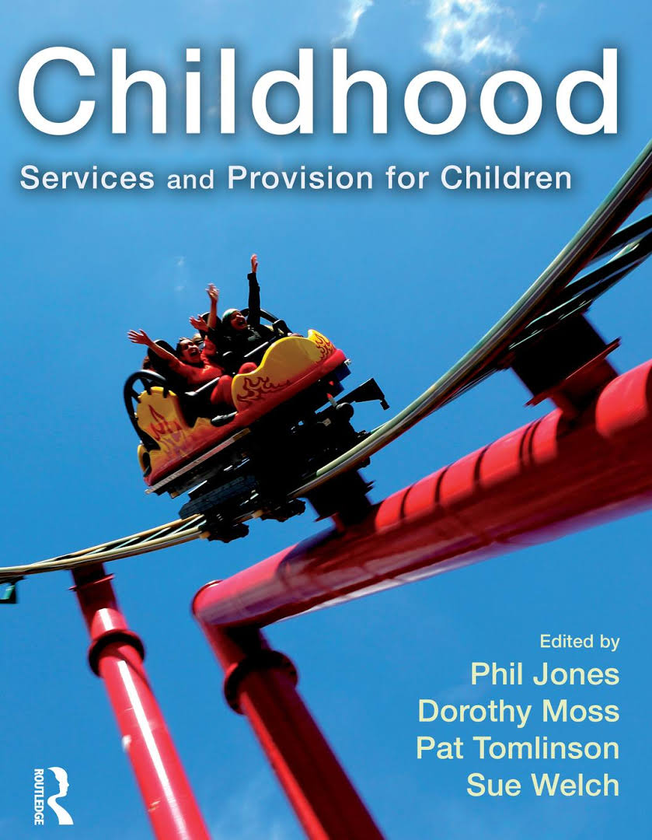
Askews PDA titles and reading lists
Has there been any interest from Academic Staff?
Interest shown by PDA titles being adopted on reading lists.
Of the titles purchased before September 2015 69 were on reading lists (16 %)
Most listed title: Childhood : services and provision for children by Phil Jones (21 lists)
1st PDA title added to reading list due to student feedback to academic.
Notes:
We have seen that the uptake from users has been good from Askews PDA but what about academics? Do they see the resources as important and of a good enough quality?
One way to see this is to look at whether any of the titles purchased have been added to any reading lists via our online reading list management system Rebus.
Of the titles purchased before September 69 were on at least one reading list which is 16% of the total collection.
The most common title was Childhood : services and provision for children by Phil Jones which was in 21 different module reading lists.
What I found is when collecting this information is that often the print book was on a reading list but the eBook wasn’t as it was purchased after the list was created. There is now a system in place to check purchased PDA titles to see if they need to be added onto resource lists which will aid discoverability and therefore increase usage.
The 1st PDA title which was added to a reading list was due to student feedback to an academic. This demonstrated the important of adding these titles to reading lists.

Slide 10
Coutts PDA
This was launched in 2011.
Focused on three main areas: Cultural, Health/Politics and Sport.
Between: August 2014 – August 2015 190 titles purchased.
September 2015 – December 2015 200 titles purchased.
Re-launched in October 2016 and currently on-going.
Purchase requirement is more: requires two different accesses to the eBook.
All titles are on the 3 user model.
Notes:
Coutts was our first PDA supplier which was via MyiLibrary again due to NSS feedback asking for more books. This collection was selected by dewey numberts originally but hasn’t been altered since the first selection.
In the first batch a total of 390 titles were bought with 190 being bought before August 2015. These are the titles which I’ve tried to analyse.
The purchasing requirements for these titles are more with two different accesses being required to trigger a purchase.
Again selection criteria included removing single user titles and certain publishers.
Coutts was originally chosen as our PDA supplier due to the fact that there titles were 3 user models which was seen as a posititve.

Slide 11
BR2 Usage for all Coutts titles
Notes:
This chart shows the total number of accesses for all Coutts titles.
As you can see once again usage is growing month on month with November 2016 being the highest month on record for number of accesses.
This is what we would expect to see as we also you Coutts as one of our title by title suppliers as well as having an ongoing PDA profile with them.

Slide 12
BR2 usage for Coutts PDA titles purchased before Sept 2015
Notes:
This chart shows the total number of accesses for PDA titles bought before September 2015.
This chart shows a very different picture compared to Askews and Holts PDA titles. The number of access is actually going down over time.
There still is interest but not in the same amount as when the eBooks are purchased, this can be seen by the fact that the highest number of accesses was at the start of the PDA profile in March 2015.
What we need to try to work out is whether there are any underlying reasons for this lack of interest from our users and whether in the long run it is best to close this profile and focus instead on Askews or investigate other purchasing strategies.

Slide 13
Usage of titles 2016/17
Using BR2 stats for September – November.
Of PDA titles purchased BEFORE Sept 2015:
67 have been accessed this academic year (35%)
Most popular: British National Formulary 70 by British Medical Association (1648 accesses this academic year)
Average usage per eBook is 35 accesses.
Notes:
When looking at the actual number of titles which have been accessed this academic year there have been 67 which is 35% of purchases. This compares favourably with Askews which had a figure of 40% so why the comparative lack of usage. Are the titles of enough interest to view but not to use indepth?
Are there more textbook type titles in the Askews profile?
Is it the case that we would already have bought textbooks via Coutts on a title by title basis so therefore the titles in the PDA profile are more specialised and form parts of users extended reading instead.
The most popular title was British National Formulary 70 by British Medical Association which has had 1648 accesses this academic year. Significantly lower than Askews at 7709. We do need to consider do both of these suppliers measure an access the same in COUNTER BR2? However, that still doesn’t explain the lack of repeat usage for Coutts titles.
The average number of accesses is 35 for all titles and 88 if only including titles which have been accessed this year.

Slide 14
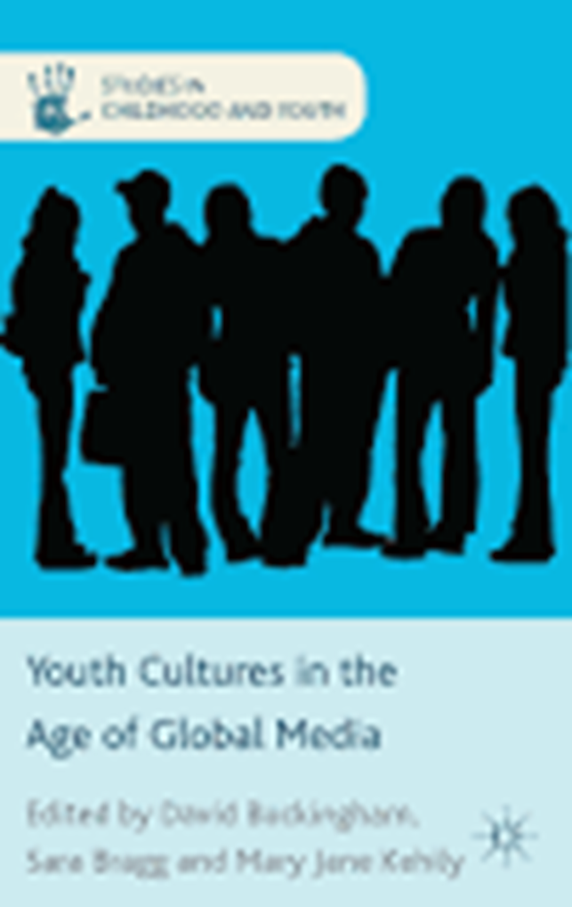
Coutts PDA titles and reading lists
Of the titles purchased before September 2015 9 were on reading lists (5 %)
Most listed title: Youth cultures in the age of global media by David Buckingham (3 lists)
Does lack of comparative repeat usage shows the need for library staff to be more involved in the selection process for PDA?
Notes:
We have seen that usage of the Coutts titles have not had repeat usage compared to Askews titles. Could this be down to a lack of engagement with these titles from academics?
Of the titles only 9 were on reading lists which equates to 5%. This does show a lack of engagement with these resources by academics. Especially when you consider that Askews had over 3 times that amount at 16%.
The most list title is Youth cultures in the age of global media by David Buckingham which is on 3 reading lists.
Is the lack of engagement due to the fact that academic librarians who know what is required for their courses not so much involved in the selection of these resources.
Are they therefore less relevant to users and therefore have a lack of long term usage?

Slide 15
Issues
As more titles added to catalogue older resources drop further down the list. How many pages will students click?
Manually checking reading lists to see if eBook copies need to be added. Time-consuming but is it worth it to make items more discoverable?
No BR1 data. How many users actually viewing items?
Currently no user tracking of who is using resources. Are they being used by many different people?
Notes:
There was numerous different issues when trying to collate these figures to discover if any trends could be spotted.
Firstly it needs to be taken into consideration that resources over time will be “pushed down” results searches are new resources are purchased. This emphasises the important of having engagement of academics via reading lists. Will students look on the second page of results. Will they even scroll down to the bottom of the first page?
It was very time consuming to analyse this data. Had to filter COUNTER reports to include only the PDA titles I wished to analyse and had to manually check titles individually on our reading list management programme.
It is also time consuming for staff to check if eBooks need to be added to already created reading lists but this should aid discoverability so it is worth it in the long run.
For both of these suppliers there is no BR1 data. Would be useful to have to discover if lots of users are accessing the items or a small number are accessing a significant amount.
We currently do not track which individual is accessing resources. This is something we are investigating via Athens authentication which would again help shape our PDA collection as we would have an idea what level of users are interacting with our resources. Hopefully we can get this usage via Schools and individuals.

Slide 16
Future
Further develop analysis of PDA title usage.
Are eBooks selected by particular school more popular than others?
Should we be more selective in what's in the profile? E.g. greater filtering by Dewey numbers.
Should we start considering using PDA for reading lists titles?
Should we be promoting these resources differently?
Can we compare PDA usage to non-PDA title usage?
Notes:
In the future we would like to develop how we analyse PDA usage even further.
For example we would like to know whether students of certain faculties are using eBooks which we had selected with them in mind e.g. their dewey number is within their topic.
Also would be interesting to see whether particular years of study is accessing the titles. Is it across the board or certain years e.g. dissertation writers in the third year.
Should we be more selective in the profile. Pick more precise numbers so we had a smaller selection but more targeted to our student needs.
Or should we go the other way and put all titles on reading lists on a PDA profile. This would provide an initial saving and would demonstrate how well the titles are used on reading lists.
Do we want to promote these resources as the student experience is the same so should we treat them any differently?
What became clear with these results is as an institution we need to review our PDA profiles and see whether we should alter our suppliers to improve our return on investment.

Slide 17
Any questions?

