Slide 1
On/Off Campus:
Responding quickly to subject support gaps in Information Literacy through the creation of online materials
Jennifer Wilson Academic Librarian for the School of building and Engineering, Leeds Law School and Leeds Business School

Slide 2
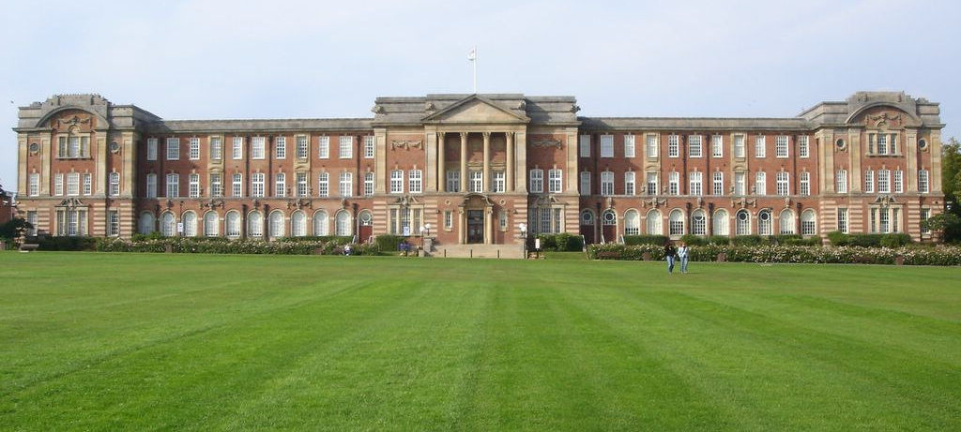
Leeds Beckett University
~20th largest university in the UK, with 26,000 students and 3,500 staff across two campuses.
University status 1992, with origins dating back to 1832.
http://www.leedsbeckett.ac.uk/

Slide 3
The problem…
Libraries have better resources than ever before, but according to academic staff, and official reports, students and researchers are relying on Google more than ever. While subscription makes discovery possible, quality research can still be missed.
And… financial, technical and organisational constraints won’t go away ☹

Slide 4
So what?...
Lower grades
Low usage of quality resources
Frustrated staff and students
Potentially decreased engagement with the Library
NSS Q19.

Slide 5
Until recently…
There was considerable pressure on academic librarians to all been seen to do the same thing, but as we know…
…the Information Literacy needs of students varies with subject.

Slide 6
Changes we wanted…
Some examples of instant IL support needs we knew we weren’t addressing well:
Reference management software support
Subject specific guidance on databases
Support for students where tutors are not engaged with the Library
Support for students who have missed their induction
On and off campus – students need the same help

Slide 7
What we tried…
Jing – 5 minute video
Free. Low-tech. Fun.
Amazing for instant support – used for…
Research student support – eg how to save results from a database to Mendeley.
Student email enquiry support – eg navigating to the right page online.
Distance learners – anything and everything!
Staff and research enquiries
https://www.techsmith.com/jing.html

Slide 8
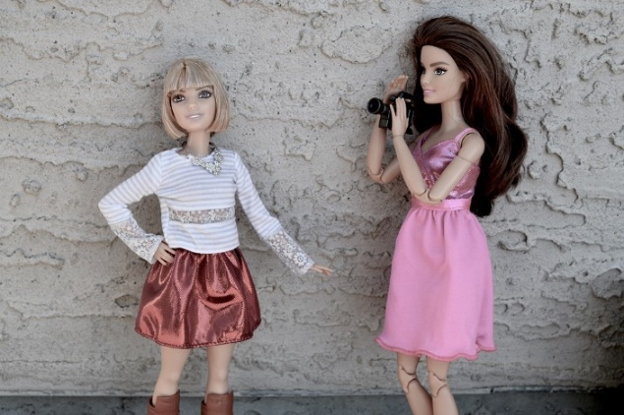
What we tried…
Video made on a smartphone
Not very pretty but they work
Still upload to the Library YouTube account but keep it private so only people with the link can view
Works best for Induction ‘mop-up’ and refresher
https://youtu.be/Kw7Z_IYEkWQ

Slide 9
What we tried…
Articulate
Articulate – excellent e-learning software with expensive licences!
In the Library we only have 1 copy
We don’t have any time to develop skills but we already have plenty of content
Get a Creative Commons licenced tutorial source code (from me?!) and open it in Articulate – 1 month free trial
Personalise (copy paste) avoiding content that might change
Especially useful for disengaged cohorts and distance learners
http://libguides.leedsbeckett.ac.uk/subject_support/building_and_construction/architectural_technology

Slide 10
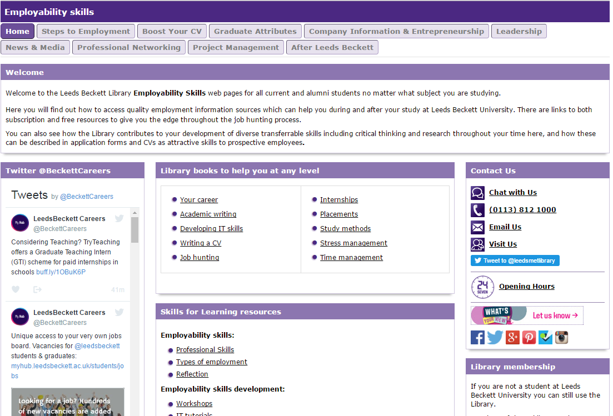
What we tried…
Libguides
Supporting the wider organisation’s employability strategy
Supporting our colleagues in careers services
Promoting and encouraging usage of our subscription content.
http://libguides.leedsbeckett.ac.uk/subject_support/employability_skills/

Slide 11
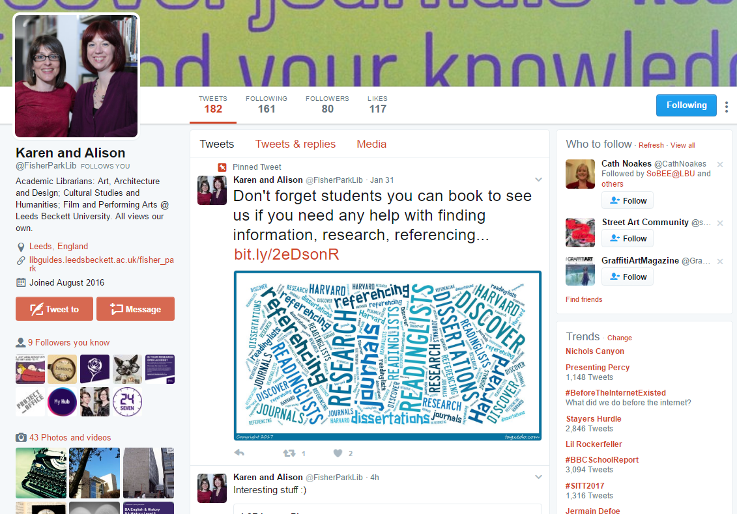
What we tried…
Twitter
Seriously late to this party, but even if you haven’t done so, have a go, it is a professional presence and you are connecting with your audience in another way!
@FisherParkLib

Slide 12
What we tried…
Back to basics: Word docs
Amazing for reference management support, in combination with Jing videos, YouTube videos and external links

Slide 13
What we learnt…
Innovation doesn’t have to be ground-breaking
Radical V. Incremental change
Some of us did and some of us didn’t
We all shared so anyone could reuse or get inspiration
Start to try small new things regularly and it will become a part of how you work

Slide 14
What worked well…
Generic
Long-term projects
Hi-tech
Big projects
Subject
Instant response
Lower-tech
Small projects

Slide 15
What next?
While maintaining a broad focus, we are:
looking out for the next University Strategy we can hi-jack
testing more free & easy tools to get our message across
learning more about on demand support – what are staff and students requesting next? What do graduates wish that someone had told them?

Slide 16
Outcomes
Improved individual support for Information Literacy skills development at the point of need
Increased understanding of staff of the impact of information literacy
Increased collaboration across all areas of the University in the promotion of information literacy skills
Increased demand for events from staff and students to support the development of information literacy skills
And finally
We had fun using free resources we didn’t need to spend all summer working on

Slide 17
Contact details
Follow-up questions, suggestions, comments and collaborations would be welcomed:
Jennifer Wilson, Academic Librarian for the School of building and Engineering, Leeds Law School and Leeds Business School
j.l.Wilson@leedsbeckett.ac.uk
0113 8123381
http://bit.ly/jenniewilson
@Buildabrarian

