Slide 1
Open journals and undergraduates How an open journal system can encourage information literacy, research and academic writing skills
Kirsty Bower
Academic Librarian; Health and Social Sciences
k.bower@leedsbeckett.ac.uk
James Fisher
Information Services Librarian
j.h.fisher@leedsbeckett.ac.uk

Slide 2
Background

Slide 3
Repository Services & Open Access engagement

Slide 4
Open Journal Systems (OJS)

Slide 9
Why create a journal?
High standard of work
Open Access
Dissemination research outputs to a wider audience
Research Excellence Framework engagement
Student employability
Making CVs stand out

Slide 10
Why create a journal?
Experience of writing for publication to encourage research/ masters/ further study/ standard of work?
Peer reviewed – quality of information sources
Connecting theory to real life
Alumni relationship

Slide 11
Institutional Strategic drivers
Excellent education experience (TEF)
Quality of teaching and assessment
New experience for the students
Research & academic enterprise (REF)
Fostering a research culture at all levels
Community of great people
Student produced & peer reviewed
Sustainable resources
Contributing to wider pool of knowledge

Slide 12
Additional strategic drivers
Graduate attributes & digital literacy
Conversations around open access, cost, quality and ethical use of information
Putting digital literacy into practice with tangible rewards

Slide 13
Feedback
“It was one of the most enjoyable assignments throughout the course, as we had a lot of freedom to write on a subject and theory of preference……..
I think the most valuable aspect of this assignment was learning the ability to synthesise theory with observation.
Experience of being an editor:
I recall a democratic process of deciding the order of the critical reflection journal…... This was good experience; working as a team to produce a document that would hopefully prove as conducive examples for future students, and good representations of the standard of teaching at Leeds Metropolitan (beckett) University”. (Jamie)

Slide 14
Feedback
“Creating work for a journal that is going to be read beyond that of the marking purposes, opens up a whole new dynamic to your module and to your degree……Having a journal written and created by student's combats the age old perspective from academics that there is nothing we can learn from students. Working on this journal therefore felt empowering, many of us got to talk more freely and express what we had learnt in a less rigid way. We felt we were being listened to, further than that we felt that our work was of genuine interest and therefore discussed topics that we were passionate and interested about” (Amy).

Slide 15
Feedback
Due to our work being published, I’ve been able to link to it on my LinkedIn and share it with people. I've been able to show our work to people otherwise not interested in Sociology, and due to my work being linked to an every day issue (eating disorders), it allows people to relate much more.
The fact that our work was published has made me proud of what I achieved and is a permanent reminder of university as a whole. People who I've met since university have been able to view what we did and the work we wrote without me even knowing them during.
It's a reminder that subjects like Sociology, which I went into thinking would be abstract to real life and would mainly be old theories, is always possible to be linked to real, modern life.
It was fun and great experience working together to get it published. It was a great way to see university out! (Jack)

Slide 16
Feedback
“I found the editing process very interesting and enjoyed the insight into the process of editing other people’s work and found the peer feedback very helpful, particularly with the outlook my peers took when it came to writing the introductory piece for the journal. This made me consider how I approached my writing in subsequent essays. It was ultimately very rewarding to see both our individual and group work published and the journal is something I can easily draw upon as a graduate to show many skills I developed through my time at university” Laura.

Slide 17
Practicalities
Small team/ time restrictions
Journal Manager
Journal Editor
Section Editor
Reviewer
Editorial and Peer Review pool – additional training
Training videos (James Fisher; Information Services Librarian)
Marketing – social media, direct contact, academic staff and alumni, open days
Inform British Council for Undergraduate Research
Copyright
ISSNs and DOIs

Slide 20
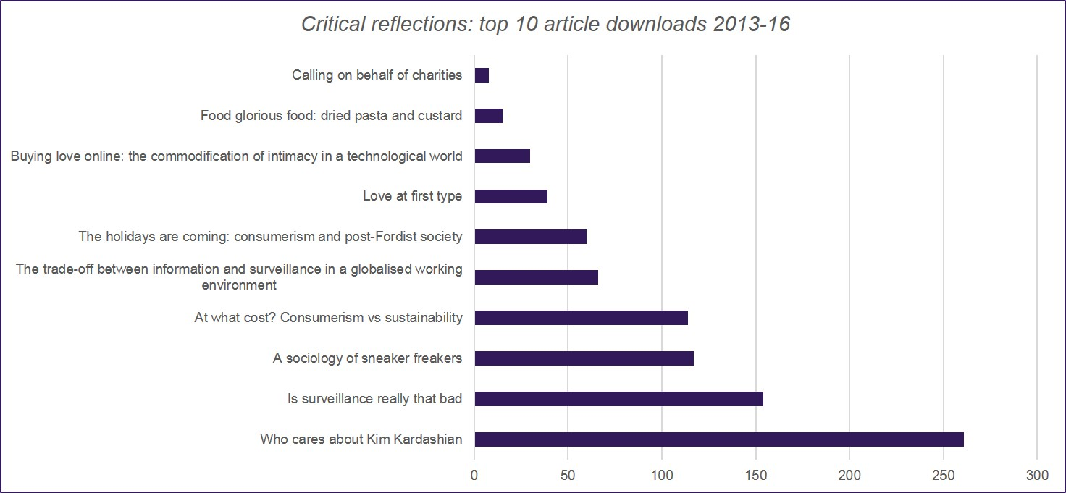

Slide 21
Key factors
Strong academic engagement
Sustainability
Consistency in the editorial team
Hosting vs publishing

Slide 22
Personal reflection
Benefits for librarians
Connection with subject
Better able to support students
Opportunities for digital literacy discussions/ sessions
Altruistic satisfaction in helping students
Shock at popularity!!!!!
Who is viewing it?

Slide 23
What is publishing anyway?
Researchgate
Academic.edu
Prezi
YouTube
Social media
Blogs

Slide 24
Should student work be published?
Quality vs nurture
If the work is of a high standard, should students publish in ‘grown up’ journals?

Slide 25
Future
Library hosting
Centralised: facilitating access to information
Ties in with digital literacy skills teaching
Gives us a hook for sessions
Interest from other subjects in health; Health Education England (NHS)
Multidisciplinary rather than subject specific journal?
Target vocational courses to create an evidence based culture
Investigate funding for peer reviewers
Gather feedback from students via survey/ questionnaire/ focus group
We’re all set for the next edition

Slide 26
Questions?
Kirsty Bower
Academic Librarian
Leeds Beckett University
K.bower@leedsbeckett.ac.uk

