Slide 1
Long distance literacies: Developing academic engagement and equality of provision for remote learners.
or
“Skills in Sync”
Katharine Stapleford - Online Learning Tutor
Lyn Farrell - Online Learning Tutor
Maria Kulas - Academic Librarian
Funded by CLT Curriculum Innovation funding
Notes:
Intro self & others
Intro project - Mention CLT funding
mention it’s in early stages
Give overview of who’s doing what

Slide 2
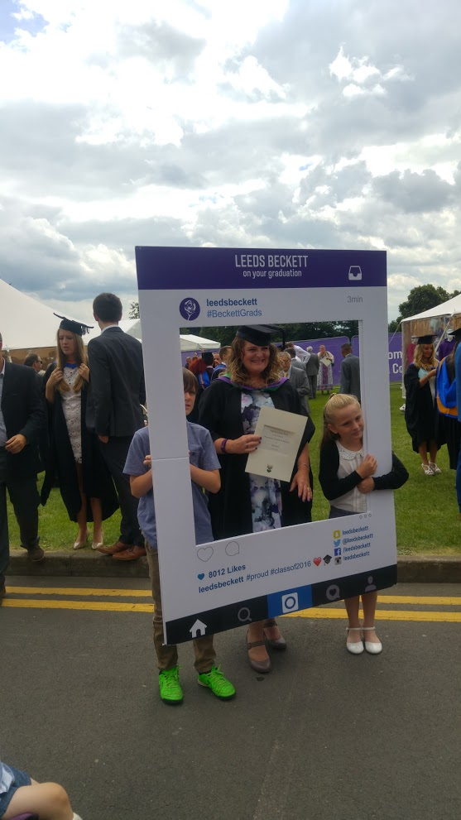
Background & rationale
Transactional distance: distance education is not simply a geographic separation of learners and teachers, but […] a pedagogical concept [...] a psychological and communications space
Moore, 1993, pp. 22-23
one of the biggest problems of DL programmes is the limitation of communication between tutor and students, and also limitation of dialogue amongst students themselves
Haghighi & Tous, 2014, p.57
Notes:
- The rationale for this project is grounded in the nature of the Online PGCE and the nature of DL.
here’s Stephanie, one of the first cohort students here at graduation.
- The Online PGCE is a Masters level course – it consists of 3 Level 7 modules. It’s a new course – Students are studying for this at the same time as their school based QTS so it’s very demanding both cognitively and in terms of workload.
- The fact that it’s a DL course adds a further element of challenge for the students. This means that the students on this course have to have recourse to significant levels of motivation to keep on top of the course tasks. As much of the built in interaction and collaborative learning is asynchronous (wikis; discussion forums; G+ communities, email, etc.)
- We’ve just completed our first year, (it’s just a one year course) – and we’ve found that many of the students fail to demonstrate the high level of academic skills required on a Masters level course.
We have referred them regularly to the S4L website and the library website, which provide excellent skills development resources – but again these are for the most part asynchronous, self-access guides – bringing us back to the isolation and issues of motivation. Some synchronous opportunities do exist but these are quite limited in terms of the teams’ capacity and are also quite generic in focus.
- On-campus students have the opportunity to attend workshops and may also receive some embedded Academic Skills input as part of their course. This has been shown to be the preferred method for skills development. Our students have not been able to benefit from this opportunity.
This is a common challenge in DL – quote Moore and Haghigi & Tous.

Slide 3
The challenge
1. Improve the academic engagement of distance learners.
2. Reduce transactional distance and increase motivation.

Slide 4
A solution
Synchronous tools can promote “togetherness” and participation (Sharma, 2006), enable collaboration (Garrison & Anderson, 2003) and dialogue (Patillo, 2007); improve instructor immediacy and presence (Baker, 2010) and increase motivation (Hrastinski, 2008b).
Notes:
- - A range of studies have shown that synchronous learning opportunities can serve to reduce the ‘Transactional Distance’ experienced students on online courses. These studies for example, found that synchronous tools can promote the dialogue, communication, and subsequently motivation, in DL courses.
So, we decided to address the students’ academic skills development by providing a structured programme of contextualised and embedded academic skills development using synchronous online learning which would provide the same interactive, social, collaborative learning opportunities as campus-based students.
We decided to use AC as the platform to do this.
- Lyn will now take you through the programme and demonstrate how the Adobe Connect webinars will work.

Slide 5
Webinar topics and timetable
Induction Webinar
Information Literacy 1
Library Catalogue, Offsite, Discover
Information Literacy 2 Advanced Search Skills, Databases
Information Literacy 3
Evaluating Sources, Referencing
Academic Literacy 1
Reflective Writing
Academic Literacy 2
Essay Style/Structure
Academic Literacy 3 Interpreting Assignment Briefs
Academic Literacy 4
Critical Thinking
Digital Literacy 1
Formatting Structured Documents
Digital Literacy 2 Effective Presentation Tools
Notes:
We wanted to run as broad a range of topics as possible given the limitations of the small research team
3 Info lit’, 4 academic lit, 2 digital lit, and an induction.
All webinars were run twice except for the end when attendance dropped and we could run a single session AND induction - three times)
We decided it was crucial to run an induction webinar, to help students familiarise themselves with the adobe connect environment so that they’re equipped to participate effectively in the later sessions.
The webinars ran throughout the academic year and were mapped them to their curriculum as much as possible
They are recorded so students who couldn’t attend can access them

Slide 6
Format and presentation consistency in Adobe Connect
Format
Pre sessional tasks
Welcome tasks
Tutor led teaching
Interactive tasks*
Group tasks
Discussions
Resources and post sessional tasks
Consistency
Presenter and moderator
Templates used for presentation slides
Welcome ‘lobby’
Start and End poll evaluations
Used same Adobe tool bank
Notes:
Webinars designed to be consistent in format and presentation.
Main aim of the sessions were to have *interactive tasks built in where possible, to ensure students are actively engaged in the learning and not just passive listeners.
No point in synchronous sessions if we don’t encourage this!
(worked for some webinars better than others - we can address that in the questions if you like!)

Slide 7
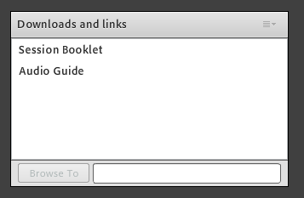
Notes:
* I’m using screen shots here so the pods are not always in the area they’d be in for an actual webinar. I’ve done this to fit them on the screen.
Every webinar had a lobby slide with attendees pane showing and chat pane so they could say hello to each other.
PHOTOS – we felt it important – personal.
Students could also download the audio guide if they were having any audio problems
This particular webinar had a session booklet that they could download
Moderator role - support the presenter by checking on basic technical issues, student questions, points raised etc. Also will help to feedback points raised in discussions and tasks.

Slide 8
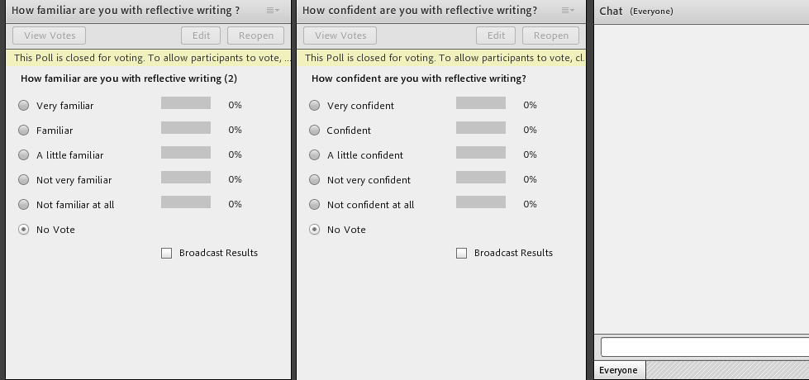
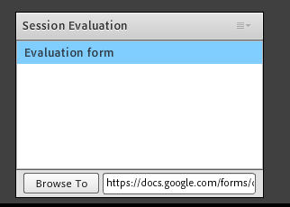
Notes:
Each webinar had a poll at the beginning and end, to measure students’ familiarity and confidence with the session when they started and finished. The chat pane was almost always visible so students could always communicate with us/each other

Slide 9
Notes:
The first slide after the aims and signposting part was done

Slide 10
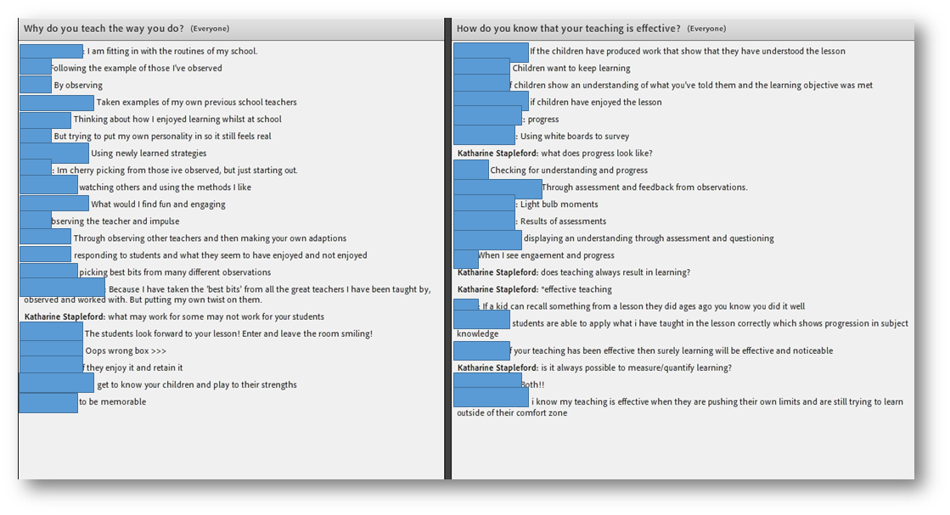
Notes:
And these are their responses. Purpose was to get them engaged in reflection before I start teaching reflection. Concrete example to help embed what I cover later on.
They’re engaged, active, thinking, discussing.
You can see occasional prompts from Katharine, who was moderator in this session, to prompt deeper reflection or other reflections, based on what they say.

Slide 11
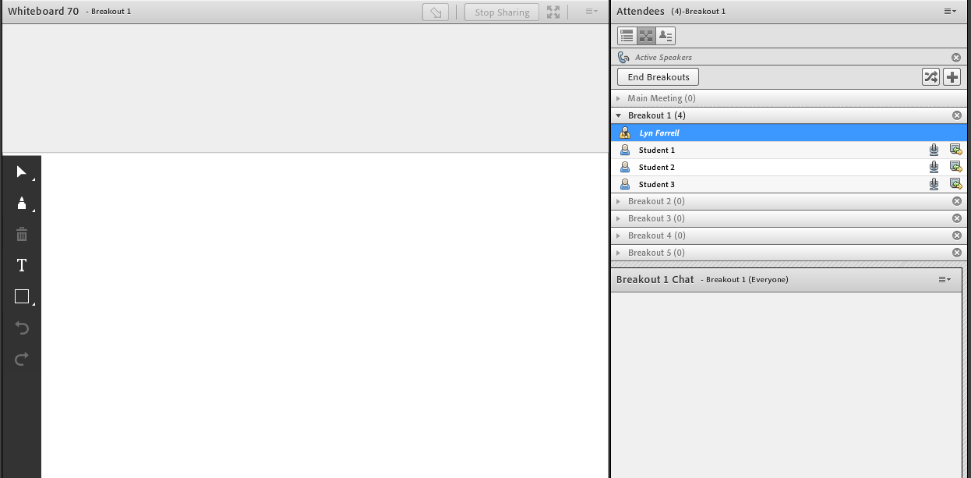
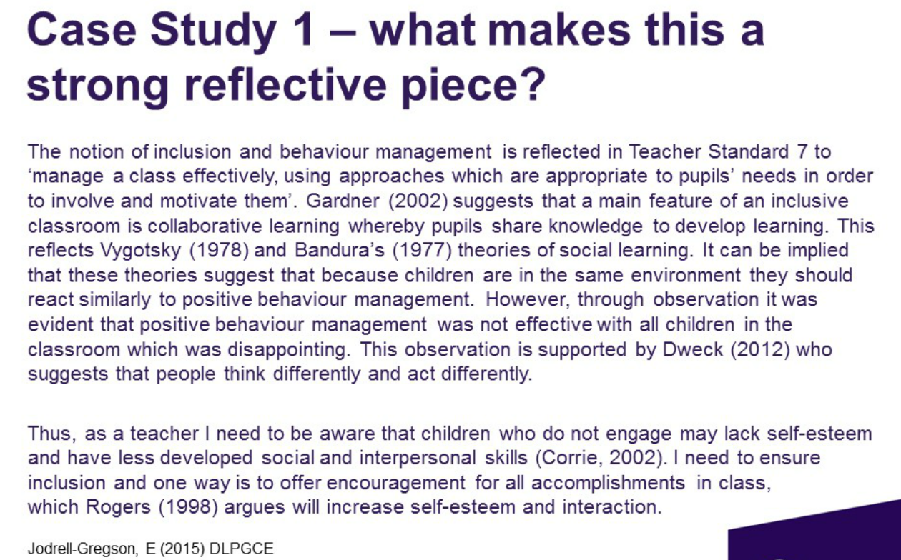
Notes:
Students put in breakout rooms in smaller groups to discuss the case study.
3 ways to communicate with each other
They can write on this whiteboard.
They also had microphones enabled so they could talk to each other
And they had the chat pane that you can see in the corner.
They had 10 minutes for the task, then brought back into the main group and each group’s findings were summarised. We tried to get a student from each group to summarise their discussion.

Slide 12
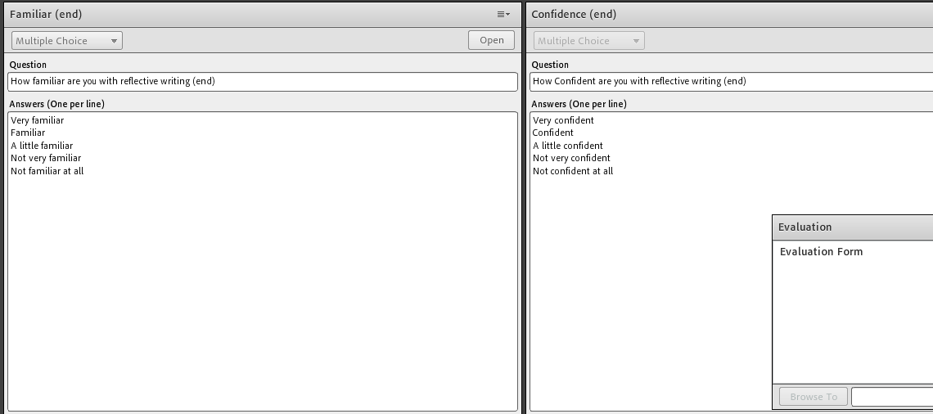
Notes:
Back to the polls and evaluation form and then session is ended.

Slide 13
Data collection & analysis
Have academic skills improved as a result of the synchronous learning?
Quantitative
Qualitative
Self-
assessment polls
Evaluation questionnaires
Focus groups
Has the synchronous learning helped to reduce transactional distance?
Notes:
Clearly it’s a bit rough & ready. The polls are an overview, rather than anything in depth. Also it’s self-perception of learning that is recorded here.
2 different cohorts of students in the study also.
BUT… will give us some indication of the value of synchronous DL for LB DLPGCE

Slide 14
Notes:
Polls and evaluation questionnaires yes’ to both questions.
Both overwhelmingly positive
I showed you the polls when I showed you the webinar so I’ve not copied them again.
They showed, in all sessions, that students felt themselves to be more confident and familiar with the skills at the end of the webinar.
Evaluations, as you can see in the example chart above, mostly show the same positive response to how useful they felt the sessions to be.
Some differences – some sessions they felt had less chance for interactivity and that’s something we envisaged. It’s where we showed them how to use databases for example.

Slide 15
Focus groups on the other hand..
They liked the concept and thought it was a good idea but…
They were inconvenient times
They were too long
They were too general: they would have preferred them to be more assignment/module content focussed
However…
They liked the group work
They felt they were interactive
Has the synchronous learning helped to reduce transactional distance?
Notes:
Only one cohort has completed the focus group so far – the other is after Easter.
We weren’t expecting this! Reporting the opposite of what they said in the polls/evaluations
Lots of food for thought:
Can’t do anything about timing
Most were an hour long, can’t do much in an hour, never mind less
We used module focussed examples a lot of the time. Should we have asked them to detail specific webinars?
(does this mean evaluation forms are not that much use to us – they’re used everywhere!) Or is it that they were asked as they’re “bogged down” in the final assignment and no doubt weary of all the work they’ve done?!
The transactional distance aspect does seem to have worked. They liked being part of a group and the interactivity of the webinars.
Do DL learners need exactly the same as campus? Is their mode of learning more open to async’ support, or do we just need to tweak them?
We’ll be looking at these questions in our write up and in the discussion hopefully at the end of this presentation.

Slide 16
Benefits and challenges
Benefits
Induction session (general questions)
Our development:
Adobe Connect
Consistency (webinar design; belongingness/identity)
Practice runs
Technical difficulties: not as bad as feared
Role of moderator
Challenges
Learning to use Adobe Connect
Variable interaction
“Radio silence”
Different experience on different devices
Timing/attendance/duration
Staff availability
Notes:
Success of induction session
Not initially planned
LeaStudents had time to ask questions: generally about the course and IT as well as the Adobe session - working full time, grade for PGCE or pass or fail, can we access the libary on-campus - unexpected benefit was that there were fewer emails at the start of the course
rned Adobe more comprehensively, eg chat function same in layouts and consistent
Lessons learned / Unanticipated Benefits
Success of induction session -
Technical difficulties were not as bad as we feared - one person attended while on beach / sipping cocktail
Our development
Learned Adobe more comprehensively for teaching, eg chat function same in all layouts
[Belongingness] and identity - consistent look to Webinars for the partnership students
Challenges
Learning to use Adobe Connect
Students not having microphones/not willing to speak
Different experience for those attending on mobile devices
timing/attendance
Staff intensive
Roles within Adobe - moderator
Roles in the delivery of online teaching programme:
Administrator - booking onto sessions, evaluation of feedback,
Moderator
Tutor
Technical Adviser
Manager/ Central contact - for example in the event of sickness, and possible cancellation of sessions
Timing of delivery of sessions and availability of support.
Moving forward
School staff to arrange Library inductions for distance learners
Roll out to other programmes

Slide 17
Moving forward
Synchronous course inductions for distance learners we support
Roll out webinar to other programmes
Clearer technical instructions/requirements (cable; audio)
Tutor webcams
More focussed content (little and often); less is more
Notes:
Success of induction session
Not initially planned
Students had time to ask questions: generally about the course and IT as well as the Adobe session - working full time, grade for PGCE or pass or fail, can we access the libary on-campus - unexpected benefit was that there were fewer emails at the start of the course
Learned Adobe more comprehensively, eg chat function same in layouts and consistent
Lessons learned / Unanticipated Benefits
Success of induction session -
Technical difficulties were not as bad as we feared - one person attended while on beach / sipping cocktail
Our development
Learned Adobe more comprehensively for teaching, eg chat function same in all layouts
[Belongingness] and identity - consistent look to Webinars for the partnership students
Challenges
Learning to use Adobe Connect
Students not having microphones/not willing to speak
Different experience for those attending on mobile devices
timing/attendance
Staff intensive
Roles within Adobe - moderator
Roles in the delivery of online teaching programme:
Administrator - booking onto sessions, evaluation of feedback,
Moderator
Tutor
Technical Adviser
Manager/ Central contact - for example in the event of sickness, and possible cancellation of sessions
Timing of delivery of sessions and availability of support.
Moving forward
School staff to arrange Library inductions for distance learners
Roll out to other programmes

Slide 18
Questions and discussion
What’s your current experience of presenting or participating in webinars?
How do you feel about them?
What support do DL students get at your institution?
Notes:
As I mentioned before, we have lots of questions ourselves for when we look at the next phase of the webinars.
The above three questions are things we’re interested to know but don’t feel you have to answer them.
Ask any questions you like. ☺

Slide 19
References
Baker, C. (2010) The Impact of Instructor Immediacy and Presence for Online Student Affective Learning, Cognition, and Motivation. Journal of Educators Online, 7(1), pp. 1-30.
Garrison, D. R., & Anderson, T. (2003) E-learning in the 21st century: a framework for research and practice. London: Routledge Falmer.
Haghighi, S., & Tous, M. D. (2014) Attitudes towards Student Support System in Distance Learning: A Questionnaire Survey. Styles of Communication, 6(1), pp. 54-72
Hrastinski, S. (2008b) The potential of synchronous communication to enhance participation in online discussions: A case study of two e-learning courses. Information & Management, 45(7), pp. 499–506.
Moore, M. (1993) Theory of transactional distance. In: Keegan, D. ed. Theoretical principles of distance education. Abingdon: Routledge.
Pattillo R.E. (2007) Decreasing transactional distance in a web-based course. Nurse Educator, 32(3), pp.109–112.
Sharma, D. C. (2006) Online Technologies Kill Distance in Learning Managing Participation in Online Journalism Courses. Journal of Creative Communications, 1(1), pp. 75–81.

