Slide 1
Narrative inquiry - Possible Selves of Healthcare students with dyslexia. A Methodological Journey
Angela Murphy
Senior Lecturer Occupational Therapy
Professional Doctorate in Education
Images: Juame Plenza, WYSP

Slide 2
Aims of the session
Introduce my study and my position.
Explore what is important to my research journey.
Share some exerts with you as an audience.
Discuss creativity within Narrative Inquiry.

Slide 3
possible selves of healthcare students with dyslexia: A Narrative Inquiry
Possible Selves (Markus and Nurius, 1986)
Occupational Potential (Wicks, 2005)
Clandinin and Connolly’s (2000; 2013) framework of narrative inquiry
Plots and three dimensional structures.
Temporality - past, present and future.
Personal and social dimensions - feelings, hopes, reactions and existential conditions/ social context.
Place - specific physical inquiry space where inquiry and events take place (Clandinin, 2006) as well as the environmental factors influencing the narratives.

Slide 4
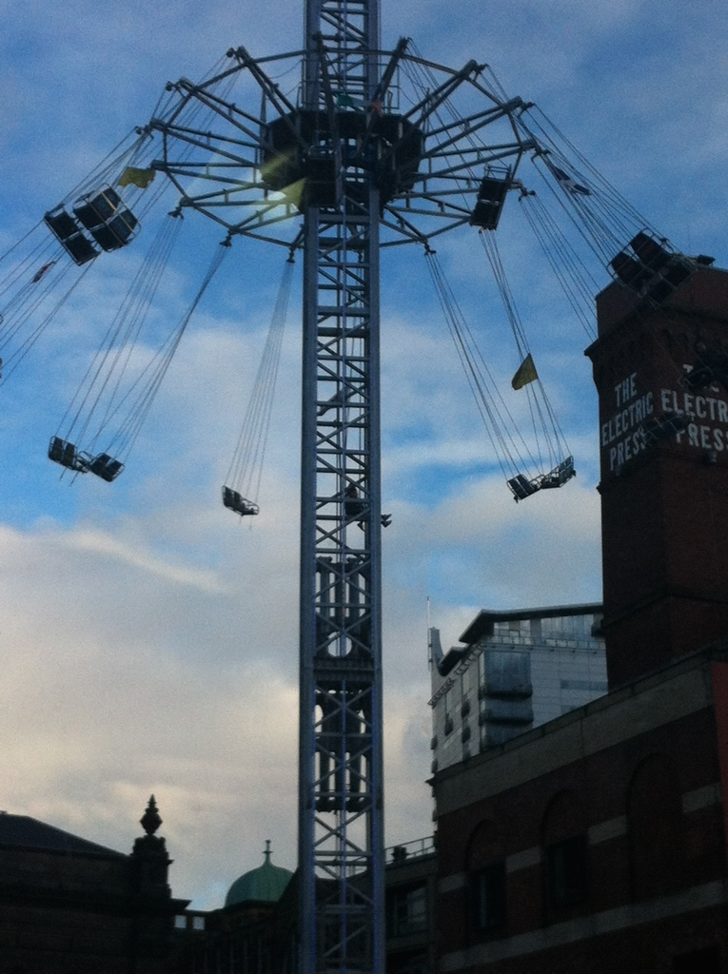
My Position
Occupational Therapy and Narrative Inquiry (share a Deweyian ontology)
Dyslexia – personal and professional - experiential reality of life in a society which so highly values literacy and numeracy.
Societal injustices (MacDonald, 2012).
Dewey (1852-1959), a philosopher and psychologist whose work acknowledged the importance and relevance of experience and the everyday things we do as humans as well as past influences on present and future selves (McDermott, 1973; Clandinin and Connolly, 2013).
Thereby generating a representation of reality and applying a pragmatic view of knowledge where representations of reality arise from experience (Clandinin, 2013).

Slide 5
Research Process –Evolving creativity
Stories of growing up with dyslexia x 3 per participant (24)
Interim analysis
Restructure stories into narratives with plots
Adequate Representation?
Chemistry of what went unsaid (Douglas, 2012)?
Role of the audience (Douglas, 2012)?

Slide 6
Narrative Inquiry, what is Important?
Positions - researcher and participants alongside each other.
Bridges - the space between researcher and participant (Douglas, 2012)
Interactive and dynamic - enables the realities to be interpreted and understood (Wicks, 2010)
Multiple levels of elucidation and analysis (Denzin and Lincoln, 2000)
Maintain the spirit of what took place in the interviews (Douglas, 2012)
Balance between the participants and researcher’s voices (Clandinin and Connolly, 2000)

Slide 7
Transactional and Interactional
,
A transformational growth of experiences out of experiences…
Interactional and dynamic inquiry space which spans across temporalities (Clandinin, 2013).

Slide 8
Acts
Act 1. Diagnosis
Act Two. Cheerleaders in the background
Act Three. Fitting the mold
The Scene…

Slide 9
Act 1, Diagnosis, Rebecca…
Rebecca: I was little, I can’t really remember too much. …felt … different and … felt that it took ages to do stuff. Felt like I took forever to do stuff and felt a bit thick really, when I was at school.
Angela (researcher): When you got the diagnosis, did you still feel that?
Rebecca: Yes, yes, it didn’t change that. No, it didn’t make me feel any different. When I had a tutor I felt a lot better. That was nice. But that was paid for. My mum paid for that. At school it wasn't very good.
We were meant to go to a specialised learning …for like a couple of hours a week or something. I was just told to read a book that was at the right level. People had more severe difficulties than me.
A lot of them had other learning problems. There was a particularly naughty child who didn’t work and that probably didn’t help. ‘Cos you was put with people who were not necessarily wanting to work so a lot of the teacher’s time was spent with them. Not with me.

Slide 10
Act 2, Importance of Family, Maria…
My mum had always, she like, no one in our family had been to university and my mum …she was a single parent and she was a cleaner when I was younger so she was very much, “you are going to university! There is no other option”.
I always used to think, “well I will go to university”. There was no question of it. I guess it must have come from my mum really … Well I could probably be a physicist (laughs) totally unrealistic expectations probably driven by my mum, saying I was going to work for NASA or something. She still says it to this day. I’m like, “mum, you do realise I'm not going to work for NASA!”
She says things like, “well I don't know why you can't do it, cos you're my daughter and you can do anything”. I think my mum thought I was some sort of genius. (Laughs). She had and still does have extremely high expectations of me that are just unrealistic.

Slide 11
Act 3, Fitting the Mold Abigail
I was pretending I could read. I was picking up books we’d read in class and was pretending to read them to the other kids. Using the pictures or how I remembered the stories. My mum knew I couldn’t read. I would just pretend to be reading when actually I wasn’t and it took me a long time to (learn to) read because I was convinced I was really clever but I was pretending to read. The teachers would have to sit me down and go over the words. I’d go off the pictures or off what I knew of the story. They would have to keep telling me to read the words. I was just telling a story with a book in my hand. (Laughs) On the first day of reception I sat down with this girl and was like “I’ll read you a story” (laughs).
So umm I went through primary school and quite quickly the teachers realised I wasn’t a genius. I couldn’t read and my main struggle was spelling …I struggled even at a young age.
I got more and more aware of it as I came up through primary school…I was always in …there was usually three tables and I was in mainly the middle or bottom table and I got more and more aware of it as I came up through primary school into year 5 and 6,… where we had to do spelling tests, spelling tests where we had to stand up and say the word. It was awful! I just, I can write them better. Even now it’s hard to do that, like, I might know them better. … and I always knew. I find that hard.
I always knew I’d be really upset … if a spelling test was coming along and then I can really remember in…year 5, a teacher stood me up and said “this is the worst speller in the world” and asked me to spell, because we were going round doing spelling; a 3 letter word and asked me to spell ‘ton’ and I put an ‘e’ on the end but I was panicking as soon as I stood up. I was really panicking. I was so upset (crying), I, …(crying).

Slide 12
Interpretations and Analysis
Allowing voices to be heard.
Working self concepts (Markus and Nurius, 1986)
Exposing the importance of congruent verses incongruent environments on perceptions of possible selves and cued environments.
The importance of family in perceiving and reaching desired Possible Selves.
The challenge of fitting into society with dyslexia.

Slide 13
Conclusion
Narrative Inquiry Allows…
Creativity
Dynamic interactional exploration
Exposes injustices

Slide 14
References
Clandinin, J., & Connelly, F. M. (2000). Narrative inquiry: Experience and story in qualitative re-search. San Francisco: Jossey-Bass.
Clandinin, J. (2006) Hand Book of Narrative Inquiry, p1-31.
Clandinin J. and Connolly, M. (2007) Mapping a Methodology…
Clandidn, J. (2013) Engaging in Narrative Inquiry. Left Coast Press Inc. Walnut Creek, California pp9-81
Connolly, M. and Clandinin, J. (1990) Stories of Experience and Narrative Enquiry. Educational Researcher. 19 (5)
Clouston, T. (2003) Narrative Methods: Talk, Listening and Representation. British Journal of Occupational Therapy 66(4) pp136-142
Denzin N. and Lincoln, Y. (2000) handbook of Qualitative Research Sage, Publishing, Thousand Oaks. Second Edition.
Douglas, K. (2012) Signals and Signs. Qualitative Inquiry 18 (6) pp525-532
Douglas, K. and Carless, D. (2013) An Invitation to Performative Research. Methodological innovations Online 8 (1) p53-64
Markus, H. & Nurius, P. (1986) Possible Selves. American Psychologist 41, 9. Pp 954-969.
MacDonald, S. (2012) Biographical pathways into criminality: understanding the relationship be-tween dyslexia and educational disengagement. Disability & Society, 27 (3). pp. 427-440.
McDermott, J. (1973) The Philosophy of John Dewey. Two Volumes in One. University of Chicago Press, Chicago.
Wicks, A. (2005) Understanding Occupational Potential Journal of Occupational Science 12 (3) p130-139

Slide 15
Images: Juame Plenza, Yorkshire Sculpture Park
https://www.google.co.uk/search?q=google+images&espv=2&biw=919&bih=643&site=webhp&source=lnms&tbm=isch&sa=X&sqi=2&ved=0ahUKEwjU09zq26DQAhVaF8AKHQ5jA8UQ_AUIBigB#q=sculpture&tbm=isch&tbs=rimg%3ACcSlkhPNmmZGIjg9YI7-7NTK5ckAqdFTmwjwlNcppC6Im7V8hChQmlQBcDb1FKrqceG6esK_1K_13hXP1nO08JK5OfYioSCT1gjv7s1MrlEeZLzSGu4yvMKhIJyQCp0VObCPARazY-uvghPScqEgmU1ymkLoibtRHmHy4FsXvW5SoSCXyEKFCaVAFwEasVjibXxEonKhIJNvUUqupx4boRJfNbh3w8skkqEgl6wr8r_1eFc_1RGSdGgshwBWhyoSCWc7Twkrk59iEQSd3UhoJuHi&imgrc=R8EQTQliuq3lQM%3A

