Slide 1
NAG eBook Accessibility Audit workshop
Monday 6th and Tuesday 7th November 2017
Gopal Dutta (Manchester Metropolitan University)
Susan Smith (Leeds Beckett University)
Vicky Dobson (Leeds Beckett University)

Slide 2
What are we doing today?
Introduction to the eBook accessibility audit project (10 - 15 mins)
Joint consortia eBooks sub-group (“top down”)
LIS-ACCESSIBILITY group (“grassroots”)
What is eBook accessibility?
Common eBook queries
The audit itself: content, participation, responses
Practical activity in pairs on laptops (15 - 20 mins)
“Mini-audit” testing for reflow, text to speech (TTS) and accessibility information
Results, feedback and discussion (10 - 15 mins)
How did your auditing compare with the national results?
Making use of the audit in decision-making and troubleshooting queries

Slide 3
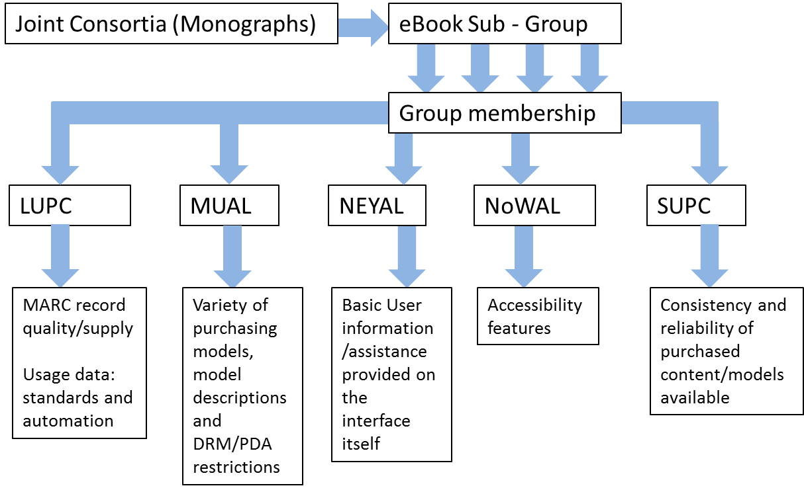

Slide 4
LIS-ACCESSIBILITY
Some of the project team got involved through the LIS-ACCESSIBILITY JISCMail list
Established in 2015 to share best practice around supporting disabled students
Discussions led to agreement on need for a clearer picture of the accessibility of eBooks provided to the UK HE sector
Decided to take a crowdsourcing approach with the aim of involving as many people as possible across the sector
Joined up with eBooks subgroup as they were also looking to audit the accessibility of different eBook platforms

Slide 5
Are eBooks accessible to disabled students?
Potential to be – inherently more flexible than print books
If compatible with assistive software they can be adapted to the needs of individual students
Due to the design of some eBooks this is not always the case - not all fully accessible
Some platforms better than others, lots of variability

Slide 6
What makes an eBook accessible?

Slide 7
What makes an eBook accessible?
From a non-technical end user perspective, different elements of accessibility can be considered under the following headings:
Range of formats
Appearance
Navigation
Read aloud
Print, copy and download
Images and icons
Support information

Slide 8
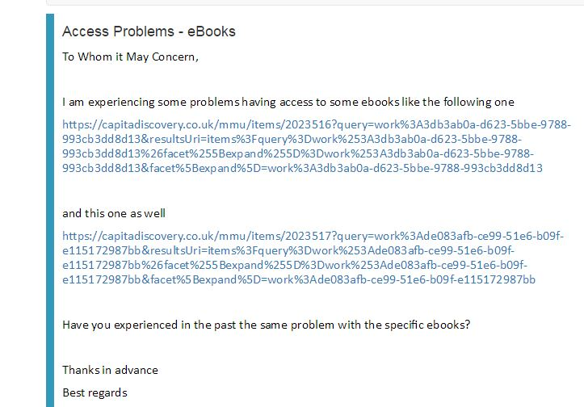
An example query

Slide 9
An example query
“…experiencing some problems having access…”

Slide 10
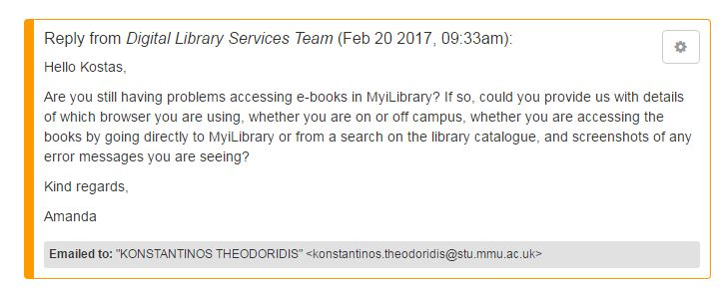
An example answer
“…experiencing some problems having access…”

Slide 11
An example answer
Which browser?
Are you on or off campus?
Are you accessing directly via the platform or via our catalogue?
Screenshots please
“…experiencing some problems having access…”

Slide 12
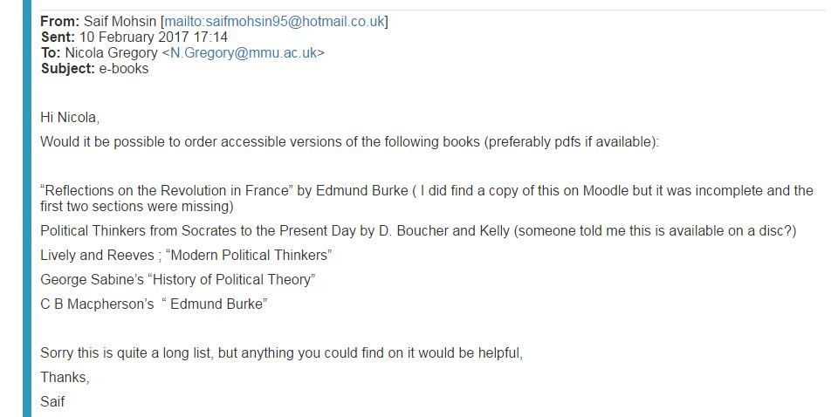
Questions about accessibility

Slide 13
Questions about accessibility
“…Accessible versions (PDFs)”
“…I did find a version of this on moodle but it was incomplete…”
“…someone told me…”
“Sorry…”

Slide 14
Questions about accessibility
“…Accessible versions (PDFs)”
“…I did find a version of this on moodle but it was incomplete…
“…someone told me…”

Slide 15
Questions about accessibility
“…preview expired…”
“…would not let me access it again…”
“…error message…”

Slide 16
Accessibility vs Usability (1)
All the information: https://www.w3.org/WAI/intro/usable
They overlap but are not quite the same:
“Accessibility addresses discriminatory aspects related to equivalent user experience for people with disabilities, including people with age-related impairments. For the web, accessibility means that people with disabilities can perceive, understand, navigate, and interact with websites and tools, and that they can contribute equally without barriers”.

Slide 17
Accessibility vs Usability (2)
“Usability and user experience design is about designing products to be effective, efficient, and satisfying. Specifically, ISO defines usability as the “extent to which a product can be used by specified users to achieve specified goals effectively, efficiently and with satisfaction in a specified context of use" (in ISO 9241-11)”.
Key point:
“While accessibility focuses on people with disabilities, many accessibility requirements also improve usability for everyone”.

Slide 18
Accessibility vs Usability (3)
Sue Smith:
“Of course if the project results in improvements in accessibility of eBooks that that should benefit everyone – just like a ramp initially intended for wheelchair users also benefits those with book trolleys.”
(personal correspondence, 8th December 2016)

Slide 19
So why does it matter?
DSA changes – more pressure on HEIs to buy resources that are accessible
Alt formats are expensive and time-consuming
It’s our job! (as librarians)
There isn’t a single, wide-ranging audit (but there are precursors)

Slide 20
So what is the accessibility audit?
https://sites.google.com/site/ebookaudit2016/
33 universities and 5 suppliers (suppliers were invited to audit their own platforms).
In total 44 platforms were tested, covering 65 publishers with nearly 280 ebooks tested

Slide 21
Some sample questions
What formats are available?
Does text reflow?
Can you use text to speech software or a screen reader?
Are there any accessibility guidelines?

Slide 22
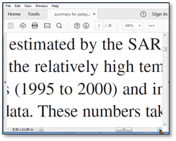
What is reflow?
Text not reflowing
Sometimes when you increase the magnification level on a document the text will run off the side of the screen.
In order to read each line you have to scroll left and right which can make it difficult to read the text.
Reflow converts the document into one column so that you don't need to scroll left and right to read it.
Text reflowing
Credit: Alistair McNaught / JISC

Slide 23
What is text to speech?
Text to speech tools (e.g. Texthelp Read & Write; ClaroRead; Balabolka etc) are used by sighted people who prefer to listen to text. They can be learned in minutes.
For today’s session, we are using a trial version of TextHelp Read&Write which works as a Google Chrome plugin

Slide 24
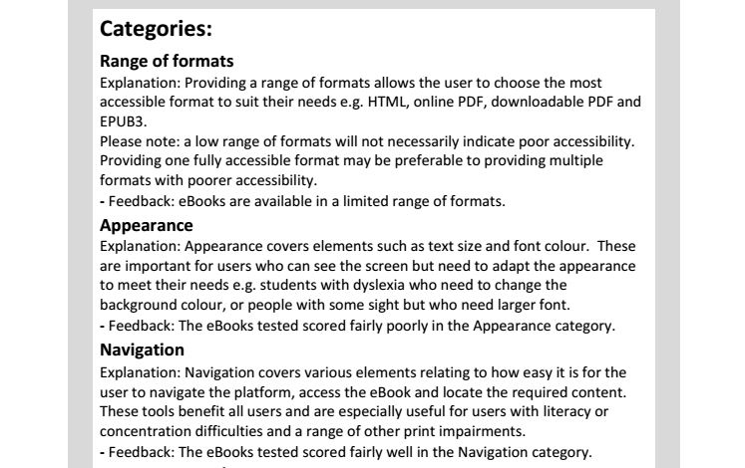
Individual platform reports

Slide 25
Individual platform reports

Slide 26
Your turn!
Please select an eBook you have access to through your organisation
Choose from one of the providers listed on the handout if possible
Use the “Read online” mode rather than downloading
Some suggestions:
Management and organisational behaviour (Mullins, Laurie)
Research methods for business students (Saunders, Mark)
Digital marketing (Chaffey, Dave)
Doing your research project (Bell, Judith)
The Study Skills Handbook (Palgrave Study Skills) (Cottrell, Stella)

Slide 27
Results
Did your results match up? (link to live results?)
How was the experience of using your own ebooks?

Slide 28
Next steps
Working on a detailed accessibility specification with examples
Keen to work together with individual providers to improve accessibility
Audit form still open – providers may re-audit themselves, contact us to let us know ebookaudithelp@gmail.com and we will update the results on the website
Possibility of large-scale re-audit at some point in future

