Slide 1
Behind the Scenes:
An operational view of the reading list challenge
Natalia Gordon MA FHEA
Information Services Librarian

Slide 2
Leeds Beckett at a glance
13 Schools (from 4 Faculties)
2 campuses: Leeds City Centre & Headingley
20,787 students (2017-18)
VLE – MyBeckett (Blackboard)
Range of courses – accelerated, full-time, part-time, full year (Long thin year), etc.
Central fund (Share-B) for items on reading lists

Slide 3
Reading list project history
2013
Project group created
Rebus:list chosen as RLMS
2014
Soft launch of the system
First reading list inputted
2015
1,000th list inputted into the system
Started in current post

Slide 4
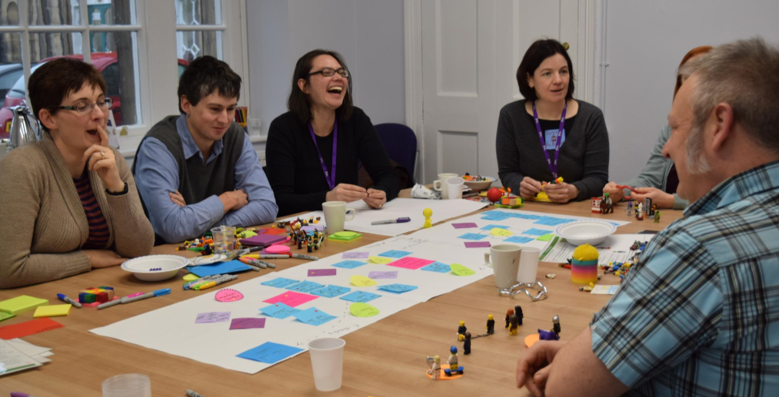
Reading list project history
2016
CIU Orders Review
2017
All lists inputted
2016-17 - 97% coverage across subject areas
StART Programme (all module codes changed)

Slide 5
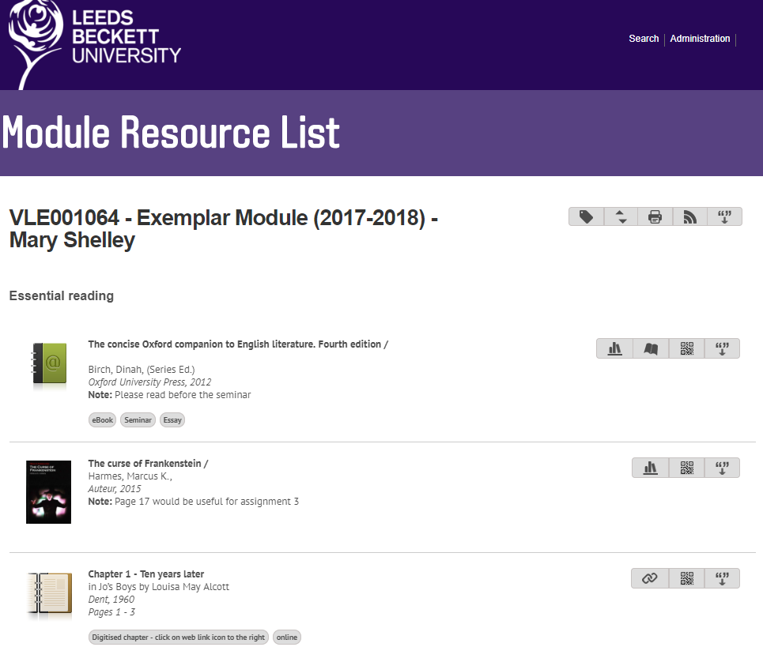
Reading lists today
Currently have 3,808 lists total
Includes different types of modules:
Active
Inactive
Ghost
Study Abroad/Placement
No reading list
2017-18 - 95% coverage of lists for active modules
2,546 lists for 2017-18
Work on the number of modules by an academic year basis

Slide 6
Continuous Improvement
Worked with the Continuous Improvement Unit (CIU)
Produced a process diagram which tracked the entire resource list process from List Acquisition, to Inputting to Ordering to Updating lists.

Slide 7
List Acquisition

Slide 8
Areas of Improvement
Module Information
Quality of lists
Wait Time
Staff Workload

Slide 9
Module information
Issue
There was no definitive list of what modules were running when
Solution
Report from Banner = up-to-date module information

Slide 10
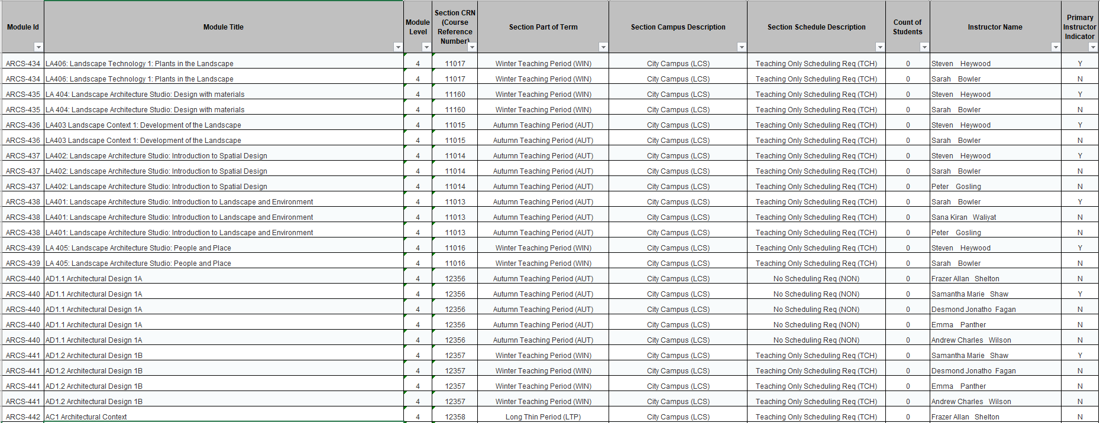
Business Objects (Bob) Report

Slide 11
Quality of lists
Issue
Resources identified for module validation were different to resources listed in handbooks
Solution
Use either handbooks or lists forwarded by academic staff
QA to use Rebus:list as part of module validation

Slide 12
Wait Time
Issue
Academics work to deadline – last minute reading lists
Solution
Use Bob report to prioritise modules
Enrol onto modules to access handbooks

Slide 13
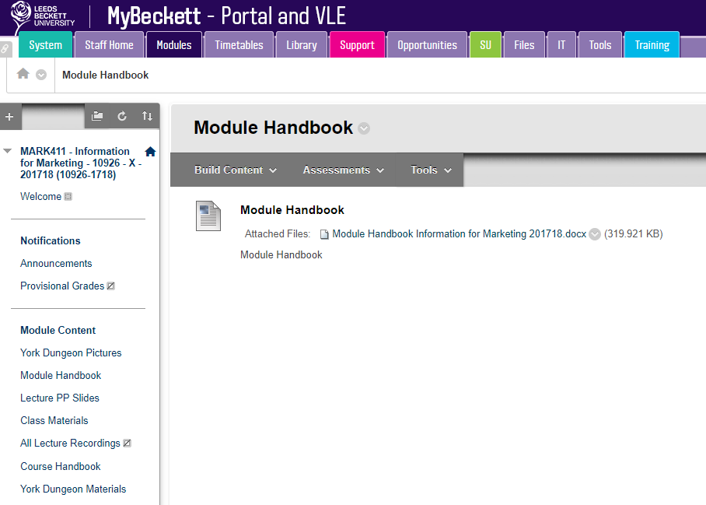
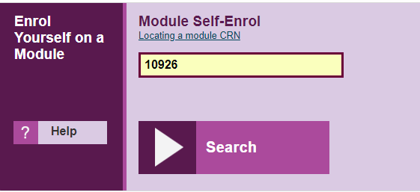
Enrol onto modules

Slide 14
Staff Workload
Issue
Increased staff workload at the beginning of each term both in the inputting of the lists and processing orders
Solution
Use Bob report to prioritise modules
Increase the number of staff inputting lists

Slide 15
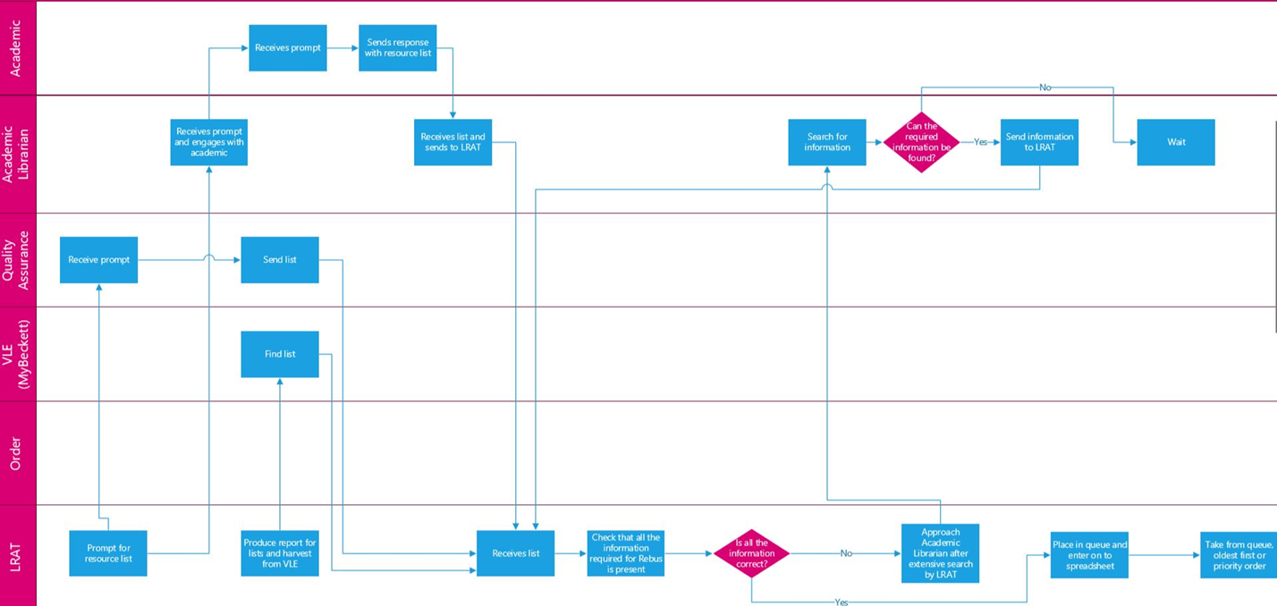
New Process

Slide 16
Pros
More streamlined process
Decision-making was quicker
Ability to prioritise workload
C&A workload spread over months rather than the weeks before term starts
An up-to-date list of active modules
Resources available for students when they need them.

Slide 17
Cons
Took a long time to set/train individuals to run the process.
Highlighted discrepancies between what should be in the system (via Banner) and what was actually happening within the modules
Little impact on academic engagement with the system - mixed feedback
Sustainable?

Slide 18
Going forward
New RLMS for 2018-19
Impact of LTI on this process
Moving from implementation to maintenance
Different KPIs
Anything else?

Slide 19
Any questions?
Contact:
Natalia Gordon
Natalia.Gordon@leedsbeckett.ac.uk
@BeckettLibrary

