Slide 1
Ear to the Ground: the value and impact of listening to our customers
Helen Loughran,
Libraries and Learning Innovation, Leeds Metropolitan University
Notes:
I’m going to talk about how we listen to our customers and staff and what we believe the value and impact to be

Slide 2
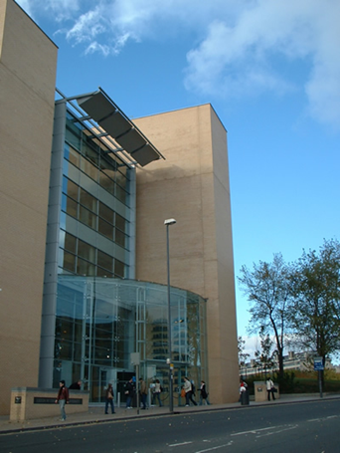
Background
Leeds Metropolitan University: c3,000 staff; 26,000 students
Libraries and Learning Innovation:
2 campus libraries
24/7/365 opening
2,100 study spaces
University IT provision
1.4 million visits a year
450,000 books / electronic resources
Virtual Learning Environment
95 FTE staff

Slide 3
Why listen to your customers?
Why not?
Role of Customer Service Excellence Standard
Notes:
We would say “Why not?” - how would you expect to deliver a service / run a business without listening to your customers
I joined the University in 2001 and the culture of listening was already strong in the Library – Libra survey etc
But
We have to acknowledge the role of the CSE Standard and its predecessor, Charter Mark, in helping to provide a framework in which we are able to listen effectively.
For example tool such as customer journey mapping is something we have only adopted fairly recently but which has proved helpful in understanding how customers view and use our services

Slide 4
Listening Framework
Strategy / Schedule of Consultation
Annual Review
Standing item on meeting agendas
Project planning
Member of staff with responsibility
Systematic collection
Looking for new opportunities
Closing the loop
Notes:
Annual review – national / university wide / local
Part of project plans
Member of staff – any LLI staff know there is someone they can report any feedback to / remind staff to ask for it etc
Systematic collection – simply having a section of our shared drive where all our data goes
New opportunities – Google Drive surveys / email students re student meeting rooms
You Said We Did

Slide 5
Listening to our students
Student Surveys (SSS/NSS/ISB)
Surveys on new services
Focus groups – “food for thought”
Students’ Union
Termly meetings
Student representatives
Faculty forums
Formal complaints procedure
Notes:
Students our biggest customer group so we will look at how we listen to them
External / national surveys – analysis of results / action plans etc
To avoid survey fatigue we don’t do a generic library survey but do service specific ones eg mobile / Offsite – some via links on web stories others targeted via email but always mindful of what else is going on in University as not yet fully coordinated approach – avoid Survey Season
Also should be about harvesting feedback already / easily available rather than setting up new – advice given to CSE applicants
Focus groups – external consultant for fair and sensitive; otherwise in house / meetings with researchers
Also take part in formal university complaints procedures for any serious issues

Slide 6
Listening to our students
Academic Quality Processes
Faculty / School Boards
Course development teams
Course reviews
Academic Librarian / Academic staff liaison
Working groups
Student liaison officers
Notes:
Also more formally our Academic Librarians and Senior Academic Librarians are well embedded into the University’s academic quality processes
Sit on School / Faculty Boards: research / student engagement etc
Again reviewed monthly to pick up any patterns / issues

Slide 7
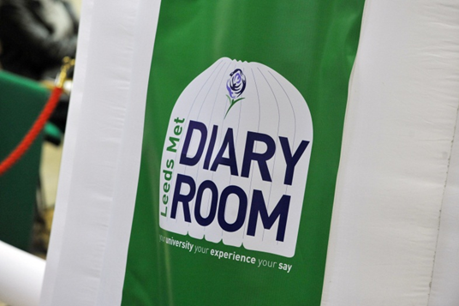
Listening to our students
Exit Polls
Diary Room / Sab on a sofa
One-to-one responses
Anecdotal / observational
Student projects
First impressions staff training
Social media
Anytime, anyplace, anywhere!
Notes:
Also have informal methods
Annual exit polls – 100 students to mark us out of 10 for library experience so far and what we can do to make it a 10
Diary Room – Sab on a Sofa – we asked if we could join in with this
One-to-ones – tours of library / coffee with the Director
Anecdotal – City Campus refurb
Involvement in student projects – Masters Consumer Behaviour – student space / ebooks
Social media – twitter “possibly the fastest complaints system in the history of customer service”
Anytime, anyplace, anywhere – asking returning students at freshers if they had been in the refurbished library area yet – any conversation with anyone reported

Slide 8
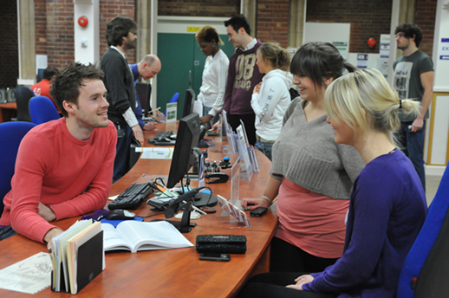
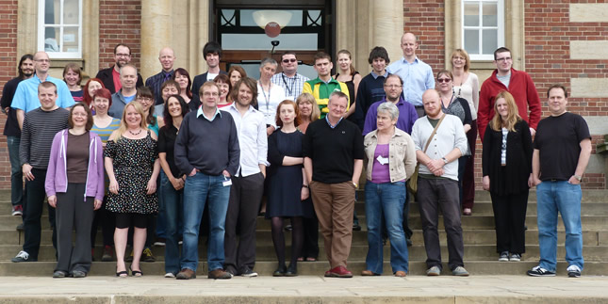
Listening to our staff
Staff suggestions
Project groups
Open Door meetings
Team meetings / 1-to-1s
Views of new staff / graduate trainee
Planning process
Notes:
Predominantly been talking about how we listen to students and academic staff but also put great value on listening to our own staff
Again these are both formal and informal – absorbing feedback all the time
Staff suggestions scheme / informal customer comments
Staff from across service coopted onto project groups

Slide 9
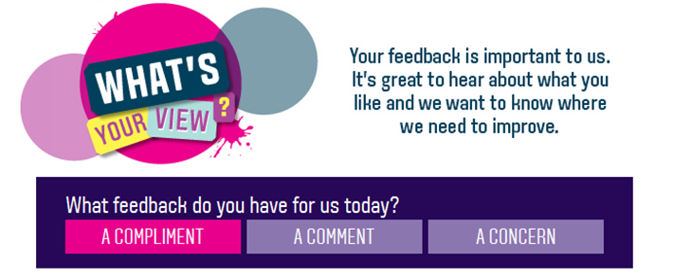
Listening to everyone
What’s Your View?
Email Us / Chat with Us
Non-users
Prospective students
Mystery visitors
Notes:
Had our own customer service scheme for over a decade but last year moved over to university wide What’s Your View? – easier to refer feedback which comes to us but we are not responsible for eg vending machines outside library. We have more confidence in this now and it is a better experience for customers
Staff attend open day events and talk to students / families about their views / expectations
Also use questionnaires at bottom of emails / chat interactions – questions about speed of service etc.
Difficult to get views of non-users – can come from course reps etc but also conducted our own survey a couple of years ago
Mystery visits give feedback from our peers as well as first impressions

Slide 10
Listening effectively
Our organisational culture
Being open and not fearful of what we might hear
Being honest about what we can / can’t do
Understanding how people want to be listened to
Showing respect and that we value our customers
Notes:
Organisational culture – begins with staff recruitment and training
You can be listening to your customers but do they know that you are? If you’re not showing it they may think you haven’t heard.
Listening to customers means you come to understand them

Slide 11
Value and impact of listening
Builds two way communication
Positive relationships
Customer insight
Confidence in our information
Provide services that are value for money
Good reputation
External validation
Notes:
One of key things is that it builds 2 way communication - If we listen to our customers they will listen to us – ebooks / digitising library
Listening with integrity builds trust – we have positive relationships with them – work with SU on water coolers / stress less campaign
Because we listen to our customers we have good insight into their needs and expectations
Related to this is that we are confident in the information we have about our customers and can therefore represent them and their needs to others (eg Estates projects / IMTS ) – often find ourselves advocating on behalf of students/customers to parts of the university who are not yet so customer focussed
Results in providing services that not only meet customer needs but are value for money
We have a high reputation across the University – we are trusted by our customers and stakeholders
Also external validation – Charter Mark in 2001, CSE more recently and provided 2 compliance pluses in our university’s recent award of the standard institution wide

Slide 12
Value and impact of listening
Staff satisfaction and morale:
Staff Survey Results 2012
Notes:
Results of 2012 staff survey:
An indicator of “engagement” which is viewed as a driver of organisational performance
Engaged staff = higher levels of discretionary effort / satisfied students
Also low rates of staff turnover

Slide 13
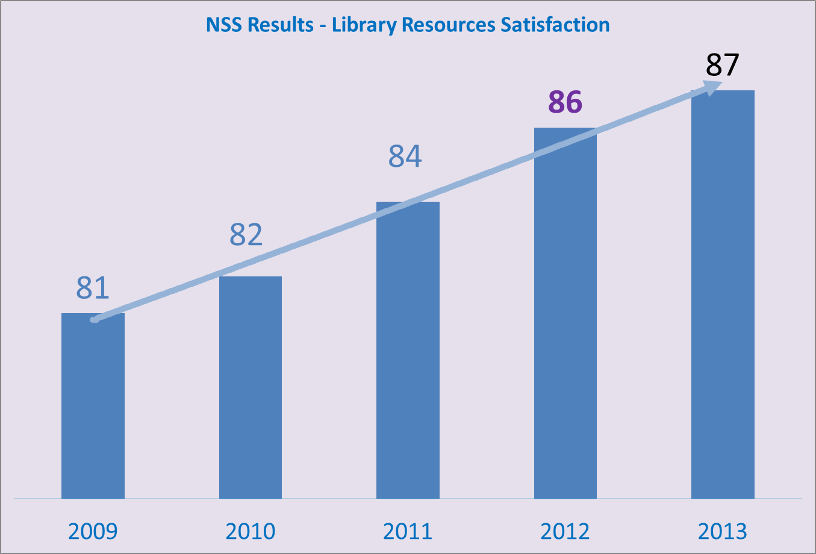
Value and impact of listening
Customer Satisfaction - students
Notes:
One of the key impacts though of listening for us has been a continuous improvement in our NSS scores over recent years.
Of course we are not the only institution to see this happening but for us it has been against a backdrop (until this last year) of fairly static stock budgets and limited investment in estates and facilities.
In fact a couple of years ago independent consultants identified LLI as being underresourced in terms of budgets and staff in comparison to our benchmark partners and yet our NSS/ISB results were increasing.
At the same time there was a CIBER report into Sconul measures demonstrating value as impacting positively on NSS scores (eg spend per FTE/floor space per FTE) and we noted that we were below average compared with our benchmark partners for almost all categories but above most of them and the sector for NSS scores.
And although our institution’s results have improved these are not at the same rate so it’s not just that we are benefitting from an overall rise in satisfaction. And in fact we consistently have some of the highest scores in the university in the NSS and our level 4/5 surveys.

Slide 14
Value and impact of listening
Customer Satisfaction - students
Year | Total Comments | % Positive | % Negative
2011 | 228 | 32% | 68%
2012 | 221 | 41% | 59%
2013 | 198 | 49% | 51%
Notes:
More recently we have also started analysing the open comments that we receive in the survey and are particularly pleased to see that the number of positive comments about our services is rising. Again, we do a benchmark exercise with colleagues from a small number of other institutions and have higher than the average for positive comments.
Of course it is hard to prove where our high levels of satisfaction come from but we believe that they don’t have to derive from high levels of investment or existing resources. Instead, amongst a range of potential influencing factors, we feel that a customer-oriented service is the single most important. And of course to provide this you need to listen to and understand your customers.

Slide 15
Value and impact of listening
“others think they listen but they don’t – you actually listen and act upon what you hear”
former SU President
Notes:
We feel that the positive feedback we receive on our services is a reflection on how well we have listened. And we also receive feedback about how good we are at listening and we are particularly proud of this comment by our former SU president.

Slide 16
Helen Loughran, Planning and Marketing Manager, Libraries and Learning Innovation, Leeds Metropolitan University h.loughran@leedsmet.ac.uk
Contact details

