Slide 1






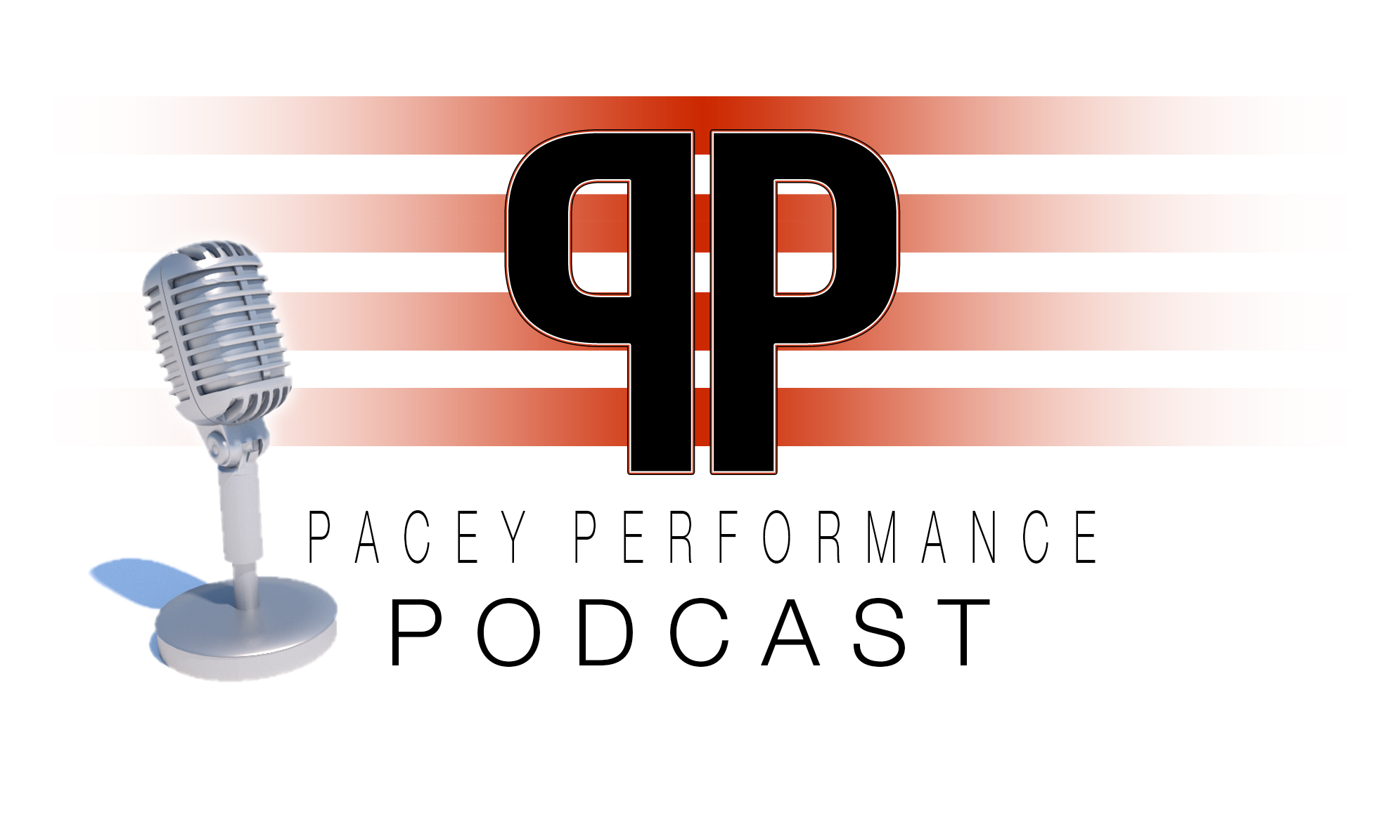










Coach Decision Making:
An Integrated Approach
to Your Planning
Prof. Kevin Till
@KTConditioning
#CARR19

Slide 2
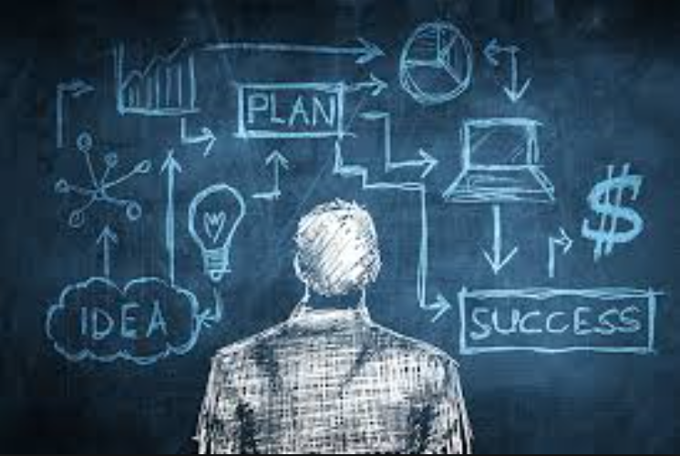

What is Planning?
Planning is the process of deciding in detail how to do something before you actually start to do it
Planning is the process of thinking about the activities required to achieve a desired goal
@KTConditioning
#CARR19

Slide 3
What is Planning?
Planning is the process of deciding in detail how to do something before you actually start to do it
Planning is the process of thinking about the activities required to achieve a desired goal
@KTConditioning
#CARR19

Slide 4
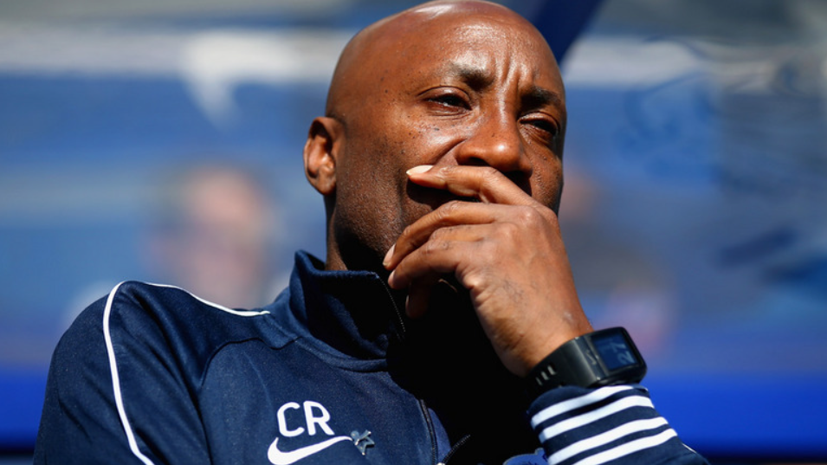
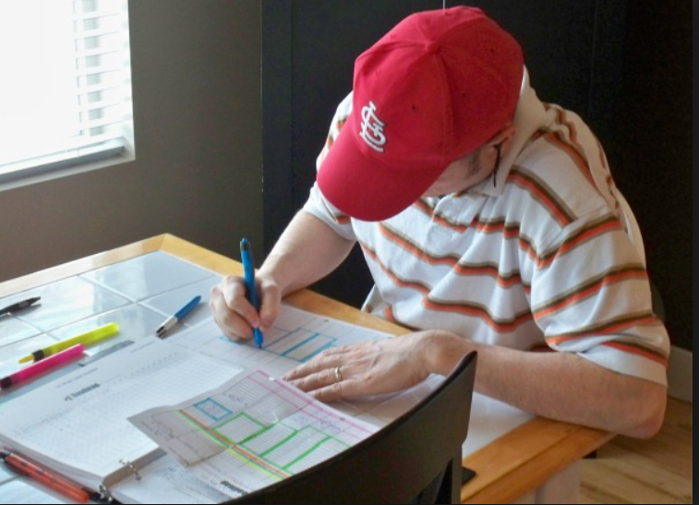
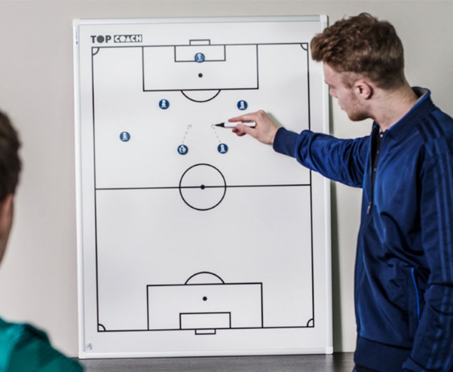
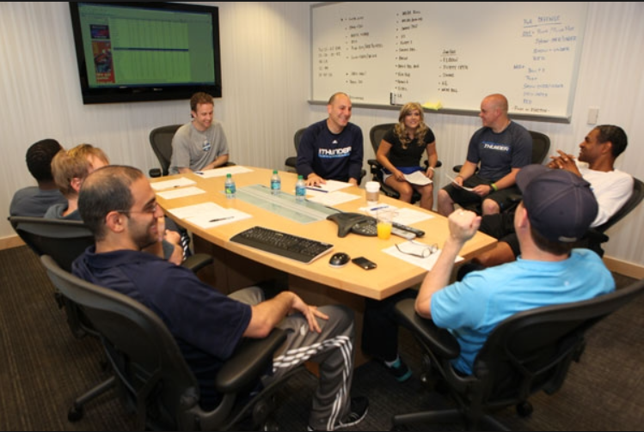
What is Planning?
Planning is the process of deciding in detail how to do something before you actually start to do it
Planning is the process of thinking about the activities required to achieve a desired goal
@KTConditioning
#CARR19

Slide 5

So, Coach Planning is a Decision-Making Process
@KTConditioning
#CARR19

Slide 6
What is Planning?
Planning is the process of deciding in detail how to do something before you actually start to do it
Planning is the process of thinking about the activities required to achieve a desired goal
@KTConditioning
#CARR19

Slide 7
What is Planning?
Planning is the process of deciding in detail how to do something before you actually start to do it
Planning is the process of thinking about the activities required to achieve a desired goal
@KTConditioning
#CARR19

Slide 8

Short Term = The Next Session
Long Term = 10 Years Time

Slide 9
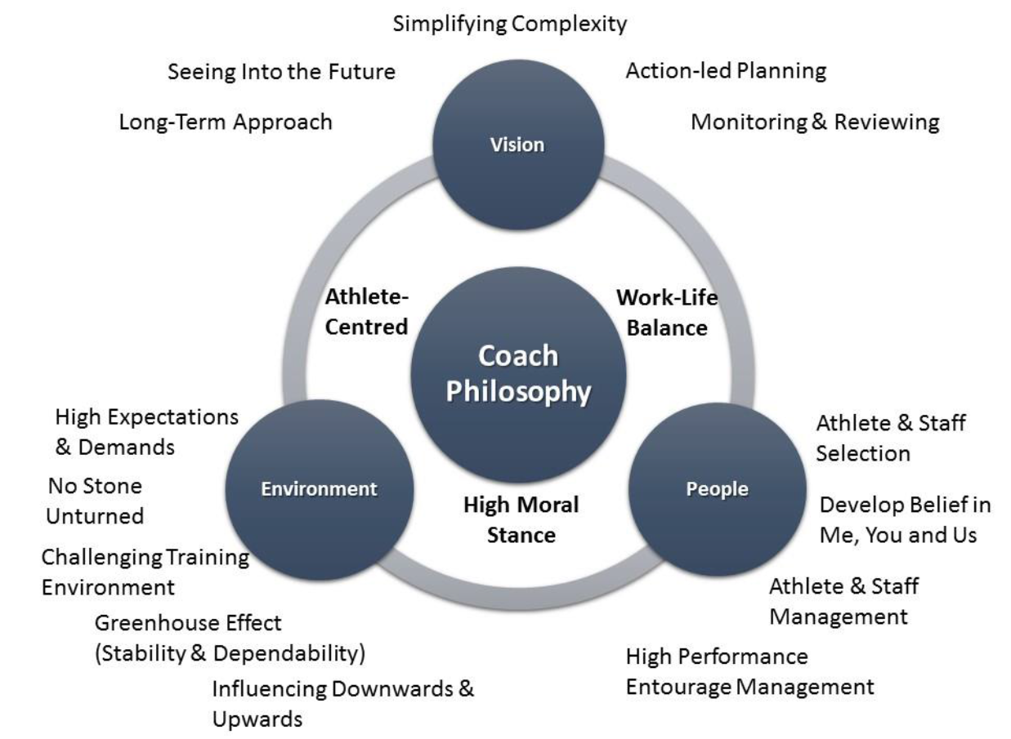
Serial Winning Coaches
Lara-Bercial & Mallett (2016) The Practices and Developmental Pathways of Professional and Olympic Serial Winning Coaches, International Journal of Sports Coaching, 3, 221-239

Slide 10
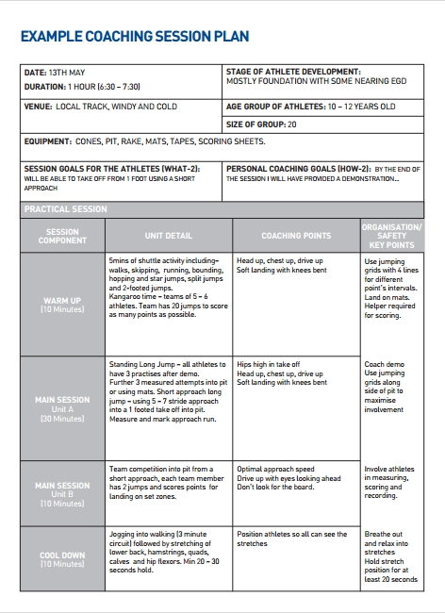
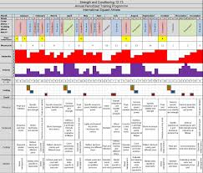
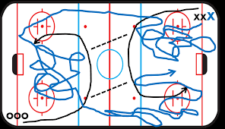
So, Coach Planning is a Decision-Making Process
@KTConditioning
#CARR19

Slide 11

Slow
‘Classical - Deliberate, Conscious, Effortful’
Fast
‘Naturalistic - Intuitive, Automatic, Unconscious’
@KTConditioning
#CARR19

Slide 12
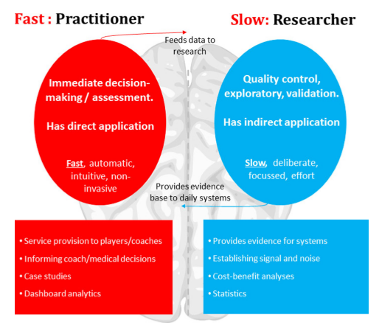

PLANNING
Coutts (2016) Working Fast and Working Slow: The Benefits of Embedding Research in High-Performance Sport, International Journal of Sports Physiology and Performance, 11, 1-2

Slide 13
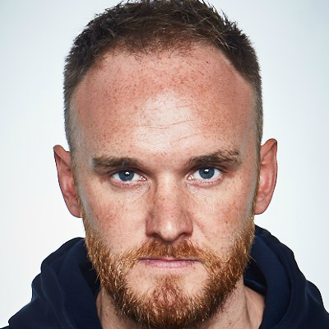
Practice
Research
Jones et al. (2017) Accessing off-ﬁeld brains in sport; an applied research model to develop practice, British Journal of Sports Medicine

Slide 14

How do you Plan (and what information do you use)…
For the Session (Short-Term)?
For the Future (Long-Term)?
@KTConditioning
#CARR19

Slide 15
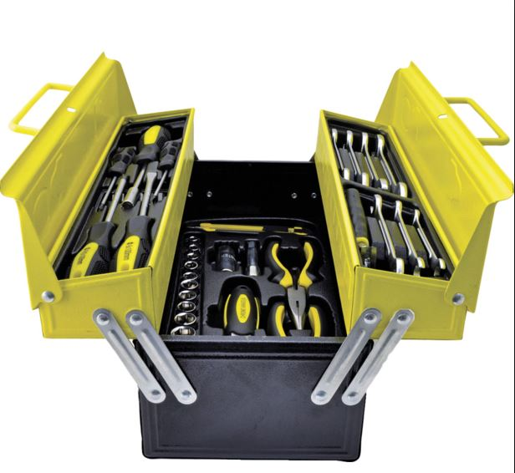
Thinking Tools
@KTConditioning
#CARR19

Slide 16
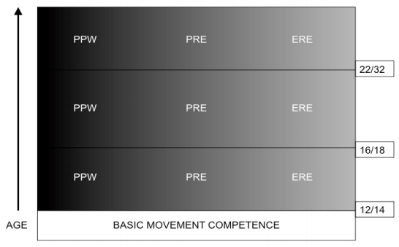
A Participant Continuum:
The Three Worlds?
Participation
For
Personal
Wellbeing
Personal
Referenced
Excellence
Elite
Referenced
Excellence
ERE = Achievement is measured against others
PRE = Achievement is referenced personally – achieving one’s best
PPW = Satisfy needs other than personal progression (e.g., social life, staying in shape)
Collins et al. (2012) Three Worlds: new directions in participant development in sport and physical activity, Sport, Education and Society, 17, 225-243

Slide 17
MENTAL MODEL & PERFORMANCE MODEL
What are the fundamental demands of the sport/setting?
What do successful athletes (participants) look like?
OUTPUT
Age/Phase/Stage
Sen.
21
20
19
18
17
16
15
14
13
12
11
10
9
8
Advanced
Intermediate
How to scaffold this journey?
Beginner
UNDERSTANDING OF CHILDREN & YOUNG PEOPLE
What are children like as they enter your programme?
(bio-psycho-social development)
INPUT
@KTConditioning
#CARR19

Slide 18
MENTAL MODEL & PERFORMANCE MODEL
What are the fundamental demands of the sport/setting?
What do successful athletes (participants) look like?
OUTPUT
Age/Phase/Stage
Sen.
21
20
19
18
17
16
15
14
13
12
11
10
9
8
Technical
Tactical
Physical
Social and Life Skills
Psycho-Behavioural
Advanced
Intermediate
How to scaffold this journey?
Beginner
UNDERSTANDING OF CHILDREN & YOUNG PEOPLE
What are children like as they enter your programme?
(bio-psycho-social development)
INPUT
@KTConditioning
#CARR19

Slide 19
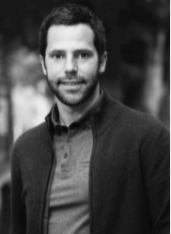

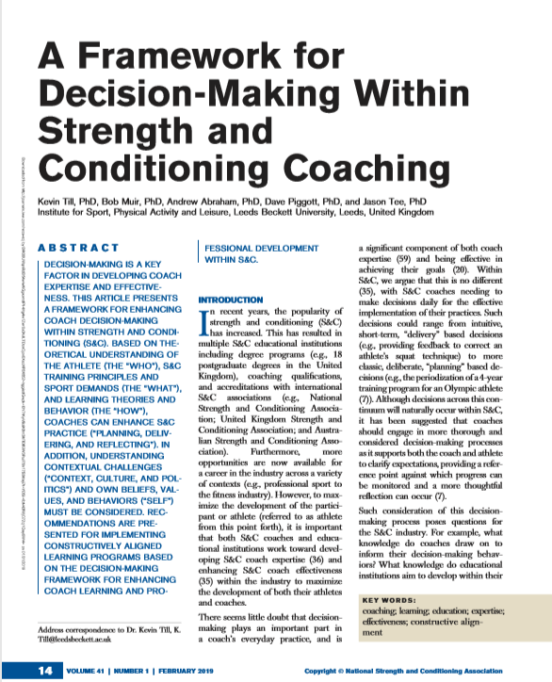
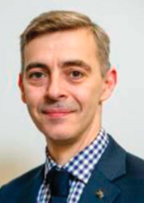
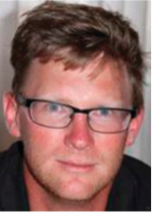
@KTConditioning

Slide 20
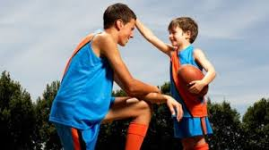
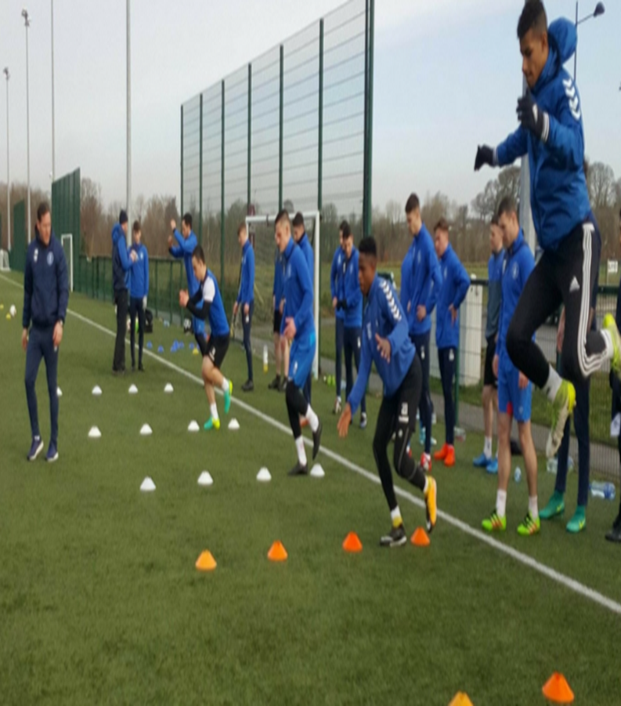
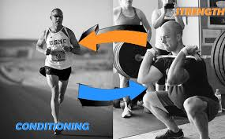
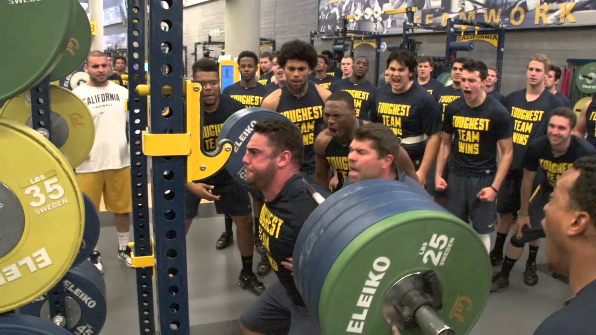
@KTConditioning
#CARR19
Understanding of Self: Personal Beliefs, Values & Behaviours
WHO
Are you coaching?
Y O U R
P R A C T I C E
Planning
Delivering
Reflecting
WHAT
Are you coaching?
HOW
Are you coaching?
Understanding of Context, Culture & Resources

Slide 21
Sex
Sleep
Age (biological)
W H O
Are you coaching?
Use Bio-Psycho-Social theories & concepts as thinking tools to understand your athletes needs and wants
Social Support
Injury & Health History
Recovery & Wellbeing
Fitness Profile
Psychological Characteristics
Motivation

Slide 22
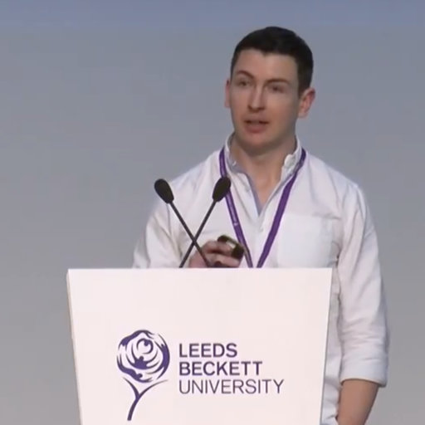

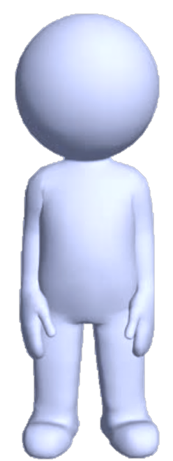
Fitness Profile
EAP Back
PDG Back
1764 N
1664 N
IMTP (Peak Force)
181 cm
86 kg
178 cm
79 kg
486 kg.m/s
454 kg.m/s
10 m Momentum
8.8 m/s
8.6 m/s
Maximum Speed

Slide 23
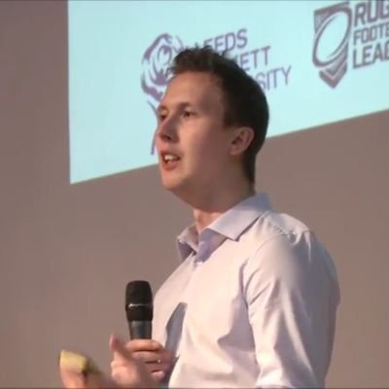
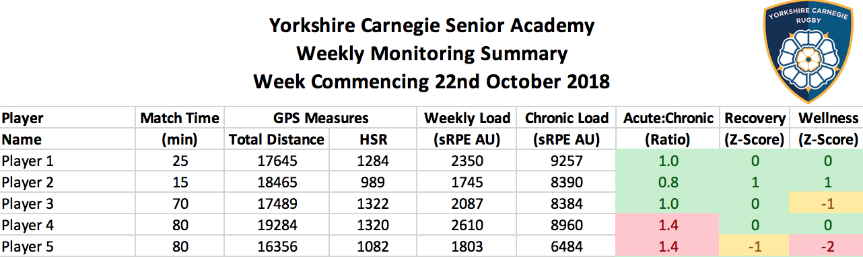
Recovery, Load & Wellbeing

Slide 24
@KTConditioning
#CARR19
Understanding of Self: Personal Beliefs, Values & Behaviours
WHO
Are you coaching?
Y O U R
P R A C T I C E
Planning
Delivering
Reflecting
WHAT
Are you coaching?
HOW
Are you coaching?
Understanding of Context, Culture & Resources

Slide 25
Technical Demands
Exercise Technique
W H A T
Are you coaching?
Use theories & concepts as thinking tools to understand the technical, tactical and physical demands of the sport to determine the programme
Tactical Demands
Measurement & Evaluation
Principles of Training
Training Modalities
Coaches Playing Style
Injury Prevention
Physical Demands

Slide 26
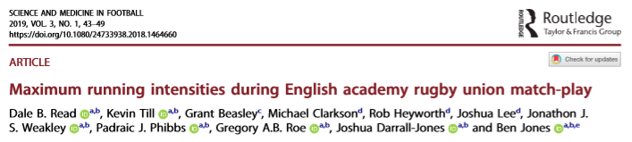
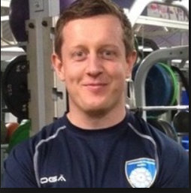
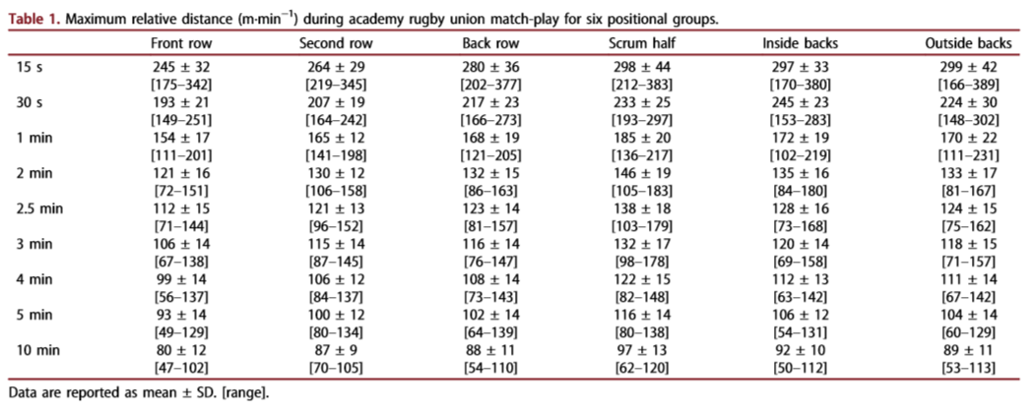
Physical Demands

Slide 27
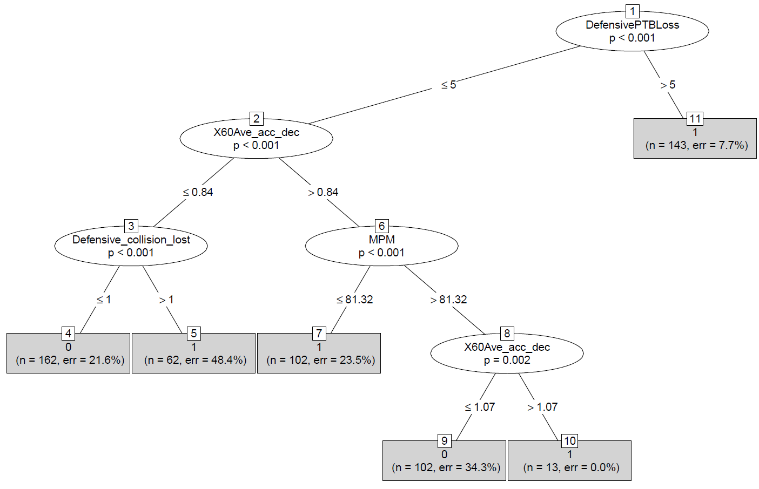
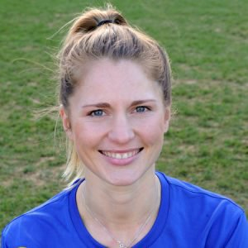
KPIs in Rugby League
CI tree: Forwards
Technical Demands
Academy forwards need to be exposed to:
greater
Scenarios of defensive play-the-ball losses

Slide 28
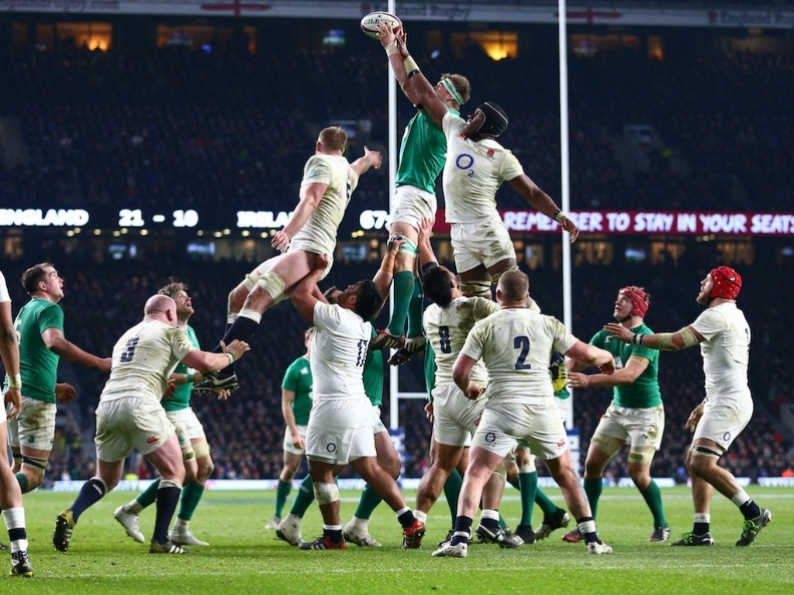
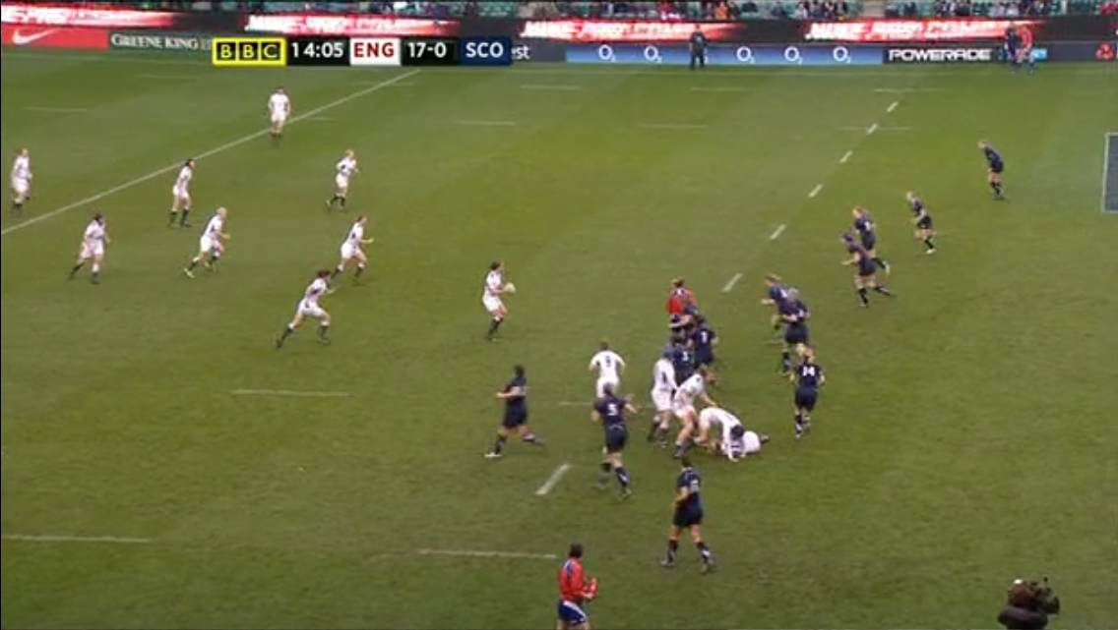
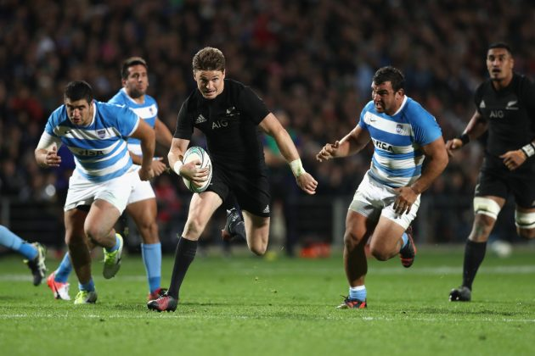

Attentional Demand
Attentional Demand
Attentional Demand
Tactical Demands

Slide 29
@KTConditioning
#CARR19
Understanding of Self: Personal Beliefs, Values & Behaviours
WHO
Are you coaching?
Y O U R
P R A C T I C E
Planning
Delivering
Reflecting
WHAT
Are you coaching?
HOW
Are you coaching?
Understanding of Context, Culture & Resources

Slide 30
Coaching Behaviours
Monitoring
Motivation
Cueing
Instruction
Feedback
Communication
Demonstration
Questioning
Humour
Activity Design
Session Design
Drills
Timings
Order
Organisation
Management
H O W
Are you coaching?
Use theories & concepts of learning and skill acquisition as thinking tools to optimise learning and development opportunities

Slide 31
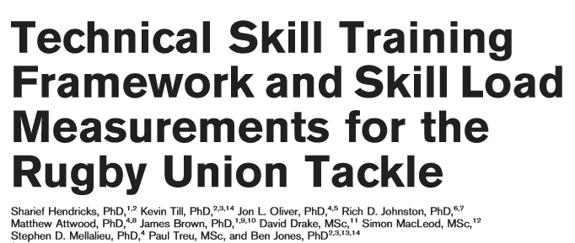
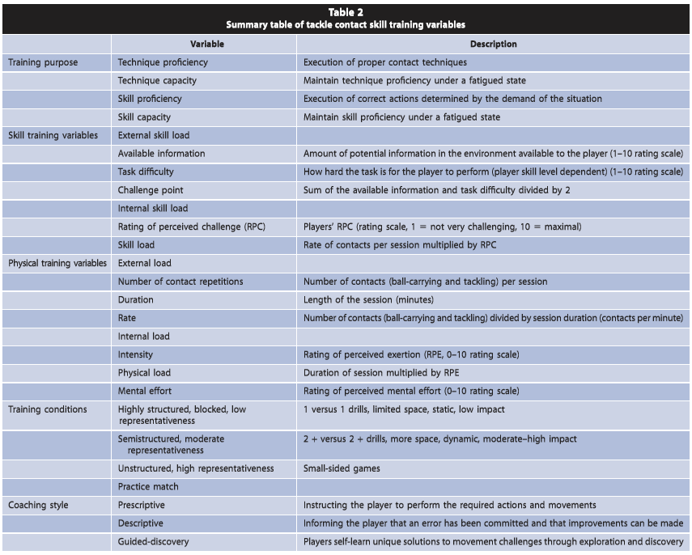
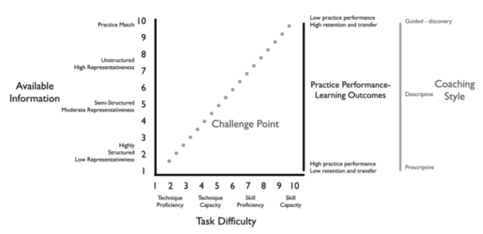
Activity Design

Slide 32
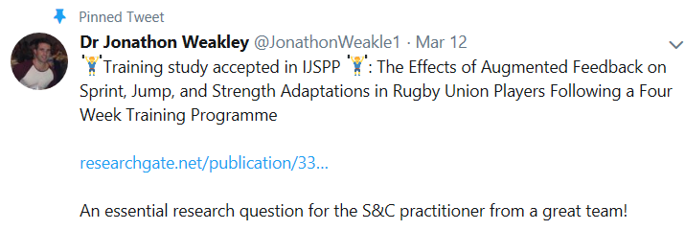
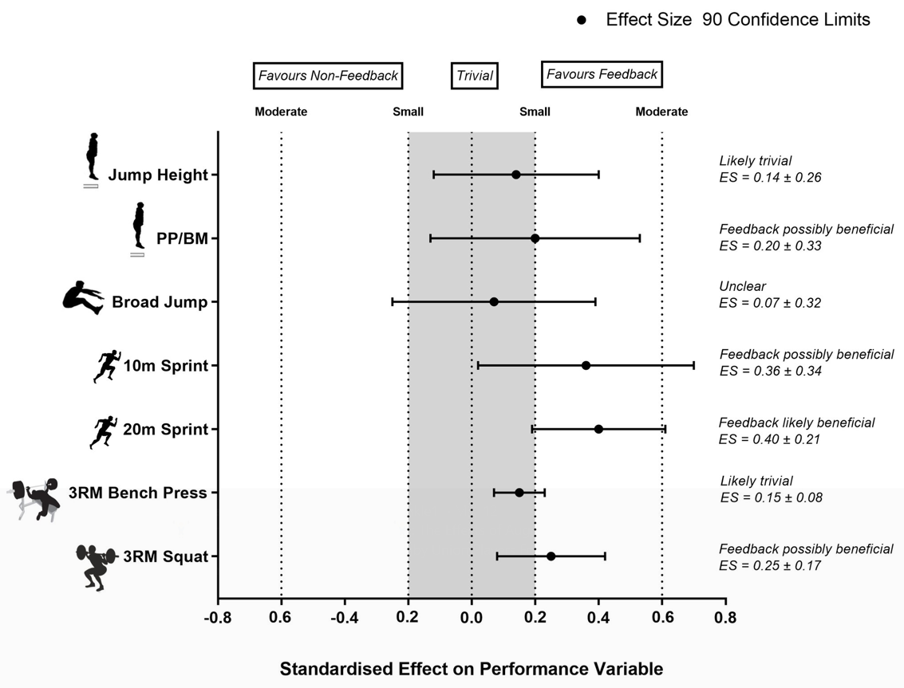
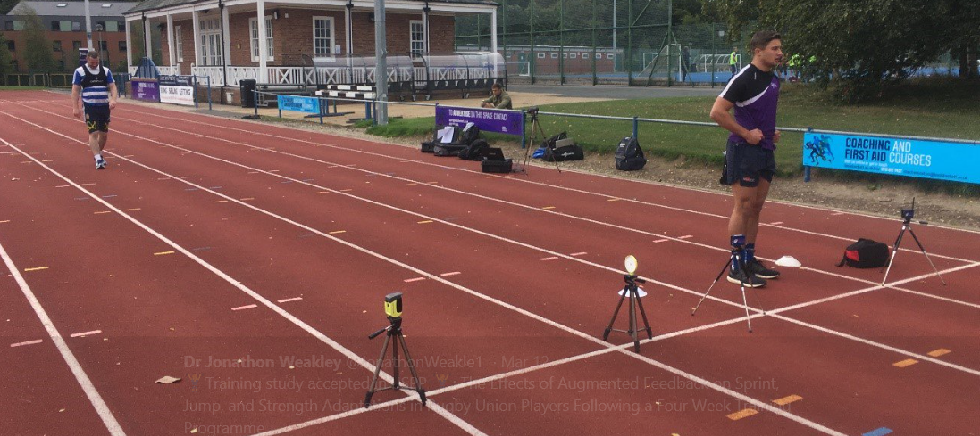
Coaching Behaviours
Feedback
Weakley et al. (2019) The Effects of Augmented Feedback on Sprint, Jump, and Strength Adaptations in Rugby Union Players Following a Four Week Training Programme, International Journal of Sports Physiology and Performance

Slide 33
2. Set the LEARNING / DEVELOPMENT OBJECTIVE(S) (Long-, Medium-, Short-Term) – are they justified, agreed, shared and understood?
3. Select the appropriate TRAINING FOCUS – which ACTIVITIES will form a suitable base for engagement based on the NEEDS and WANTS of the athlete(s)
Y O U R
P R A C T I C E
The way you facilitate athlete learning and development through your…
PLANNING
DELIVERY
REFLECTION &
Integration with Others
Recognise the GROUP and INDIVIDUAL NEEDS and WANTS of your PARTICIPANT(S) – what is appropriate and how do we know?
4. Plan the constraints of the ENVIRONMENT –
make decisions about HOW to optimise development by planning ACTIVITIES and BEHAVIOURS to support learning
@KTConditioning
#CARR19

Slide 34

The Coaching Practice Planning & Reflective Framework
Learner
Engagement
Technical
Tactical
Physical
Social and Life Skills
Psycho-Behavioural
Learning
Activity Structure
Coach Behavioural Strategies
Game-Centered
Problem Setting
Session Objectives
Technique-Centered
Problem Solving
Goals
Micro Cycles
Outcomes
1
2
3
5
6
7
The Coaching Practice Planning and Reflective Framework (Muir et al., 2011)

Slide 35
Organisations Values, Practices and Traditions
People (coaches, players, parents)
WHO
Are you coaching?
Resources & Physical Constraints
Y O U R
P R A C T I C E
Planning
Delivering
Reflecting
Sport NGB Policies
WHAT
Are you coaching?
HOW
Are you coaching?
Understanding of Context, Culture & Resources

Slide 36





What are the planning roles & responsibilities?
Are you generating WHO, WHAT & HOW data to inform your planning?
Resources & Physical Constraints
WHO
Are you coaching?
Y O U R
P R A C T I C E
Planning
Delivering
Reflecting
WHAT
Are you coaching?
HOW
Are you coaching?
Understanding of Context, Culture & Resources

Slide 37
Resources & Physical Constraints
??
WHO
Are you coaching?
Y O U R
P R A C T I C E
Planning
Delivering
Reflecting
WHAT
Are you coaching?
HOW
Are you coaching?
Understanding of Context, Culture & Resources

Slide 38
Solution: A RAMPAGE Session
@KTConditioning
#CARR19
Section |  | Description | Physical Qualities | Tech-Tact | Psy-Soc
R | Raise | Raise body temperature | Locomotor Skills | *** | Observe & Use Coaching Behaviours linked to Session Objective
A | Activate | Activate muscles and mobilise the joints | Stability, Mobility & Strength | *
M | Mobilise
P | Potentiate | Increase the intensity of the activity | Speed, Agility, Power | **
A | Activity | Main technical / Tactical activity |  | *****
G | Games | Focus for implementation of the skill activity within game based situation | Metabolic Conditioning | ****
E | Evaluate | Evaluate the session during a cool down | Flexibility, Landing Mechanics | **

Slide 39
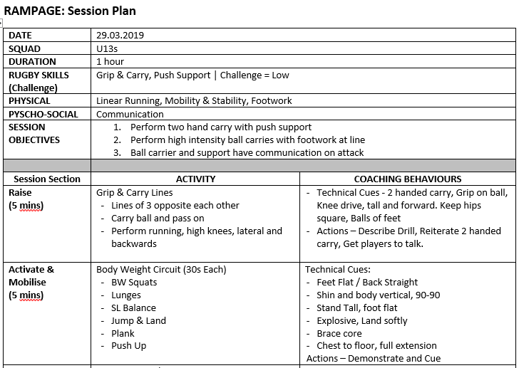
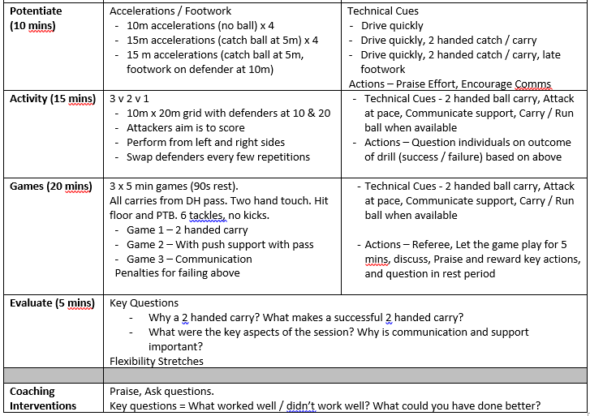
Example Session Plan
@KTConditioning
#CARR19

Slide 40
Summary
@KTConditioning
#CARR19
Planning = Making Decisions for the Future (short- & long-term)
The Best Coaches Plan! Spend time planning to enhance your participants future
Research = Knowledge: What do you know that you don’t use and what don't you know that you could use?
The Framework for Coach Decision Making helps us consider WHO, WHAT and HOW we are coaching to help our Planning
Consider the resources available to YOU in YOUR CONTEXT
Good Luck with Your Planning!

Slide 41
Thank You
Any Questions
Prof. Kevin Till
@KTConditioning
#CARR19

