Slide 1
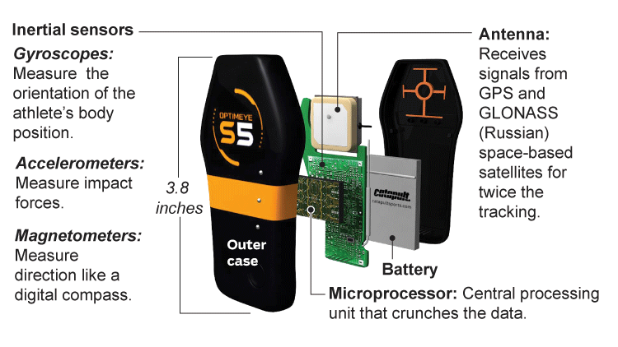
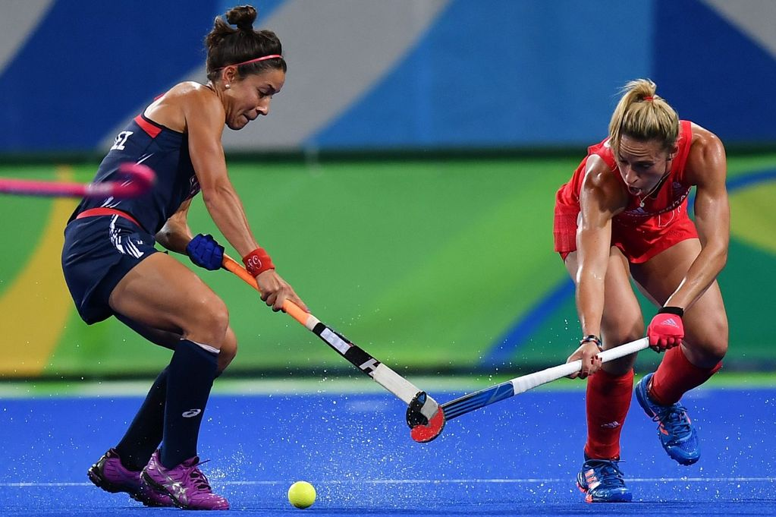
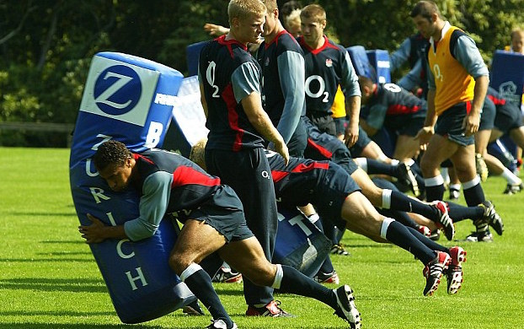
Quantifying Training Load in Youth Sport Athletes:
A Comparison of Session-RPE, the Summated Heart
Rate Zone Method and External Training Load Measures
Sean Scantlebury^{1,2}, Kevin Till¹ & Ben Jones^{1,2}
s.scantlebury@leedsbeckett.ac.uk @seanscants
INTRODUCTION
To optimise training adaptions whilst minimising the risk of injury and over training, coaches and sports science practitioners must be able to accurately quantify both internal and external training load.
Therefore, the purpose of this study was to assess the accuracy of the Session-Rating of Perceived Exertion (s-RPE) method in quantifying internal training load in comparison to the summated heart rate zone (SHRZ) method and to assess the influence of external training load variables on s-RPE.
METHOD
10 female hockey players and 11 male rugby union players wore a micro-technology unit and heart rate belt during every school training session over an 8 week period with a SHRZ score, total distance and player load^{tm} collected during each session.
s-RPE was collected 30 minutes post session.
A total of 125 training observations (64 rugby and 61 hockey) were collected.
Pearson correlation coefficients and 90% confidence intervals were calculated.
RESULTS
Table 1. Pearson correlation coefficients and 90% confidence intervals for internal and external measures of training load
Table 2. Session averages for internal and external training load variables for both hockey and rugby
Variables | Hockey | Rugby
s-RPE & SHRZ | r= 0.75, CI: 0.64 to 0.83 | r= 0.58, CI: 0.43 to 0.70
s-RPE & Player loadTM | r= 0.55, CI: 0.39 to 0.69 | r= 0.64, CI: 0.50 to 0.75
s-RPE & Total Distance | r= 0.42, CI: 0.23 to 0.58 | r= 0.66, CI: 0.52 to 0.76
Variable | Hockey | Rugby
Session duration (mins) | 63 ± 24 | 49 ± 15
Session-RPE (AU) | 240 ± 194 | 147 ± 128
SHRZ (AU) | 151 ± 46 | 118 ± 42
Player loadTM (AU) | 232 ± 85 | 244±± 82
Total distance (m) | 2719 ± 966 | 2649 ± 923
CONCLUSIONS
The large correlations found between s-RPE and the SHRZ method highlights the potential for s-RPE to be used as an efficient technique in quantifying internal training load within adolescent rugby and hockey athletes.
Furthermore, the large and moderate correlations found between measures of total distance & PlayerLoadTM to s-RPE demonstrate that internal load is influenced by the external load variables.
ACKNOWLEDGMENTS
This research, travel and conference fees were funded by the Carnegie Adolescent Rugby Research (CARR) project.
BASES 2016 Conference, East Midland’s Conference Centre, 29th-30th November 2016

